Slide 1


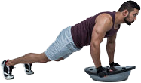


ENTRENAMIENTO FÍSICO-DEPORTIVO -
PARA COMPETIDORES Y POBLACIÓN GENERAL:
Enfoque Integral-Funcional
Prof. Edgar Lopategui Corsino
M.A., Fisiología del Ejercicio
Web: http://www.saludmed.com/
E-Mail: elopategui@intermetro.edu
Artículo: http://www.saludmed.com/
articulos/Fisiologia_del_Ejercicio/Entrena-Funcional_Poblacion-Atletas.html

Slide 2
ACCESO A LA PRESENTACIÓN:
http://www.saludmed.com/articulos/Fisiologia_del_Ejercicio/Entrena-Funcional_Poblacion-Atletas.pdf
Notes:
2

Slide 3

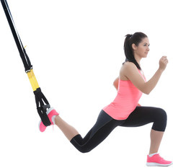
BOSQUEJO
Agradecimientos
Propósito principal de la: Ponencia
Material educativo: Recursos y publicaciones
Consideraciones preliminares
Trasfondo histórico: Origen y desarrollo
Escenarios: Contextos donde se aplica el
entrenamiento funcional
Conceptos fundamentales: Terminología básica
Marco conceptual: Entrena Integrado-Funcional
Características y Principios: Entrena Funcional
Notes:
3

Slide 4

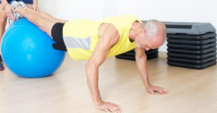
BOSQUEJO
Pilares: Entrenamiento Integrado-Funcional
Planificación y diseño: Entrena Integrado-Funcional
Evaluación: Demandas específicas y
Pruebas Funcionales
Calentamiento dinámico o activo
Componentes: Entrenamiento Integrado-Funcional
Metodología y modalidades: Entrenamiento
Integrado-Funcional
Ejemplos/aplicaciones de programas de: Entrenamiento Integrado-Funcional
Preguntas
Cómo contactar al deponente: Correo/Teléfono
Notes:
4

Slide 5

Notes:
5

Slide 6

AGRADECIMIENTOS
UNIVERSIDAD AUTÓNOMA DE CHIRIQUÍ
Alda Cano de Araúz, M. A.
Erenia Staff Ruiz
Decana
Facultad de Humanidades
Secretaria-Despacho
Facultad de Humanidades
Doctor Eric Cabrera
Magister Daniel Carrillo
Notes:
6

Slide 7

Notes:
7

Slide 8
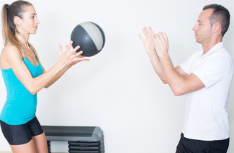
ENTRENAMIENTO FÍSICO-DEPORTIVO:
ATLETAS Y POBLACIÓN GENERAL
INTEGRADO-FUNCIONAL
PROPÓSITO DE LA PONENCIA
Elaborar un esquema del
entrenamiento físico que enfatizara el
componente funcional, o integral, del
individuo sometido bajo este régimen
Notes:
8

Slide 9

Notes:
9

Slide 10

SALUDMED: CIENCIAS DEL MOVIMIENTO HUMANO Y DE LA SALUD
DIRECCIÓN DEL SITIO WEB: http://www.saludmed.com
Notes:
10

Slide 11

Notes:
11

Slide 12

DISEÑO DE PROGRAMAS DE EJERCICIOS – Literatura Académica
DIRECCIÓN DEL SITIO WEB:
http://www.saludmed.com/entrenafuncional/
contenido/entrenamientointegradoyfuncional.html
Notes:
12

Slide 13

Notes:
13

Slide 14

2016
Boyle, M. (2016). New Functional Training for Sports (2da. ed.). Champaign, IL: Human Kinetics. 243 pp.
Notes:
14

Slide 15
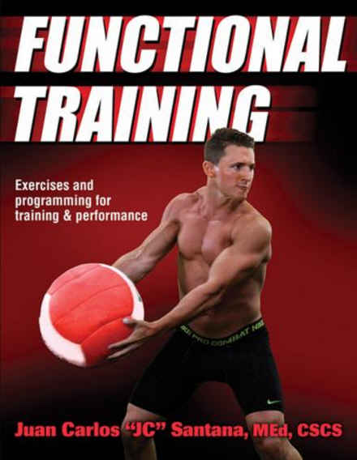
2016
Santana, J. C. (2016). Functional Training: Exercises and Programming for Training & Performance. Champaign, IL: Human Kinetics. 288 pp.
Notes:
15

Slide 16
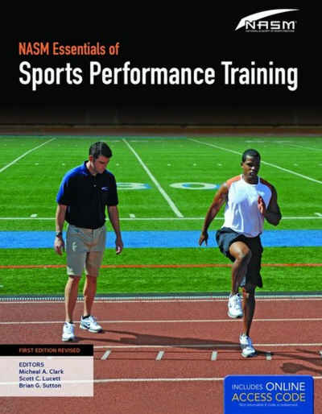
2015
Clark, M. A., & Lucett, S. C. (Eds.). (2015). NASM's Essentials of Sports Performance Training (Ed. Rev). Burlington, MA: Jones & Bartlett Learning. 647 pp.
Notes:
16

Slide 17
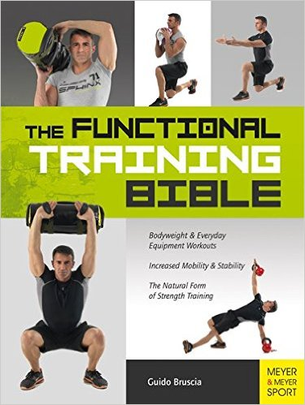
2015
Bruscia, G. (2015). The Functional Training Bible. Oxford, OXON, UK: Meyer & Meyer Sport (UK) Ltd. 510 pp.
Notes:
17

Slide 18
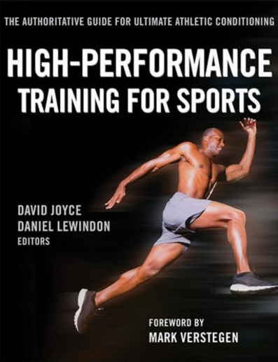
2014
Joyce, D., & Lewindon, D. (Eds.). (2014). High-Performance Training for Sports. Champaign, IL: Human Kinetics. 377 pp.
Notes:
18

Slide 19

2014
Liebenson, G. (2014). Functional Training Handbook. Philadelphia, PA: Lippincott Williams & Wilkins, Wolters Kluwer Health. 472 pp.
Notes:
19

Slide 20
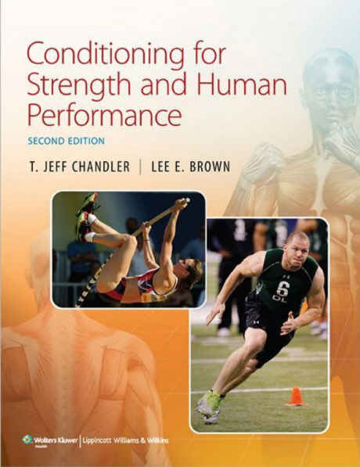
2013
Chandler, T. J., & Brown, L. E. (2013). Conditioning for Strength and Human Performance (2da. ed.). Philadelphia, PA: Wolters Kluwer/Lippincott Williams & Wilkins. 569 pp.
Notes:
20

Slide 21
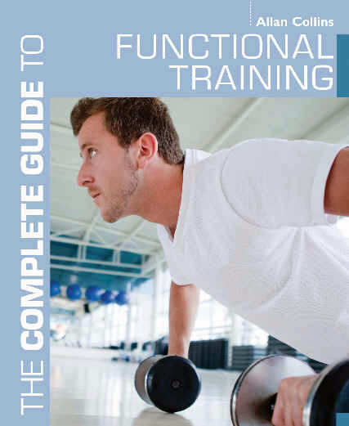
2012
Collins, A. (2012). The Complete Guide to Functional Training [Version para un lector digital]. London: Bloonsbury Publishing Plc.
Notes:
21

Slide 22

2012
National Strength & Conditioning Association [NSCA], & Hoffman, J. R. (Ed.). (2012). Science of Strength and Conditioning Series: NSCA’s Guide to Program Design. Champaign, IL: Human Kinetics. 325 pp.
Notes:
22

Slide 23
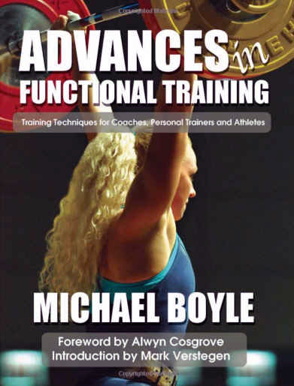
2010
Boyle, M. (2010). Advances in Functional Training: Training Techniques for Coaches, Personal Trainers and Athletes. Santa Cruz, CA: On Target Publications. 315 pp.
Notes:
23

Slide 24
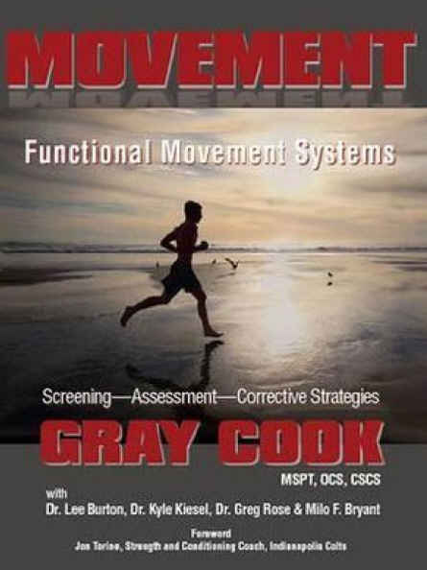
2010
Cook, G., Burton, L., Kiesel, K., Rose, G., & Bryant, M. F. (2010). Movement Functional Movement Systems: Screening, Assessment, Corrective Strategies. Aptos, CA: On Target Publication. 416 pp.
Notes:
24

Slide 25
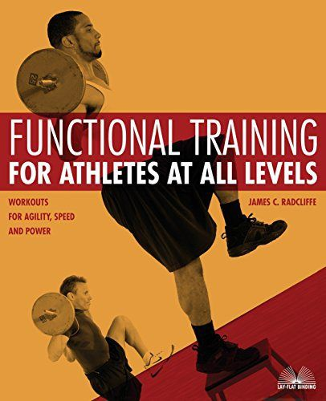
2007
Radcliffe, J. (2007). Functional Training for Athletes at all Levels: Workouts for Agility, Speed and Power. Berkeley, CA: Ulysses Press. 290 pp.
Notes:
25

Slide 26
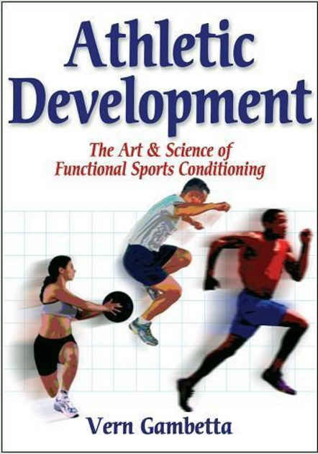
2007
Gambetta, V. (2007). Athletic Development The Art & Science of Functional Sports Conditioning. Champaign, IL: Human Kinetics. 299 pp.
Notes:
26

Slide 27
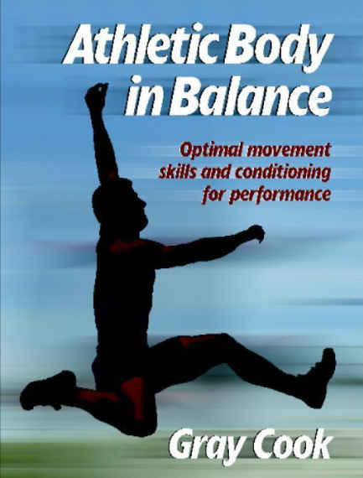
2003
Cook, G., (2003). Athletic Body in Balance: Optimal Movement Skills and Conditioning for Performance. Champaign, IL: Human Kinetics. 234 pp.
Notes:
27

Slide 28

Notes:
28

Slide 29
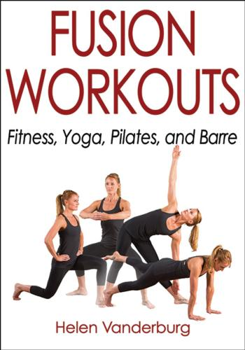
2017
Vanderburg, H. (2017). Fusion Workouts: Fitness, Yoga, Pilates, and Barre. Champaign, IL: Human Kinetics. 304 pp.
Notes:
29

Slide 30

2016
Goldenberg, L., & Twist, P. (2016). Strength Ball Training (3ra. ed.). Champaign, IL: Human Kinetics. 352 pp.
Notes:
30

Slide 31

2015
Collins, P. (2016). Entrenamiento de la Velocidad en el Deporte. Badalona, España: Editorial Paidotribo.
Notes:
31

Slide 32

2015
Barrett, S. (2016): Entrenamiento Total en Suspensión. Badalona, España: Editorial Paidotribo. 168 pp
Notes:
32

Slide 33
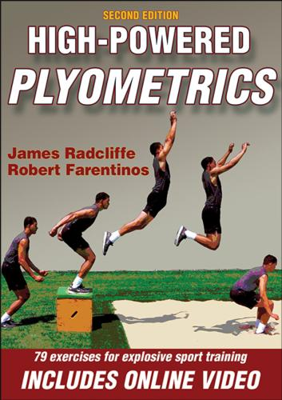
2015
Radcliffe, J., & Farentinos, R. (2015). High-Powered Plyometrics (2da. ed.). Champaign, IL: Human Kinetics. 200 pp.
Notes:
33

Slide 34

2015
Brown, L. E., & Ferrigno, V. A. (Eds.). (2015). Training for Speed, Agility, and Quickness (3ra. ed.). Champaign, Illinois: Human Kinetics. 293 pp.
Notes:
34

Slide 35

2015
Winchester, M. (2015). Warrior WOD Trainer: Crush a Different Cross-Training Routine Every Day. Berkeley, CA: Ulysses Press. 184 pp.
Notes:
35

Slide 36

2015
Hirshberg, B. (2015). Sandbag Training Bible: Functional Workouts To Tone, Sculpt and Strengthen your Entire Body. Berkeley, CA: Ulysses Press 144 pp.
Notes:
36

Slide 37

2015
Pratt, B. (2015). The Complete Guide to Suspended Fitness Training. New York, NY: Bloomsbury Sports: An imprint of Bloomsbury Publishing Plc. 176 pp.
Notes:
37

Slide 38
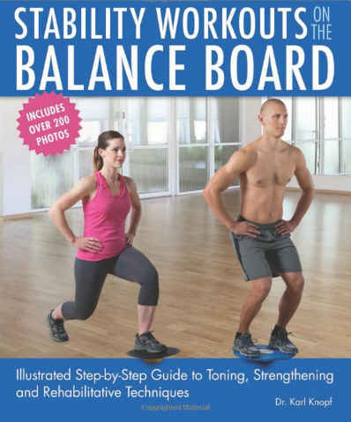
2015
Knopf, K. (2015). Stability Workouts on the Balance Board: Illustrated Step-by-Step Guide to Toning, Strengthening and Rehabilitative Techniques. Berkeley, CA: Ulysses Press. 144 pp.
Notes:
38

Slide 39

2015
Inkster, K. (2015). Foam Rolling: 40 Exercises for Massage, Injury Prevention, and Core Strength. New York, NY: W.W. Norton & Company, Inc. 160 pp.
Notes:
39

Slide 40

2015
Thompson, J. (2015). Weighted Vest Workouts: Supercharge Your Workout f
or Weight Loss, Muscle Building, Cardio Endurance and Core Strength. Berkeley, CA: Ulysses Press.144 pp.
Notes:
40

Slide 41
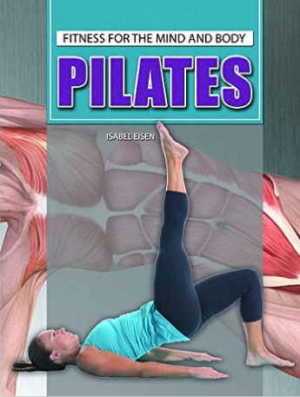
2015
Eisen, I. (2015). Pilates. New York, NY: Young Adult - Rosen Publishing. 192 pp.
Notes:
41

Slide 42

2014
Willardson, J. M. (Ed.). (2014). Developing the Core. Champaign, IL: Human Kinetics. 215 pp.
Notes:
42

Slide 43
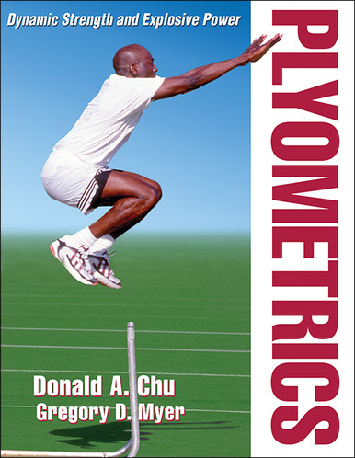
2013
Chu, D. A., & Myer,G. D. (2013). Plyometrics. Champaign, IL: Human Kinetics. 242 pp.
Notes:
43

Slide 44
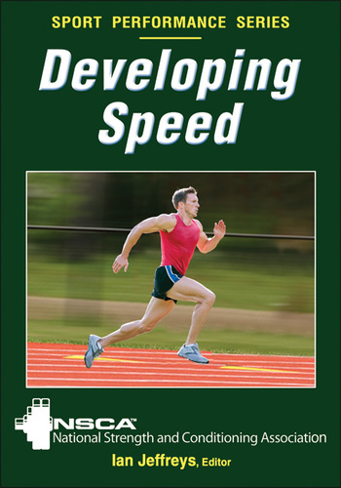
2013
National Strength & Conditioning Association [NSCA], & Jeffreys, I. (Eds.). (2013). Developing Speed. Champaign, IL: Human Kinetics. 224 pp.
Notes:
44

Slide 45
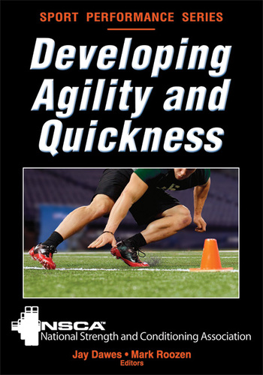
2012
Dawes, J., & Roozen, M. (2012). Developing Agility, and Quickness. Champaign, IL: Human Kinetics. 200 pp.
Notes:
45

Slide 46
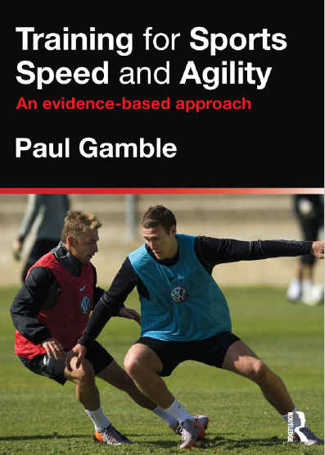
2012
Gamble, P. (2012). Training for Sport Speed and Agility: An Evidence-Based Approach. New York, NY: Routledge, an Imprint of the Taylor & Francias Group. 200 pp.
Notes:
46

Slide 47
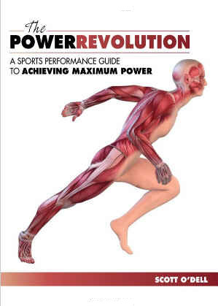
2012
O’Dell, S. (2012). The Power Revolution: A Sports Performance Guide to Achieving Maximum Power. Monterey, CA: Coaches Choice. 215 pp.
Notes:
47

Slide 48
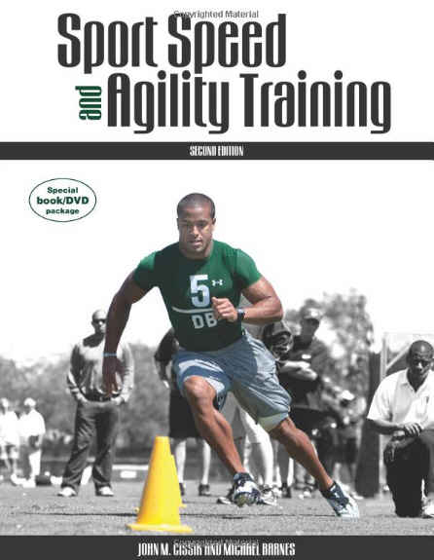
2010
Cissik, J. M., & Barnes, M. (2011). Sport Speed and Agility (2da. ed.). Monterey, CA: Coaches Choice. 260 pp.
Notes:
48

Slide 49
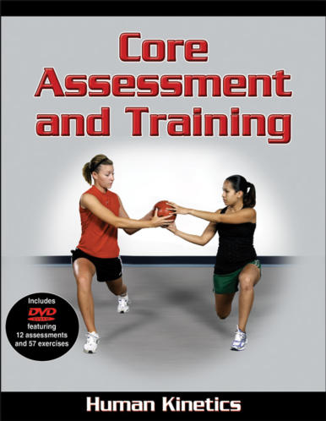
2010
Brumitt, J. (2010). Core Assessment and Training. Champaign, IL: Human Kinetics. 154 pp.
Notes:
49

Slide 50
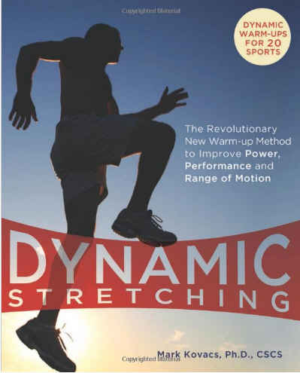
2009
Kovacs, M. (2009). Dynamic Stretching: The Revolutionary New Warm-up Method to Improve Power, Performance and Range of Motion. Berkeley, CA: Ulysses Press. 144 pp.
Notes:
50

Slide 51
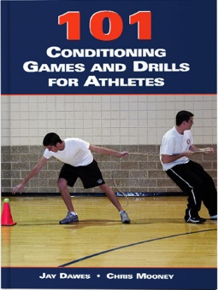
2006
Dawes, J., & Mooney, C. (2006). 101 Conditioning Games and Drills for Athletes. Monterey, CA: Coaches Choice. 134 pp.
Notes:
51

Slide 52
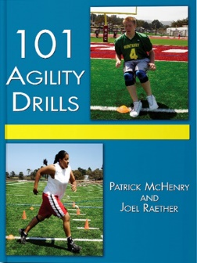
2004
McHenry, P., & Raether, J. (2004). 101 Agility Drills. Monterey, CA: Coaches Choice. 150 pp.
Notes:
52

Slide 53
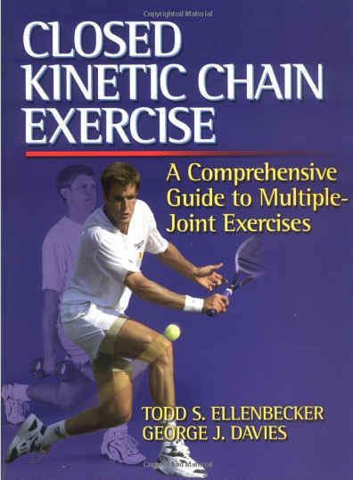
2001
Ellenbecker, T. S., & Davies, G. J. (2001). Closed Kinetic Chain Exercises: A Comprehensice Guide to Multiple Joint Exercises. Champaign, IL: Human Kinetics, Inc. 128 pp.
Notes:
53

Slide 54

Notes:
54

Slide 55
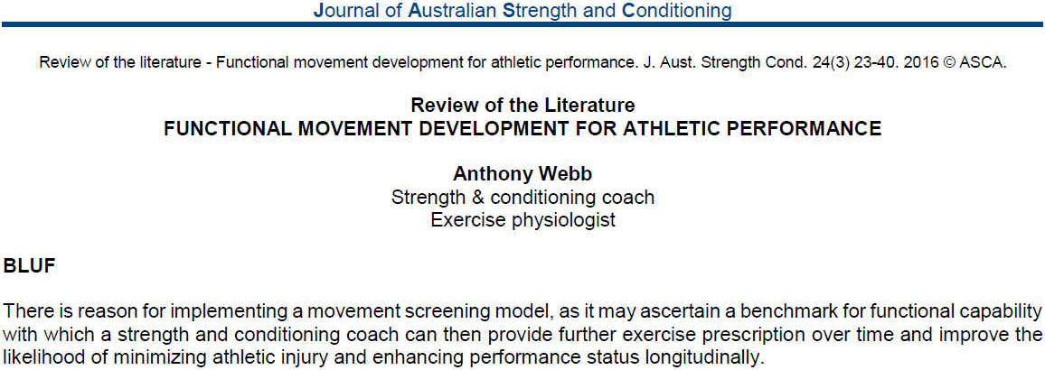
2016
Webb, A. (2016). Functional movement development for athletic performance. Journal of Australian Strength & Conditioning, 24(3), 23-40. Recuperado de la base de datos de EBSCOhost (SPORTDiscus with Full Text)
Notes:
55

Slide 56
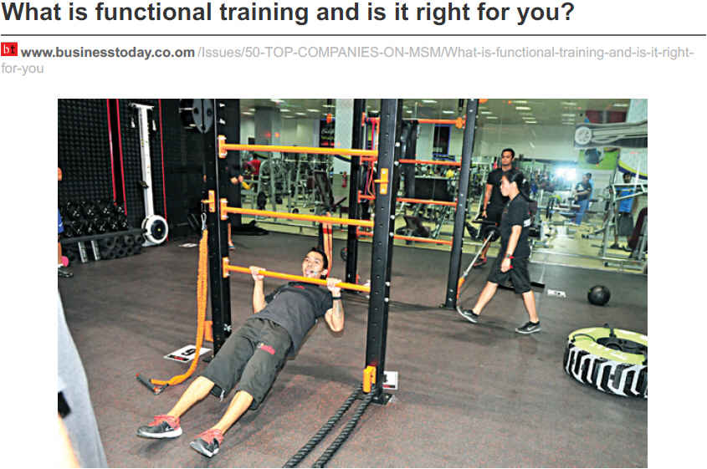
2016
D'ewes, D. (2016). What is functional training and is it right for you?. Businesstoday, (210), 1-3. Recuperado de la base de datos de EBSCOhost (Business Source Complete)
Notes:
56

Slide 57
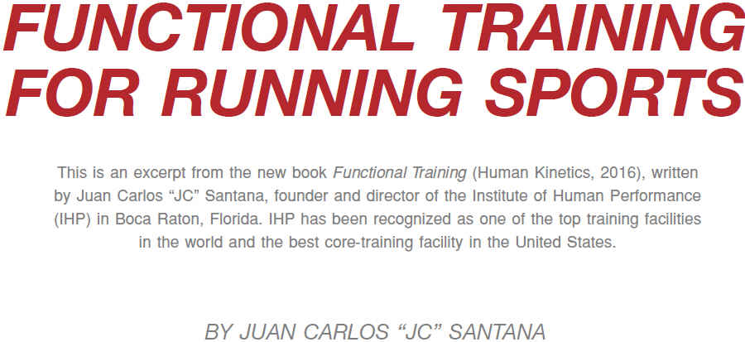
2016
Santana, J. C. (2016). Functional training for running sports. Track Coach, (214), 6835-6841. Recuperado de la base de datos de EBSCOhost (SPORTDiscus with Full Text)
Notes:
57

Slide 58

2016
Fort-Vanmeerhaeghe, A., Romero-Rodriguez, D., Montalvo, A. M., Kiefer, A. W., Lloyd, R. S., & Myer, G. D. (2016). Integrative neuromuscular training and injury prevention in youth athletes. Part I: Identifying risk factors. Strength & Conditioning Journal, 38(3), 36-48. Recuperado de http://www.revdesportiva.pt/files/para_publicar/Integrative_Neuromuscular_Training_and_Injury.5.pdf
Notes:
58

Slide 59
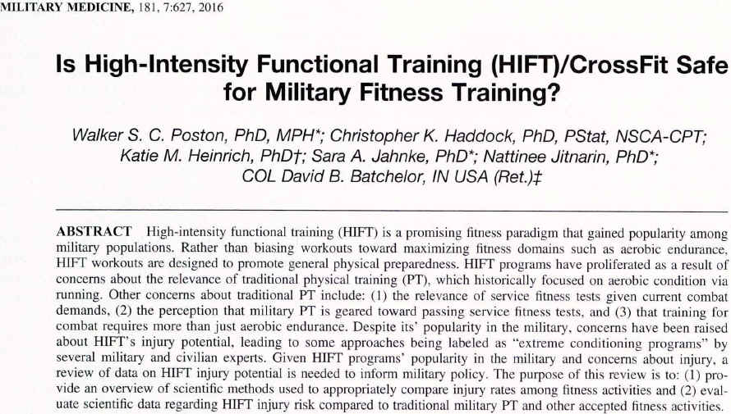
2016
Poston, W. C., Haddock, C. K., Heinrich, K. M., Jahnke, S. A., Jitnarin, N., & Batchelor, D. B. (2016). Is High-intensity functional training (HIFT)/CrossFit safe for military fitness training?. Military Medicine, 181(7), 627-637. doi:10.7205/MILMED-D-15-00273. Recuperado de la base de datos de EBSCOhost (SPORTDiscus with Full Text)
Notes:
59

Slide 60

2015
King, M., & Stanforth, D. (2015). The movement-based programming method for select populations. ACSM s Health & Fitness Journal, 19(1), 17-22. Recuperado de http://journals.lww.com/acsm-healthfitness/Fulltext/2015/01000/THE_MOVEMENT_BASED_PROGRAMMING_METHOD_FOR_SELECT.6.aspx
Notes:
60

Slide 61
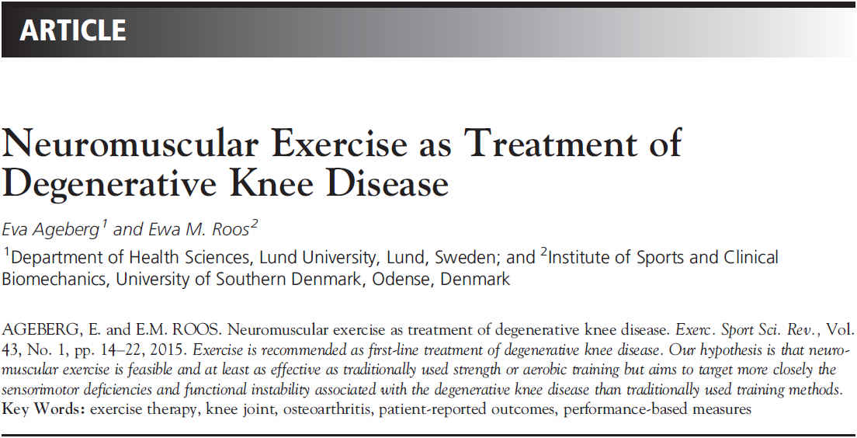
2015
Ageberg, E., & Roos, E. M. (2015). Neuromuscular exercise as treatment of degenerative knee disease. Exercise & Sport Sciences Reviews, 43(1), 14-22. Recuperado de http://journals.lww.com/acsm-essr/Fulltext/2015/01000/Neuromuscular_Exercise_as_Treatment_of.5.aspx
Notes:
61

Slide 62
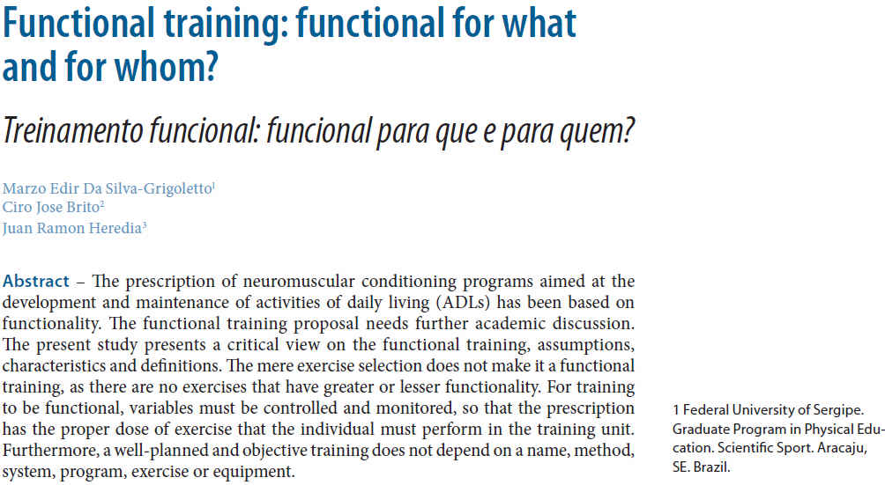
2014
Da Silva-Grigoletto, M. E., Brito, C. J., & Heredia, J. R. (2014). Functional training: functional for what and for whom? / Treinamento funcional: funcional para que e para quem?. Brazilian Journal of Kineanthropometry & Human Performance, 16(6), 714-719. Recuperado de http://www.scielo.br/pdf/rbcdh/v16n6/1980-0037-rbcdh-16-06-00709.pdf
Notes:
62

Slide 63
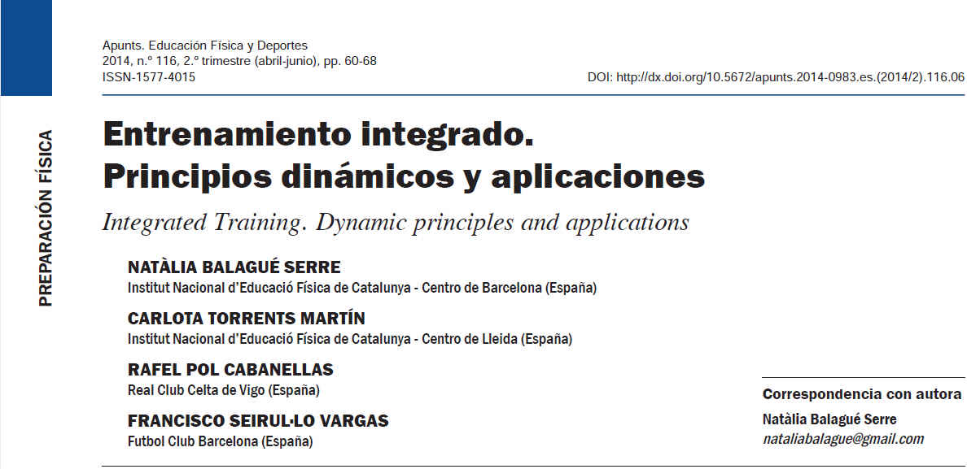
2014
Balagué Serre, N., Torrents Martín, C., Pol Cabanellas, R., & Seirul.Lo Vargas, F. (2014). Entrenamiento integrado. Principios dinámicos y aplicaciones. Apunts: Educacion Fisica y Deportes, (116), 60-68. doi:10.5672/apunts.2014-0983.es.(2014/2).116.06. Recuperado de http://www.raco.cat/index.php/ApuntsEFD/article/viewFile/279286/366994
Notes:
63

Slide 64
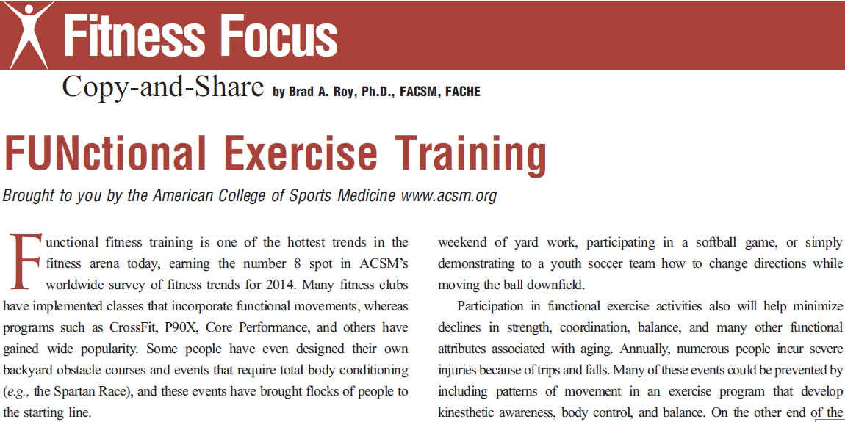
2014
Roy, B. A. (2014). FUNctional exercise training. ACSM's Health & Fitness Journal, 18(3), 3. Recuperado de http://journals.lww.com/acsm-healthfitness/Fulltext/2014/05000/FUNctional_Exercise_Training.3.aspx
Notes:
64

Slide 65
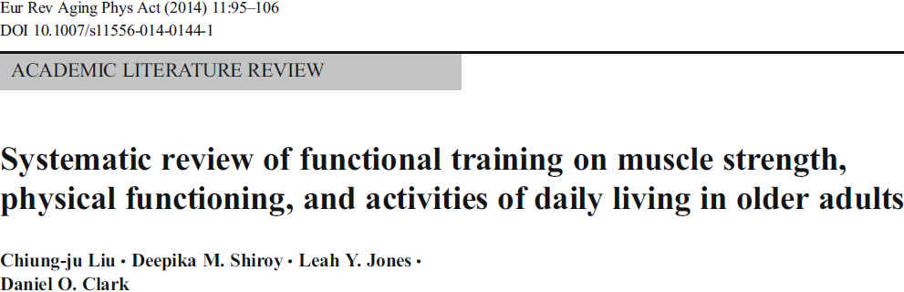
2014
Liu, C., Shiroy, D., Jones, L., & Clark, D. (2014). Systematic review of functional training on muscle strength, physical functioning, and activities of daily living in older adults. European Reviews of Aging & Physical Activity, 11(2), 95-106. Recuperado de la base de datos de EBSCOhost (SPORTDiscus with Full Text)
Notes:
65

Slide 66

2014
Dalcourt, M. (2014). Loaded movement training. IDEA Fitness Journal, 11(5), 30-37. Recuperado de la basede datos de EBSCOhost (SPORTDiscus with Full Text)
Notes:
66

Slide 67

2013
Peterson, J. A. (2013). Take ten. 10 nice-to-know facts about functional training. ACSM's Health & Fitness Journal, 17(5), 48. Recuperado de http://journals.lww.com/acsm-healthfitness/Fulltext/2013/09000/10_Nice_to_Know_Facts_About_Functional_Training.15.aspx
Notes:
67

Slide 68
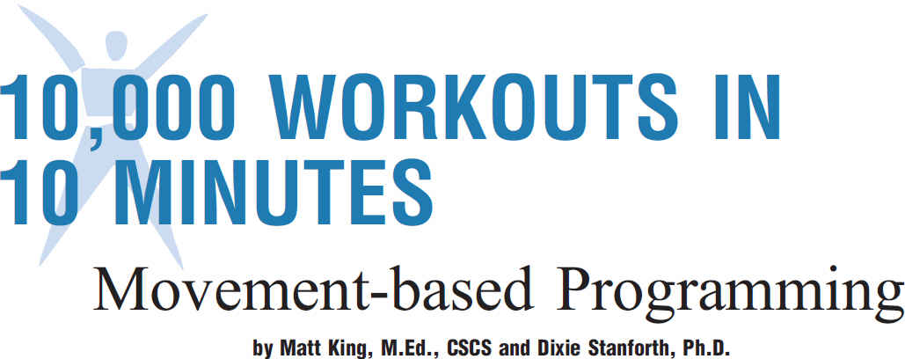
2013
King, M., & Stanforth, D. (2013). 10,000 workouts in 10 minutes: Movement-based programming. ACSM's Health & Fitness Journal, 17(1), 5-14. Recuperado de http://journals.lww.com/acsm-healthfitness/Fulltext/2013/01000/10,000_WORKOUTS_IN_10_MINUTES__Movement_based.5.aspx
Notes:
68

Slide 69

2012
Sipe, C., & Ritchie, D. (2012). The significant 7 principles of functional training for mature adults. IDEA Fitness Journal, 9(1), 42-49. Recuperado de la base de datos de EBSCOhost (SPORTDiscus with Full Text)
Notes:
69

Slide 70
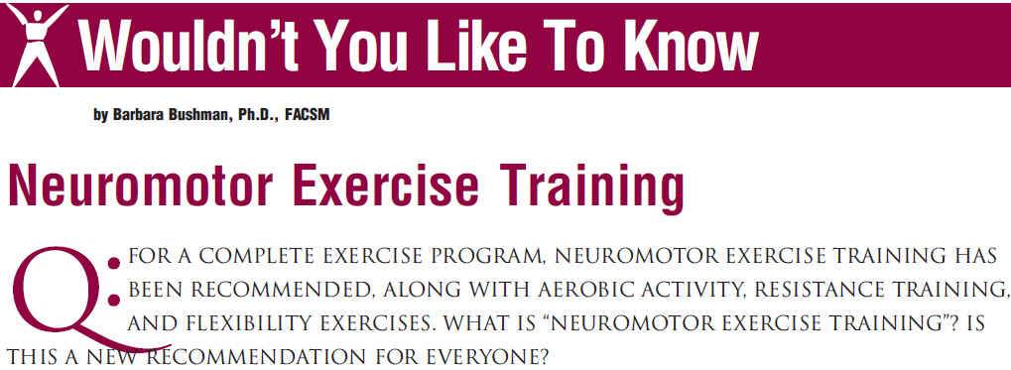
2012
Bushman, B. A. (2012). Wouldn't you like to know. Neuromotor exercise training. ACSM's Health & Fitness Journal, 16(6), 4-7. Recuperado de http://journals.lww.com/acsm-healthfitness/Fulltext/2012/11000/Neuromotor_Exercise_Training.4.aspx
Notes:
70

Slide 71
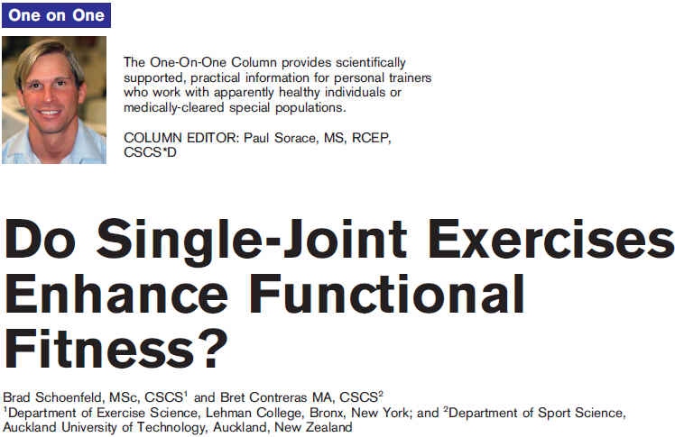
2012
Schoenfeld, B., & Contreras, B. (2012). Do single-joint exercises enhance functional fitness? Strength & Conditioning Journal, 34(1), 63-65. Recuperado de https://bretcontreras.com/wp-content/uploads/Do-Single-Joint-Exercises-Enhance-Functional-Fitness.pdf
Notes:
71

Slide 72
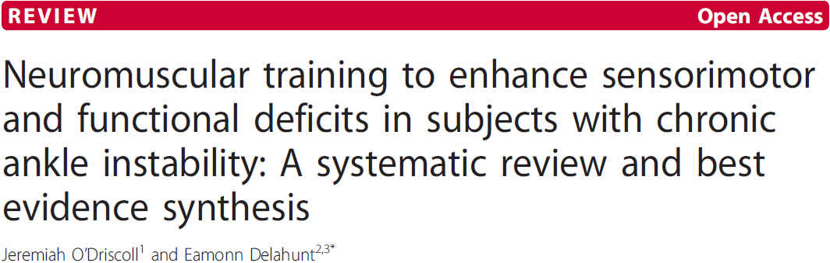
2011
O'Driscoll1, J. & Delahunt, E. (2011). Neuromuscular training to enhance sensorimotor and functional deficits in subjects with chronic ankle instability: A systematic review and best evidence synthesis. (2011). SMARTT: Sports Medicine, Arthroscopy, Rehabilitation, Therapy & Technology, 3(1), 19-38. Recuperado de http://www.ncbi.nlm.nih.gov/pmc/articles/PMC3189141/pdf/1758-2555-3-19.pdf
Notes:
72

Slide 73
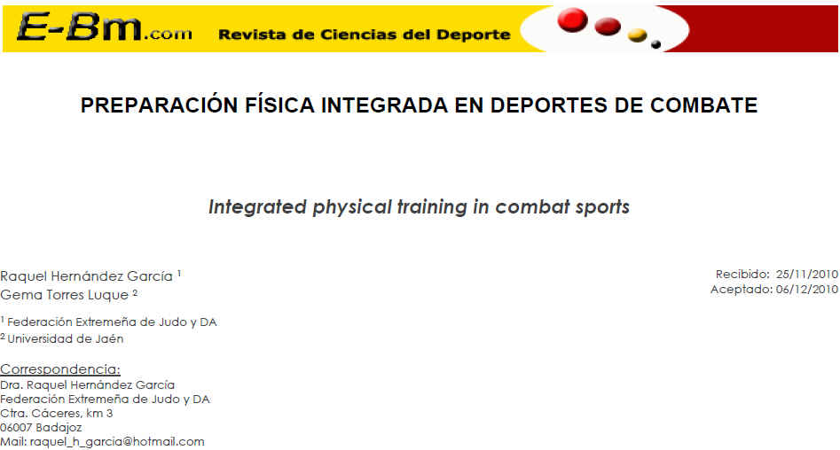
2011
Hernández García, R., & Torres Luque, G. (2011). Preparación física integrada en deportes de combate. E-Balonmano.Com: Journal of Sports Science / Revista de Ciencias del Deporte, 731-38. Recuperado de http://www.e-balonmano.com/ojs/index.php/revista/article/view/72/68
Notes:
73

Slide 74
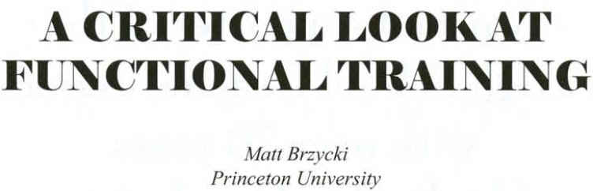
2011
Brzycki, M. (2011). A critical look at functional training. Texas Coach, (January), 44-47. Recuperado de https://www.princeton.edu/campusrec/stephens-fitness-center/fitness-articles/MB-2011-01a.pdf
Notes:
74

Slide 75
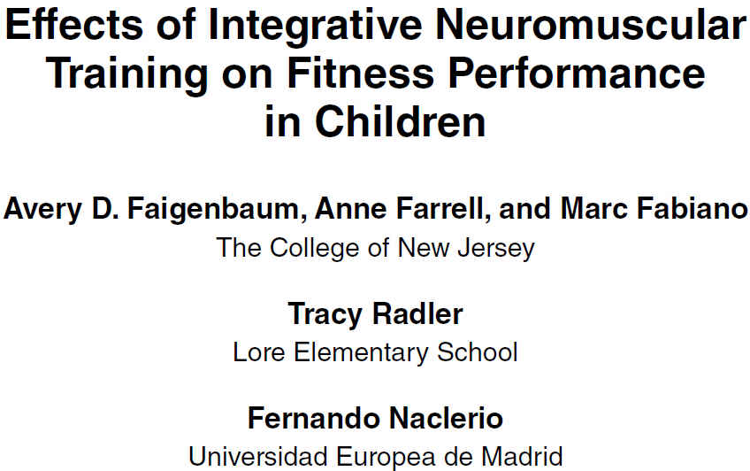
2011
Faigenbaum, A. D., Farrell, A., Fabiano, M., Radler, T., Naclerio, F., Ratamess, N. A., & ... Myer, G. D. (2011). Effects of integrative neuromuscular training on fitness performance in children. Pediatric Exercise Science, 23, 573-584. Recuperado de la base de datos de EBSCOhost (SPORTDiscus with Full Text).
Notes:
75

Slide 76
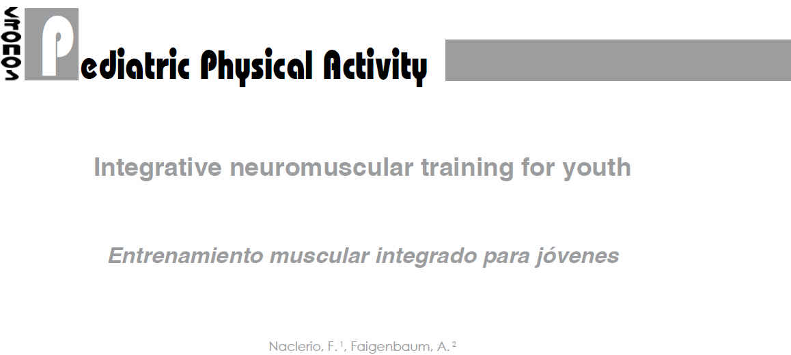
2011
Naclerio, F., & Faigenbaum, A. (2011). Integrative neuromuscular training for youth. Revista Kronos, 10(1), 49-56. Recuperado de la base de datos de EBSCOhost (SPORTDiscus with Full Text)
Notes:
76

Slide 77
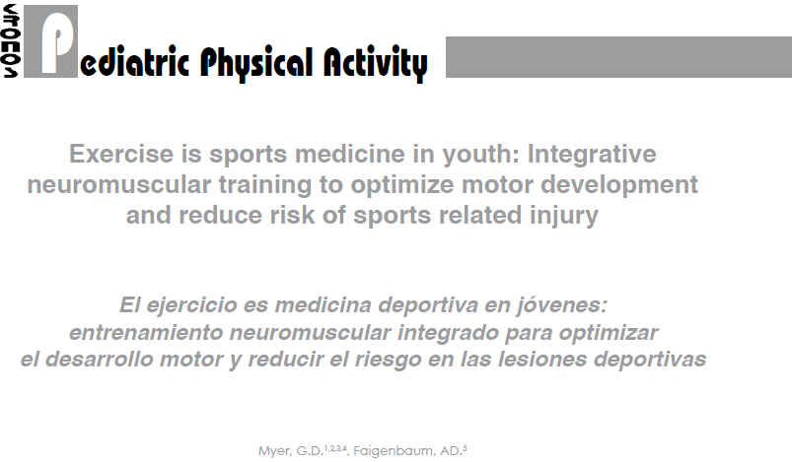
2011
Myer, G. D., & Faigenbaum, A. D. (2011). Exercise is sports medicine in youth: Integrative neuromuscular training to optimize motor development and reduce risk of sports related injury. Revista Kronos, 10(1), 39-48. Recuperado de http://abacus.universidadeuropea.es/bitstream/handle/11268/3102/Kronos_X_1_5.pdf?sequence=1&isAllowed=y
Notes:
77

Slide 78
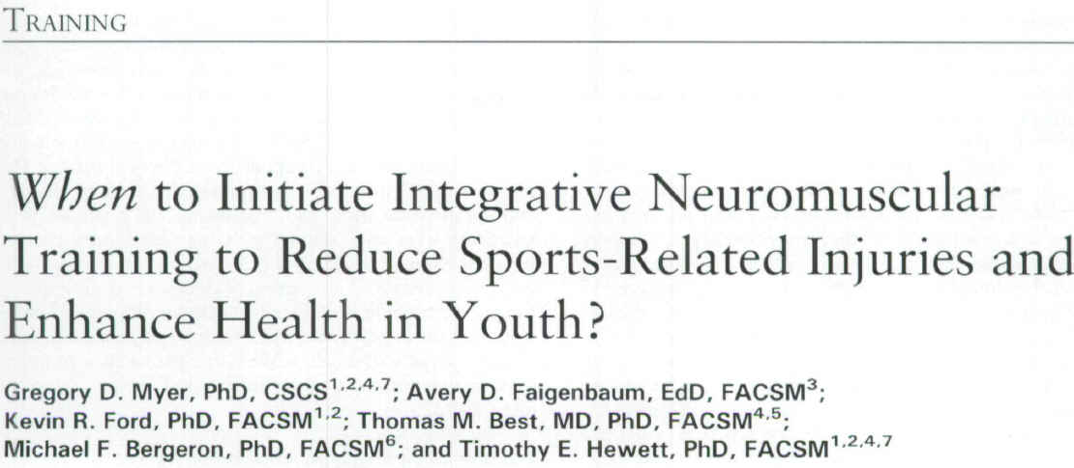
2011
Myer, G. D., Faigenbaum, A. D., Ford, K. R., Best, T. M., Bergeron, M. F., & Hewett, T. E. (2011). When to Initiate Integrative Neuromuscular Training to Reduce Sports-Related Injuries and Enhance Health in Youth?. Current Sports Medicine Reports, 10(3), 157-166. Recuperado de http://www.ncbi.nlm.nih.gov/pmc/articles/PMC3105332/pdf/nihms-289927.pdf
Notes:
78

Slide 79

2011
Daehan, K., Van Ryssegem, G., & Junggi, H. (2011). Clinician's corner: Overcoming the myth of proprioceptive training. Clinical Kinesiology (Online Edition), 18-28. Recuperado de http://www.academia.edu/4248611/Overcoming_The_Myth_Of_Proprioceptive_Training
Notes:
79

Slide 80

2010
Beckham, S. G., & Harper, M. (2010). Functional training: Fad or here to stay? ACSM's Health & Fitness Journal, 14(6), 24-30. Recuperado de http://journals.lww.com/acsm-healthfitness/Fulltext/2010/11000/FUNCTIONAL_TRAINING__Fad_or_Here_to_Stay_.8.aspx
Notes:
80

Slide 81
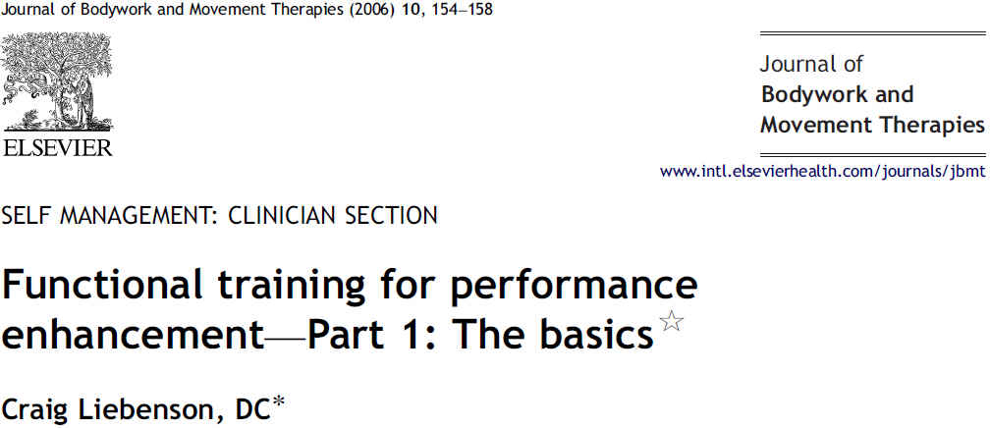
2006
Liebernson, C. (2006). Functional training for performance enhancement - Part 1: The basics. Journal of Bodywork & Movement Therapies, 10(2), 154-158. Recuperado de http://www.avordchiropractic.com/doc/Functional%20training%20for%20Performance%20enhancement.pdf
Notes:
81

Slide 82

2002
Siff, M. (2002). Functional training revisited. Strength & Conditioning Journal, 24(5), 42-46. Recuperado de http://encontroswf.com/wp-content/uploads/2015/04/Artigo-ACSM-2009_Exercise-and-physical-activity-for-older-adults-72.pdf
Notes:
82

Slide 83

2001
Risberg, M. A., Mork, M. M., Jenssen, H. K., & Holm, I. I. (2001). Design and implementation of a neuromuscular training program following anterior cruciate ligament reconstruction. Journal of Orthopaedic & Sports Physical Therapy, 31, 620-631. Recuperado de la base de datos de EBSCOhost (SPORTDiscus with Full Text).
Notes:
83

Slide 84

Notes:
84

Slide 85

http://www.nsca.com
Notes:
85

Slide 86

http://www.nasm.org
Notes:
86

Slide 87

THE AMERICAN COUNCIL ON EXERCISE (ACE):
https://www.acefitness.org/
Notes:
87

Slide 88

Notes:
88

Slide 89

FUNCTIONAL TRAINING INSTITUTE:
DIRECCIÓN DEL SITIO WEB: http://www.functionaltraininginstitute.com/
Notes:
89

Slide 90

FUNCTIONAL MOVEMENT SCREEN:
DIRECCIÓN DEL SITIO WEB: http://www.functionalmovement.com/
Notes:
90

Slide 91

FUNCTIONAL MOVEMENT SCREEN:
DIRECCIÓN DEL SITIO WEB: http://www.movementbook.com/
Notes:
91

Slide 92

Notes:
92

Slide 93

ENTRENAMIENTO: FÍSICO-DEPORTIVO
* De Naturaleza: Integrado-Funcional*
NOTA. Adaptado de: ¨Essentials of Integrated Training,¨ por M. A. Clark & S. C. Lucett. En NASM Essentials of Sports Performance Training. (p. 3), por M. A. Clark & S. C. Lucett, (Eds.), 2015, Burlington, MA: Jones & Bartlett Learning. Copyright 2015 por: National Academy of Sports Medicine, an Ascend Learning Company.

Slide 94

NOTA. Adaptado de: ¨Essentials of Integrated Training,¨ por M. A. Clark & S. C. Lucett. En NASM Essentials of Sports Performance Training. (p. 3), por M. A. Clark & S. C. Lucett, (Eds.), 2015, Burlington, MA: Jones & Bartlett Learning. Copyright 2015 por: National Academy of Sports Medicine, an Ascend Learning Company

Slide 95

NOTA. Adaptado de: ¨Essentials of Integrated Training,¨ por M. A. Clark & S. C. Lucett. En NASM Essentials of Sports Performance Training. (p. 3), por M. A. Clark & S. C. Lucett, (Eds.), 2015, Burlington, MA: Jones & Bartlett Learning. Copyright 2015 por: National Academy of Sports Medicine, an Ascend Learning Company

Slide 96

ENTRENAMIENTO FÍSICO-DEPORTIVO: INTEGRADO-FUNCIONAL
NOTA. Adaptado de: “Chapter 1: Essential considerations in designing a rehabilitation program for the injured patient,” por W. E. Prentice. Rehabilitation Techniques for Sports Medicine and Athletic Training. 6ta. ed.; (p. 7), por W. E. Prentice (Ed.), 2015, Thorofare, NJ: SLACK incorporated. Copyright 2015 por William E. Prentice
Notes:
96

Slide 97

Notes:
97

Slide 98

ENTRENAMIENTO FÍSICO-DEPORTIVO:
INTEGRADO-FUNCIONAL
CINÉTICA
El estudio de las acciones
generadas por las fuerzas
que se encuentran
vinculadas con el
el momimiento humano
NOTA. Adaptado de: Basic Biomechanics. 6ta. ed.; (pp. 3, 519), por S. J. Hall, 2012, New York: The McGraw-Hill Companies, Inc. Copyright 2012 por the McGraw-Hill Companies, Inc.
Notes:
98

Slide 99

ENTRENAMIENTO FÍSICO-DEPORTIVO:
INTEGRADO-FUNCIONAL
FUERZA
La acción de
empujar o halar
sobre el
cuerpo humano
NOTA. Información obtenida de: Basic Biomechanics. 6ta. ed.; (pp. 63, 518), por S. J. Hall, 2012, New York: The McGraw-Hill Companies, Inc. Copyright 2012 por the McGraw-Hill Companies, Inc.
Notes:
99

Slide 100

ENTRENAMIENTO FÍSICO-DEPORTIVO:
INTEGRADO-FUNCIONAL
MOVIMIENTO
La acción, o proceso,
de cambiar de posición,
de un punto a otro,
dentro de un contexto
de espacio y tiempo
NOTA. Información obtenida de: Biomechanics of Sport and Exercise. 3ra. ed.; (p. 52), por P. M. McGinnis, 2013, Champaign, IL: Human Kinetics. Copyright 2013 por Peter M. McGinnis.
Notes:
100

Slide 101


ENTRENAMIENTO FÍSICO-DEPORTIVO:
INTEGRADO-FUNCIONAL
CADENA CINÉTICA
Sistemas orgánicos funcionales
(muscular/miofascial, articular y
nervioso) que operan
simultáneamenta (unidad
functional integrado), con el fin
de establecer una eficiencia
estructural y funcional
NOTA. Adaptado de: “Chapter 1: Essential considerations in designing a rehabilitation program for the injured patient,” por W. E. Prentice. Rehabilitation Techniques for Sports Medicine and Athletic Training. 6ta. ed.; (p. 7), por W. E. Prentice (Ed.), 2015, Thorofare, NJ: SLACK incorporated. Copyright 2015 por William E. Prentice
Notes:
101

Slide 102

ENTRENAMIENTO FÍSICO-DEPORTIVO:
INTEGRADO-FUNCIONAL
CADENA CINÉTICA
El principio de la cadena cinética
describe cómo los sistemas articular,
muscular (músculos esqueléticos,
miofascia, tendones) y nervioso (el
regulador), interactúan, unos con
otros, durante las ejecuciones de los
movimientos de naturaleza
integrada-funcional
NOTA. Adaptado de: Core Assessment and Training. (p. 23), por J. Brumitt, 2010, Champaign, IL: Human Kinetics, Inc. Copyright 2010 por the Human Kinetics, Inc.
Notes:
102

Slide 103

NOTA. Adaptado de: Core Assessment and Training. (p. 24), por J. Brumitt, 2010, Champaign, IL: Human Kinetics, Inc. Copyright 2010 por the Human Kinetics, Inc.
Notes:
103

Slide 104

Notes:
104

Slide 105

Notes:
105

Slide 106

Notes:
106

Slide 107

Notes:
107

Slide 108

Notes:
108

Slide 109

NOTA. Adaptado de: “Chapter 1: Essential considerations in designing a rehabilitation program for the injured patient,” por W. E. Prentice. Rehabilitation Techniques for Sports Medicine and Athletic Training. 6ta. ed.; (p. 7), por W. E. Prentice (Ed.), 2015, Thorofare, NJ: SLACK incorporated. Copyright 2015 por William E. Prentice
Notes:
109

Slide 110


ENTRENAMIENTO FÍSICO-DEPORTIVO:
INTEGRADO-FUNCIONAL
CADENA CINÉTICA
Concepto de la Cadena Cinética:
Unidad funcional integrada -
Integración funcional de los sistemas:
Constituyentes (eslabones/segmentos):
Músculos, tendones y fascia (miofascia)
Sistema nervioso (el regulador/coordinador)
Sistema articular y componentes (Ej: ligamentos)
Patología:
La disrupción de un sistema provoca compensaciones y adaptaciones en los demás
NOTA. Adaptado de: “Chapter 1: Essential considerations in designing a rehabilitation program for the injured patient,” por W. E. Prentice. Rehabilitation Techniques for Sports Medicine and Athletic Training. 6ta. ed.; (p. 7), por W. E. Prentice (Ed.), 2015, Thorofare, NJ: SLACK incorporated. Copyright 2015 por William E. Prentice
Notes:
110

Slide 111

NOTA. Adaptado de: “Chapter 1: Essential considerations in designing a rehabilitation program for the injured patient,” por W. E. Prentice. Rehabilitation Techniques for Sports Medicine and Athletic Training. 6ta. ed.; (p. 7), por W. E. Prentice (Ed.), 2015, Thorofare, NJ: SLACK incorporated. Copyright 2015 por William E. Prentice
Notes:
111

Slide 112

NOTA. Tomado de: Arnheim´s Principles of Athletic Training: A Competency-Based Approach. 12th. ed.; (p. 451), por W. E. Prentice, 2006, New York, NY: The McGraw-Hill Companes, Inc. Copyright 2006 por The McGraw-Hill Companes, Inc.
Notes:
112

Slide 113

NOTA. Tomado de: Arnheim´s Principles of Athletic Training: A Competency-Based Approach. 12th. ed.; (pp. 451-452), por W. E. Prentice, 2006, New York, NY: The McGraw-Hill Companes, Inc. Copyright 2006 por The McGraw-Hill Companes, Inc.
Notes:
113

Slide 114

NOTA. Tomado de: Arnheim´s Principles of Athletic Training: A Competency-Based Approach. 12th. ed.; (p. 452), por W. E. Prentice, 2006, New York, NY: The McGraw-Hill Companes, Inc. Copyright 2006 por The McGraw-Hill Companes, Inc.
Notes:
114

Slide 115

NOTA. Adaptado de: “Chapter 1: Essential considerations in designing a rehabilitation program for the injured patient,” por W. E. Prentice. Rehabilitation Techniques for Sports Medicine and Athletic Training. 6ta. ed.; (p. 7), por W. E. Prentice (Ed.), 2015, Thorofare, NJ: SLACK incorporated. Copyright 2015 por William E. Prentice
Notes:
115

Slide 116

NOTA. Adaptado de: ¨Essentials of Integrated Training,¨ por M. A. Clark & S. C. Lucett. En NASM Essentials of Sports Performance Training. (p. 3), por M. A. Clark & S. C. Lucett, (Eds.), 2015, Burlington, MA: Jones & Bartlett Learning. Copyright 2015 por: National Academy of Sports Medicine, an Ascend Learning Company.
Notes:
116

Slide 117

NOTA. Adaptado de: ¨Essentials of Integrated Training,¨ por M. A. Clark & S. C. Lucett. En NASM Essentials of Sports Performance Training. (p. 3), por M. A. Clark & S. C. Lucett, (Eds.), 2015, Burlington, MA: Jones & Bartlett Learning. Copyright 2015 por: National Academy of Sports Medicine, an Ascend Learning Company
Notes:
117

Slide 118

NOTA. Adaptado de: Closed Kinetic Chain Exercises: A Comprehensice Guide to Multiple Joint Exercises. (p. 19), por T. S. Ellenbecker & G. J. Davies, 2001, Champaign, IL: Human Kinetics, Inc. Copyright 2001 por Todd S. Ellenbecker y George J. Davis
Notes:
118

Slide 119

NOTA. Adaptado de: Closed Kinetic Chain Exercises: A Comprehensice Guide to Multiple Joint Exercises. (p. 19), por T. S. Ellenbecker & G. J. Davies, 2001, Champaign, IL: Human Kinetics, Inc. Copyright 2001 por Todd S. Ellenbecker y George J. Davis
Notes:
119

Slide 120

NOTA. Adaptado de: “Chapter 1: Essential considerations in designing a rehabilitation program for the injured patient,” por W. E. Prentice. Rehabilitation Techniques for Sports Medicine and Athletic Training. 6ta. ed.; (p. 7), por W. E. Prentice (Ed.), 2015, Thorofare, NJ: SLACK incorporated. Copyright 2015 por William E. Prentice
Notes:
120

Slide 121

NOTA. Adaptado de: “Chapter 1: Essential considerations in designing a rehabilitation program for the injured patient,” por W. E. Prentice. Rehabilitation Techniques for Sports Medicine and Athletic Training. 6ta. ed.; (p. 7), por W. E. Prentice (Ed.), 2015, Thorofare, NJ: SLACK incorporated. Copyright 2015 por William E. Prentice
Notes:
121

Slide 122



NOTA. Adaptado de: “Chapter 1: Essential considerations in designing a rehabilitation program for the injured patient,” por W. E. Prentice. Rehabilitation Techniques for Sports Medicine and Athletic Training. 6ta. ed.; (p. 7), por W. E. Prentice (Ed.), 2015, Thorofare, NJ: SLACK incorporated. Copyright 2015 por William E. Prentice
Notes:
122

Slide 123

NOTA. Adaptado de: “Chapter 1: Essential considerations in designing a rehabilitation program for the injured patient,” por W. E. Prentice. Rehabilitation Techniques for Sports Medicine and Athletic Training. 6ta. ed.; (p. 7), por W. E. Prentice (Ed.), 2015, Thorofare, NJ: SLACK incorporated. Copyright 2015 por William E. Prentice
Notes:
123

Slide 124

NOTA. Adaptado de: “Chapter 1: Essential considerations in designing a rehabilitation program for the injured patient,” por W. E. Prentice. Rehabilitation Techniques for Sports Medicine and Athletic Training. 6ta. ed.; (p. 7), por W. E. Prentice (Ed.), 2015, Thorofare, NJ: SLACK incorporated. Copyright 2015 por William E. Prentice
Notes:
124

Slide 125

NOTA. Adaptado de: “Chapter 1: Essential considerations in designing a rehabilitation program for the injured patient,” por W. E. Prentice. Rehabilitation Techniques for Sports Medicine and Athletic Training. 6ta. ed.; (p. 7), por W. E. Prentice (Ed.), 2015, Thorofare, NJ: SLACK incorporated. Copyright 2015 por William E. Prentice
Notes:
125

Slide 126

NOTA. Adaptado de: “Chapter 1: Essential considerations in designing a rehabilitation program for the injured patient,” por W. E. Prentice. Rehabilitation Techniques for Sports Medicine and Athletic Training. 6ta. ed.; (pp. 312, 333), por W. E. Prentice (Ed.), 2015, Thorofare, NJ: SLACK incorporated. Copyright 2015 por William E. Prentice
Notes:
126

Slide 127

NOTA. Adaptado de: “Chapter 1: Essential considerations in designing a rehabilitation program for the injured patient,” por W. E. Prentice. Rehabilitation Techniques for Sports Medicine and Athletic Training. 6ta. ed.; (pp. 312, 333), por W. E. Prentice (Ed.), 2015, Thorofare, NJ: SLACK incorporated. Copyright 2015 por William E. Prentice
Notes:
127

Slide 128

NOTA. Adaptado de: “Chapter 1: Essential considerations in designing a rehabilitation program for the injured patient,” por W. E. Prentice. Rehabilitation Techniques for Sports Medicine and Athletic Training. 6ta. ed.; (pp. 312), por W. E. Prentice (Ed.), 2015, Thorofare, NJ: SLACK incorporated. Copyright 2015 por William E. Prentice
Notes:
128

Slide 129

NOTA. Adaptado de: “Chapter 1: Essential considerations in designing a rehabilitation program for the injured patient,” por W. E. Prentice. Rehabilitation Techniques for Sports Medicine and Athletic Training. 6ta. ed.; (pp. 312), por W. E. Prentice (Ed.), 2015, Thorofare, NJ: SLACK incorporated. Copyright 2015 por William E. Prentice
Notes:
129

Slide 130

NOTA. Adaptado de: “Chapter 1: Essential considerations in designing a rehabilitation program for the injured patient,” por W. E. Prentice. Rehabilitation Techniques for Sports Medicine and Athletic Training. 6ta. ed.; (pp. 313, 335), por W. E. Prentice (Ed.), 2015, Thorofare, NJ: SLACK incorporated. Copyright 2015 por William E. Prentice
Notes:
130

Slide 131

NOTA. Adaptado de: “Chapter 1: Essential considerations in designing a rehabilitation program for the injured patient,” por W. E. Prentice. Rehabilitation Techniques for Sports Medicine and Athletic Training. 6ta. ed.; (pp. 314, 335), por W. E. Prentice (Ed.), 2015, Thorofare, NJ: SLACK incorporated. Copyright 2015 por William E. Prentice
Notes:
131

Slide 132

NOTA. Adaptado de: “Chapter 1: Essential considerations in designing a rehabilitation program for the injured patient,” por W. E. Prentice. Rehabilitation Techniques for Sports Medicine and Athletic Training. 6ta. ed.; (pp. 313, 335), por W. E. Prentice (Ed.), 2015, Thorofare, NJ: SLACK incorporated. Copyright 2015 por William E. Prentice
Notes:
132

Slide 133

Notes:
133

Slide 134


ENTRENAMIENTO FÍSICO-DEPORTIVO:
INTEGRADO-FUNCIONAL
TRASFONDO HISTÓRICO
GRIEGOS Y ROMANOS
Origen:
Necesidad de mejorar la capacidad atlética de los soldados:
fortaleza muscular y destrezas
Importancia:
Sobrevivir batallas prolongadas
Bases para los:
Juegos Olímpicos
Notes:
134

Slide 135

ENTRENAMIENTO FÍSICO-DEPORTIVO:
INTEGRADO-FUNCIONAL
TRASFONDO HISTÓRICO
ENTRENAMIENTO CLÁSICO
Finales de los 1800 y principios de los 1900:
Cultura física
Desarrollo de los sistemas de entrenamiento físico:
Calistenia médica:
Ejercicios que emplean la resistencia provista por la masa corporal (eso del cuerpo), con fines del mejoramiento de la salud
Inicios de entrenamiento funcional:
Bola medicinal, pesa rusa (kettlebell), sogas, mancuernas (dumbells), bastoncillos indios (indian clubs), hartera o barra de pesa (barbell)
Notes:
135

Slide 136
Últimos 25 años
Antes todo era funcional – se practicaba el deporte
Finales de los años 60:
Orientado a las destrezas – por ausencia de tecnología
Década de los 80:
Entrenamiento de la fortaleza muscular tradicional:
Resultado:
Mayor incidencia de lesiones
Disminución en el rendimiento, o ejecutoria, atlética
Década de los 90:
Surge el movimiento del entrenamiento funcional:
Adelanto en programas de entrenamieto específicos al deporte, así como ejercicios particulares
NOTA. Tomado de: Functional Training: Exercises and Programming for Training & Performance. (pp. x-xiii), por J. C. Santana, 2015, Champaign, IL: Human Kinetics. Copyright 2016 por Juan Carlos Santana.
Notes:
136

Slide 137

NOTA. Tomado de: Functional Training: Exercises and Programming for Training & Performance. (p. x), por J. C. Santana, 2016, Champaign, IL: Human Kinetics. Copyright 2016 por Juan Carlos Santana.
Notes:
137

Slide 138


ENTRENAMIENTO FÍSICO-DEPORTIVO:
INTEGRADO-FUNCIONAL
TRASFONDO HISTÓRICO
EVOLUCIÓN
Finales de los años Sesenta – Ausencia máquinas alta tecnología:
NOTA. Tomado de: Functional Training: Exercises and Programming for Training & Performance. (p. xii), por J. C. Santana, 2016, Champaign, IL: Human Kinetics. Copyright 2016 por Juan Carlos Santana.
Notes:
138

Slide 139




ENTRENAMIENTO FÍSICO-DEPORTIVO:
INTEGRADO-FUNCIONAL
TRASFONDO HISTÓRICO
EVOLUCIÓN
Años Ochenta – Desarrollo tecnología entrenamiento fortaleza:
Consecuencias:
Pobre rendimiento en las destrezas competitivas
Incremento en la incidencia de traumas/lesiones
NOTA. Tomado de: Functional Training: Exercises and Programming for Training & Performance. (p. xii), por J. C. Santana, 2016, Champaign, IL: Human Kinetics. Copyright 2016 por Juan Carlos Santana.
Notes:
139

Slide 140




ENTRENAMIENTO FÍSICO-DEPORTIVO:
INTEGRADO-FUNCIONAL
TRASFONDO HISTÓRICO
EVOLUCIÓN
Década de los Noventa – ”Back to Basics”:
Surge el movimiento del:
Entrenamiento Funcional:
Se comercializa:
Ha crecido desde entonces:
Auge actual
NOTA. Tomado de: Functional Training: Exercises and Programming for Training & Performance. (p. xii), por J. C. Santana, 2016, Champaign, IL: Human Kinetics. Copyright 2016 por Juan Carlos Santana.
Notes:
140

Slide 141

Notes:
141

Slide 142

ENTRENAMIENTO FÍSICO-DEPORTIVO:
INTEGRADO-FUNCIONAL
ESCENARIOS
CONTEXTOS PARA SU USO
Entrenamiento físico-deportivo para atletas
Entrenamiento físico-preventivo para la población general
Individuos aparentemente saludables
Grupo pediátrico
Colectivo geriático
Embarazadas
Programa de ejercicios terapéuticos para la rehabilitación de lesiones deportivas
Notes:
142

Slide 143

Notes:
143

Slide 144

Notes:
144

Slide 146
TIPOS DE RECEPTORES SENSORIALES:
SISTEMA NERVIOSO PERIFÉRICO (SNP)
Sistema Sensorial (Aferente)
Receptores Sensitivos
Exteroceptores
Interoceptores
Responden a Estímulos
Fuera del Cuerpo
(Piel, Oido, Vista)
Responden a Estímulos
Dentro del Cuerpo
(Corazón, Vasos, Pulmones, Gastro)
Proprioceptores
Responde a: Movimientos/Tensión Muscular
Músculos
(Huso Muscular)
Tendones/
Ligamentos
(ÓrganosTendinosos
de Golgi)
Articulaciones
(Receptores Articulares)
Oído Interno
(Receptores Vestibulares)

Slide 147

ENTRENAMIENTO FÍSICO-DEPORTIVO:
INTEGRADO-FUNCIONAL
ENTRENAMIENTO FUNCIONAL
TÉRMINOS AFINES
Entrenamiento funcional y ejercicios funcionales
Entrenamiento integrado
Entrenamiento neuromuscular integrado
Entrenamiento neuromotor y ejercicios neuromotores
Entrenamiento propioceptivo
Entrenamiento de perturbación
Entrenamiento de la fortaleza muscular funcional

Slide 148

Notes:
148

Slide 149

Notes:
149

Slide 150

Notes:
150

Slide 151

Notes:
151

Slide 152

Notes:
152

Slide 153

Notes:
153

Slide 154

Notes:
154

Slide 155

Notes:
155

Slide 156

Notes:
156

Slide 157

Notes:
157

Slide 158

Notes:
158

Slide 159


ENTRENAMIENTO FÍSICO-DEPORTIVO:
INTEGRADO-FUNCIONAL
ENTRENAMIENTO FUNCIONAL
DESARROLLO DEL CONCEPTO
Función
Funcional
Funcionalidad
Entrenamiento funcional

Slide 160



ENTRENAMIENTO FÍSICO-DEPORTIVO:
INTEGRADO-FUNCIONAL
FUNCIÓN
Tener un
propósito
o deber
NOTA. Adaptado de: New Functional Training for Sports. 2da. ed.; (p. 1), por R. M. Boyle, 2016, Champaign, IL: Human Kinetics. Copyright 2016 por Michael Boyle

Slide 161

ENTRENAMIENTO FÍSICO-DEPORTIVO:
INTEGRADO-FUNCIONAL
FUNCIÓN
La acción de una
persona, u objeto,
para la cual está
hecha, preparada
o existe
NOTA. Tomado de: Functional Training: Exercises and Programming for Training & Performance. (p. 13, por J. C. Santana, 2016, Champaign, IL: Human Kinetics. Copyright 2016 por Juan Carlos Santana.

Slide 162

ENTRENAMIENTO FÍSICO-DEPORTIVO:
INTEGRADO-FUNCIONAL
FUNCIÓN
La acción para la cual
un individuo, u objeto, se
encuentra particularmente
preparado, o para que sea
usado, o para lo cual
lo cual existe
NOTA. Tomado de: Functional Training: Exercises and Programming for Training & Performance. (p. 13), por J. C. Santana, 2016, Champaign, IL: Human Kinetics. Copyright 2016 por Juan Carlos Santana.

Slide 163

ENTRENAMIENTO FÍSICO-DEPORTIVO:
INTEGRADO-FUNCIONAL
FUNCIÓN
Representa un movimiento
integrado y multiplanar,
que involucra aceleración,
desaceleración y
estabilización
NOTA. Adaptado de: ¨Essentials of Integrated Training,¨ por M. A. Clark & S. C. Lucett. En NASM Essentials of Sports Performance Training. (p. 3), por M. A. Clark & S. C. Lucett, (Eds.), 2015, Burlington, MA: Jones & Bartlett Learning. Copyright 2015 por: National Academy of Sports Medicine, an Ascend Learning Company.

Slide 164

ENTRENAMIENTO FÍSICO-DEPORTIVO:
INTEGRADO-FUNCIONAL
FUNCIONAL
Se refiere a
desempeñar una
función específica
o deber práctico
NOTA. Adaptado de: New Functional Training for Sports. 2da. ed.; (p. 1), por R. M. Boyle, 2016, Champaign, IL : Human Kinetics. Copyright 2004 por Michael Boyle; Athlete Development: The Art & Science of Functional Sports Conditioning. (p. 3), por V. Gambetta, 2007, Champaign, IL : Human Kinetics. Copyright 2007 por Vern Gambetta.
Notes:
164

Slide 165

ENTRENAMIENTO FÍSICO-DEPORTIVO:
INTEGRADO-FUNCIONAL
FUNCIONAL
Integrado
Sistemático
Progresivo
Destreza general/común al deporte
Demanda propioceptiva
Fundamentado en la anatomía funcional
Prácticas basadas en evidencias
NOTA. Adaptado de: ¨Essentials of Integrated Training,¨ por M. A. Clark & S. C. Lucett. En NASM Essentials of Sports Performance Training. (p. 10), por M. A. Clark & S. C. Lucett, (Eds.), 2015, Burlington, MA: Jones & Bartlett Learning. Copyright 2015 por: National Academy of Sports Medicine, an Ascend Learning Company.
Clíncas: Centros de Terapéutica y Rehabilitación
Notes:
165

Slide 166

ENTRENAMIENTO FÍSICO-DEPORTIVO:
INTEGRADO-FUNCIONAL
FUNCIONALIDAD
Conjunto de
características que
confieren atributos
prácticos y útiles
Notes:
166

Slide 167

ENTRENAMIENTO FÍSICO-DEPORTIVO:
INTEGRADO-FUNCIONAL
FUNCIONALIDAD
Situaciones reales
de la vida cotidiana
y competencia
deportiva
Notes:
167

Slide 168

ENTRENAMIENTO FÍSICO-DEPORTIVO:
INTEGRADO-FUNCIONAL
ENTRENAMIENTO FUNCIONAL
Sistema de
acondicionamiento físico
dirigido a llevar a cabo
una función, algún
requisito, una utilidad
o propósito
NOTA. Tomado de: Functional Training: Exercises and Programming for Training & Performance. (p. 13), por J. C. Santana, 2016, Champaign, IL: Human Kinetics. Copyright 2016 por Juan Carlos Santana

Slide 169

ENTRENAMIENTO FÍSICO-DEPORTIVO:
INTEGRADO-FUNCIONAL
ENTRENAMIENTO FUNCIONAL
Estrategia dirigida a
ejecutar algún tipo
de función,
requisito, deber,
utilidad o propósito
NOTA. Tomado de: Functional Training: Exercises and Programming for Training & Performance. (p.13), por J. C. Santana, 2016, Champaign, IL: Human Kinetics. Copyright 2016 por Juan Carlos Santana

Slide 170

ENTRENAMIENTO FÍSICO-DEPORTIVO:
INTEGRADO-FUNCIONAL
ENTRENAMIENTO FUNCIONAL
Actividad de
acondicionamiento
físico-deportivo
dirigido hacia un
propósito
NOTA. Adaptado de: New Functional Training for Sports. 2da. ed.; (p. 1), por R. M. Boyle, 2016, Champaign, IL: Human Kinetics. Copyright 2016 por Michael Boyle

Slide 171

ENTRENAMIENTO FÍSICO-DEPORTIVO:
INTEGRADO-FUNCIONAL
ENTRENAMIENTO FUNCIONAL
Se refiere a un enfoque
del entrenamiento
físico-deportivo
encausado por un
propósito particular
NOTA. Adaptado de: "Functional training circuits", por: C. Vives. . En National Strength and Conditioning Association. Clínica Caribeña NSCA 2009 (28 y 29 de marzo de 2009). San Juan, Puerto Rico., por NASCA, 2009,.

Slide 172

ENTRENAMIENTO FÍSICO-DEPORTIVO:
INTEGRADO-FUNCIONAL
ENTRENAMIENTO FUNCIONAL
Aquel tipo de
entrenamiento físico
que incorpora
movimientos o
actividades que poseen
un propósito
NOTA. Informcaión de: "Systematic review of functional training on muscle strength, physical functioning, and activities of daily living in older adults", por: C. Liu, D. Shiroy, L. Jones, & D. Clark, 2014, European Reviews of Aging & Physical Activity, 11(2), 95-106. Recuperado de la base de datos de EBSCOhost (SPORTDiscus with Full Text).

Slide 173

ENTRENAMIENTO FÍSICO-DEPORTIVO:
INTEGRADO-FUNCIONAL
ENTRENAMIENTO FUNCIONAL
Tipo de metodología para el entrenamiento
físico-deportivo, de naturaleza integrada,
caracterizada por la práctica de patrones de
movimientos fundamentales, destrezas o
actividades, las cuales incorporan la activación
de multiples grupos musculares de forma
coordinada, así como movimientos
multiarticulares realizados en un ambiente
multiplanar, que es necesario para el éxito
atlético, ocupacional y elevada funcionalidad
en las actividades básicas de la vida diaria.

Slide 174

ENTRENAMIENTO FÍSICO-DEPORTIVO:
INTEGRADO-FUNCIONAL
ENTRENAMIENTO FUNCIONAL
Sistema total integral, de tipo progresivo y functional,
para el entrenamiento físico-deportivo, el cual se
encuentra centrado en un propósito principal,
es decir, alcanzar las metas del
entrenamiento/rendimiento (o requisitos deseados
de la actividad) del atleta, o población general, que
conlleva optimizar ciertos movimientos o actividades,
por medio de la práctica, eficiente y precisa, de
patrones motrices básicos, comunes en los eventos
competitivos, así como aquellos elementos
neuromotores que se aproximan en la manera que las
personas ejecutan sus actividades de la vida diaria

Slide 175


ENTRENAMIENTO FÍSICO-DEPORTIVO:
INTEGRADO-FUNCIONAL
ENTRENAMIENTO FUNCIONAL
Estrategia de acondicionamiento físico, de tipo Integrado, que enfatiza la activación de todos los constituyente de la cadena cinética, el cual incorpora una serie progresiva de movimientos motrices fundamentales o communes/similares en un amplio espectro de los deportes, que se encuentran vinculados con la actividad o deporte que practica el individuo, de manera que asista en el logro de su meta de entrenamiento, incluyendo la transferencia efectiva de las adaptaciones morfofuncionales, adquiridas durante el entrenamiento, hacia la ejecutoria competitiva, o para la vida cotidiana
NOTA. Adaptado de: Athlete Development: The Art & Science of Functional Sports Conditioning. (pp. 3-6), por V. Gambetta, 2007, Champaign, IL : Human Kinetics. Copyright 2007 por Vern Gambetta.

Slide 176

ENTRENAMIENTO FÍSICO-DEPORTIVO:
INTEGRADO-FUNCIONAL
ENTRENAMIENTO DE LA APTITUD FUNCIONAL
Se refiere a una estrategia de
acondicionamiento físico, caracterizado
por ejercicios neuromotores, los cuales
incluyen destrezas motrices, el
entrenamiento propioceptivo, el
desarrollo de la fortaleza muscular
funcional, así como la incorporación de
otras actividades físicas de naturaleza
neuromuscular
Nota. Adaptado de: Guidelines for Exercise Testing and Prescription. 9na. ed.; p. 185, por American College of Sports Medicine, 2014, Philadelphia: Lippincott Williams & Wilkins. Copyright 2014 por American College of Sports Medicine

Slide 177

ENTRENAMIENTO FÍSICO-DEPORTIVO:
INTEGRADO-FUNCIONAL
ENTRENAMIENTO INTEGRADO
Entrenamiento físico-deportivo de naturaleza
exhaustivo/completo, sistemática, integral y
funcional, dirigido a mejorar todos los
componentes requeridos para alcanzar una
óptima ejecutoria deportiva-competitiva y
prevenir las lesiones atléticas
NOTA. Adaptado de: ¨Essentials of Integrated Training,¨ por M. A. Clark & S. C. Lucett. En NASM Essentials of Sports Performance Training. (p. 3), por M. A. Clark & S. C. Lucett, (Eds.), 2015, Burlington, MA: Jones & Bartlett Learning. Copyright 2015 por: National Academy of Sports Medicine, an Ascend Learning Company.

Slide 178

ENTRENAMIENTO FÍSICO-DEPORTIVO:
INTEGRADO-FUNCIONAL
EJERCICIOS FUNCIONALES
Patrones de movimientos integrados,
multi-articulares y multi-planares, los
cuales contemplan la aceleración de
las coyunturas articulares,
propiocepción/estabilización
dinámica y desaceleración, con el fin
de mejorar la ejecución del
movimiento, la fortaleza del tronco y
eficacia neuromuscular
NOTA. Adaptado de: ¨Essentials of Integrated Training,¨ por M. A. Clark & S. C. Lucett. En NASM Essentials of Sports Performance Training. (p. 3), por M. A. Clark & S. C. Lucett, (Eds.), 2015, Burlington, MA: Jones & Bartlett Learning. Copyright 2010 por: National Academy of Sports Medicine, an Ascend Learning Company.
Notes:
178

Slide 179

ENTRENAMIENTO FÍSICO-DEPORTIVO:
INTEGRADO-FUNCIONAL
ENTRENAMIENTO FUNCIONAL
Se enfoca hacia la aplicación de la
fortaleza muscular funcional a las
destrezas deportivas (es decir, la
coordinación de diversos sistemas
musculares), y no necesariamente
la propia destreza deportiva, es decir,
no se fundamente en el entrenamiento
físico específico al deportivo.
NOTA. Tomado de: Functional Training: Exercises and Programming for Training & Performance. (p. 4), por J. C. Santana, 2016, Champaign, IL: Human Kinetics. Copyright 2016 por Juan Carlos Santana

Slide 180

ENTRENAMIENTO FÍSICO-DEPORTIVO:
INTEGRADO-FUNCIONAL
ENTRENAMIENTO FUNCIONAL
Desarrollo de la
fortaleza muscular
específica a una
actividad dada
NOTA. Tomado de: Functional Training: Exercises and Programming for Training & Performance. (p. xi), por J. C. Santana, 2016, Champaign, IL: Human Kinetics. Copyright 2016 por Juan Carlos Santana

Slide 181

ENTRENAMIENTO FÍSICO-DEPORTIVO:
INTEGRADO-FUNCIONAL
ENTRENAMIENTO FUNCIONAL
Dirigido a desarrollar
la fortaleza muscular
de naturaleza
funcional
NOTA. Tomado de: Functional Training: Exercises and Programming for Training & Performance. (p. 3), por J. C. Santana, 2016, Champaign, IL: Human Kinetics. Copyright 2016 por Juan Carlos Santana

Slide 182

ENTRENAMIENTO FÍSICO-DEPORTIVO:
INTEGRADO-FUNCIONAL
ENTRENAMIENTO FUNCIONAL
Define los patrones de
movimiento que emplean
múltiples articulaciones,
actúan sobre distintos
ejes y dentro de
diversos planos
NOTA. Adaptado de: New Functional Training for Sports. 2da. ed.; (pp. 1-3), por R. M. Boyle, 2016, Champaign, IL : Human Kinetics. Copyright 20016 por Michael Boyle; Athlete Development: The Art & Science of Functional Sports Conditioning. (pp. 3-4), por V. Gambetta, 2007, Champaign, IL : Human Kinetics. Copyright 2007 por Vern Gambetta.

Slide 183

ENTRENAMIENTO FÍSICO-DEPORTIVO:
INTEGRADO-FUNCIONAL
ENTRENAMIENTO FUNCIONAL
Es integrado pues los
movimientos son
originados de
múltiples partes del cuerpo
y dentro de
diversos planos
NOTA. Adaptado de: Athlete Development: The Art & Science of Functional Sports Conditioning. (p. 3), por V. Gambetta, 2007, Champaign, IL : Human Kinetics. Copyright 2007 por Vern Gambetta.

Slide 184

ENTRENAMIENTO FÍSICO-DEPORTIVO:
INTEGRADO-FUNCIONAL
ESCUELA DE DEPORTE GENERAL
Acciones similares:
Destrezas generales que aplican para una amplia gama de deportes
Ejemplos:
Eventos de velocidad, golpear, saltar, movimientos laterales, y otros
NOTA. Adaptado de: New Functional Training for Sports. 2da. ed.; (p. 1), por R. M. Boyle, 2016, Champaign, IL: Human Kinetics. Copyright 2016 por Michael Boyle

Slide 185

ENTRENAMIENTO FÍSICO-DEPORTIVO:
INTEGRADO-FUNCIONAL
NOTA. Adaptado de: ¨Essentials of Integrated Training,¨ por M. A. Clark & S. C. Lucett. En NASM Essentials of Sports Performance Training. (p. 3), por M. A. Clark & S. C. Lucett, (Eds.), 2015, Burlington, MA: Jones & Bartlett Learning. Copyright 2015 por: National Academy of Sports Medicine, an Ascend Learning Company.
Notes:
185

Slide 186

NOTA. Adaptado de: ¨Essentials of Integrated Training,¨ por M. A. Clark & S. C. Lucett. En NASM Essentials of Sports Performance Training. (p. 3), por M. A. Clark & S. C. Lucett, (Eds.), 2015, Burlington, MA: Jones & Bartlett Learning. Copyright 2015 por: National Academy of Sports Medicine, an Ascend Learning Company.

Slide 187

ENTRENAMIENTO: FÍSICO-DEPORTIVO
* De Naturaleza: Integrado-Funcional*
NOTA. Adaptado de: ¨Essentials of Integrated Training,¨ por M. A. Clark & S. C. Lucett. En NASM Essentials of Sports Performance Training. (p. 3), por M. A. Clark & S. C. Lucett, (Eds.), 2015, Burlington, MA: Jones & Bartlett Learning. Copyright 2015 por: National Academy of Sports Medicine, an Ascend Learning Company.
Notes:
187

Slide 188

NOTA. Adaptado de: ¨Essentials of Integrated Training,¨ por M. A. Clark & S. C. Lucett. En NASM Essentials of Sports Performance Training. (p. 4), por M. A. Clark & S. C. Lucett, (Eds.), 2015, Burlington, MA: Jones & Bartlett Learning. Copyright 2010 por: National Academy of Sports Medicine, an Ascend Learning Company.

Slide 189

NOTA. Adaptado de: ¨Essentials of Integrated Training,¨ por M. A. Clark & S. C. Lucett. En NASM Essentials of Sports Performance Training. (pp. 3-4,7), por M. A. Clark & S. C. Lucett, (Eds.), 2015, Burlington, MA: Jones & Bartlett Learning. Copyright 2015 por: National Academy of Sports Medicine, an Ascend Learning Company.

Slide 190

ENTRENAMIENTO FÍSICO-DEPORTIVO:
INTEGRADO-FUNCIONAL
FORTALEZA MUSCULAR FUNCIONAL
Aquella magnitude de la fortaleza
muscular que el deportista puede aplicar
en el escenario de entrenamiento y
competencia, la cual es necesaria para la
ejecución efectiva en deportes, siempre
que no sea una actividad vinculada con la
halterofilia (levantamiento de pesas)
NOTA. Adaptado de: Functional Training: Exercises and Programming for Training & Performance. (p. 3), por J. C. Santana, 2016, Champaign, IL: Human Kinetics. Copyright 2016 por Juan Carlos Santana

Slide 191

ENTRENAMIENTO FÍSICO-DEPORTIVO:
INTEGRADO-FUNCIONAL
FORTALEZA MUSCULAR FUNCIONAL
La cantidad de fortaleza
muscular que un atleta
puede aplicar/usar en el
campo de entrenamiento
y competencia
NOTA. Tomado de: Functional Training: Exercises and Programming for Training & Performance. (p. 3), por J. C. Santana, 2016, Champaign, IL: Human Kinetics. Copyright 2016 por Juan Carlos Santana

Slide 192

ENTRENAMIENTO FÍSICO-DEPORTIVO:
INTEGRADO-FUNCIONAL
FORTALEZA MUSCULAR FUNCIONAL
Aquella fortaleza
muscular necesaria para
la ejecución efectiva en
el deporte, la cual no se
encuentra asociada con
la halterofilia
NOTA. Adaptado de: Functional Training: Exercises and Programming for Training & Performance. (p. 3), por J. C. Santana, 2016, Champaign, IL: Human Kinetics. Copyright 2016 por Juan Carlos Santana

Slide 193

ENTRENAMIENTO FÍSICO-DEPORTIVO:
INTEGRADO-FUNCIONAL
FORTALEZA MUSCULAR FUNCIONAL
Representa la estrategia de
entrenamiento progresivo más efectivo,
dirigido a mejorar la ejecutoria deportiva,
sin la necesidad de incorporar sesiones
de práctica, o ejercicios, específicos
al deporte que participa el atleta
NOTA. Adaptado de: Functional Training: Exercises and Programming for Training & Performance. (p. 4), por J. C. Santana, 2016, Champaign, IL: Human Kinetics. Copyright 2016 por Juan Carlos Santana

Slide 194

ENTRENAMIENTO FÍSICO-DEPORTIVO:
INTEGRADO-FUNCIONAL
FORTALEZA MUSCULAR FUNCIONAL
Permite al atleta aplicar la
fortaleza muscular
a la destreza deportiva,
sin tener que ejecutar la
propia destreza
NOTA. Tomado de: Functional Training: Exercises and Programming for Training & Performance. (p. 4), por J. C. Santana, 2016, Champaign, IL: Human Kinetics. Copyright 2016 por Juan Carlos Santana

Slide 195

NO ES EL ENFOQUE DEL ENTRENAMIENTO FUNCIONAL:
ENTRENAMIENTO FÍSICO-DEPORTIVO:
INTEGRADO-FUNCIONAL
ENTRENAMIENTO
ESPECÍFICO AL DEPORTE
Conjunto de ejercicios indicados
durante las fases posteriores al
entrenamiento, cuando es
necesario el desarrollo de la
fortaleza muscular específica
NOTA. Tomado de: Functional Training: Exercises and Programming for Training & Performance. (p. 3), por J. C. Santana, 2016, Champaign, IL: Human Kinetics. Copyright 2016 por Juan Carlos Santana

Slide 196

NO ES EL ENFOQUE DEL ENTRENAMIENTO FUNCIONAL:
ENTRENAMIENTO FÍSICO-DEPORTIVO:
INTEGRADO-FUNCIONAL
ENTRENAMIENTO
ESPECÍFICO AL DEPORTE
Intenta simular la
destreza deportiva
con alguna resistencia
externa liviana
NOTA. Tomado de: Functional Training: Exercises and Programming for Training & Performance. (p. 3), por J. C. Santana, 2016, Champaign, IL: Human Kinetics. Copyright 2016 por Juan Carlos Santana

Slide 197



NO ES EL ENFOQUE DEL ENTRENAMIENTO FUNCIONAL:
ENTRENAMIENTO FÍSICO-DEPORTIVO:
INTEGRADO-FUNCIONAL
ENTRENAMIENTO
ESPECÍFICO AL DEPORTE
Entrenamiento de ciertos
patrones de movimientos
específicos al deporte en
que compite el atleta
NOTA. Adaptado de: New Functional Training for Sports. 2da. ed.; (p. 1), por R. M. Boyle, 2016, Champaign, IL: Human Kinetics. Copyright 2016 por Michael Boyle

Slide 198

NO ES EL ENFOQUE DEL ENTRENAMIENTO FUNCIONAL:
NOTA. Tomado de: Functional Training: Exercises and Programming for Training & Performance. (p. 4), por J. C. Santana, 2016, Champaign, IL: Human Kinetics. Copyright 2016 por Juan Carlos Santana

Slide 199

NOTA. Adaptado de: Functional Training: Exercises and Programming for Training & Performance. (p. 4), por J. C. Santana, 2016, Champaign, IL: Human Kinetics. Copyright 2016 por Juan Carlos Santana

Slide 200


ENTRENAMIENTO FÍSICO-DEPORTIVO:
INTEGRADO-FUNCIONAL
FORTALEZA MUSCULAR FUNCIONAL
CARACTERÍSTICA
Cualidad del movimiento funcional:
La fortaleza muscular funcional:
Se entrena y evalúa:
Fundamentado en la:
Calidad del movimiento:
No existe la cuantificación (Ej: carga o número)
NOTA. Adaptado de: Functional Training: Exercises and Programming for Training & Performance. (p. 4), por J. C. Santana, 2016, Champaign, IL: Human Kinetics. Copyright 2016 por Juan Carlos Santana

Slide 201

ENTRENAMIENTO FÍSICO-DEPORTIVO:
INTEGRADO-FUNCIONAL
CONCEPTOS FUNDAMENTALES
FORTALEZA MUSCULAR FUNCIONAL
La habilidad del sistema neuromuscular de contraerse eccéntricamente (fase de desaceleración o reducción de la fuerza), concéntricamente (fase de aceleración o o generación de la fuerza) e isométricamente (dinámicamente estabilizar todo el sistema de movimiento humano, de naturaleza funcional [cadena kinética]), en una manera eficiente, efectiva y utlizando los tres planos de movimiento
NOTA. Adaptado de: ¨Essentials of Integrated Training,¨ por M. A. Clark & S. C. Lucett. En NASM Essentials of Sports Performance Training. (p. 3), por M. A. Clark & S. C. Lucett, (Eds.), 2015, Burlington, MA: Jones & Bartlett Learning. Copyright 2015 por: National Academy of Sports Medicine, an Ascend Learning Company.
Notes:
201

Slide 202

NOTA. Adaptado de: ¨Essentials of Integrated Training,¨ por M. A. Clark & S. C. Lucett. En NASM Essentials of Sports Performance Training. (p. 3), por M. A. Clark & S. C. Lucett, (Eds.), 2015, Burlington, MA: Jones & Bartlett Learning. Copyright 2015 por: National Academy of Sports Medicine, an Ascend Learning Company.
Notes:
202

Slide 203

ENTRENAMIENTO FÍSICO-DEPORTIVO:
INTEGRADO-FUNCIONAL
CONCEPTOS FUNDAMENTALES
EFICIENCIA NEUROMUSCULAR
La habilidad del sistema nervioso central (SNC) de permitir agonistas, antagonistas, sinergistas, estabilizadores y neutralizadores de trabajar sinergéticamente (para producir fuerza, reducir fuerza y dinámicamente estabilizar todo el sistema de movimiento humano), eficientemente e independientemente durante actividades atléticas de naturaleza dinámicas (que involucran la cadena cinética)
NOTA. Adaptado de: ¨Essentials of Integrated Training,¨ por M. A. Clark & S. C. Lucett. En NASM Essentials of Sports Performance Training. (pp. 3-4), por M. A. Clark & S. C. Lucett, (Eds.), 2015, Burlington, MA: Jones & Bartlett Learning. Copyright 2015 por: National Academy of Sports Medicine, an Ascend Learning Company.
Notes:
203

Slide 204

ENTRENAMIENTO: FÍSICO-DEPORTIVO
* De Naturaleza: Integrado-Funcional*
NOTA. Adaptado de: ¨Essentials of Integrated Training,¨ por M. A. Clark & S. C. Lucett. En NASM Essentials of Sports Performance Training. (pp. 3-4), por M. A. Clark & S. C. Lucett, (Eds.), 2015, Burlington, MA: Jones & Bartlett Learning. Copyright 2015 por: National Academy of Sports Medicine, an Ascend Learning Company.
Notes:
204

Slide 205

Notes:
205

Slide 206
Unidad Funcional
NÚCLEO
Músculos del Centro
del Cuerpo (Core)
Pelvis
Músculo
Pélvico
Torácica
Espina
Cervical
Cadera
Espalda baja
Abdomen
Funcionan como:
Es donde está localizado el
centro de gravedad y el comienzo
de todos los movimientos
Conectores del Cuerpo,
Cadena Cinética
Sistema de Estabilización
Fortaleza
Muscular
Tolerancia
Muscular
Potencia
Muscular
Estabiliza
el Control
Notes:
206

Slide 207


ENTRENAMIENTO: INTEGRADO-FUNCIONAL
MARCO CONCEPTUAL
PRINCIPIO DE LA CADENA CINÉTICA
EL ORGANISMO HUMANO COMO UN TODO:
Entrenamiento del Sistema Total/Holístico:
* La Cadena Cinética *
Cada enlace de la
cadena:
  Posee una función
  específica:
Cada enlace de la
cadena:
  Forma parte de un
  todo integrado:
    Resultado:
      Flujo eficiente
      de movimientos
Notes:
207

Slide 208

ENTRENAMIENTO: INTEGRADO-FUNCIONAL
MARCO CONCEPTUAL
PRINCIPIO DE LA CADENA CINÉTICA
EL ORGANISMO HUMANO COMO UN TODO:
Entrenamiento del Sistema Total/Holístico:
* La Cadena Cinética *
Definición de
función:
  Entender la
  interrelación e
  interdependencia:
    de los:
      Enlaces
Notes:
208

Slide 209

ENTRENAMIENTO: INTEGRADO-FUNCIONAL
MARCO CONCEPTUAL
PRINCIPIO DE LA CADENA CINÉTICA
EL ORGANISMO HUMANO COMO UN TODO:
Entrenamiento del Sistema Total/Holístico:
* La Cadena Cinética *
El entrenamiento
funcional consiste de
  Flujos de movimientos
  libres (No segmentados)
  Movimientos rítmicos
  (No descoordinados)
Notes:
209

Slide 210

ENTRENAMIENTO: INTEGRADO-FUNCIONAL
MARCO CONCEPTUAL
PRINCIPIO DE LA CADENA CINÉTICA
EL ORGANISMO HUMANO COMO UN TODO:
Entrenamiento del Sistema Total/Holístico:
* EJERCICIO DE: Cadena Cinética Cerrada*
Definición:
  Los extremos distales de la cadena
  (o segmento) se encuentran fijos,
  con el movimiento ocurriendo
  alrededor de ese segmento fijo y
  empleando algún tipo de carga
Notes:
210

Slide 211

ENTRENAMIENTO: INTEGRADO-FUNCIONAL
MARCO CONCEPTUAL
PRINCIPIO DE LA CADENA CINÉTICA
EL ORGANISMO HUMANO COMO UN TODO:
Entrenamiento del Sistema Total/Holístico:
* EJERCICIO DE: Cadena Cinética Cerrada*
Ventajas:
  Son más aplicables a la función
  normal del ser humano
  Se emplea la masa
  corporal (peso) del
  participante
  Mantiene las relaciones musculares
Notes:
211

Slide 212


ENTRENAMIENTO FÍSICO-DEPORTIVO:
INTEGRADO-FUNCIONAL
MARCO CONCEPTUAL
LOS FUNDAMENTOS
* CONSTANTES DEL MOVIMIENTO *
El Cuerpo
La fuerza de gravedad
El Suelo
NOTA. Adaptado de: Athlete Development: The Art & Science of Functional Sports Conditioning. (p. 21), por V. Gambetta, 2007, Champaign, IL : Human Kinetics. Copyright 2007 por Vern Gambetta
Notes:
212

Slide 213




ENTRENAMIENTO: INTEGRADO-FUNCIONAL
EQUIPOS Y MATERIALES
Notes:
213

Slide 214




ENTRENAMIENTO: INTEGRADO-FUNCIONAL
EQUIPOS Y MATERIALES
Notes:
214

Slide 215



ENTRENAMIENTO: INTEGRADO-FUNCIONAL
EQUIPOS Y MATERIALES
Notes:
215

Slide 216






ENTRENAMIENTO: INTEGRADO-FUNCIONAL
EQUIPOS Y MATERIALES
Notes:
216

Slide 217









ENTRENAMIENTO: INTEGRADO-FUNCIONAL
EQUIPOS Y MATERIALES
Notes:
217

Slide 218





ENTRENAMIENTO: INTEGRADO-FUNCIONAL
EQUIPOS Y MATERIALES
Notes:
218

Slide 219







ENTRENAMIENTO: INTEGRADO-FUNCIONAL
EQUIPOS Y MATERIALES
Notes:
219

Slide 220


ENTRENAMIENTO FÍSICO-DEPORTIVO:
INTEGRADO-FUNCIONAL
MARCO CONCEPTUAL
EQUIPOS Y MATERIALES
Bola medicinal o de resistencia
Bola estabilizadora o sueca
BOSU®
Almoadilla de balance (Airex® pad)
Disco de hule (DynaDisc, stability disc)
Pesas de campana, o pesa rusa (kettlebell)
Rolo de hule-espuma (foam roller)
Notes:
220

Slide 221


ENTRENAMIENTO FÍSICO-DEPORTIVO:
INTEGRADO-FUNCIONAL
MARCO CONCEPTUAL
EQUIPOS Y MATERIALES
Entrenador de la estabilidad de “Thera-Band”
Fitter®
Tabla de deslizamiento
Escalera de agilidad
Vallas y cajas de salto o pliométricas
Equipo para entrenamiento de suspensión (TRX)
Barra osilatoria del hombro (Bodyblade)
Notes:
221

Slide 222



ENTRENAMIENTO FÍSICO-DEPORTIVO:
INTEGRADO-FUNCIONAL
MARCO CONCEPTUAL
EQUIPOS Y MATERIALES
Tablón Reebok® para el "Core"
Plataforma para el tobillo
Tabla mesedora/sillón
Rueda de entrenamiento para el abdomen
Mochilas de arena
Sogas para entrenamiento funcional
Viga deportiva
Notes:
222

Slide 223

Notes:
223

Slide 224

Notes:
224

Slide 225

ENTRENAMIENTO: FÍSICO-DEPORTIVO
* De Naturaleza: Integrado-Funcional*
NOTA. Adaptado de: ¨Essentials of Integrated Training,¨ por M. A. Clark & S. C. Lucett. En NASM Essentials of Sports Performance Training. (p. 3), por M. A. Clark & S. C. Lucett, (Eds.), 2015, Burlington, MA: Jones & Bartlett Learning. Copyright 2015 por: National Academy of Sports Medicine, an Ascend Learning Company.
Notes:
225

Slide 226


ENTRENAMIENTO: FÍSICO-DEPORTIVO
* De Naturaleza: Integrado-Funcional*
Especificidad: Propósito del entrenamiento - Destrezas
Activa diversos segmentos del cuerpo: Multi-articular
Entrenamiento multi-planar: Incorpora los tres planos
Emplea: Ejercicios de cadena kinética cerrada
Superficies inestables: Estabilidad Dinámica
Movimientos: Aceleración y Desaceleración
Contracciones: Eccéntricas, Concéntricas, Isométricas
Múltiples modalidades: Bolas, Bandas, BOSU, Bancos…
Ciclos de: Estiramiento-Acortamiento Muscular
No convencional: Sogas entrenamiento, Bultos arena...
Continuo de la Función: Nivel de Funcionalidad

Slide 227

ENTRENAMIENTO FÍSICO-DEPORTIVO:
INTEGRADO-FUNCIONAL
CARACTERÍSTICAS:
Activa de forma INTEGRADA todos los componentes de la cadena cinética:
La mayoría de los movimientos se llevan acabo mediante ejercicios de cadena cinética cerrada
Enseña al atleta a manejar su propia corporal
(peso del cuerpo)
Notes:
227

Slide 228

ENTRENAMIENTO FÍSICO-DEPORTIVO:
INTEGRADO-FUNCIONAL
CARACTERÍSTICAS:
Activa/integra simultáneamente movimientos que participan con una variedad de constituyentes del cuerpo humano:
Incorpora diversos segmentos del cuerpo: Multiarticular
Involucra múltiples grupos musculares
Entrenamiento multiplanar:
Incorpora los tres planos de movimiento
Notes:
228

Slide 229

ENTRENAMIENTO FÍSICO-DEPORTIVO:
INTEGRADO-FUNCIONAL
CARACTERÍSTICAS
Entrenamiento de movimientos comunes en los deportes:
Patrones de movimiento fundamentales y destrezas que inciden en las actividades competitivas:
Se entrenan los movimientos, no algún grupo muscular específico (integra grupos musculares en patrones de movimiento):
El deporte como un movimiento, no una destreza
Los movimientos se encuentran en un continuo de función
Notes:
229

Slide 230


ENTRENAMIENTO FÍSICO-DEPORTIVO:
INTEGRADO-FUNCIONAL
CARACTERÍSTICAS:
Aplicación de tareas dinámicas sobre superficies inestables (Estabilidad Dinámica):
Se emplean movimientos que se realizan bajo alteraciones consistentes en la base de apoyo:
Se introducen cantidades controladas de inestabilidad, de manera que el individuo pueda reaccionar
Ayuda a reataurar la propia estabilidad (dinámica):
Estímulo propioceptivo
Se involucra la co-activación de los músculos estabilizadores mientras se realiza el movimiento
Notes:
230

Slide 231

ENTRENAMIENTO FÍSICO-DEPORTIVO:
INTEGRADO-FUNCIONAL
CARACTERÍSTICAS:
Se trabajan los ciclos de estiramiento-acortamiento muscular
Se dirige al desarrollo de la fortaleza muscular de naturaleza funcional
Esto permite al atleta aplicar la Fortaleza muscular a una destreza deportiva
Se evalúa y entrena la calidad (cualidad) del movimiento
Notes:
231

Slide 232

ENTRENAMIENTO FÍSICO-DEPORTIVO:
INTEGRADO-FUNCIONAL
CARACTERÍSTICAS:
Ayuda a la transferencia del entrenamiento a la competencia
Aplicación de la anatomía funcional al entrenamiento físico-Deportivo (Boyle, 2016, p. 22)
Se enfatiza en lograr un balance entre la fuerza requerida para empujar y halar (Boyle, 2016, p. 3)
Notes:
232

Slide 233

ENTRENAMIENTO FÍSICO-DEPORTIVO:
INTEGRADO-FUNCIONAL
CARACTERÍSTICAS:
Emplea múltiples modalidades:
Esto incluye - Ejemplos:
Bolas medicinales, bolas estabilizadoras, BOSU®, superficies inestables (entrenamiento de perturbación), bandas elásticas, pesas libres, mancuernas, máquinas, cajas de salto (entrenamiento pliométrico), TRX (entrenamiento de suspensión), escaleras de agilidad y otras
NOTA. Adaptado de: ¨Essentials of Integrated Training,¨ por M. A. Clark & S. C. Lucett. En NASM Essentials of Sports Performance Training. (p. 7), por M. A. Clark & S. C. Lucett, (Eds.), 2015, Burlington, MA: Jones & Bartlett Learning. Copyright 2015 por: National Academy of Sports Medicine, an Ascend Learning Company.
Notes:
233

Slide 234

ENTRENAMIENTO FÍSICO-DEPORTIVO:
INTEGRADO-FUNCIONAL
CARACTERÍSTICAS:
Entrenamiento no convencional:
Esto incluye - Ejemplos:
Sogas de entrenamiento, bultos/mochilas de arena, barriles, marrones grandes, gomas grandes de camiones, cadenas de entrenamiento (levantamiento), carretillas de potencia, troncos de árboles (o su equivalencia comercial), yugos de entrenamiento, bastones indios, y otros
NOTA. Adaptado de: The Complete Guide to Functional Training [Version para un lector digital]. por A. Collins, 2012, London, UK: Bloonsbury Publishing Plc. Copyright 2012 por Allan Collins
Notes:
234

Slide 235

Notes:
235

Slide 236

NOTA. Adaptado de: ¨Essentials of Integrated Training,¨ por M. A. Clark & S. C. Lucett. En NASM Essentials of Sports Performance Training. (pp. 4-6), por M. A. Clark & S. C. Lucett, (Eds.), 2015, Burlington, MA: Jones & Bartlett Learning. Copyright 2015 por: National Academy of Sports Medicine, an Ascend Learning Company.
Notes:
236

Slide 237

ENTRENAMIENTO FÍSICO-DEPORTIVO:
INTEGRADO-FUNCIONAL
PRINCIPIOS:
Un programa de entrenamiento integrado-funcional se enfoca en utilizar todos los planos de movimiento, mientras activa el espectro de contracción muscular completo (eccéntrico, isométrico y concéntrico) empleando diversas modalidades (Ej: bolas medicinales, bandas elásticas, mancuernas, y otros), así como la incorporación de la flexibilidad, la zona media del cuerpo (core), el balance dinámico, entrenamiento pliométrico, entrenamiento de la velocidad/agilidad/rapidez, entrenamiento con resistencias integrado y entrenamiento específico al deporte, para eficientemente y efectivamente preparar a los atletas para una ejecutoria deportiva óptima y la prevención de lesiones
NOTA. Reproducido de: ¨Essentials of Integrated Training,¨ por M. A. Clark & S. C. Lucett. En NASM Essentials of Sports Performance Training. (p. 7), por M. A. Clark & S. C. Lucett, (Eds.), 2015, Burlington, MA: Jones & Bartlett Learning. Copyright 2015 por: National Academy of Sports Medicine, an Ascend Learning Company.
Notes:
237

Slide 238

CICLOS DE
ESTIRAMIENTO-ACORTAMIENTO
Representa un estiramiento activo (contracción eccéntrica) de un músculo esquelético, seguido inmediátamente de un acortamiento
(contracción concéntrica)
del mismo músculo
NOTA. Reproducido de: ¨Essentials of Integrated Training,¨ por M. A. Clark & S. C. Lucett. En NASM Essentials of Sports Performance Training. (p. 4), por M. A. Clark & S. C. Lucett, (Eds.), 2015, Burlington, MA: Jones & Bartlett Learning. Copyright 2015 por: National Academy of Sports Medicine, an Ascend Learning Company.
Notes:
238

Slide 239

ENTRENAMIENTO FÍSICO-DEPORTIVO:
INTEGRADO-FUNCIONAL
PRINCIPIOS
CICLOS DE ESTIRAMIENTO-ACORTAMIENTO
La actividad deportiva se caracteriza por la ejecución de movimientos atléticos que utilizan secuencias combinadas de acciones musculares eccéntrica seguida, inmediatamente,
de una concéntrica
NOTA. Adaptado de: ¨Essentials of Integrated Training,¨ por M. A. Clark & S. C. Lucett. En NASM Essentials of Sports Performance Training. (p. 4), por M. A. Clark & S. C. Lucett, (Eds.), 2015, Burlington, MA: Jones & Bartlett Learning. Copyright 2015 por: National Academy of Sports Medicine, an Ascend Learning Company.
Notes:
239

Slide 240

ENTRENAMIENTO FÍSICO-DEPORTIVO:
INTEGRADO-FUNCIONAL
PRINCIPIOS
CICLOS DE ESTIRAMIENTO-ACORTAMIENTO
Estos ciclos de movimientos son muy comunes en actividades atléticas de naturaleza explosiva (potencia), que requieran
velocidad y fortaleza muscular
NOTA. Adaptado de: ¨Essentials of Integrated Training,¨ por M. A. Clark & S. C. Lucett. En NASM Essentials of Sports Performance Training. (p. 4), por M. A. Clark & S. C. Lucett, (Eds.), 2015, Burlington, MA: Jones & Bartlett Learning. Copyright 2015 por: National Academy of Sports Medicine, an Ascend Learning Company.
Notes:
240

Slide 241

ENTRENAMIENTO FÍSICO-DEPORTIVO:
INTEGRADO-FUNCIONAL
PRINCIPIOS
CICLOS DE ESTIRAMIENTO-ACORTAMIENTO
Los patrones motrices más comunes que activan los ciclos de estiramiento-acortamientos son, todo tipo de salto, los lanzamientos, el correr (particularmente en los eventos de velocidad), y otros
NOTA. Adaptado de: ¨Essentials of Integrated Training,¨ por M. A. Clark & S. C. Lucett. En NASM Essentials of Sports Performance Training. (p. 4), por M. A. Clark & S. C. Lucett, (Eds.), 2015, Burlington, MA: Jones & Bartlett Learning. Copyright 2015 por: National Academy of Sports Medicine, an Ascend Learning Company.
Notes:
241

Slide 242

ENTRENAMIENTO: FÍSICO-DEPORTIVO
* De Naturaleza: Integrado-Funcional - PRINCIPIOS*
NOTA. Adaptado de: ¨Essentials of Integrated Training,¨ por M. A. Clark & S. C. Lucett. En NASM Essentials of Sports Performance Training. (p. 4), por M. A. Clark & S. C. Lucett, (Eds.), 2015, Burlington, MA: Jones & Bartlett Learning. Copyright 2015 por: National Academy of Sports Medicine, an Ascend Learning Company.
Notes:
242

Slide 243

NOTA. Adaptado de: ¨Essentials of Integrated Training,¨ por M. A. Clark & S. C. Lucett. En NASM Essentials of Sports Performance Training. (p. 4), por M. A. Clark & S. C. Lucett, (Eds.), 2015, Burlington, MA: Jones & Bartlett Learning. Copyright 2015 por: National Academy of Sports Medicine, an Ascend Learning Company.
Notes:
243

Slide 244



NOTA. Adaptado de: ¨Essentials of Integrated Training,¨ por M. A. Clark & S. C. Lucett. En NASM Essentials of Sports Performance Training. (p. 4), por M. A. Clark & S. C. Lucett, (Eds.), 2015, Burlington, MA: Jones & Bartlett Learning. Copyright 2015 por: National Academy of Sports Medicine, an Ascend Learning Company.
Notes:
244

Slide 245

ENTRENAMIENTO FÍSICO-DEPORTIVO:
INTEGRADO-FUNCIONAL
CARACTERÍSTICAS
CONTINUO DEL ENTRENAMIENTO INTEGRADO
Se refiere a la incorporación paulatina de elementos funcionales que integran patrones de movimiento multiplanares bajo el control del sistema nervioso central, con el fin de optimizar la flexibilidad dinámica, la velocidad, agilidad, rapidez y fortaleza muscular
de naturaleza funcional
NOTA. Adaptado de: ¨Essentials of Integrated Training,¨ por M. A. Clark & S. C. Lucett. En NASM Essentials of Sports Performance Training. (p. 4), por M. A. Clark & S. C. Lucett, (Eds.), 2015, Burlington, MA: Jones & Bartlett Learning. Copyright 2015 por: National Academy of Sports Medicine, an Ascend Learning Company.
Notes:
245

Slide 246

ENTRENAMIENTO FÍSICO-DEPORTIVO:
INTEGRADO-FUNCIONAL
PRINCIPIOS
ENTRENANDO BAJO
TODOS LOS PLANOS DE MOVIMIENTO
Para poder lograr un efectivo programa de entrenamiento físico-deportivo, así como la disminución de los traumas asociados a la práctica deportiva, es necesario entrenar bajo los tres planos de movimientos, que son: el plano sagital (medial o antero-posterior), coronal (lateral o frontal), y el transversal (u horizontal)
NOTA. Adaptado de: ¨Essentials of Integrated Training,¨ por M. A. Clark & S. C. Lucett. En NASM Essentials of Sports Performance Training. (p. 5), por M. A. Clark & S. C. Lucett, (Eds.), 2015, Burlington, MA: Jones & Bartlett Learning. Copyright 2015 por: National Academy of Sports Medicine, an Ascend Learning Company.
Notes:
246

Slide 247

NOTA. Adaptado de: ¨Essentials of Integrated Training,¨ por M. A. Clark & S. C. Lucett. En NASM Essentials of Sports Performance Training. (p. 4), por M. A. Clark & S. C. Lucett, (Eds.), 2015, Burlington, MA: Jones & Bartlett Learning. Copyright 2015 por: National Academy of Sports Medicine, an Ascend Learning Company.

Slide 248

ENTRENAMIENTO FÍSICO-DEPORTIVO:
INTEGRADO-FUNCIONAL
PRINCIPIOS
ENTRENANDO CON POSTURA ÓPTIMA
Es de vital importancia entrenar con una postura apropiada (alineamiento de los segmentos corporales), de manera que se asegure la integridad funcional del sistema de movimientos humano (se evitan las compensaciones), y así prevenir disturbios a nivel del balance muscular, alteraciones artrocinemáticas,
y la sobrecarga de los tejidos
NOTA. Adaptado de: ¨Essentials of Integrated Training,¨ por M. A. Clark & S. C. Lucett. En NASM Essentials of Sports Performance Training. (pp. 5-6), por M. A. Clark & S. C. Lucett, (Eds.), 2015, Burlington, MA: Jones & Bartlett Learning. Copyright 2015 por: National Academy of Sports Medicine, an Ascend Learning Company.
Notes:
248

Slide 249

INHIBICIÓN RECÍPROCA ALTERADA
Cuando un músculo tenso ocasiona una disminución en la actividad nerviosa para su antagonista funcional
NOTA. Reproducido de: ¨Essentials of Integrated Training,¨ por M. A. Clark & S. C. Lucett. En NASM Essentials of Sports Performance Training. (p. 6), por M. A. Clark & S. C. Lucett, (Eds.), 2015, Burlington, MA: Jones & Bartlett Learning. Copyright 2015 por: National Academy of Sports Medicine, an Ascend Learning Company.
Notes:
249

Slide 250

DOMINANCIA SINERGÍSTICA
Cuando un sinergista compensa por un motor primario débil o inhibido, en un intento por mantener la producción de fuerza y los patrones de movimiento funcionales
NOTA. Reproducido de: ¨Essentials of Integrated Training,¨ por M. A. Clark & S. C. Lucett. En NASM Essentials of Sports Performance Training. (p. 6), por M. A. Clark & S. C. Lucett, (Eds.), 2015, Burlington, MA: Jones & Bartlett Learning. Copyright 2015 por: National Academy of Sports Medicine, an Ascend Learning Company.
Notes:
250

Slide 251

ENTRENAMIENTO FÍSICO-DEPORTIVO:
INTEGRADO-FUNCIONAL
PRINCIPIOS
ENTRENANDO PARA EL
BALANCE MUSCULAR ÓPTIMO
Uno de los objetivos principales del entrenamiento físico-deportivo, enfocado hacia un balance muscular óptimo, es prevenir la sobreactividad de los músculos esqueléticos, el acortamiento adaptativo de éstos, o ambos, de manera que no se experimente una inhibición recíproca alterada y la dominancia sinergistica, como ocurre en la presencia de cambios sutiles en la postura, una sobrecarga del patrón, lesiones y una eficiencia neuromuscular deficiente (esto altera la longitud de los músculos esqueléticos y puede conducir a inbalances musculares
NOTA. Adaptado de: ¨Essentials of Integrated Training,¨ por M. A. Clark & S. C. Lucett. En NASM Essentials of Sports Performance Training. (p. 6), por M. A. Clark & S. C. Lucett, (Eds.), 2015, Burlington, MA: Jones & Bartlett Learning. Copyright 2015 por: National Academy of Sports Medicine, an Ascend Learning Company.
Notes:
251

Slide 252

ENTRENAMIENTO FÍSICO-DEPORTIVO:
INTEGRADO-FUNCIONAL
PRINCIPIOS
ENTRENANDO PARA LA
FUNCIÓN MUSCULAR ÓPTIMA
Los músculos trabajan eccéntricamente, isométricamente y concéntricamente bajo los tres planos de movimiento
NOTA. Reproducido de: ¨Essentials of Integrated Training,¨ por M. A. Clark & S. C. Lucett. En NASM Essentials of Sports Performance Training. (p. 6), por M. A. Clark & S. C. Lucett, (Eds.), 2015, Burlington, MA: Jones & Bartlett Learning. Copyright 2015 por: National Academy of Sports Medicine, an Ascend Learning Company.
Notes:
252

Slide 253

ENTRENAMIENTO FÍSICO-DEPORTIVO:
INTEGRADO-FUNCIONAL
PRINCIPIOS
ENTRENANDO PARA LA
FUNCIÓN MUSCULAR ÓPTIMA
El movimiento es un evento complejo regulado por el sistema nervioso central, el cual ejecuta patrones de movimientos pre-programados que pueden ser modificados en respuesta a la gravedad, fuerzas de reacciones contra el suelo y el momentum, que deben ser entrenados correspondientemente
NOTA. Reproducido de: ¨Essentials of Integrated Training,¨ por M. A. Clark & S. C. Lucett. En NASM Essentials of Sports Performance Training. (p. 6), por M. A. Clark & S. C. Lucett, (Eds.), 2015, Burlington, MA: Jones & Bartlett Learning. Copyright 2015 por: National Academy of Sports Medicine, an Ascend Learning Company.
Notes:
253

Slide 254

Notes:
254

Slide 255

NOTA. Adaptado de: "Functional training circuits", por: C. Vives. . En National Strength and Conditioning Association. Clínica Caribeña NSCA 2009 (28 y 29 de marzo de 2009). San Juan, Puerto Rico., por NASCA, 2009,.
Notes:
255

Slide 256

ENTRENAMIENTO FÍSICO-DEPORTIVO:
INTEGRADO-FUNCIONAL
PILARES
LOCOMOCIÓN
Características de la locomoción:
Estabilidad en una sola pierna
Rotación
NOTA. Tomado de: Functional Training: Exercises and Programming for Training & Performance. (p. 13), por J. C. Santana, 2016, Champaign, IL: Human Kinetics. Copyright 2016 por Juan Carlos Santana
Notes:
256

Slide 257

ENTRENAMIENTO FÍSICO-DEPORTIVO:
INTEGRADO-FUNCIONAL
PILARES
LOCOMOCIÓN
LOCOMOCIÓN EN UNA SOLA PIERNA:
Los 7 Fotogramas
La locomoción ocurre en una sola pierna a la vez, creando una estructura que transfiere fuerzas desde el suelo hacia el resto del cuerpo
NOTA. Reproducido de: Functional Training: Exercises and Programming for Training & Performance. (pp. 13-14), por J. C. Santana, 2016, Champaign, IL: Human Kinetics. Copyright 2016 por Juan Carlos Santana
Notes:
257

Slide 258

ENTRENAMIENTO FÍSICO-DEPORTIVO:
INTEGRADO-FUNCIONAL
PILARES
LOCOMOCIÓN
ROTACIÓN:
La rotación representa el componente principal de la locomoción, la cual es necesaria para cancelar fuerzas rotacionales entre la región superior e inferior del cuerpo, esto mantiene el alineamiento y balance del cuerpo, necesario para correr eficientemente
NOTA. Reproducido de: Functional Training: Exercises and Programming for Training & Performance. (p. 14), por J. C. Santana, 2016, Champaign, IL: Human Kinetics. Copyright 2016 por Juan Carlos Santana
Notes:
258

Slide 259

ENTRENAMIENTO FÍSICO-DEPORTIVO:
INTEGRADO-FUNCIONAL
PILARES
LOCOMOCIÓN
INTREGRA LOS 4 PILARES
PILAR 1: Principal destreza biomotora
PILAR 2: Con cada paso, el centro de masa
se mueve horizontalmente y verticalmente
(niveles de cambio)
NOTA. Reproducido de: Functional Training: Exercises and Programming for Training & Performance. (p. 14), por J. C. Santana, 2016, Champaign, IL: Human Kinetics. Copyright 2016 por Juan Carlos Santana
Notes:
259

Slide 260

ENTRENAMIENTO FÍSICO-DEPORTIVO:
INTEGRADO-FUNCIONAL
PILARES
LOCOMOCIÓN
INTREGRA LOS 4 PILARES
PILAR 3: La locomoción involucra los
movimientos contralaterales de empujar y
halar que se manifiesta en la región superior
del cuerpo (empujar y halar)
NOTA. Reproducido de: Functional Training: Exercises and Programming for Training & Performance. (p. 14), por J. C. Santana, 2016, Champaign, IL: Human Kinetics. Copyright 2016 por Juan Carlos Santana
Notes:
260

Slide 261

ENTRENAMIENTO FÍSICO-DEPORTIVO:
INTEGRADO-FUNCIONAL
PILARES
LOCOMOCIÓN
INTREGRA LOS 4 PILARES
PILAR 4: Los movimientos contralaterales
entre la región superior e inferior del
cuerpo, genera el componente
rotacional (rotación) de la locomoción lineal,
que es fundamental para un movimiento
hacia alfrente eficiente
NOTA. Reproducido de: Functional Training: Exercises and Programming for Training & Performance. (p. 14), por J. C. Santana, 2016, Champaign, IL: Human Kinetics. Copyright 2016 por Juan Carlos Santana
Notes:
261

Slide 262

ENTRENAMIENTO FÍSICO-DEPORTIVO:
INTEGRADO-FUNCIONAL
PILARES
NIVELES DE CAMBIO
Se refiere a los niveles de cambio en el
centro de masa del individuo
NOTA. Reproducido de: Functional Training: Exercises and Programming for Training & Performance. (p. 14), por J. C. Santana, 2016, Champaign, IL: Human Kinetics. Copyright 2016 por Juan Carlos Santana
Notes:
262

Slide 263

ENTRENAMIENTO FÍSICO-DEPORTIVO:
INTEGRADO-FUNCIONAL
PILARES
NIVELES DE CAMBIO
Los niveles de cambio se caracterizan por -
Movimientos que bajan o suben el centro de masa, a nivel de:
el tronco
las extremidades inferiores, o
una combinación de movimientos en el tronco y extremidades inferiores
NOTA. Reproducido de: Functional Training: Exercises and Programming for Training & Performance. (p. 14), por J. C. Santana, 2016, Champaign, IL: Human Kinetics. Copyright 2016 por Juan Carlos Santana
Notes:
263

Slide 264


ENTRENAMIENTO FÍSICO-DEPORTIVO:
INTEGRADO-FUNCIONAL
PILARES
NIVELES DE CAMBIO
Importancia:
Necesario para realizar diversas tareas no locomotoras, tales como:
Recogiendo objetos
Tomando posiciones bajas con el cuerpo
Levantarse del suelo
NOTA. Reproducido de: Functional Training: Exercises and Programming for Training & Performance. (p. 14), por J. C. Santana, 2016, Champaign, IL: Human Kinetics. Copyright 2016 por Juan Carlos Santana
Notes:
264

Slide 265


ENTRENAMIENTO FÍSICO-DEPORTIVO:
INTEGRADO-FUNCIONAL
PILARES
NIVELES DE CAMBIO
Extremidad inferior:
Se evidencian niveles de cambio al flexionar el tobillo, rodilla y cadera, como ocurre al:
Realizar sentadillas (squats)
Ejecutar zancadas (lunges)
Subir o bajar objetos
NOTA. Reproducido de: Functional Training: Exercises and Programming for Training & Performance. (p. 14), por J. C. Santana, 2016, Champaign, IL: Human Kinetics. Copyright 2016 por Juan Carlos Santana
Notes:
265

Slide 266


ENTRENAMIENTO FÍSICO-DEPORTIVO:
INTEGRADO-FUNCIONAL
PILARES
NIVELES DE CAMBIO
Extremidad inferior:
Método principal para la producción de fuerza:
Mecanismo de extensión triple, a nivel del:
Tobillo
Rodilla
Cadera
NOTA. Reproducido de: Functional Training: Exercises and Programming for Training & Performance. (p. 14), por J. C. Santana, 2016, Champaign, IL: Human Kinetics. Copyright 2016 por Juan Carlos Santana
Notes:
266

Slide 267

ENTRENAMIENTO FÍSICO-DEPORTIVO:
INTEGRADO-FUNCIONAL
PILARES
NIVELES DE CAMBIO
El tronco:
Ayuda a desplazar el centro de masa verticalmente al:
Flexionar la columna vertebral
Extender la columna vertebral
NOTA. Reproducido de: Functional Training: Exercises and Programming for Training & Performance. (p. 14), por J. C. Santana, 2016, Champaign, IL: Human Kinetics. Copyright 2016 por Juan Carlos Santana
Notes:
267

Slide 268

ENTRENAMIENTO FÍSICO-DEPORTIVO:
INTEGRADO-FUNCIONAL
PILARES
NIVELES DE CAMBIO
Niveles de cambio funcionales –
EJEMPLOS: Voleo bajo en tenis de campo, un “suplex” en lucha olímpica, gatear luego de una caida:
Requisitos:
Combinación de:
Flexión del tronco
Flexión de la extremidad inferior
NOTA. Reproducido de: Functional Training: Exercises and Programming for Training & Performance. (p. 14), por J. C. Santana, 2016, Champaign, IL: Human Kinetics. Copyright 2016 por Juan Carlos Santana
Notes:
268

Slide 269

ENTRENAMIENTO FÍSICO-DEPORTIVO:
INTEGRADO-FUNCIONAL
PILARES
NIVELES DE CAMBIO
Descenso del nivel de cambio –
IMPLICACIÓN: Flexión Total del Cuerpo:
Causa:
La fuerza de gravedad:
Esto significa que es la gravedad, no la cadena flexora de los músculos esqueléticos, la responsable del descenso del nivel de cambio
NOTA. Reproducido de: Functional Training: Exercises and Programming for Training & Performance. (p. 14), por J. C. Santana, 2016, Champaign, IL: Human Kinetics. Copyright 2016 por Juan Carlos Santana
Notes:
269

Slide 270

ENTRENAMIENTO FÍSICO-DEPORTIVO:
INTEGRADO-FUNCIONAL
PILARES
NIVELES DE CAMBIO
La Cadena Extensora del Sistema Muscular:
Función:
Controla la velocidad y el grado de flexión en función:
Implicación:
Las Lesiones de cambio de nivel:
Ocurren comúnmente en las estructuras posteriores al cuerpo (Ej: tendón de Aquiles, músculos isquiotibiales [de la corva], espalda baja)
NOTA. Reproducido de: Functional Training: Exercises and Programming for Training & Performance. (p. 14), por J. C. Santana, 2016, Champaign, IL: Human Kinetics. Copyright 2016 por Juan Carlos Santana
Notes:
270

Slide 271

ENTRENAMIENTO FÍSICO-DEPORTIVO:
INTEGRADO-FUNCIONAL
PILARES
EMPUJANDO Y HALANDO
Estos movimientos involucran la extremidad superior y puede desplazar el centro de masa combinado
NOTA. Reproducido de: Functional Training: Exercises and Programming for Training & Performance. (p. 14), por J. C. Santana, 2016, Champaign, IL: Human Kinetics. Copyright 2016 por Juan Carlos Santana
Notes:
271

Slide 272

ENTRENAMIENTO FÍSICO-DEPORTIVO:
INTEGRADO-FUNCIONAL
PILARES
EMPUJANDO Y HALANDO
HALAR:
Cualquier movimiento que
trae los codos o manos hacia adentro o hacia la línea principal del cuerpo
NOTA. Reproducido de: Functional Training: Exercises and Programming for Training & Performance. (p. 14), por J. C. Santana, 2016, Champaign, IL: Human Kinetics. Copyright 2016 por Juan Carlos Santana
Notes:
272

Slide 273

ENTRENAMIENTO FÍSICO-DEPORTIVO:
INTEGRADO-FUNCIONAL
PILARES
EMPUJANDO Y HALANDO
HALAR:
Halar, atrae cosas hacia nosotros, con el fin de:
Sostener, o
Cargar
Halar, ocurre durante la etapa inicial de aceleración encargada lanzar un objeto
NOTA. Reproducido de: Functional Training: Exercises and Programming for Training & Performance. (p. 14), por J. C. Santana, 2016, Champaign, IL: Human Kinetics. Copyright 2016 por Juan Carlos Santana
Notes:
273

Slide 274

ENTRENAMIENTO FÍSICO-DEPORTIVO:
INTEGRADO-FUNCIONAL
PILARES
EMPUJANDO Y HALANDO
EMPUJAR:
Cualquier movimiento que trae los codos o las manos hacia afuera, o fuera de la línea principal del cuerpo
NOTA. Reproducido de: Functional Training: Exercises and Programming for Training & Performance. (p. 14), por J. C. Santana, 2016, Champaign, IL: Human Kinetics. Copyright 2016 por Juan Carlos Santana
Notes:
274

Slide 275

ENTRENAMIENTO FÍSICO-DEPORTIVO:
INTEGRADO-FUNCIONAL
PILARES
EMPUJANDO Y HALANDO
EMPUJAR:
Empujar, involucra actividades, tales como:
Empujar fuera un oponente
Empujarse fuera del suelo, para levantarse, luego de una caida
Empujar, ocurre durante la etapa tardía de la aceleración y seguimiento (follow-through)
NOTA. Reproducido de: Functional Training: Exercises and Programming for Training & Performance. (p. 14), por J. C. Santana, 2016, Champaign, IL: Human Kinetics. Copyright 2016 por Juan Carlos Santana
Notes:
275

Slide 276

ENTRENAMIENTO FÍSICO-DEPORTIVO:
INTEGRADO-FUNCIONAL
PILARES
EMPUJANDO Y HALANDO
FORMAN PARTE DE:
Reflejos
Sistema biomecánico
NOTA. Reproducido de: Functional Training: Exercises and Programming for Training & Performance. (p. 14), por J. C. Santana, 2016, Champaign, IL: Human Kinetics. Copyright 2016 por Juan Carlos Santana
Notes:
276

Slide 277

ENTRENAMIENTO FÍSICO-DEPORTIVO:
INTEGRADO-FUNCIONAL
PILARES
ROTACIÓN
POTENCIA ROTATORIA:
Importancia:
La mayoría de los movimientos en el deporte:
Son explosivos
Involucran el plano transversal:
Aquel plano de movimiento donde se lleva a cabo la rotación
NOTA. Reproducido de: Functional Training: Exercises and Programming for Training & Performance. (p. 15), por J. C. Santana, 2016, Champaign, IL: Human Kinetics. Copyright 2016 por Juan Carlos Santana
Notes:
277

Slide 278

ENTRENAMIENTO FÍSICO-DEPORTIVO:
INTEGRADO-FUNCIONAL
PILARES
ROTACIÓN
POTENCIA ROTATORIA:
Músculos de la zona media del cuerpo (core):
Complejo Lumbo-Abdominal o Músculos Estabilizadores del Tronco y la Pelvis
La mayoría de éstos músculos son diagonales
93%:
se orientan diagonalmente u horizontalmente
Tienen como una de sus prIncipales funciones la:
ROTACIÓN
NOTA. Reproducido de: Functional Training: Exercises and Programming for Training & Performance. (p. 15), por J. C. Santana, 2016, Champaign, IL: Human Kinetics. Copyright 2016 por Juan Carlos Santana
Notes:
278

Slide 279

Notes:
279

Slide 280


ENTRENAMIENTO FÍSICO-DEPORTIVO:
INTEGRADO-FUNCIONAL
PLANIFICACION Y DISEÑO
Consideraciones preliminares
Introducción
Bases del programa
Diseño del programa
Variables de entrenamiento
Entrenamiento a largo plazo
Lo esencial para el diseño del programa
Periodización
Notes:
280

Slide 281


ENTRENAMIENTO FÍSICO-DEPORTIVO:
INTEGRADO-FUNCIONAL
PLANIFICACION Y DISEÑO
Ciclos de entrenamiento
Bloques de entrenamiento
Recuperación y optimización
Temporada competitiva extendida
Modelo OPTTM
Clasificación de los ejercicios
Herramientas de entrenamiento
El continuo funcional
Notes:
281

Slide 282


ENTRENAMIENTO FÍSICO-DEPORTIVO:
INTEGRADO-FUNCIONAL
PLANIFICACION Y DISEÑO
La atleta femenina
Desarrollo atlético a largo plazo
Integración de los elementos del diseño
Resumen/Conclusión
Notes:
282

Slide 283

ENTRENAMIENTO FÍSICO-DEPORTIVO:
INTEGRADO-FUNCIONAL
PLANIFICACION Y DISEÑO
CONSIDERACIONES PRELIMINARES
Ajustar el plan a las necesidades de los atletas, o individuos que se ejercitan como salud preventiva
NOTA. Adaptado de: New Functional Training for Sports. 2da. ed.; (pp. 23-24), por R. M. Boyle, 2016, Champaign, IL: Human Kinetics. Copyright 2016 por Michael Boyle
Notes:
283

Slide 284

ENTRENAMIENTO FÍSICO-DEPORTIVO:
INTEGRADO-FUNCIONAL
PLANIFICACION Y DISEÑO
CONSIDERACIONES PRELIMINARES
El plan para un atleta novato no tiene que ser tan detallado, como sí lo debería ser el de un competidor elite
NOTA. Tomado de: Athlete Development: The Art & Science of Functional Sports Conditioning. (p. 81), por V. Gambetta, 2007, Champaign, IL : Human Kinetics. Copyright 2007 por Vern Gambetta
Notes:
284

Slide 285

ENTRENAMIENTO FÍSICO-DEPORTIVO:
INTEGRADO-FUNCIONAL
PLANIFICACION Y DISEÑO
CONSIDERACIONES PRELIMINARES
La clave para un plan de entrenamiento a largo plazo es de continuamente evaluar el progreso del entrenamiento y la competición, de manera que el plan, y el trabajo subsiguiente, sea más específico
NOTA. Reproducido de: Athlete Development: The Art & Science of Functional Spoerts Conditioning. (p. 81), por V. Gambetta, 2007, Champaign, IL : Human Kinetics. Copyright 2007 por Vern Gambetta
Notes:
285

Slide 286

ENTRENAMIENTO FÍSICO-DEPORTIVO:
INTEGRADO-FUNCIONAL
PLANIFICACION Y DISEÑO
CONSIDERACIONES PRELIMINARES
El primer paso en el proceso de entrenamiento es la planificación, lo cual involucra colectar todos los componentes y elementos necesarios (competencias, evaluaciones, modos de entrenamiento, actividades deportivas y no deportivas) para mejorar la ejecutoria competitiva
NOTA. Reproducido de: Athlete Development: The Art & Science of Functional Spoerts Conditioning. (p. 81), por V. Gambetta, 2007, Champaign, IL : Human Kinetics. Copyright 2007 por Vern Gambetta
Notes:
286

Slide 287

ENTRENAMIENTO FÍSICO-DEPORTIVO:
INTEGRADO-FUNCIONAL
PLANIFICACION Y DISEÑO
INTRODUCCIÓN
Para poder lograr un éxito consistente con los atletas, el especialista del ejercicio debe ser capaz de diseñar una programa de entrenamiento integrado-funcional, fundamentado en las necesidades del atleta
NOTA. Reproducido de: ¨Program Design Principles and Application,¨ por M. A. Clark & S. C. Lucett. En NASM Essentials of Sports Performance Training. (p. 385), por M. A. Clark & S. C. Lucett, (Eds.), 2015, Burlington, MA: Jones & Bartlett Learning. Copyright 2015 por: National Academy of Sports Medicine, an Ascend Learning Company.
Notes:
287

Slide 288

ENTRENAMIENTO FÍSICO-DEPORTIVO:
INTEGRADO-FUNCIONAL
PLANIFICACION Y DISEÑO
INTRODUCCIÓN
DISEÑO DE PROGRAMA:
La aplicación de un sistema o plan, con propósitos definidos, dirigido al logro de una meta específica
NOTA. Reproducido de: ¨Program Design Principles and Application,¨ por M. A. Clark & S. C. Lucett. En NASM Essentials of Sports Performance Training. (p. 385), por M. A. Clark & S. C. Lucett, (Eds.), 2015, Burlington, MA: Jones & Bartlett Learning. Copyright 2015 por: National Academy of Sports Medicine, an Ascend Learning Company.
Notes:
288

Slide 289

ENTRENAMIENTO FÍSICO-DEPORTIVO:
INTEGRADO-FUNCIONAL
PLANIFICACION Y DISEÑO
INTRODUCCIÓN
DISEÑO DE PROGRAMA:
Representa un sistema, o plan, con propósito, confeccionado para ayudar al individuo alcanzar una meta específica
NOTA. Reproducido de: ¨Program Design Principles and Application,¨ por M. A. Clark & S. C. Lucett. En NASM Essentials of Sports Performance Training. (p. 385), por M. A. Clark & S. C. Lucett, (Eds.), 2015, Burlington, MA: Jones & Bartlett Learning. Copyright 2015 por: National Academy of Sports Medicine, an Ascend Learning Company.
Notes:
289

Slide 290

ENTRENAMIENTO FÍSICO-DEPORTIVO:
INTEGRADO-FUNCIONAL
PLANIFICACION Y DISEÑO
INTRODUCCIÓN
DISEÑO DE PROGRAMA –Sistema con Propósito:
Provee una vía para que el atleta pueda cumplir con la meta pre-establecida
NOTA. Reproducido de: ¨Program Design Principles and Application¨ por M. A. Clark & S. C. Lucett. En NASM Essentials of Sports Performance Training. (p. 385), por M. A. Clark & S. C. Lucett, (Eds.), 2015, Burlington, MA: Jones & Bartlett Learning. Copyright 2015 por: National Academy of Sports Medicine, an Ascend Learning Company.
Notes:
290

Slide 291

ENTRENAMIENTO FÍSICO-DEPORTIVO:
INTEGRADO-FUNCIONAL
PLANIFICACION Y DISEÑO
BASES DEL PROGRAMA
Buscar los ingredientes que se ajusten a las necesidades del individuo o evento competitivo que participa
NOTA. Adaptado de: Advances in Functional Training: Training Techniques for Coaches, Personal Trainers and Athletes. (p. 236), por R. M. Boyle, 2010, Santa Cruz, CA: On Target Publications. Copyright 2010 por Michael John Boyle
Notes:
291

Slide 292

ENTRENAMIENTO FÍSICO-DEPORTIVO:
INTEGRADO-FUNCIONAL
PLANIFICACION Y DISEÑO
BASES DEL PROGRAMA
Programando para acondicionamiento y aptitud física
Programando para el desarrollo de la fortaleza muscular funcional
NOTA. Adaptado de: New Functional Training for Sports. 2da. ed.; (pp. 24-25), por R. M. Boyle, 2016, Champaign, IL: Human Kinetics. Copyright 2016 por Michael Boyle
Notes:
292

Slide 293

ENTRENAMIENTO FÍSICO-DEPORTIVO:
INTEGRADO-FUNCIONAL
PLANIFICACION Y DISEÑO
DISEÑO DEL PROGRAMA
Consiste en la confección un plan sistematizado de entrenamiento integrado-funcional, dirigido hacia la consecución de unas metas particulares del atleta o persona que entrena
Notes:
293

Slide 294

ENTRENAMIENTO FÍSICO-DEPORTIVO:
INTEGRADO-FUNCIONAL
PLANIFICACION Y DISEÑO
VARIABLES DE ENTRENAMIENTO
Volumen
Intensidad
NOTA. Reproducido de: Functional Training: Exercises and Programming for Training & Performance. (p. 155), por J. C. Santana, 2016, Champaign, IL: Human Kinetics. Copyright 2016 por Juan Carlos Santana
Notes:
294

Slide 295


ENTRENAMIENTO FÍSICO-DEPORTIVO:
INTEGRADO-FUNCIONAL
PLANIFICACION Y DESEÑO
ENTRENAMIENTO A LARGO PLAZO
Cuatro fases:
Iniciación
Entrenamiento básico
Entrenamiento de edificación
Entrenamiento de alto rendimiento
NOTA. Reproducido de: Athlete Development: The Art & Science of Functional Spoerts Conditioning. (p. 81), por V. Gambetta, 2007, Champaign, IL : Human Kinetics. Copyright 2007 por Vern Gambetta
Notes:
295

Slide 296

ENTRENAMIENTO FÍSICO-DEPORTIVO:
INTEGRADO-FUNCIONAL
PLANIFICACION Y DESEÑO
LO ESENCIAL PARA EL DISEÑO DEL PROGRAMA
Aprender primero los patrones básicos
Comenzar con ejercicios soportan la masa
corporal
Progresar desde lo simple hasta lo complejo
Aplicar el concepto de resistencia progresiva
NOTA. Areproducido de: New Functional Training for Sports. 2da. ed.; (pp. 25-26), por R. M. Boyle, 2016, Champaign, IL: Human Kinetics. Copyright 2016 por Michael Boyle
Notes:
296

Slide 297

ENTRENAMIENTO FÍSICO-DEPORTIVO:
INTEGRADO-FUNCIONAL
PLANIFICACION Y DESEÑO
PERIODIZACIÓN
Sistema de entrenamiento físico-deportivo que varía la intensidad y el volumen a través de tres etapas de entrenamiento, que son: preparatoria, competitiva y transitoria
Notes:
297

Slide 298

ENTRENAMIENTO FÍSICO-DEPORTIVO:
INTEGRADO-FUNCIONAL
PLANIFICACION Y DESEÑO
CICLOS DE ENTRENAMIENTO
Fase de hipertrofia o acondicionamiento
Fase de fortaleza
Fase de potencia
Fase de potencia-tolerancia
NOTA. Reproducido de: Functional Training: Exercises and Programming for Training & Performance. (p. 156), por J. C. Santana, 2016, Champaign, IL: Human Kinetics. Copyright 2016 por Juan Carlos Santana
Notes:
298

Slide 299


ENTRENAMIENTO FÍSICO-DEPORTIVO:
INTEGRADO-FUNCIONAL
PLANIFICACION Y DESEÑO
BLOQUES DE ENTRENAMIENTO
Bloque introductorio
Bloque preparatorio
Bloque competitivo
Bloque transitorio
NOTA. Reproducido de: Athlete Development: The Art & Science of Functional Spoerts Conditioning. (pp. 84-85), por V. Gambetta, 2007, Champaign, IL : Human Kinetics. Copyright 2007 por Vern Gambetta
Notes:
299

Slide 300

ENTRENAMIENTO FÍSICO-DEPORTIVO:
INTEGRADO-FUNCIONAL
PLANIFICACION Y DESEÑO
RECUPERACIÓN Y OPTIMIZACIÓN
La meta de un entrenamiento es optimizar el estado de preparación para la competencia más importante del año
NOTA. Reproducido de: Athlete Development: The Art & Science of Functional Spoerts Conditioning. (p. 101), por V. Gambetta, 2007, Champaign, IL : Human Kinetics. Copyright 2007 por Vern Gambetta
Notes:
300

Slide 301

ENTRENAMIENTO FÍSICO-DEPORTIVO:
INTEGRADO-FUNCIONAL
PLANIFICACION Y DESEÑO
TEMPORADA COMPETITIVA EXTENDIDA
Ajustar el entrenamiento integrado-funcional para temporadas deportivas que se extienden
NOTA. Reproducido de: Athlete Development: The Art & Science of Functional Spoerts Conditioning. (p. 104), por V. Gambetta, 2007, Champaign, IL : Human Kinetics. Copyright 2007 por Vern Gambetta
Notes:
301

Slide 302

ENTRENAMIENTO FÍSICO-DEPORTIVO:
INTEGRADO-FUNCIONAL
PLANIFICACION Y DESEÑO
EL MODELO OPTTM
”OPTIMUM PERFORMANCE TRAINING” :
FASE1: Entrenamiento para la Estabilización
FASE 2: Entrenamiento para la Fortaleza
FASE 3: Entrenamiento para la Hipertrofia
NOTA. Reproducido de: ¨Essentials of Integrated Training,¨ por M. A. Clark & S. C. Lucett. En NASM Essentials of Sports Performance Training. (p/p. 11), por M. A. Clark & S. C. Lucett, (Eds.), 2015, Burlington, MA: Jones & Bartlett Learning. Copyright 2015 por: National Academy of Sports Medicine, an Ascend Learning Company.
Notes:
302

Slide 303

ENTRENAMIENTO FÍSICO-DEPORTIVO:
INTEGRADO-FUNCIONAL
PLANIFICACION Y DESEÑO
EL MODELO OPTTM
”OPTIMUM PERFORMANCE TRAINING” :
FASE 4: Entrenamiento para la
Fortaleza máxima
FASE 5: Entrenamiento para la Potencia
FASE 6: Entrenamiento para la
Potencia Máxima
NOTA. Reproducido de: ¨Essentials of Integrated Training,¨ por M. A. Clark & S. C. Lucett. En NASM Essentials of Sports Performance Training. (p/p. 11), por M. A. Clark & S. C. Lucett, (Eds.), 2015, Burlington, MA: Jones & Bartlett Learning. Copyright 2015 por: National Academy of Sports Medicine, an Ascend Learning Company.
Notes:
303

Slide 304


ENTRENAMIENTO FÍSICO-DEPORTIVO:
INTEGRADO-FUNCIONAL
PLANIFICACION Y DESEÑO
CLASIFICACIÓN DE LOS EJERCICIOS
Línea de base
Progresión
Regresión
NOTA. Reproducido de: New Functional Training for Sports. 2da. ed.; (p. 27), por R. M. Boyle, 2016, Champaign, IL: Human Kinetics. Copyright 2016 por Michael Boyle
Notes:
304

Slide 305

ENTRENAMIENTO FÍSICO-DEPORTIVO:
INTEGRADO-FUNCIONAL
PLANIFICACION Y DESEÑO
HERRAMIENTAS DE ENTRENAMIENTO
Bolas medicinales
Chalecos con resistencias y correas
Rolos de hule-espuma
Bolas estabilizadoras
Tabla de deslizamiento
Tabla de deslizamiento compacta
NOTA. Reproducido de: New Functional Training for Sports. 2da. ed.; (pp. 28-31), por R. M. Boyle, 2016, Champaign, IL: Human Kinetics. Copyright 2016 por Michael Boyle
Notes:
305

Slide 306

ENTRENAMIENTO FÍSICO-DEPORTIVO:
INTEGRADO-FUNCIONAL
PLANIFICACION Y DESEÑO
HERRAMIENTAS DE ENTRENAMIENTO
Deslizadores pequeños (Valslides)
Escaleras de agilidad
Bola de medialuna BOSU
Entrenadores de Suspensión
Bandas elásticas (AT Sports Flex)
NOTA. Reproducido de: New Functional Training for Sports. 2da. ed.; (pp. 31-32), por R. M. Boyle, 2016, Champaign, IL: Human Kinetics. Copyright 2016 por Michael Boyle
Notes:
306

Slide 307

ENTRENAMIENTO FÍSICO-DEPORTIVO:
INTEGRADO-FUNCIONAL
PLANIFICACION Y DESEÑO
EL CONTINUO FUNCIONAL
Se refiere al espectro de ejercicios funcionales ubicados en una escala continua, desde el ejercicio menos funcional hasta el ejercicio más funcional
NOTA. Reproducido de: New Functional Training for Sports. 2da. ed.; (p. 32), por R. M. Boyle, 2016, Champaign, IL: Human Kinetics. Copyright 2016 por Michael Boyle
Notes:
307

Slide 308

ENTRENAMIENTO FÍSICO-DEPORTIVO:
INTEGRADO-FUNCIONAL
PLANIFICACION Y DESEÑO
EL CONTINUO FUNCIONAL
Ejercicio menos funcional:
Press rescostado con las piernas
Siguiente ejercicio menos funcional:
Sentadilla de pie con máquina
Le sigue: Sentadilla con la barra de pesa
NOTA. Reproducido de: New Functional Training for Sports. 2da. ed.; (pp. 32-33), por R. M. Boyle, 2016, Champaign, IL: Human Kinetics. Copyright 2016 por Michael Boyle
Notes:
308

Slide 309

ENTRENAMIENTO FÍSICO-DEPORTIVO:
INTEGRADO-FUNCIONAL
PLANIFICACION Y DESEÑO
EL CONTINUO FUNCIONAL
Ejercicio más funcional:
Sentadilla con la barra de pesa,
con una pierna
NOTA. Reproducido de: New Functional Training for Sports. 2da. ed.; (pp. 32-33), por R. M. Boyle, 2016, Champaign, IL: Human Kinetics. Copyright 2016 por Michael Boyle
Notes:
309

Slide 310



ENTRENAMIENTO FÍSICO-DEPORTIVO:
INTEGRADO-FUNCIONAL
PLANIFICACION Y DESEÑO
LA ATLETA FEMENINA
Las mujeres son más entrenables
NOTA. Adapatado de: New Functional Training for Sports. 2da. ed.; (pp. 34), por R. M. Boyle, 2016, Champaign, IL: Human Kinetics. Copyright 2016 por Michael Boyle
Notes:
310

Slide 311


ENTRENAMIENTO FÍSICO-DEPORTIVO:
INTEGRADO-FUNCIONAL
PLANIFICACION Y DESEÑO
DESARROLLO ATLÉTICO LARGO A PLAZO
Años de entrenamiento
para desarrollar un atleta
NOTA. Reproducido de: Athlete Development: The Art & Science of Functional Spoerts Conditioning. (p. 114), por V. Gambetta, 2007, Champaign, IL : Human Kinetics. Copyright 2007 por Vern Gambetta
Notes:
311

Slide 312


ENTRENAMIENTO FÍSICO-DEPORTIVO:
INTEGRADO-FUNCIONAL
PLANIFICACION Y DESEÑO
INTEGRACIÓN DE LOS ELEMENTOS DEL DISEÑO
Duración de fase de periodización
NOTA. Reproducido de: Functional Training: Exercises and Programming for Training & Performance. (p. 157), por J. C. Santana, 2016, Champaign, IL: Human Kinetics. Copyright 2016 por Juan Carlos Santana
Notes:
312

Slide 313



ENTRENAMIENTO FÍSICO-DEPORTIVO:
INTEGRADO-FUNCIONAL
PLANIFICACION Y DESEÑO
RESUMEN/CONCLUSIÓN
La prioridad es la seguridad y la efectividad del programa
NOTA. Reproducido de: Functional Training: Exercises and Programming for Training & Performance. (p. 158), por J. C. Santana, 2016, Champaign, IL: Human Kinetics. Copyright 2016 por Juan Carlos Santana
Notes:
313

Slide 314

Notes:
314

Slide 315


ENTRENAMIENTO FÍSICO-DEPORTIVO:
INTEGRADO-FUNCIONAL
EVALUACIÓN
DEMANDAS ESPECÍFICAS
Justificación
Modelo
Métodos
Notes:
315

Slide 316
ENTRENAMIENTO FÍSICO-DEPORTIVO:
INTEGRADO-FUNCIONAL
EVALUACIÓN
DEMANDAS ESPECÍFICAS
JUSTIFICACIÓN
Notes:
316

Slide 317
ENTRENAMIENTO FÍSICO-DEPORTIVO:
INTEGRADO-FUNCIONAL
EVALUACIÓN
DEMANDAS ESPECÍFICAS
MODELO
Notes:
317

Slide 318
ENTRENAMIENTO FÍSICO-DEPORTIVO:
INTEGRADO-FUNCIONAL
EVALUACIÓN
DEMANDAS ESPECÍFICAS
MÉTODOS
Notes:
318

Slide 319

ENTRENAMIENTO FÍSICO-DEPORTIVO:
INTEGRADO-FUNCIONAL
EVALUACIÓN
PRUEBAS FUNCIONALES
Introducción
Terminología básica
Procedimientos y guías generales
Los componentes de las pruebas funcionales
Catálogo: Protocolo de pruebas funcionales
Notes:
319

Slide 320
ENTRENAMIENTO FÍSICO-DEPORTIVO:
INTEGRADO-FUNCIONAL
EVALUACIÓN
PRUEBAS FUNCIONALES
INTRODUCCIÓN
Notes:
320

Slide 321
ENTRENAMIENTO FÍSICO-DEPORTIVO:
INTEGRADO-FUNCIONAL
EVALUACIÓN
PRUEBAS FUNCIONALES
TERMINOLOGÍA BÁSICA
Notes:
321

Slide 322
ENTRENAMIENTO FÍSICO-DEPORTIVO:
INTEGRADO-FUNCIONAL
EVALUACIÓN
PRUEBAS FUNCIONALES
PROCEDIMIENTOS Y GUÍAS GENERALES
Notes:
322

Slide 323

ENTRENAMIENTO FÍSICO-DEPORTIVO:
INTEGRADO-FUNCIONAL
EVALUACIÓN
PRUEBAS FUNCIONALES
PROTOCOLO DE PRUEBAS FUNCIONALES
Notes:
323

Slide 324
ENTRENAMIENTO FÍSICO-DEPORTIVO:
INTEGRADO-FUNCIONAL
EVALUACIÓN
PRUEBAS FUNCIONALES
FUNCTIONAL MOVEMENT SCREEN
(FMS)
Diseñado para identificar individuos que han desarrolado patrones de movimiento compensatorios en la cadena cinática
NOTA. Reproducido de: Functional Testing in Human Performance. (p. 90), por M. P. Reiman, & R. C. Manske, 2009, Champaign, IL: Human Kinetics. Copyright 2009 por Michael P. Reiman and Robert C. Manske
Notes:
324

Slide 325

ENTRENAMIENTO FÍSICO-DEPORTIVO:
INTEGRADO-FUNCIONAL
EVALUACIÓN
PRUEBAS FUNCIONALES
FUNCTIONAL MOVEMENT SCREEN (FMS)
7 Movimientos:
Sentadilla profunda
El paso de la valla
Zancada en-línea
Movilidad del hombro
Levantamiento de la pierna recta activa
Estabilidad del tronco
Estabilidad rotatoria
NOTA. Reproducido de: Functional Testing in Human Performance. (p. 90), por M. P. Reiman, & R. C. Manske, 2009, Champaign, IL: Human Kinetics. Copyright 2009 por Michael P. Reiman and Robert C. Manske
Notes:
325

Slide 326

Notes:
326

Slide 327

ENTRENAMIENTO FÍSICO-DEPORTIVO:
INTEGRADO-FUNCIONAL
CALENTAMIENTO DINÁMICO
Introducción y marco conceptual
Conceptos fundamentales
Justificación: Beneficios del Calentamiento Funcional
Tipos de ejercicios: Incorporados en el calentamiento activo
Medidas preparatorias
Planificación: Diseño e implementación de la sesiones de calentamiento dinámico y ejercicio de flexibilidad activa
Ejemplos de ejecicios: que pueden ser parte del calentamiuento dinámico
Notes:
327

Slide 328
ENTRENAMIENTO FÍSICO-DEPORTIVO:
INTEGRADO-FUNCIONAL
CALENTAMIENTO DINÁMICO
CONSIDERACIONES PRELIMINARES
Notes:
328

Slide 329
ENTRENAMIENTO FÍSICO-DEPORTIVO:
INTEGRADO-FUNCIONAL
CALENTAMIENTO DINÁMICO
CONCEPTOS FUNDAMENTALES
Notes:
329

Slide 330
ENTRENAMIENTO FÍSICO-DEPORTIVO:
INTEGRADO-FUNCIONAL
CALENTAMIENTO DINÁMICO
JUSTIFICACIÓN
Notes:
330

Slide 331

ENTRENAMIENTO FÍSICO-DEPORTIVO:
INTEGRADO-FUNCIONAL
CALENTAMIENTO DINÁMICO
TIPOS DE EJERCICIOS
Notes:
331

Slide 332
ENTRENAMIENTO FÍSICO-DEPORTIVO:
INTEGRADO-FUNCIONAL
CALENTAMIENTO DINÁMICO
MEDIDAS PREPARATORIAS
Notes:
332

Slide 333
ENTRENAMIENTO FÍSICO-DEPORTIVO:
INTEGRADO-FUNCIONAL
CALENTAMIENTO DINÁMICO
ESTRUCTURA
Notes:
333

Slide 334

ENTRENAMIENTO FÍSICO-DEPORTIVO:
INTEGRADO-FUNCIONAL
CALENTAMIENTO DINÁMICO
EJEMPLOS DE EJERCICIOS
Notes:
334

Slide 335

ENTRENAMIENTO FÍSICO-DEPORTIVO:
INTEGRADO-FUNCIONAL
CALENTAMIENTO DINÁMICO
EJEMPLOS DE EJERCICIOS
Notes:
335

Slide 336

ENTRENAMIENTO FÍSICO-DEPORTIVO:
INTEGRADO-FUNCIONAL
CALENTAMIENTO DINÁMICO
EJEMPLOS DE EJERCICIOS
Notes:
336

Slide 337

ENTRENAMIENTO FÍSICO-DEPORTIVO:
INTEGRADO-FUNCIONAL
CALENTAMIENTO DINÁMICO
EJEMPLOS DE EJERCICIOS
Notes:
337

Slide 338

ENTRENAMIENTO FÍSICO-DEPORTIVO:
INTEGRADO-FUNCIONAL
CALENTAMIENTO DINÁMICO
EJEMPLOS DE EJERCICIOS
Notes:
338

Slide 339

ENTRENAMIENTO FÍSICO-DEPORTIVO:
INTEGRADO-FUNCIONAL
CALENTAMIENTO DINÁMICO
EJEMPLOS DE EJERCICIOS
Notes:
339

Slide 340

ENTRENAMIENTO FÍSICO-DEPORTIVO:
INTEGRADO-FUNCIONAL
CALENTAMIENTO DINÁMICO
EJEMPLOS DE EJERCICIOS
Notes:
340

Slide 341

ENTRENAMIENTO FÍSICO-DEPORTIVO:
INTEGRADO-FUNCIONAL
CALENTAMIENTO DINÁMICO
EJEMPLOS DE EJERCICIOS
Notes:
341

Slide 342

ENTRENAMIENTO FÍSICO-DEPORTIVO:
INTEGRADO-FUNCIONAL
CALENTAMIENTO DINÁMICO
EJEMPLOS DE EJERCICIOS
Notes:
342

Slide 343

ENTRENAMIENTO FÍSICO-DEPORTIVO:
INTEGRADO-FUNCIONAL
CALENTAMIENTO DINÁMICO
EJEMPLOS DE EJERCICIOS
Notes:
343

Slide 344

ENTRENAMIENTO FÍSICO-DEPORTIVO:
INTEGRADO-FUNCIONAL
CALENTAMIENTO DINÁMICO
EJEMPLOS DE EJERCICIOS
Notes:
344

Slide 345

ENTRENAMIENTO FÍSICO-DEPORTIVO:
INTEGRADO-FUNCIONAL
CALENTAMIENTO DINÁMICO
EJEMPLOS DE EJERCICIOS
Notes:
345

Slide 346

ENTRENAMIENTO FÍSICO-DEPORTIVO:
INTEGRADO-FUNCIONAL
CALENTAMIENTO DINÁMICO
EJEMPLOS DE EJERCICIOS
Notes:
346

Slide 347

ENTRENAMIENTO FÍSICO-DEPORTIVO:
INTEGRADO-FUNCIONAL
CALENTAMIENTO DINÁMICO
EJEMPLOS DE EJERCICIOS
Notes:
347

Slide 348

ENTRENAMIENTO FÍSICO-DEPORTIVO:
INTEGRADO-FUNCIONAL
CALENTAMIENTO DINÁMICO
EJEMPLOS DE EJERCICIOS
Notes:
348

Slide 349

ENTRENAMIENTO FÍSICO-DEPORTIVO:
INTEGRADO-FUNCIONAL
CALENTAMIENTO DINÁMICO
EJEMPLOS DE EJERCICIOS
Notes:
349

Slide 350

ENTRENAMIENTO FÍSICO-DEPORTIVO:
INTEGRADO-FUNCIONAL
CALENTAMIENTO DINÁMICO
EJEMPLOS DE EJERCICIOS
Notes:
350

Slide 351

Notes:
351

Slide 352

NOTA. Adaptado de: ¨Essentials of Integrated Training,¨ por M. A. Clark & S. C. Lucett. En NASM Essentials of Sports Performance Training. (p. 4), por M. A. Clark & S. C. Lucett, (Eds.), 2015, Burlington, MA: Jones & Bartlett Learning. Copyright 2015 por: National Academy of Sports Medicine, an Ascend Learning Company.
Notes:
352

Slide 353

NOTA. Adaptado de: ¨Essentials of Integrated Training,¨ por M. A. Clark & S. C. Lucett. En NASM Essentials of Sports Performance Training. (pp. 4, 7), por M. A. Clark & S. C. Lucett, (Eds.), 2015, Burlington, MA: Jones & Bartlett Learning. Copyright 2015 por: National Academy of Sports Medicine, an Ascend Learning Company.
Notes:
353

Slide 354


ENTRENAMIENTO FÍSICO-DEPORTIVO:
INTEGRADO-FUNCIONAL
COMPONENTES
Entrenamiento de la: Flexibilidad
Entrenamiento: Cardiorrespiratorio
Entrenamiento: complejo lumbo-pélvico-cadera (core)
Entrenamiento del: Balance/Estabilidad Dinámico
Entrenamiento: Pliométrico
Entrenamiento de la: Velocidad, Agilidad y Rapidez
Entrenamiento con resistencias: Integrado y Multiplanar
Acondicionamiento: Específico al Deporte
NOTA. Adaptado de: ¨Essentials of Integrated Training,¨ por M. A. Clark & S. C. Lucett. En NASM Essentials of Sports Performance Training. (pp. 7-8), por M. A. Clark & S. C. Lucett, (Eds.), 2015, Burlington, MA: Jones & Bartlett Learning. Copyright 2015 por: National Academy of Sports Medicine, an Ascend Learning Company.
Notes:
354

Slide 355

ENTRENAMIENTO FÍSICO-DEPORTIVO:
INTEGRADO-FUNCIONAL
COMPONENTES:
Desarrollo de la fortaleza muscular funcional
Entrenamiento funcional de la tolerancia
muscular
Entrenamiento integrado de la potencia
neuromuscular máxima
Diseño de un programa para el entrenamiento
de la velocidad

Slide 356

ENTRENAMIENTO FÍSICO-DEPORTIVO:
INTEGRADO-FUNCIONAL
COMPONENTES:
Desarrollo integrado de la flexibilidad
Entrenamiento integrado del balance: Postura,
estabilización y propiocepción
Entrenamiento integrado de la zona media del
cuerpo: Complejo lumbo-abdominal, o músculos
estabilizadores del tronco y la pelvis - CORE
Entrenamiento de la tolerancia cardiorrespiratoria
o aeróbica

Slide 357
ENTRENAMIENTO FÍSICO-DEPORTIVO:
INTEGRADO-FUNCIONAL
COMPONENTES
FORTALEZA MUSCULAR

Slide 358
ENTRENAMIENTO FÍSICO-DEPORTIVO:
INTEGRADO-FUNCIONAL
COMPONENTES
TOLERANCIA MUSCULAR

Slide 359
ENTRENAMIENTO FÍSICO-DEPORTIVO:
INTEGRADO-FUNCIONAL
COMPONENTES
POTENCIA MUSCULAR

Slide 360
ENTRENAMIENTO FÍSICO-DEPORTIVO:
INTEGRADO-FUNCIONAL
COMPONENTES
VELOCIDAD, AGILIDAD Y RAPIDEZ

Slide 361
ENTRENAMIENTO FÍSICO-DEPORTIVO:
INTEGRADO-FUNCIONAL
COMPONENTES
FLEXIBILIDAD

Slide 362
ENTRENAMIENTO FÍSICO-DEPORTIVO:
INTEGRADO-FUNCIONAL
COMPONENTES
BALANCE DINÁMICO

Slide 363
ENTRENAMIENTO FÍSICO-DEPORTIVO:
INTEGRADO-FUNCIONAL
COMPONENTES
ZONA MEDIA – “CORE”

Slide 364
ENTRENAMIENTO FÍSICO-DEPORTIVO:
INTEGRADO-FUNCIONAL
COMPONENTES
CAPACIDAD AERÓBICA

Slide 365
ENTRENAMIENTO FÍSICO-DEPORTIVO:
INTEGRADO-FUNCIONAL
COMPONENTES
EJEMPLOS
Notes:
365

Slide 366

Notes:
366

Slide 367

ENTRENAMIENTO FÍSICO-DEPORTIVO:
INTEGRADO-FUNCIONAL
METODOLOGÍA Y MODALIDADES
Entrenamiento pliométrico:
Ciclos de estiramiento y acortamiento
Entrenamiento integrado empleando diversos
balones de acondicionamiento
Entrenamiento en suspensión o TRX
Levantamiento olímpico funcional:
Actividades funcionales de halterofilia
Notes:
367

Slide 368

ENTRENAMIENTO FÍSICO-DEPORTIVO:
INTEGRADO-FUNCIONAL
METODOLOGÍA Y MODALIDADES
Entrenamiento integrado con resistencias:
Aplicaciones prácticas con equipos de carácter
funcional
Entrenamiento de perturbación/propioceptivo:
Superficies inestables, máquinas de vibración, y
varas para el entrenamiento propioceptivo en
oscilación
Entrenamiento con sogas
Notes:
368

Slide 369

ENTRENAMIENTO FÍSICO-DEPORTIVO:
INTEGRADO-FUNCIONAL
METODOLOGÍA Y MODALIDADES
Entrenamiento funcional no convencional
- mediado por implementos:
Equipos de entrenamiento con resistencias
no estándar
Circuitos de entrenamiento funcional
Juegos y ejercicios fundamentales en destrezas
Motoras y deportiva dirigido a entrenar las
Cualidades funcionales de los atletas
Notes:
369

Slide 370
ENTRENAMIENTO FÍSICO-DEPORTIVO:
INTEGRADO-FUNCIONAL
METODOLOGÍA Y MODALIDADES
PLIOMÉTRICOS
Notes:
370

Slide 371
ENTRENAMIENTO FÍSICO-DEPORTIVO:
INTEGRADO-FUNCIONAL
METODOLOGÍA Y MODALIDADES
BALONES
Notes:
371

Slide 372
ENTRENAMIENTO FÍSICO-DEPORTIVO:
INTEGRADO-FUNCIONAL
METODOLOGÍA Y MODALIDADES
ENTRENAMIENTO EN SUSPENSIÓN
Notes:
372

Slide 373
ENTRENAMIENTO FÍSICO-DEPORTIVO:
INTEGRADO-FUNCIONAL
METODOLOGÍA Y MODALIDADES
HALTEROFILIA
Notes:
373

Slide 374
ENTRENAMIENTO FÍSICO-DEPORTIVO:
INTEGRADO-FUNCIONAL
METODOLOGÍA Y MODALIDADES
RESISTENCIAS FUNCIONALES
Notes:
374

Slide 375
ENTRENAMIENTO FÍSICO-DEPORTIVO:
INTEGRADO-FUNCIONAL
METODOLOGÍA Y MODALIDADES
ENTRENAMIENTO DE PERTURBACIÓN
Notes:
375

Slide 376
ENTRENAMIENTO FÍSICO-DEPORTIVO:
INTEGRADO-FUNCIONAL
METODOLOGÍA Y MODALIDADES
ENTRENAMIENTO CON SOGAS
Notes:
376

Slide 377
ENTRENAMIENTO FÍSICO-DEPORTIVO:
INTEGRADO-FUNCIONAL
METODOLOGÍA Y MODALIDADES
MEDIADO POR IMPLEMENTOS
Notes:
377

Slide 378
ENTRENAMIENTO FÍSICO-DEPORTIVO:
INTEGRADO-FUNCIONAL
METODOLOGÍA Y MODALIDADES
CIRCUITOS
Notes:
378

Slide 379
ENTRENAMIENTO FÍSICO-DEPORTIVO:
INTEGRADO-FUNCIONAL
METODOLOGÍA Y MODALIDADES
JUEGOS MOTORES
Notes:
379

Slide 380

Notes:
380

Slide 381
ENTRENAMIENTO FÍSICO-DEPORTIVO:
INTEGRADO-FUNCIONAL
PROGRAMAS
EJEMPLOS
Notes:
381

Slide 382

Notes:
382

Slide 383

NOTA. Tomado de: Functional Training: Exercises and Programming for Training & Performance. (p. 53), por J. C. Santana, 2016, Champaign, IL: Human Kinetics. Copyright 2016 por Juan Carlos Santana
Notes:
383

Slide 384
















ENTRENAMIENTO INTEGRADO-FUNCIONAL:
PROGRAMA DE EJERCICIOS
PESO CORPORAL: CALISTÉNICOS
Notes:
384

Slide 385

ENTRENAMIENTO INTEGRADO-FUNCIONAL:
PROGRAMA DE EJERCICIOS
PESO CORPORAL: CALISTÉNICOS
Subir
Escalón
Notes:
385

Slide 386

ENTRENAMIENTO INTEGRADO-FUNCIONAL:
PROGRAMA DE EJERCICIOS
PESO CORPORAL: CALISTÉNICOS
Alcance del
Corredor
Notes:
386

Slide 387
ENTRENAMIENTO INTEGRADO-FUNCIONAL:
PROGRAMA DE EJERCICIOS
PESO CORPORAL: CALISTÉNICOS
Rotación de una desde Cadera
Notes:
387

Slide 388

ENTRENAMIENTO INTEGRADO-FUNCIONAL:
PROGRAMA DE EJERCICIOS
PESO CORPORAL: CALISTÉNICOS
Plancha (Plank)
Notes:
388

Slide 389

ENTRENAMIENTO INTEGRADO-FUNCIONAL:
PROGRAMA DE EJERCICIOS
PESO CORPORAL: CALISTÉNICOS
Plancha Lateral
MÚSCULOS:
Primarios:
Oblicuos externos e interno, glúteo medial, cuadrado lumbrar
MÚSCULOS:
Secundarios:
Recto abdominal, erectores de la espina, multifido
Notes:
389

Slide 390

ENTRENAMIENTO INTEGRADO-FUNCIONAL:
PROGRAMA DE EJERCICIOS
PESO CORPORAL: CALISTÉNICOS
Plancha Lateral en T
Notes:
390

Slide 391
ENTRENAMIENTO INTEGRADO-FUNCIONAL:
PROGRAMA DE EJERCICIOS
PESO CORPORAL: CALISTÉNICOS
DIPS
Notes:
391

Slide 392
ENTRENAMIENTO INTEGRADO-FUNCIONAL:
PROGRAMA DE EJERCICIOS
PESO CORPORAL: CALISTÉNICOS
SALTO VERTICAL
Notes:
392

Slide 393
ENTRENAMIENTO INTEGRADO-FUNCIONAL:
PROGRAMA DE EJERCICIOS
PESO CORPORAL: CALISTÉNICOS
PATINADOR
Notes:
393

Slide 394

ENTRENAMIENTO INTEGRADO-FUNCIONAL:
PROGRAMA DE EJERCICIOS
PESO CORPORAL: CALISTÉNICOS
LAGARTIJAS
MÚSCULOS:
Primarios:
Pectoral mayor, tríceps braquial,
deltoide anterior
MÚSCULOS:
Secundarios:
Serrato anterior, trapecio, recto abdominal
Notes:
394

Slide 395

ENTRENAMIENTO INTEGRADO-FUNCIONAL:
PROGRAMA DE EJERCICIOS
PESO CORPORAL: CALISTÉNICOS
LAGARTIJAS: Con una Mano
MÚSCULOS:
Primarios:
Pectoral mayor, tríceps braquial, deltoide anterior
MÚSCULOS:
Secundarios:
Serrato anterior, trapecio, recto abdominal, oblicuo interno, oblicuo externo
Notes:
395

Slide 396

ENTRENAMIENTO INTEGRADO-FUNCIONAL:
PROGRAMA DE EJERCICIOS
PESO CORPORAL: CALISTÉNICOS
LAGARTIJAS: en “T”
Notes:
396

Slide 397






ENTRENAMIENTO INTEGRADO-FUNCIONAL:
PROGRAMA DE EJERCICIOS
PESO CORPORAL: CALISTÉNICOS
LAGARTIJAS
Notes:
397

Slide 398








ENTRENAMIENTO INTEGRADO-FUNCIONAL:
PROGRAMA DE EJERCICIOS
BANDAS Y POLEAS: ROTA/DESACELERA
Notes:
398

Slide 399






ENTRENAMIENTO INTEGRADO-FUNCIONAL:
PROGRAMA DE EJERCICIOS
MANCUERNAS Y PESAS RUSAS: IMBALANCES MUSC
Notes:
399

Slide 400

ENTRENAMIENTO INTEGRADO-FUNCIONAL:
PROGRAMA DE EJERCICIOS
MANCUERNAS:
FORTALEZA FUNCIONAL: HOMBROS
PRESS LATERAL SOBRE LA CABEZA
Notes:
400

Slide 401

ENTRENAMIENTO INTEGRADO-FUNCIONAL:
PROGRAMA DE EJERCICIOS
MANCUERNAS:
FORTALEZA FUNCIONAL: EXTREM INFERIOR
ZANCADA (LUNGE)
Notes:
401

Slide 402

ENTRENAMIENTO INTEGRADO-FUNCIONAL:
PROGRAMA DE EJERCICIOS – EQUIPOS:
PESAS RUSAS: PESAS DE CAMPANA
OSCILACIÓN CON UNA MANOS
Notes:
402

Slide 403

ENTRENAMIENTO INTEGRADO-FUNCIONAL:
PROGRAMA DE EJERCICIOS – EQUIPOS:
PESAS RUSAS: PESAS DE CAMPANA
OSCILACIÓN CON DOS MANOS
Notes:
403

Slide 404

ENTRENAMIENTO INTEGRADO-FUNCIONAL:
PROGRAMA DE EJERCICIOS – EQUIPOS:
PESAS RUSAS: PESAS DE CAMPANA
Notes:
404

Slide 405

ENTRENAMIENTO INTEGRADO-FUNCIONAL:
PROGRAMA DE EJERCICIOS
PESAS RUSAS: PESAS DE CAMPANA
Notes:
405

Slide 406

ENTRENAMIENTO INTEGRADO-FUNCIONAL:
PROGRAMA DE EJERCICIOS – EQUIPOS:
PESAS RUSAS: PESAS DE CAMPANA
SENTADILLAS O ENCUCLILLADO
Notes:
406

Slide 407

ENTRENAMIENTO INTEGRADO-FUNCIONAL:
PROGRAMA DE EJERCICIOS – EQUIPOS:
PESAS RUSAS: PESAS DE CAMPANA
SENTADILLAS O ENCUCLILLADO
Notes:
407

Slide 408

ENTRENAMIENTO INTEGRADO-FUNCIONAL:
PROGRAMA DE EJERCICIOS – EQUIPOS:
PESAS RUSAS: PESAS DE CAMPANA
ZANCADA
(LUNGE)
Notes:
408

Slide 409

ENTRENAMIENTO INTEGRADO-FUNCIONAL:
PROGRAMA DE EJERCICIOS – EQUIPOS:
PESAS RUSAS: PESAS DE CAMPANA
Notes:
409

Slide 410

ENTRENAMIENTO INTEGRADO-FUNCIONAL:
PROGRAMA DE EJERCICIOS – EQUIPOS:
PESAS RUSAS: PESAS DE CAMPANA
LAGARTIJAS
Notes:
410

Slide 411
ENTRENAMIENTO INTEGRADO-FUNCIONAL:
PROGRAMA DE EJERCICIOS
BANDAS Y POLEAS: ROTA/DESACELERA
Notes:
411

Slide 412
ENTRENAMIENTO INTEGRADO-FUNCIONAL:
PROGRAMA DE EJERCICIOS
ENTRENAMIENTO: BALANCE DINÁMICO O PROPIOCEPTIVO
ESTABILIDAD POSTURAL: ESTÁTICA Y DINÁMICA
Notes:
412

Slide 413

ENTRENAMIENTO INTEGRADO-FUNCIONAL:
PROGRAMA DE EJERCICIOS
ENTRENAMIENTO: BALANCE DINÁMICO O PROPIOCEPTIVO
ESTABILIDAD POSTURAL: ESTÁTICA Y DINÁMICA
ZANCADA (LUNGE)
Notes:
413

Slide 414






ENTRENAMIENTO INTEGRADO-FUNCIONAL:
PROGRAMA DE EJERCICIOS
EQUIPOS: BOLA MEDICINAL
Notes:
414

Slide 415
ENTRENAMIENTO INTEGRADO-FUNCIONAL:
PROGRAMA DE EJERCICIOS
EQUIPOS: BOLA MEDICINAL
ROTACIÓN
HORIZONTAL
DEL
TRONCO
Notes:
415

Slide 416
ENTRENAMIENTO INTEGRADO-FUNCIONAL:
PROGRAMA DE EJERCICIOS
EQUIPOS: BOLA MEDICINAL
ROTACIÓN DIAGONAL
Notes:
416

Slide 417

ENTRENAMIENTO INTEGRADO-FUNCIONAL:
PROGRAMA DE EJERCICIOS
EQUIPOS: BOLA MEDICINAL
ZANCADA (LUNGE) CON ROTACIÓN
Notes:
417

Slide 418

ENTRENAMIENTO INTEGRADO-FUNCIONAL:
PROGRAMA DE EJERCICIOS
EQUIPOS: BOLA MEDICINAL
LAGARTIJAS
Notes:
418

Slide 419

ENTRENAMIENTO INTEGRADO-FUNCIONAL:
PROGRAMA DE EJERCICIOS
EQUIPOS: BOLA ESTABILIZADORA
ENCUCLILLADO DE RODILLA
EJERCICIOS ESTABILIZACIÓN PARA LA ZONA MEDIA DEL CUERPO (CORE) -
PROGRAMA DE ESTABILIDAD DINÁMICA: BOLAS SUECAS
Notes:
419

Slide 420

ENTRENAMIENTO INTEGRADO-FUNCIONAL:
PROGRAMA DE EJERCICIOS
EQUIPOS: BOLA ESTABILIZADORA
ABDOMINALES
Notes:
420

Slide 421

ENTRENAMIENTO INTEGRADO-FUNCIONAL:
PROGRAMA DE EJERCICIOS
EQUIPOS: BOLA ESTABILIZADORA
ABDOMINALES
Notes:
421

Slide 422

ENTRENAMIENTO INTEGRADO-FUNCIONAL:
PROGRAMA DE EJERCICIOS
EQUIPOS: BOLA ESTABILIZADORA
ZONA MEDIA
Notes:
422

Slide 423

ENTRENAMIENTO INTEGRADO-FUNCIONAL:
PROGRAMA DE EJERCICIOS
EQUIPOS: BOLA ESTABILIZADORA
ESTABILIDAD EN PUENTE CON UNA PIERNA
Notes:
423

Slide 424

ENTRENAMIENTO INTEGRADO-FUNCIONAL:
PROGRAMA DE EJERCICIOS
EQUIPOS: BOLA ESTABILIZADORA
Notes:
424

Slide 425
ENTRENAMIENTO INTEGRADO-FUNCIONAL:
PROGRAMA DE EJERCICIOS
EQUIPOS: BOLA ESTABILIZADORA
LARGARTIJA A RODILLA EN ABDOMEN
EJERCICIOS ESTABILIZACIÓN PARA LA ZONA MEDIA DEL CUERPO (CORE) -
PROGRAMA DE ESTABILIDAD DINÁMICA: BOLAS SUECAS
Notes:
425

Slide 426

ENTRENAMIENTO INTEGRADO-FUNCIONAL:
PROGRAMA DE EJERCICIOS
EQUIPOS: RUEDA ABDOMINAL
Notes:
426

Slide 427





ENTRENAMIENTO INTEGRADO-FUNCIONAL:
PROGRAMA DE EJERCICIOS
EQUIPOS: TABLONCILLO RODANTE
Notes:
427

Slide 428

ENTRENAMIENTO INTEGRADO-FUNCIONAL:
PROGRAMA DE EJERCICIOS
EQUIPOS: HALTEROFILIA TRADICIONAL
Notes:
428

Slide 429
CRÉDITOS DE ILUSTRACIONES:
Adobe Systems Incorporated (2016). Adobe Stock (https://stock.adobe.com/). San Jose, CA: Adobe Systems Incorporated
Corel Corporation (1996). Corel Mega Gallery. Ontario, Canada: Corel Corporation
Lemaire, S. B. (2003). Physigraphe Clipart®: Specialized Image Collection of Exercise. Quebec, Canada: Physigraphe
LifeART (1997). Super Anatomy. Cleveland, OH: LifeART - TechPool Studios, Inc.
Nova Development and its licensors (1995-2006). Art Explosion 800,000 Premium-Quality Graphics. Calabasas, CA: Nova Development
Búsqueda en “Google images”
Notes:
429

Slide 430

GRACIAS
Notes:
430

Slide 431

¿PREGUNTAS?

Slide 432



CONTACTO:
Correo electrónico:
elopategui@intermetro.edu
Dirección y Teléfono:
Universidad Interamericana de Puerto Rico
Recinto Metropolitano
Tel: 787-250-1912, X2286, 2245
Página Web:
www.saludmed.com

