Slide 1


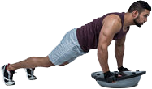


METODOLOGÍA DEL ENTRENAMIENTO FUNCIONAL:
Orientación
Prof. Edgar Lopategui Corsino
M.A., Fisiología del Ejercicio
Web: http://www.saludmed.com/
E-Mail: elopategui@intermetro.edu
saludmedpr@gmail.com
Curso: http://www.saludmed.com/entrenafuncional/entrenafuncional.html

Slide 2
ACCESO A LA PRESENTACIÓN:
http://www.saludmed.com/
entrenafuncional/presentaciones/
01_entrenafuncional-ORIENTA.pdf
Notes:
2

Slide 3

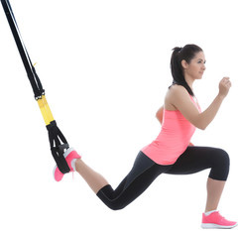
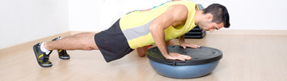

BOSQUEJO
Agradecimientos
Material educativo: Recursos y publicaciones
Preguntas
Cómo contactar al profesor: Correo/Teléfono
Notes:
3

Slide 4

Notes:
4

Slide 5
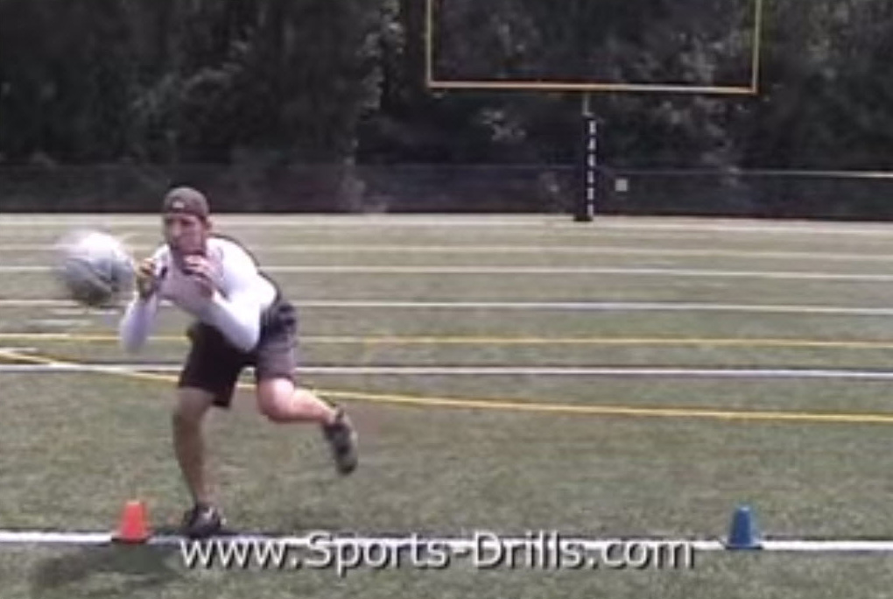
NOTA: Reproducido de: renoelliott2013 (2007, 13 de septiembre). Functional Sports Training Drills & Exercises [Archivo de video]. Recuperado de https://www.youtube.com/watch?v=8EpqHV4eicg
Notes:
5

Slide 6
BIOENERGÉTICA: AVALÚO
* Lista Focalizada*
Fundamentado en la presentación del video anterior, mencione tres términos, palabras o frases que puedan surgir de su pensamiento al ver tal película. Tienen 3 minutos para completar esta actividad:
1.
2.
3.
Notes:
6

Slide 7

Notes:
7

Slide 8
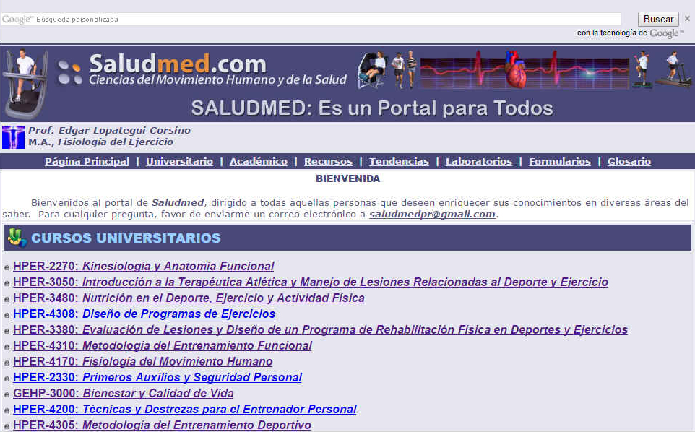
SALUDMED: CIENCIAS DEL MOVIMIENTO HUMANO Y DE LA SALUD
DIRECCIÓN DEL SITIO WEB: http://www.saludmed.com
Notes:
8

Slide 9

Notes:
9

Slide 10
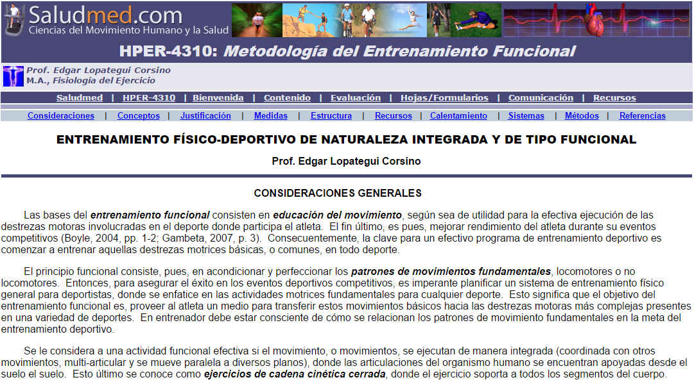
DISEÑO DE PROGRAMAS DE EJERCICIOS – Literatura Académica
DIRECCIÓN DEL SITIO WEB:
http://www.saludmed.com/entrenafuncional/
contenido/entrenamientointegradoyfuncional.html
Notes:
10

Slide 11

Notes:
11

Slide 12
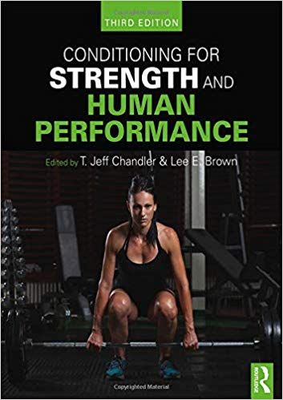
2019
Chandler, T. J., & Brown, L. E. (Eds), (2019). Conditioning for Strength and Human Performance (3ra ed.). New York, NY: Routledge, an imprint of the Taylor & Francis Group, an informa business.
Notes:
12

Slide 13
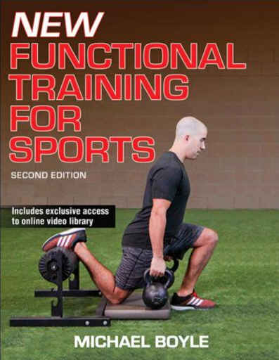
2016
Boyle, M. (2016). New Functional Training for Sports (2da ed.). Champaign, IL: Human Kinetics.
Notes:
13

Slide 14
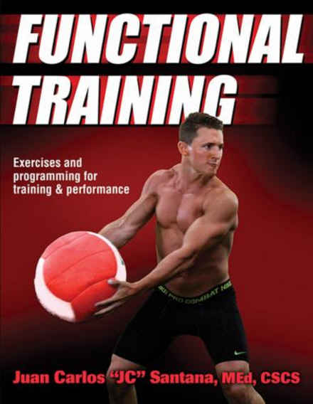
2016
Santana, J. C. (2016). Functional Training: Exercises and Programming for Training & Performance. Champaign, IL: Human Kinetics. 288 pp.
Notes:
14

Slide 15
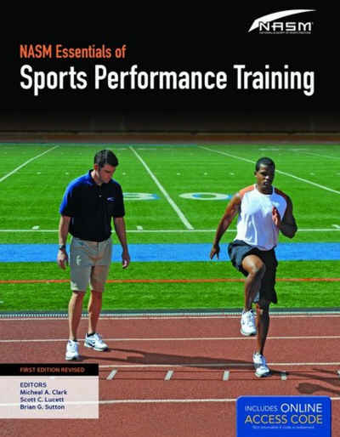
2015
Clark, M. A., & Lucett, S. C. (Eds.). (2015). NASM's Essentials of Sports Performance Training (Ed. Rev). Burlington, MA: Jones & Bartlett Learning. 647 pp.
Notes:
15

Slide 16
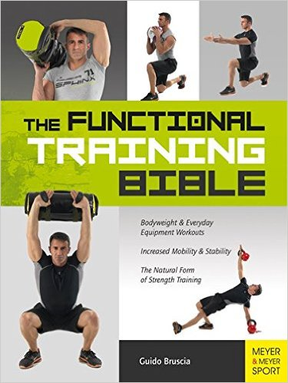
2015
Bruscia, G. (2015). The Functional Training Bible. Oxford, OXON, UK: Meyer & Meyer Sport (UK) Ltd. 510 pp.
Notes:
16

Slide 17
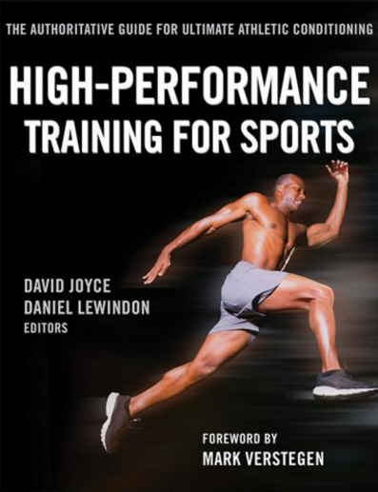
2014
Joyce, D., & Lewindon, D. (Eds.). (2014). High-Performance Training for Sports. Champaign, IL: Human Kinetics. 377 pp.
Notes:
17

Slide 18
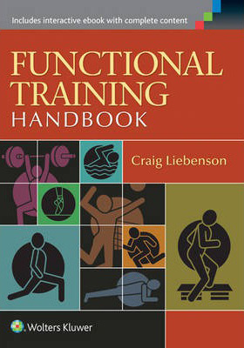
2014
Liebenson, G. (2014). Functional Training Handbook. Philadelphia, PA: Lippincott Williams & Wilkins, Wolters Kluwer Health. 472 pp.
Notes:
18

Slide 19
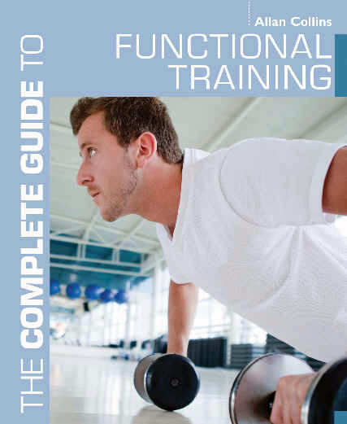
2012
Collins, A. (2012). The Complete Guide to Functional Training [Version para un lector digital]. London: Bloonsbury Publishing Plc.
Notes:
19

Slide 20
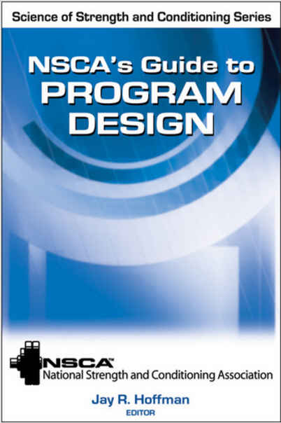
2012
National Strength & Conditioning Association [NSCA], & Hoffman, J. R. (Ed.). (2012). Science of Strength and Conditioning Series: NSCA’s Guide to Program Design. Champaign, IL: Human Kinetics. 325 pp.
Notes:
20

Slide 21
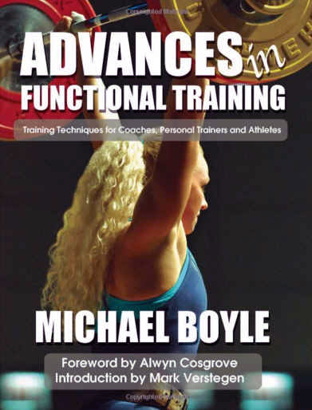
2010
Boyle, M. (2010). Advances in Functional Training: Training Techniques for Coaches, Personal Trainers and Athletes. Santa Cruz, CA: On Target Publications. 315 pp.
Notes:
21

Slide 22
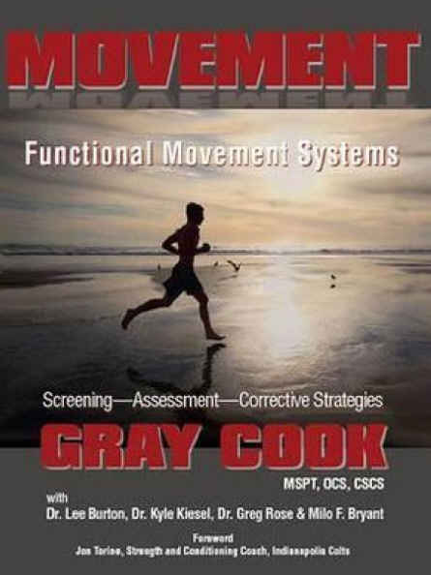
2010
Cook, G., Burton, L., Kiesel, K., Rose, G., & Bryant, M. F. (2010). Movement Functional Movement Systems: Screening, Assessment, Corrective Strategies. Aptos, CA: On Target Publication. 416 pp.
Notes:
22

Slide 23
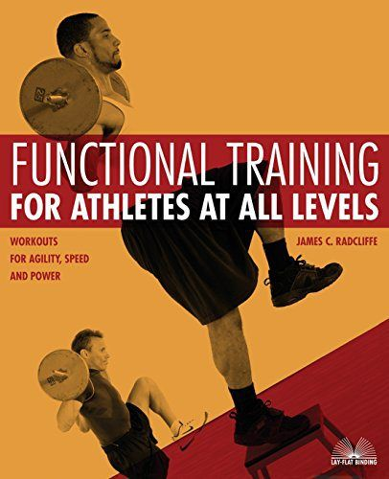
2007
Radcliffe, J. (2007). Functional Training for Athletes at all Levels: Workouts for Agility, Speed and Power. Berkeley, CA: Ulysses Press. 290 pp.
Notes:
23

Slide 24
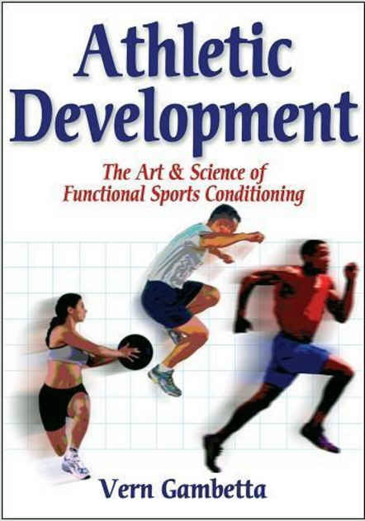
2007
Gambetta, V. (2007). Athletic Development The Art & Science of Functional Sports Conditioning. Champaign, IL: Human Kinetics. 299 pp.
Notes:
24

Slide 25
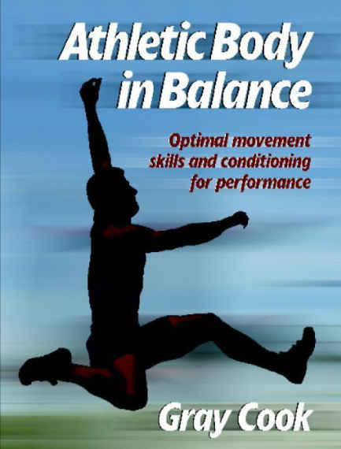
2003
Cook, G., (2003). Athletic Body in Balance: Optimal Movement Skills and Conditioning for Performance. Champaign, IL: Human Kinetics. 234 pp.
Notes:
25

Slide 26

Notes:
26

Slide 27
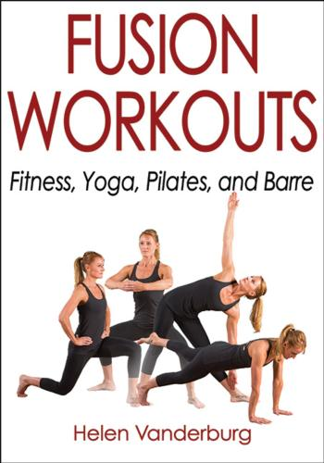
2017
Vanderburg, H. (2017). Fusion Workouts: Fitness, Yoga, Pilates, and Barre. Champaign, IL: Human Kinetics. 304 pp.
Notes:
27

Slide 28
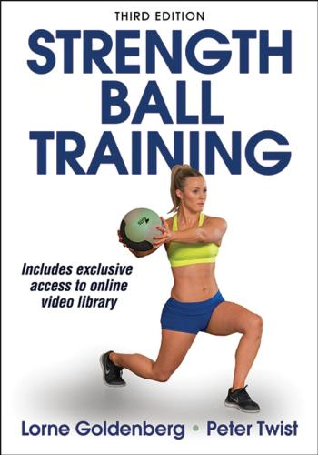
2016
Goldenberg, L., & Twist, P. (2016). Strength Ball Training (3ra. ed.). Champaign, IL: Human Kinetics. 352 pp.
Notes:
28

Slide 29
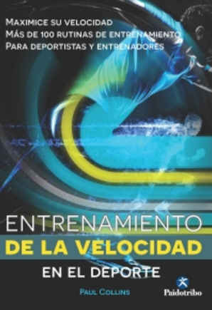
2015
Collins, P. (2016). Entrenamiento de la Velocidad en el Deporte. Badalona, España: Editorial Paidotribo.
Notes:
29

Slide 30
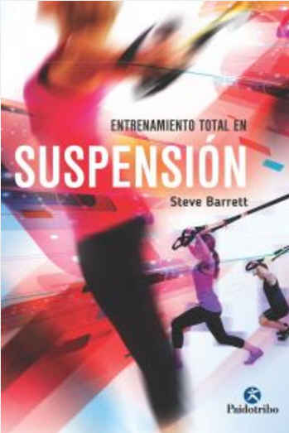
2015
Barrett, S. (2016): Entrenamiento Total en Suspensión. Badalona, España: Editorial Paidotribo. 168 pp
Notes:
30

Slide 31
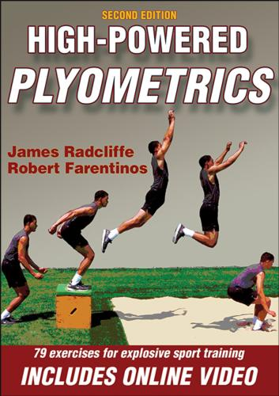
2015
Radcliffe, J., & Farentinos, R. (2015). High-Powered Plyometrics (2da. ed.). Champaign, IL: Human Kinetics. 200 pp.
Notes:
31

Slide 32
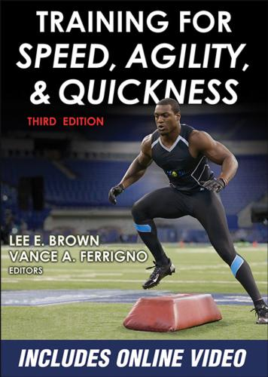
2015
Brown, L. E., & Ferrigno, V. A. (Eds.). (2015). Training for Speed, Agility, and Quickness (3ra. ed.). Champaign, Illinois: Human Kinetics. 293 pp.
Notes:
32

Slide 33
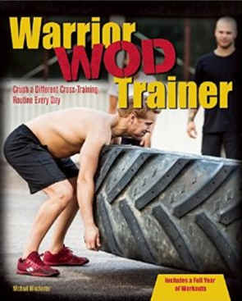
2015
Winchester, M. (2015). Warrior WOD Trainer: Crush a Different Cross-Training Routine Every Day. Berkeley, CA: Ulysses Press. 184 pp.
Notes:
33

Slide 34
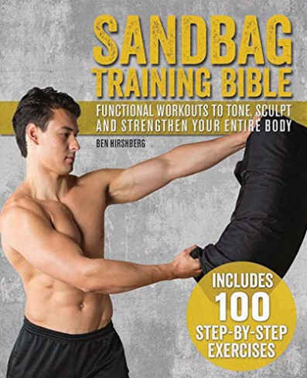
2015
Hirshberg, B. (2015). Sandbag Training Bible: Functional Workouts To Tone, Sculpt and Strengthen your Entire Body. Berkeley, CA: Ulysses Press 144 pp.
Notes:
34

Slide 35
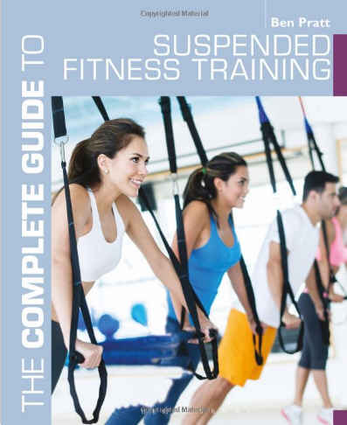
2015
Pratt, B. (2015). The Complete Guide to Suspended Fitness Training. New York, NY: Bloomsbury Sports: An imprint of Bloomsbury Publishing Plc. 176 pp.
Notes:
35

Slide 36
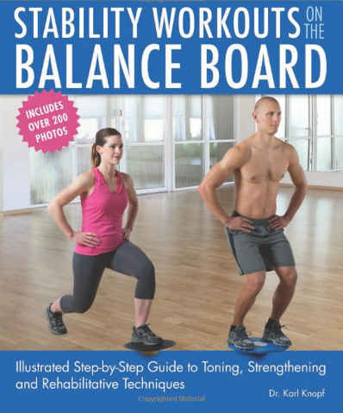
2015
Knopf, K. (2015). Stability Workouts on the Balance Board: Illustrated Step-by-Step Guide to Toning, Strengthening and Rehabilitative Techniques. Berkeley, CA: Ulysses Press. 144 pp.
Notes:
36

Slide 37
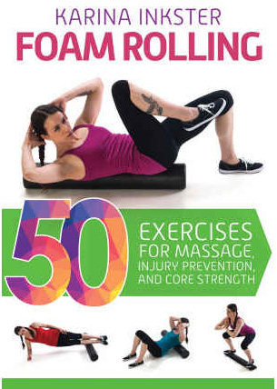
2015
Inkster, K. (2015). Foam Rolling: 40 Exercises for Massage, Injury Prevention, and Core Strength. New York, NY: W.W. Norton & Company, Inc. 160 pp.
Notes:
37

Slide 38

2015
Thompson, J. (2015). Weighted Vest Workouts: Supercharge Your Workout f
or Weight Loss, Muscle Building, Cardio Endurance and Core Strength. Berkeley, CA: Ulysses Press.144 pp.
Notes:
38

Slide 39
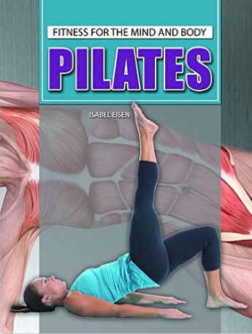
2015
Eisen, I. (2015). Pilates. New York, NY: Young Adult - Rosen Publishing. 192 pp.
Notes:
39

Slide 40
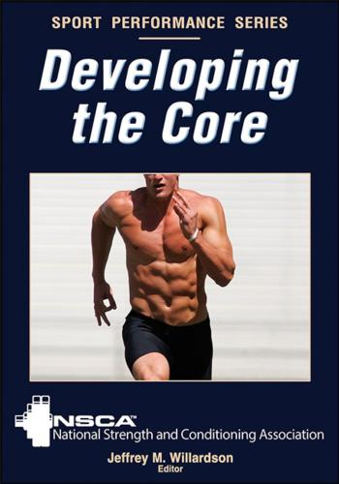
2014
Willardson, J. M. (Ed.). (2014). Developing the Core. Champaign, IL: Human Kinetics. 215 pp.
Notes:
40

Slide 41
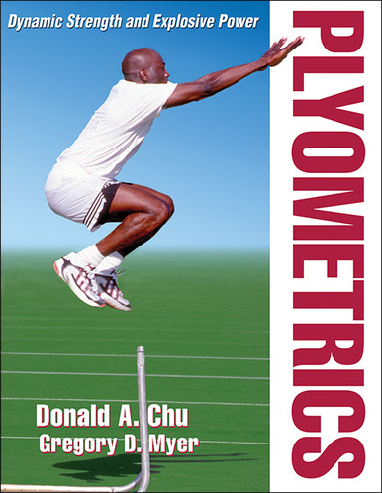
2013
Chu, D. A., & Myer,G. D. (2013). Plyometrics. Champaign, IL: Human Kinetics. 242 pp.
Notes:
41

Slide 42
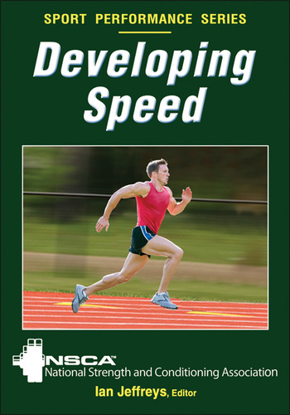
2013
National Strength & Conditioning Association [NSCA], & Jeffreys, I. (Eds.). (2013). Developing Speed. Champaign, IL: Human Kinetics. 224 pp.
Notes:
42

Slide 43
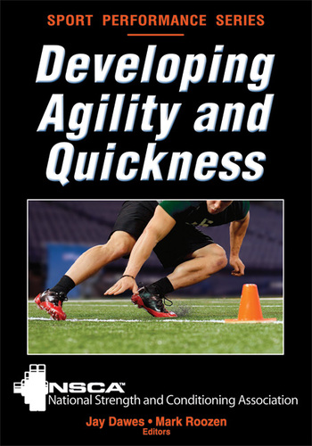
2012
Dawes, J., & Roozen, M. (2012). Developing Agility, and Quickness. Champaign, IL: Human Kinetics. 200 pp.
Notes:
43

Slide 44
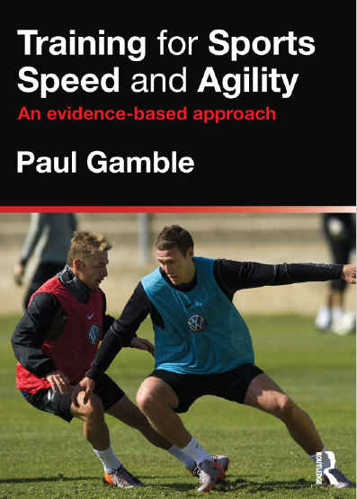
2012
Gamble, P. (2012). Training for Sport Speed and Agility: An Evidence-Based Approach. New York, NY: Routledge, an Imprint of the Taylor & Francias Group. 200 pp.
Notes:
44

Slide 45
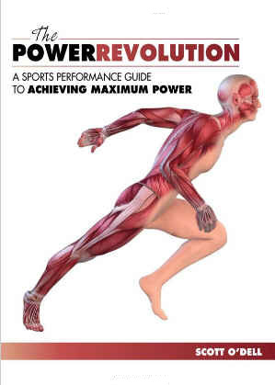
2012
O’Dell, S. (2012). The Power Revolution: A Sports Performance Guide to Achieving Maximum Power. Monterey, CA: Coaches Choice. 215 pp.
Notes:
45

Slide 46
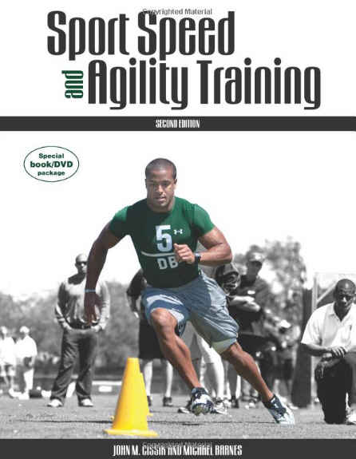
2010
Cissik, J. M., & Barnes, M. (2011). Sport Speed and Agility (2da. ed.). Monterey, CA: Coaches Choice. 260 pp.
Notes:
46

Slide 47
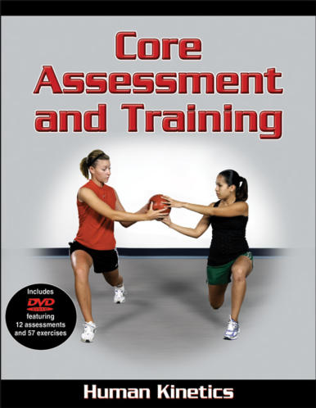
2010
Brumitt, J. (2010). Core Assessment and Training. Champaign, IL: Human Kinetics. 154 pp.
Notes:
47

Slide 48
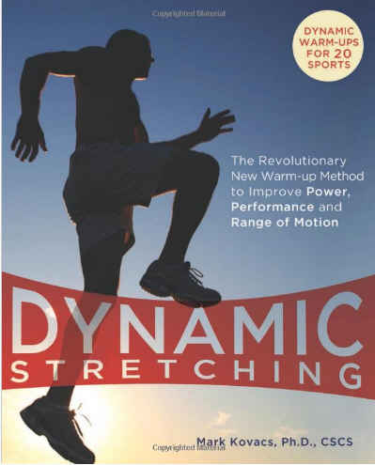
2009
Kovacs, M. (2009). Dynamic Stretching: The Revolutionary New Warm-up Method to Improve Power, Performance and Range of Motion. Berkeley, CA: Ulysses Press. 144 pp.
Notes:
48

Slide 49
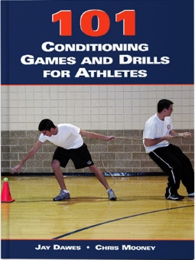
2006
Dawes, J., & Mooney, C. (2006). 101 Conditioning Games and Drills for Athletes. Monterey, CA: Coaches Choice. 134 pp.
Notes:
49

Slide 50
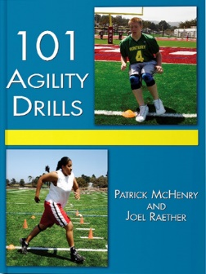
2004
McHenry, P., & Raether, J. (2004). 101 Agility Drills. Monterey, CA: Coaches Choice. 150 pp.
Notes:
50

Slide 51
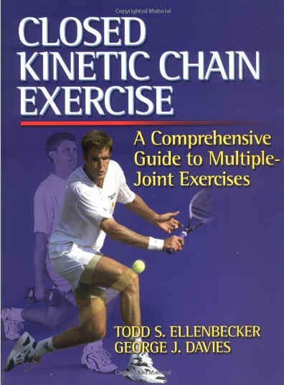
2001
Ellenbecker, T. S., & Davies, G. J. (2001). Closed Kinetic Chain Exercises: A Comprehensice Guide to Multiple Joint Exercises. Champaign, IL: Human Kinetics, Inc. 128 pp.
Notes:
51

Slide 52

Notes:
52

Slide 53
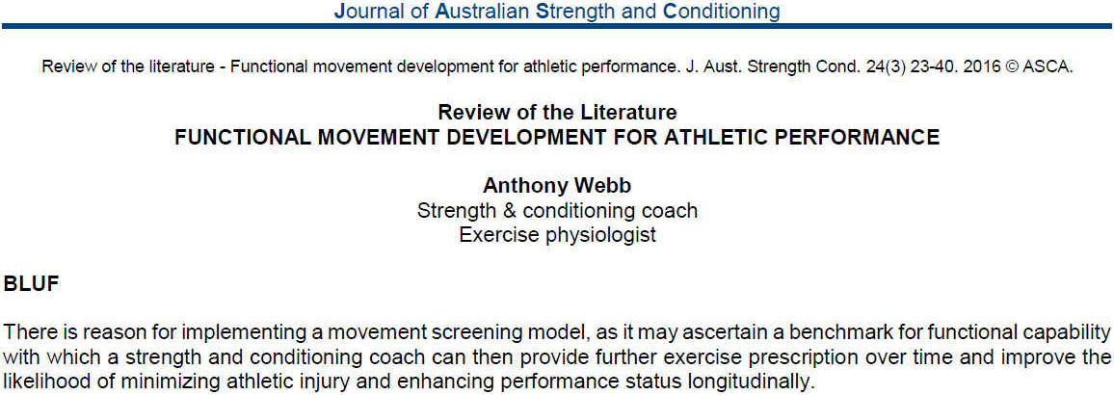
2016
Webb, A. (2016). Functional movement development for athletic performance. Journal of Australian Strength & Conditioning, 24(3), 23-40. Recuperado de la base de datos de EBSCOhost (SPORTDiscus with Full Text)
Notes:
53

Slide 54
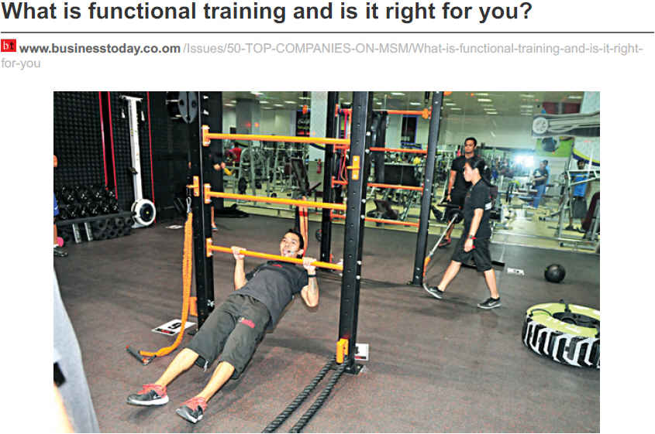
2016
D'ewes, D. (2016). What is functional training and is it right for you?. Businesstoday, (210), 1-3. Recuperado de la base de datos de EBSCOhost (Business Source Complete)
Notes:
54

Slide 55
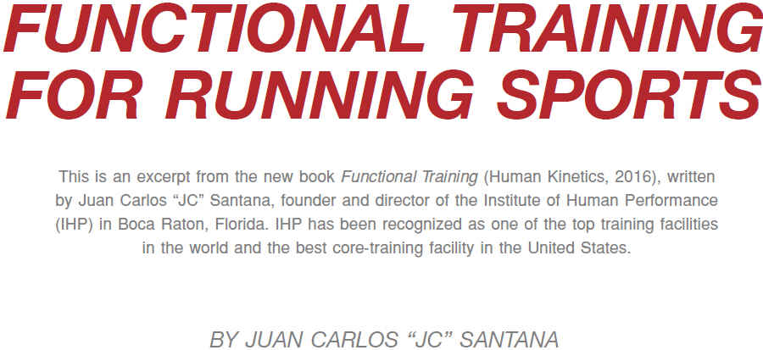
2016
Santana, J. C. (2016). Functional training for running sports. Track Coach, (214), 6835-6841. Recuperado de la base de datos de EBSCOhost (SPORTDiscus with Full Text)
Notes:
55

Slide 56
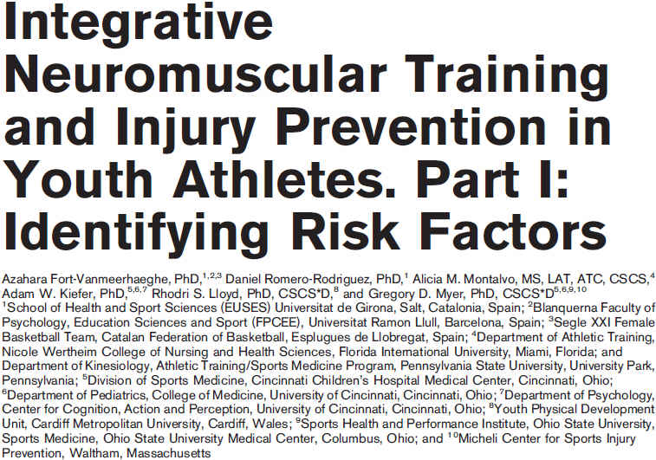
2016
Fort-Vanmeerhaeghe, A., Romero-Rodriguez, D., Montalvo, A. M., Kiefer, A. W., Lloyd, R. S., & Myer, G. D. (2016). Integrative neuromuscular training and injury prevention in youth athletes. Part I: Identifying risk factors. Strength & Conditioning Journal, 38(3), 36-48. Recuperado de http://www.revdesportiva.pt/files/para_publicar/Integrative_Neuromuscular_Training_and_Injury.5.pdf
Notes:
56

Slide 57
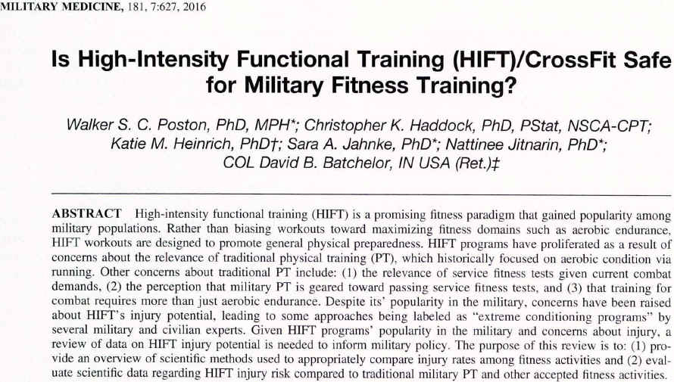
2016
Poston, W. C., Haddock, C. K., Heinrich, K. M., Jahnke, S. A., Jitnarin, N., & Batchelor, D. B. (2016). Is High-intensity functional training (HIFT)/CrossFit safe for military fitness training?. Military Medicine, 181(7), 627-637. doi:10.7205/MILMED-D-15-00273. Recuperado de la base de datos de EBSCOhost (SPORTDiscus with Full Text)
Notes:
57

Slide 58
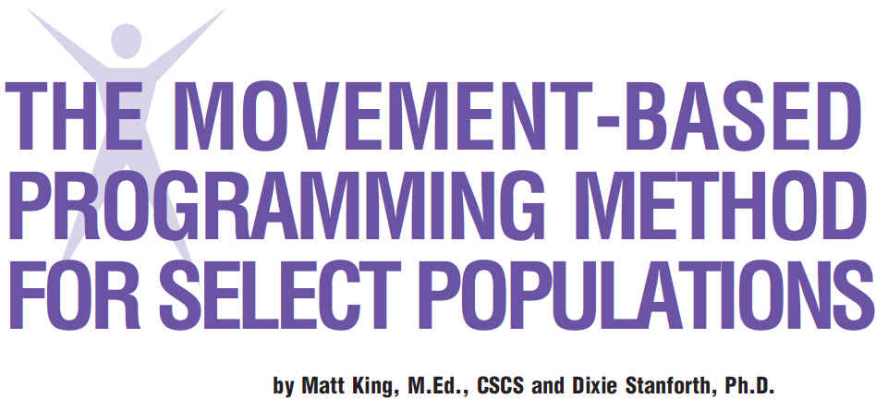
2015
King, M., & Stanforth, D. (2015). The movement-based programming method for select populations. ACSM s Health & Fitness Journal, 19(1), 17-22. Recuperado de http://journals.lww.com/acsm-healthfitness/Fulltext/2015/01000/THE_MOVEMENT_BASED_PROGRAMMING_METHOD_FOR_SELECT.6.aspx
Notes:
58

Slide 59

2015
Ageberg, E., & Roos, E. M. (2015). Neuromuscular exercise as treatment of degenerative knee disease. Exercise & Sport Sciences Reviews, 43(1), 14-22. Recuperado de http://journals.lww.com/acsm-essr/Fulltext/2015/01000/Neuromuscular_Exercise_as_Treatment_of.5.aspx
Notes:
59

Slide 60

2014
Da Silva-Grigoletto, M. E., Brito, C. J., & Heredia, J. R. (2014). Functional training: functional for what and for whom? / Treinamento funcional: funcional para que e para quem?. Brazilian Journal of Kineanthropometry & Human Performance, 16(6), 714-719. Recuperado de http://www.scielo.br/pdf/rbcdh/v16n6/1980-0037-rbcdh-16-06-00709.pdf
Notes:
60

Slide 61

2014
Balagué Serre, N., Torrents Martín, C., Pol Cabanellas, R., & Seirul.Lo Vargas, F. (2014). Entrenamiento integrado. Principios dinámicos y aplicaciones. Apunts: Educacion Fisica y Deportes, (116), 60-68. doi:10.5672/apunts.2014-0983.es.(2014/2).116.06. Recuperado de http://www.raco.cat/index.php/ApuntsEFD/article/viewFile/279286/366994
Notes:
61

Slide 62

2014
Roy, B. A. (2014). FUNctional exercise training. ACSM's Health & Fitness Journal, 18(3), 3. Recuperado de http://journals.lww.com/acsm-healthfitness/Fulltext/2014/05000/FUNctional_Exercise_Training.3.aspx
Notes:
62

Slide 63

2014
Liu, C., Shiroy, D., Jones, L., & Clark, D. (2014). Systematic review of functional training on muscle strength, physical functioning, and activities of daily living in older adults. European Reviews of Aging & Physical Activity, 11(2), 95-106. Recuperado de la base de datos de EBSCOhost (SPORTDiscus with Full Text)
Notes:
63

Slide 64

2014
Dalcourt, M. (2014). Loaded movement training. IDEA Fitness Journal, 11(5), 30-37. Recuperado de la basede datos de EBSCOhost (SPORTDiscus with Full Text)
Notes:
64

Slide 65

2013
Peterson, J. A. (2013). Take ten. 10 nice-to-know facts about functional training. ACSM's Health & Fitness Journal, 17(5), 48. Recuperado de http://journals.lww.com/acsm-healthfitness/Fulltext/2013/09000/10_Nice_to_Know_Facts_About_Functional_Training.15.aspx
Notes:
65

Slide 66

2013
King, M., & Stanforth, D. (2013). 10,000 workouts in 10 minutes: Movement-based programming. ACSM's Health & Fitness Journal, 17(1), 5-14. Recuperado de http://journals.lww.com/acsm-healthfitness/Fulltext/2013/01000/10,000_WORKOUTS_IN_10_MINUTES__Movement_based.5.aspx
Notes:
66

Slide 67

2012
Sipe, C., & Ritchie, D. (2012). The significant 7 principles of functional training for mature adults. IDEA Fitness Journal, 9(1), 42-49. Recuperado de la base de datos de EBSCOhost (SPORTDiscus with Full Text)
Notes:
67

Slide 68

2012
Bushman, B. A. (2012). Wouldn't you like to know. Neuromotor exercise training. ACSM's Health & Fitness Journal, 16(6), 4-7. Recuperado de http://journals.lww.com/acsm-healthfitness/Fulltext/2012/11000/Neuromotor_Exercise_Training.4.aspx
Notes:
68

Slide 69

2012
Schoenfeld, B., & Contreras, B. (2012). Do single-joint exercises enhance functional fitness? Strength & Conditioning Journal, 34(1), 63-65. Recuperado de https://bretcontreras.com/wp-content/uploads/Do-Single-Joint-Exercises-Enhance-Functional-Fitness.pdf
Notes:
69

Slide 70

2011
O'Driscoll1, J. & Delahunt, E. (2011). Neuromuscular training to enhance sensorimotor and functional deficits in subjects with chronic ankle instability: A systematic review and best evidence synthesis. (2011). SMARTT: Sports Medicine, Arthroscopy, Rehabilitation, Therapy & Technology, 3(1), 19-38. Recuperado de http://www.ncbi.nlm.nih.gov/pmc/articles/PMC3189141/pdf/1758-2555-3-19.pdf
Notes:
70

Slide 71

2011
Hernández García, R., & Torres Luque, G. (2011). Preparación física integrada en deportes de combate. E-Balonmano.Com: Journal of Sports Science / Revista de Ciencias del Deporte, 731-38. Recuperado de http://www.e-balonmano.com/ojs/index.php/revista/article/view/72/68
Notes:
71

Slide 72

2011
Brzycki, M. (2011). A critical look at functional training. Texas Coach, (January), 44-47. Recuperado de https://www.princeton.edu/campusrec/stephens-fitness-center/fitness-articles/MB-2011-01a.pdf
Notes:
72

Slide 73

2011
Faigenbaum, A. D., Farrell, A., Fabiano, M., Radler, T., Naclerio, F., Ratamess, N. A., & ... Myer, G. D. (2011). Effects of integrative neuromuscular training on fitness performance in children. Pediatric Exercise Science, 23, 573-584. Recuperado de la base de datos de EBSCOhost (SPORTDiscus with Full Text).
Notes:
73

Slide 74

2011
Naclerio, F., & Faigenbaum, A. (2011). Integrative neuromuscular training for youth. Revista Kronos, 10(1), 49-56. Recuperado de la base de datos de EBSCOhost (SPORTDiscus with Full Text)
Notes:
74

Slide 75

2011
Myer, G. D., & Faigenbaum, A. D. (2011). Exercise is sports medicine in youth: Integrative neuromuscular training to optimize motor development and reduce risk of sports related injury. Revista Kronos, 10(1), 39-48. Recuperado de http://abacus.universidadeuropea.es/bitstream/handle/11268/3102/Kronos_X_1_5.pdf?sequence=1&isAllowed=y
Notes:
75

Slide 76

2011
Myer, G. D., Faigenbaum, A. D., Ford, K. R., Best, T. M., Bergeron, M. F., & Hewett, T. E. (2011). When to Initiate Integrative Neuromuscular Training to Reduce Sports-Related Injuries and Enhance Health in Youth?. Current Sports Medicine Reports, 10(3), 157-166. Recuperado de http://www.ncbi.nlm.nih.gov/pmc/articles/PMC3105332/pdf/nihms-289927.pdf
Notes:
76

Slide 77

2011
Daehan, K., Van Ryssegem, G., & Junggi, H. (2011). Clinician's corner: Overcoming the myth of proprioceptive training. Clinical Kinesiology (Online Edition), 18-28. Recuperado de http://www.academia.edu/4248611/Overcoming_The_Myth_Of_Proprioceptive_Training
Notes:
77

Slide 78

2010
Beckham, S. G., & Harper, M. (2010). Functional training: Fad or here to stay? ACSM's Health & Fitness Journal, 14(6), 24-30. Recuperado de http://journals.lww.com/acsm-healthfitness/Fulltext/2010/11000/FUNCTIONAL_TRAINING__Fad_or_Here_to_Stay_.8.aspx
Notes:
78

Slide 79

2006
Liebernson, C. (2006). Functional training for performance enhancement - Part 1: The basics. Journal of Bodywork & Movement Therapies, 10(2), 154-158. Recuperado de http://www.avordchiropractic.com/doc/Functional%20training%20for%20Performance%20enhancement.pdf
Notes:
79

Slide 80

2002
Siff, M. (2002). Functional training revisited. Strength & Conditioning Journal, 24(5), 42-46. Recuperado de http://encontroswf.com/wp-content/uploads/2015/04/Artigo-ACSM-2009_Exercise-and-physical-activity-for-older-adults-72.pdf
Notes:
80

Slide 81

2001
Risberg, M. A., Mork, M. M., Jenssen, H. K., & Holm, I. I. (2001). Design and implementation of a neuromuscular training program following anterior cruciate ligament reconstruction. Journal of Orthopaedic & Sports Physical Therapy, 31, 620-631. Recuperado de la base de datos de EBSCOhost (SPORTDiscus with Full Text).
Notes:
81

Slide 82

Notes:
82

Slide 83

http://www.nsca.com
Notes:
83

Slide 84

http://www.nasm.org
Notes:
84

Slide 85

THE AMERICAN COUNCIL ON EXERCISE (ACE):
https://www.acefitness.org/
Notes:
85

Slide 86

Notes:
86

Slide 87

FUNCTIONAL TRAINING INSTITUTE:
DIRECCIÓN DEL SITIO WEB: http://www.functionaltraininginstitute.com/
Notes:
87

Slide 88

FUNCTIONAL MOVEMENT SCREEN:
DIRECCIÓN DEL SITIO WEB: http://www.functionalmovement.com/
Notes:
88

Slide 89

FUNCTIONAL MOVEMENT SCREEN:
DIRECCIÓN DEL SITIO WEB: http://www.movementbook.com/
Notes:
89

Slide 90

GRACIAS
Notes:
90

Slide 91

¿PREGUNTAS?

Slide 92



CONTACTO:
Correo electrónico:
elopategui@intermetro.edu
Dirección y Teléfono:
Universidad Interamericana de Puerto Rico
Recinto Metropolitano
Tel: 787-250-1912, X2286, 2245
Página Web:
www.saludmed.com

