Slide 1
RUTINA DE EJERCICIOS: SEGÚN EL DEPORTE Y SUS NECESIDADES BIOMOTORAS
Prof. Edgar Lopategui Corsino

Slide 2
NOTA. Reproducido de: Functional Training: Exercises and Programming for Training & Performance. (p. 207), por J. C. Santana, 2016, Champaign, IL: Human Kinetics. Copyright 2016 por Juan Carlos Santana

Slide 3
DEPORTES INTERMITENTES CARACTERIZADOS POR UNA DEMANDA ALTA DE POTENCIA

Slide 4
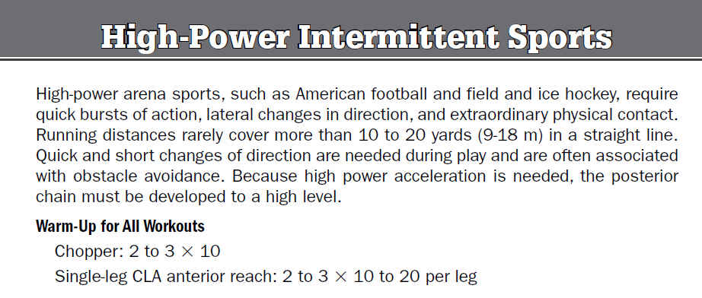
NOTA. Tomado de: Functional Training: Exercises and Programming for Training & Performance. (p. 208), por J. C. Santana, 2016, Champaign, IL: Human Kinetics. Copyright 2016 por Juan Carlos Santana

Slide 6
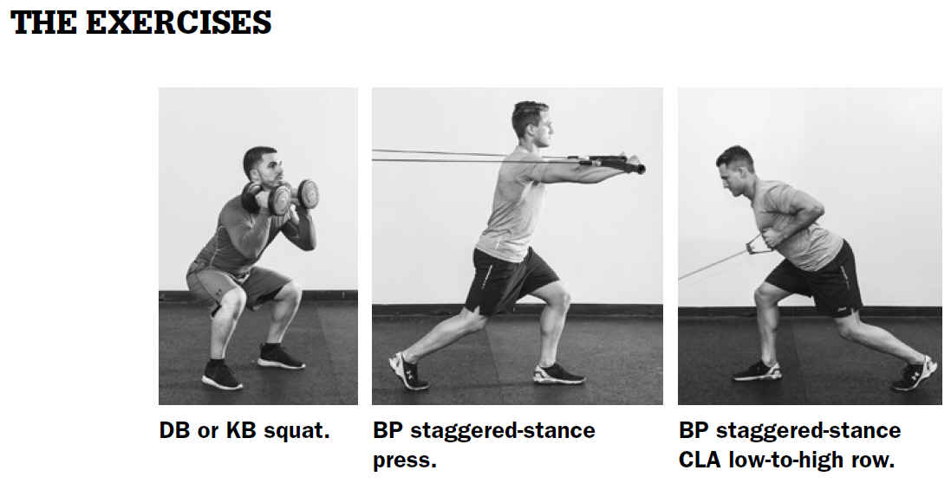
DB = Dumbbells, KB = Kettlebells, BP = Bands and Pulleys, CLA = Contralateral-Arm

Slide 7
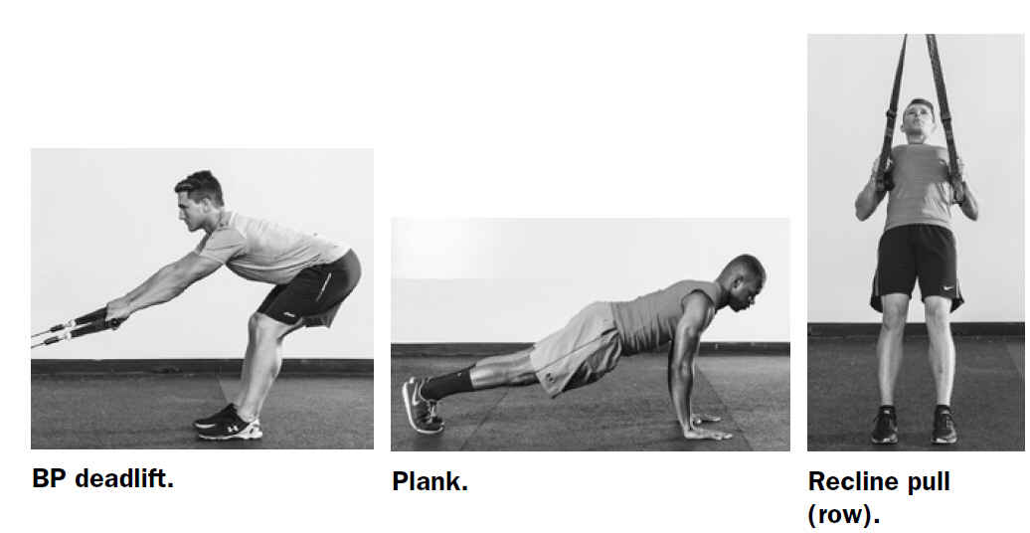
BP = Bands and Pulleys

Slide 8
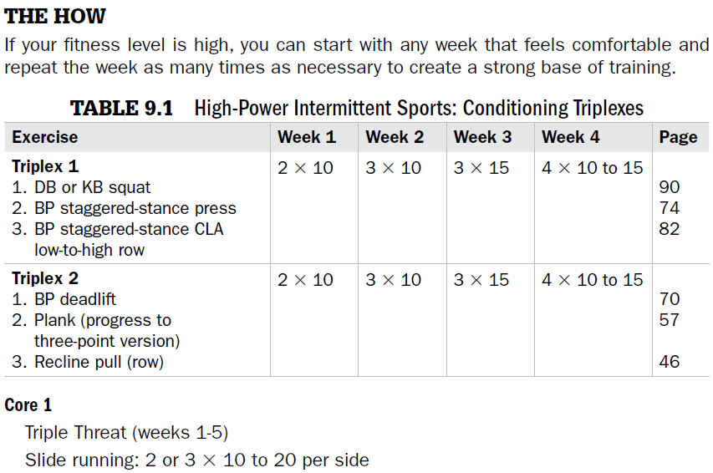

Slide 10
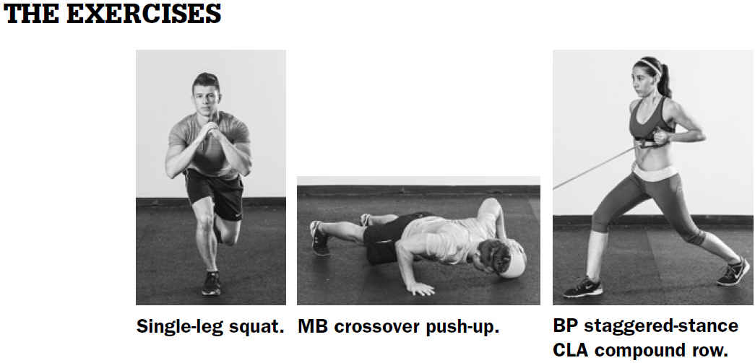
MB = Medicine Balls, BP = Bands and Pulleys, CLA = Contralateral-Arm

Slide 11
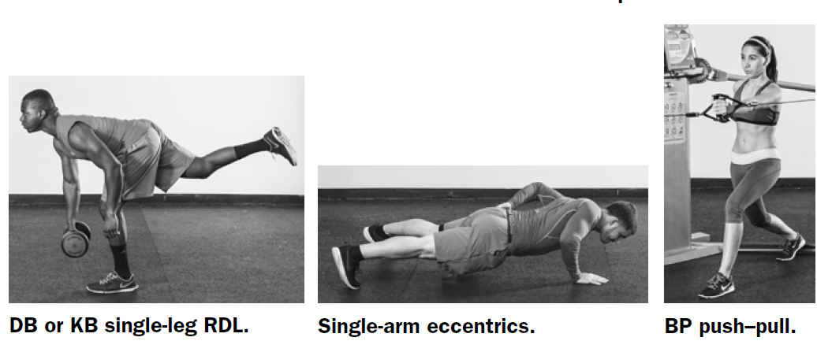
DB = Dumbbells, KB = Kettlebells, BP = Bands and Pulleys

Slide 12
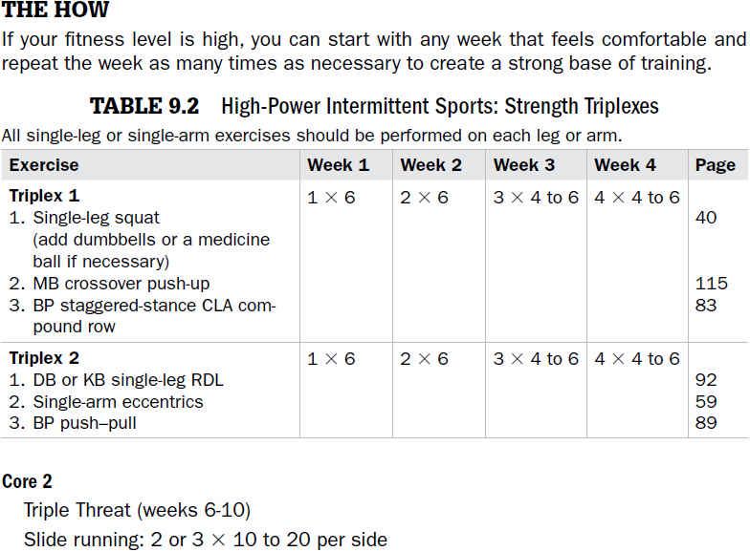

Slide 13
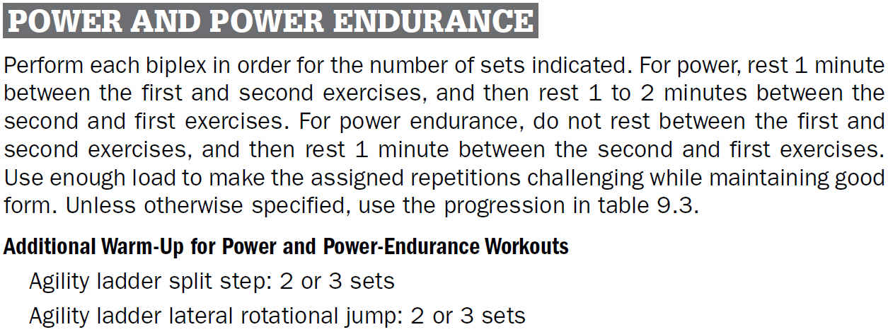

Slide 14
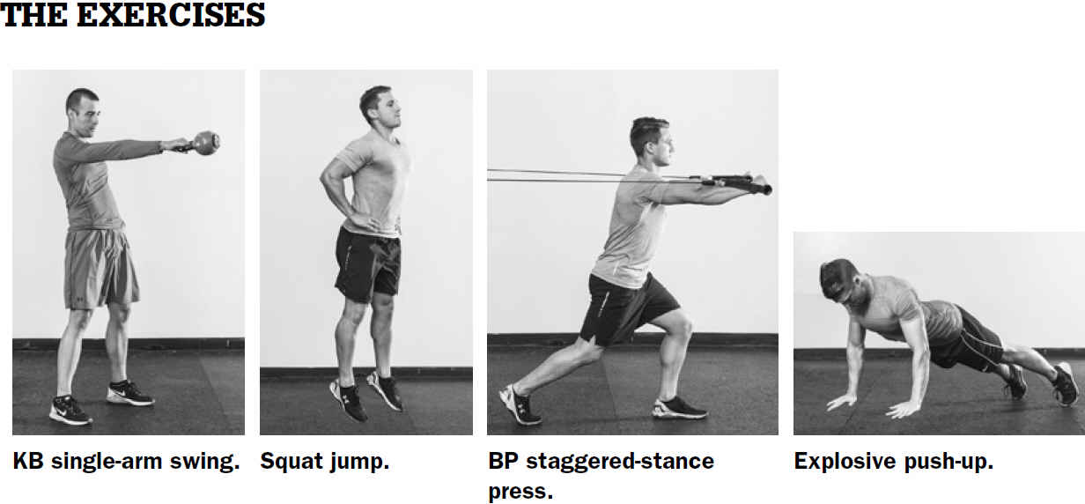
KB = Kettlebells, BP = Bands and Pulleys

Slide 15
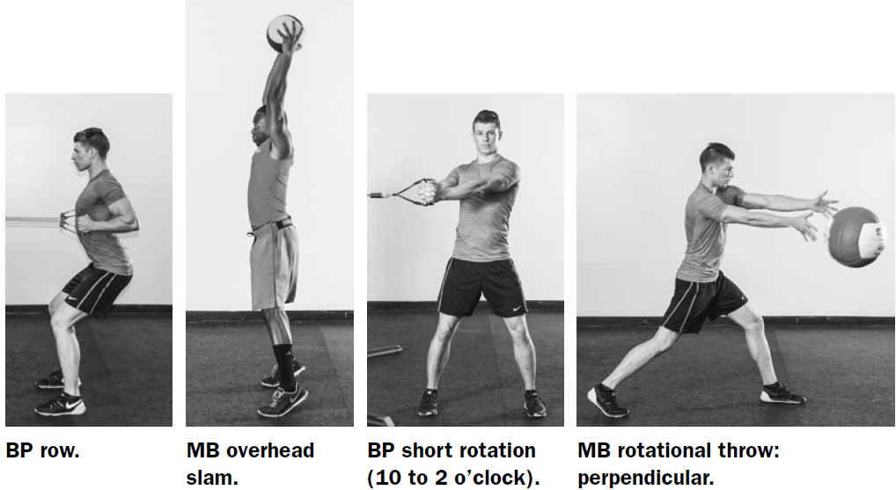
BP = Bands and Pulleys, MB = Medicine Balls

Slide 16
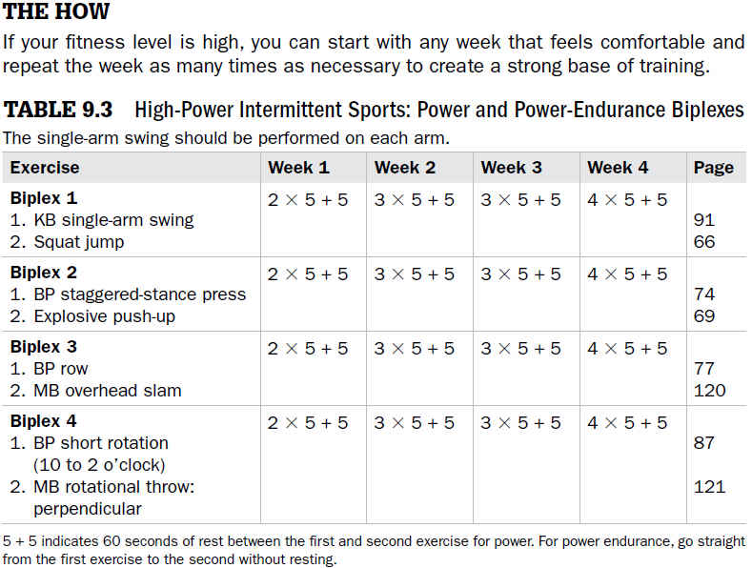

Slide 17
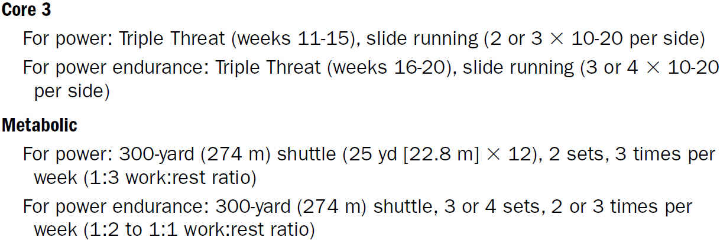
HOW TO - continuación

Slide 18
DEPORTES DE RAQUETAS

Slide 19
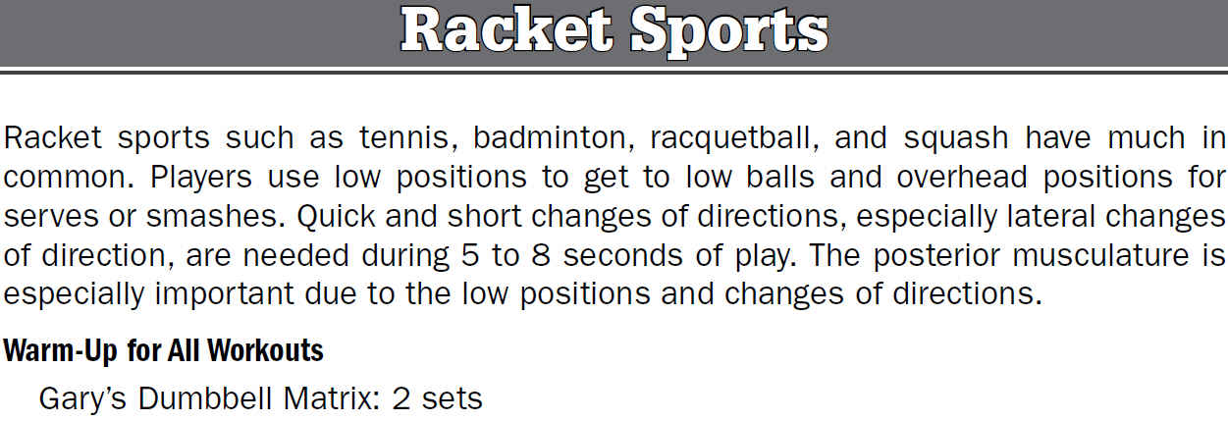
NOTA. Tomado de: Functional Training: Exercises and Programming for Training & Performance. (p. 212), por J. C. Santana, 2016, Champaign, IL: Human Kinetics. Copyright 2016 por Juan Carlos Santana

Slide 21
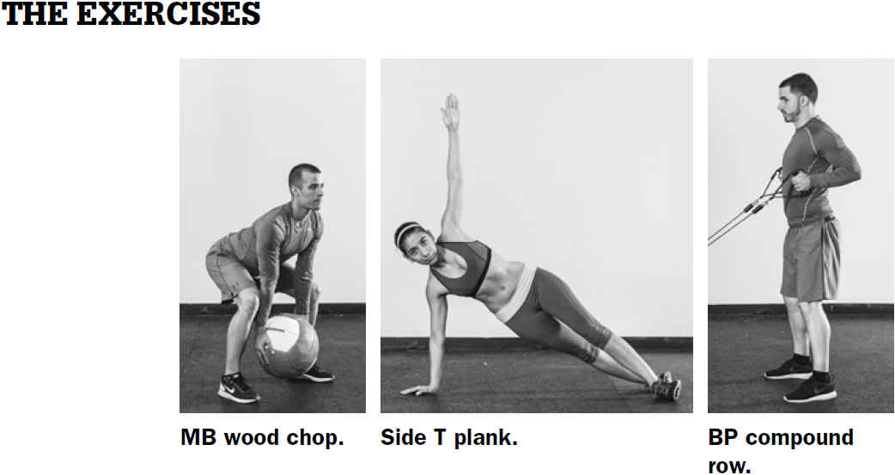
MB = Medicine Ballas, BP = Bands and Pulleys

Slide 22
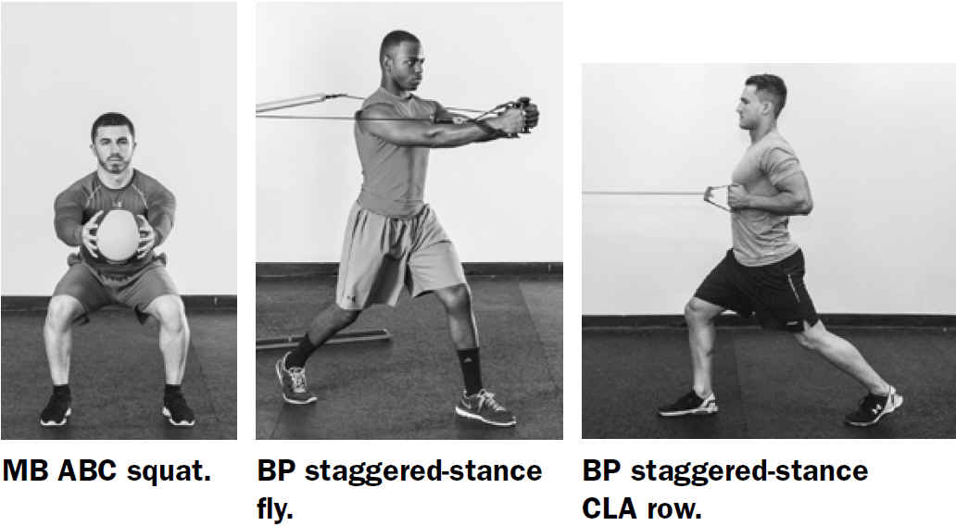
MB = Medicine Balls, ABC = , BP = Bands and Pulleys, CLA = Contralateral-Arm

Slide 23
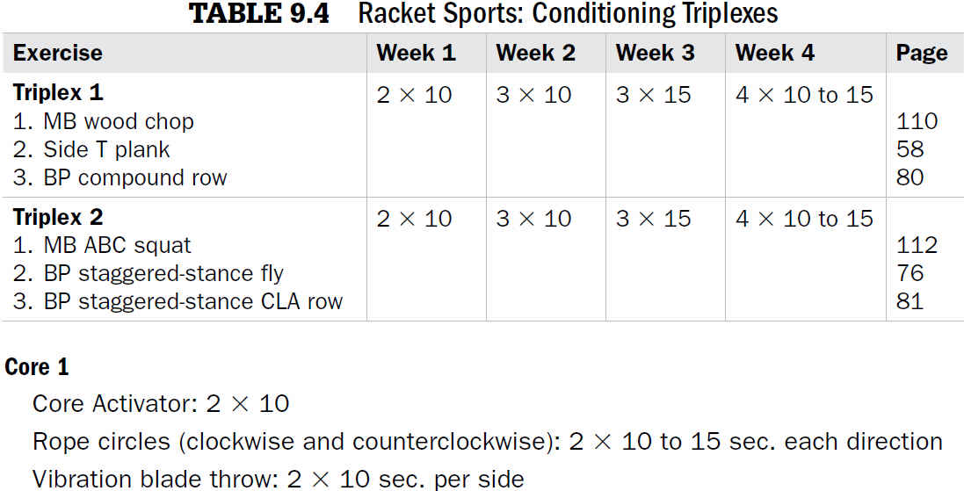

Slide 25
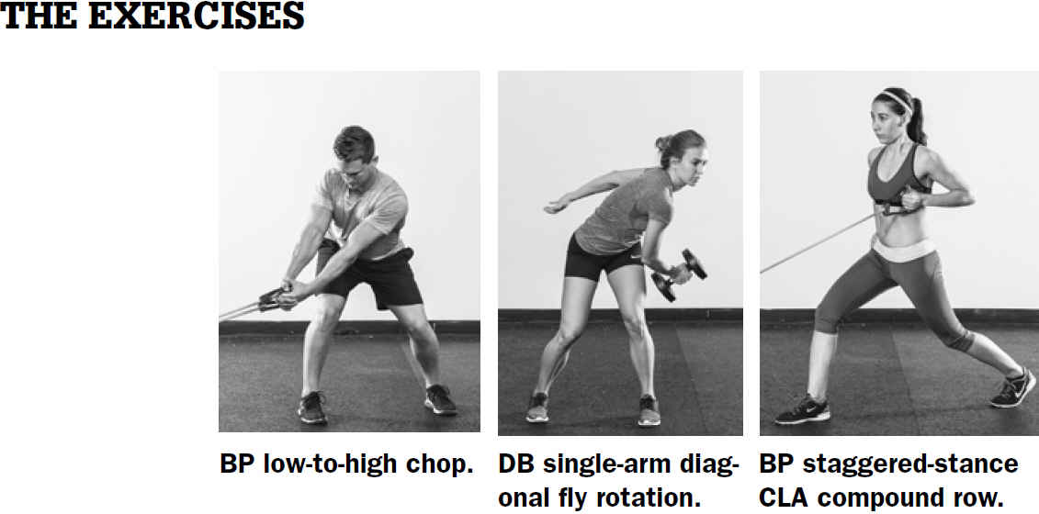
BP = Bands and Pulleys, DB = Dumbbells, CLA = Contralateral-Arm

Slide 26
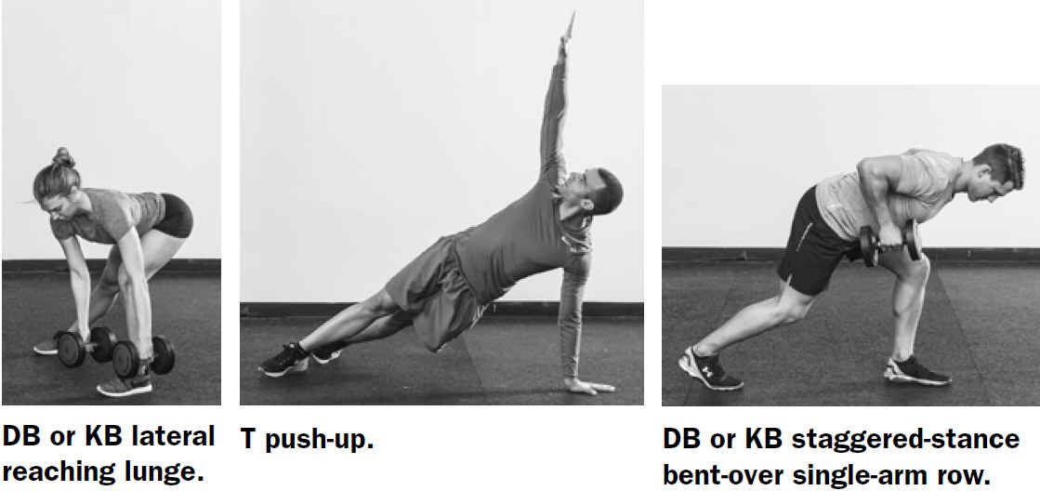
DB = Dumbbells, KB = Kettlebells

Slide 27
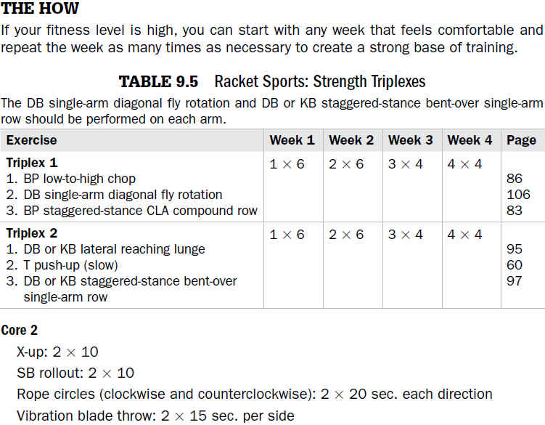

Slide 28
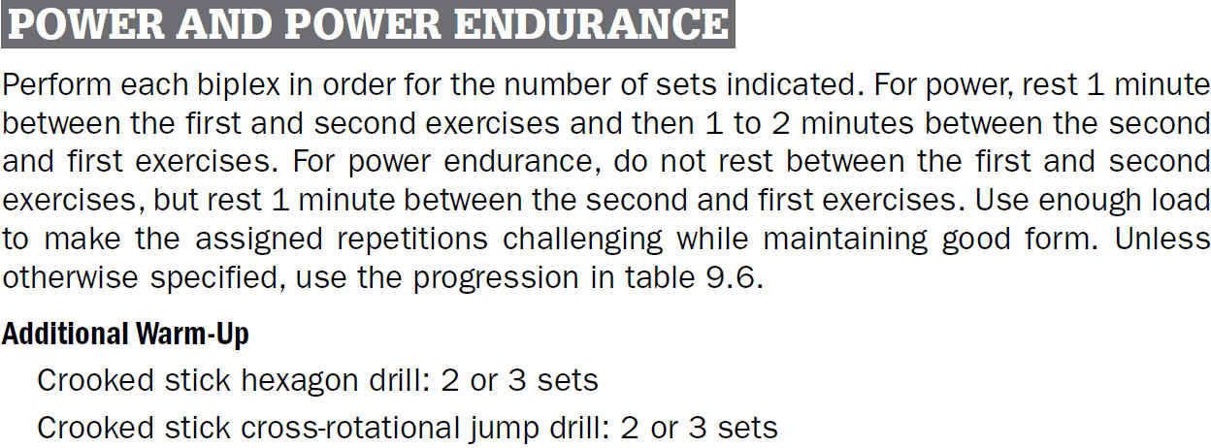

Slide 29
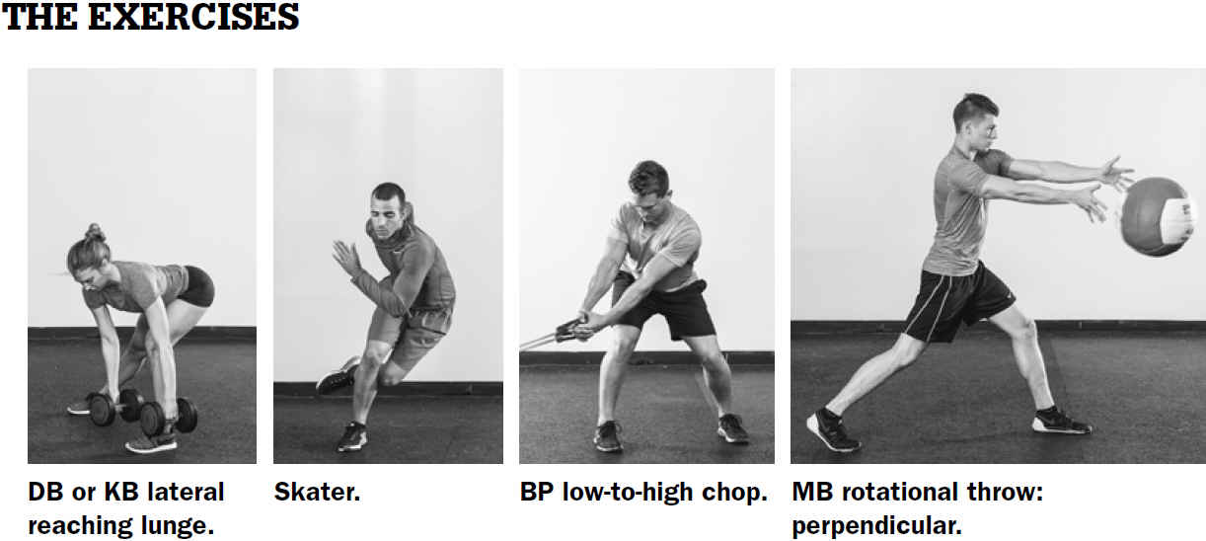
DB = Dumbbells, KB = Kettlebells, MB = Medicine Balls

Slide 30
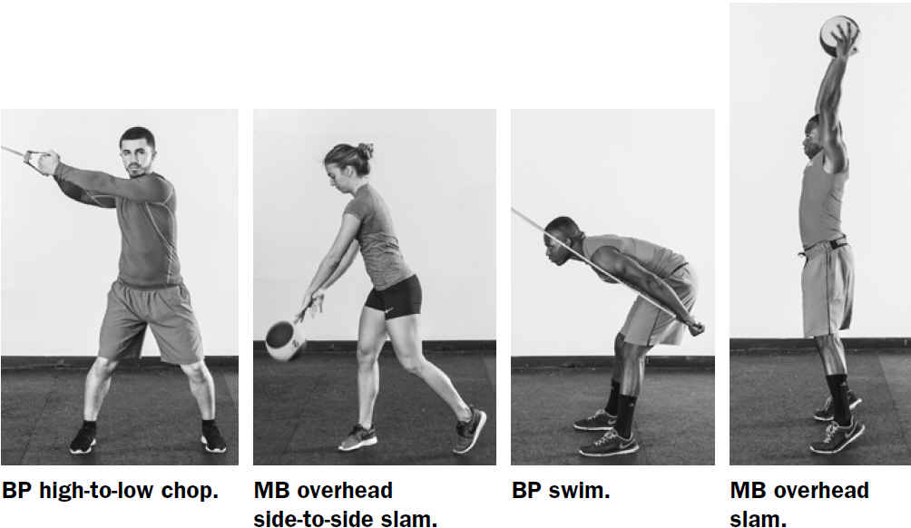
BP = Bands and Pulleys, MB = Medicine Balls

Slide 31
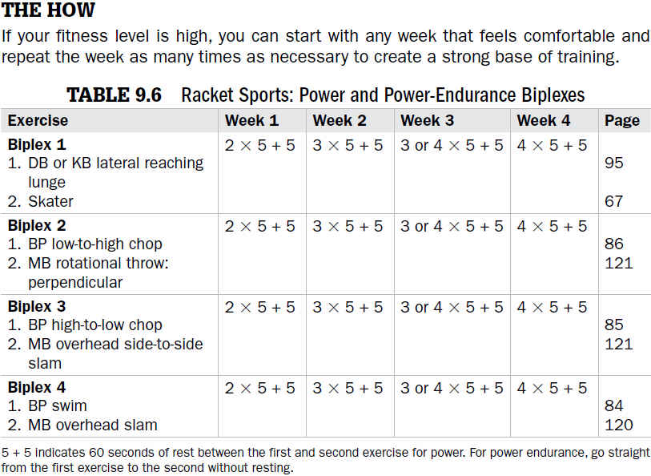
Biplex = 1 Traditional exercise + 1 functional exercise

Slide 32
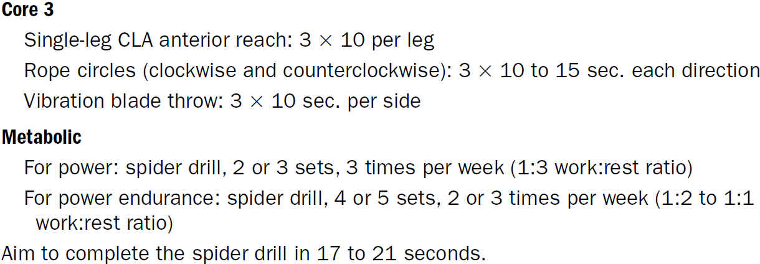
HOW TO - continuación

Slide 33
DEPORTES DE BATEAR, LANZAR Y ATRAPAR

Slide 36
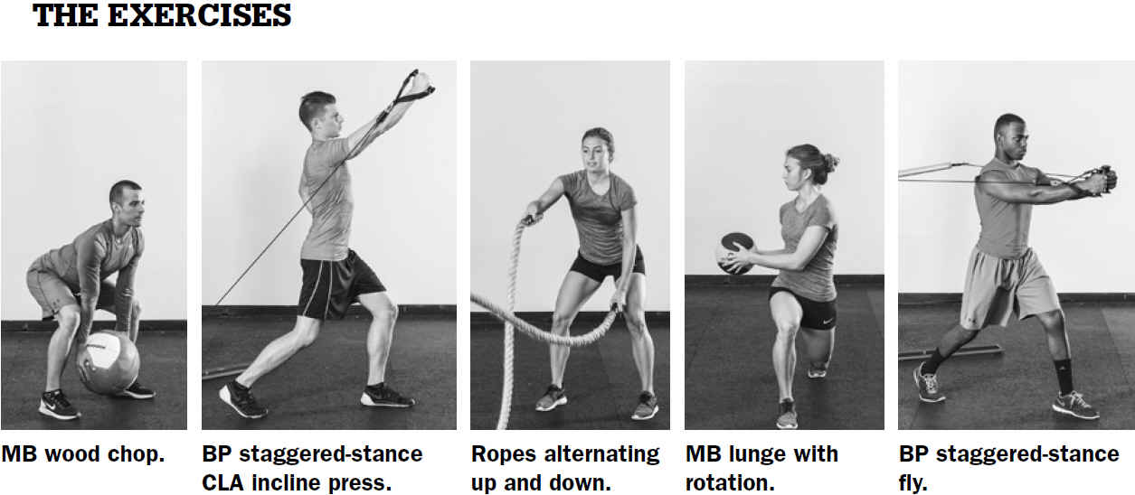
MB = Medicine Balls, BP = Bands and Pulleys

Slide 37
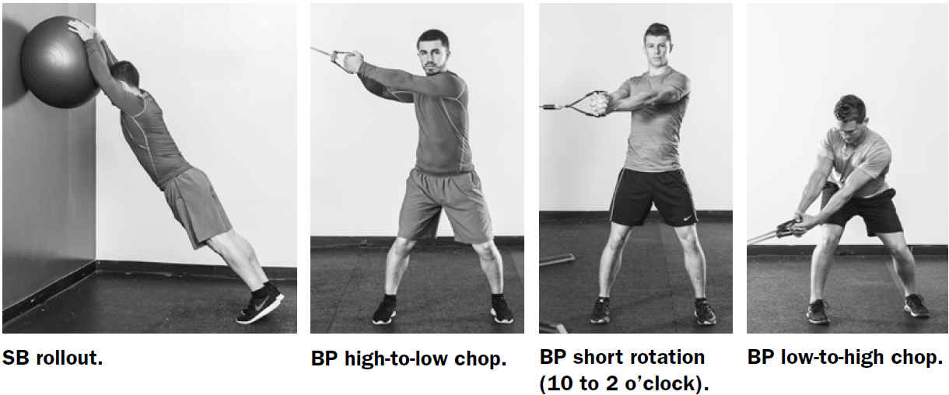
SB = Stability Balls, BP = Bands and Pulleys, CLA = Contralateral-Arm

Slide 38
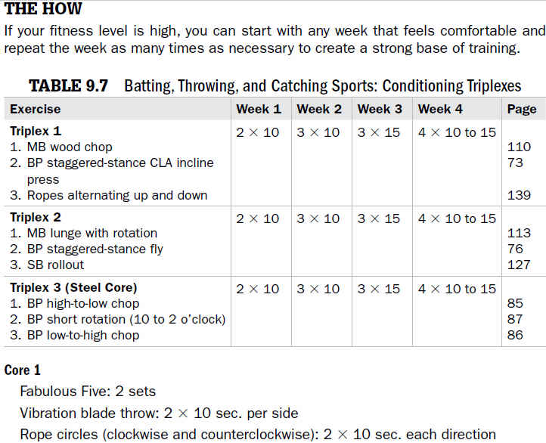
Triplex = 1 Traditional exercise + 2 functional exercise

Slide 40
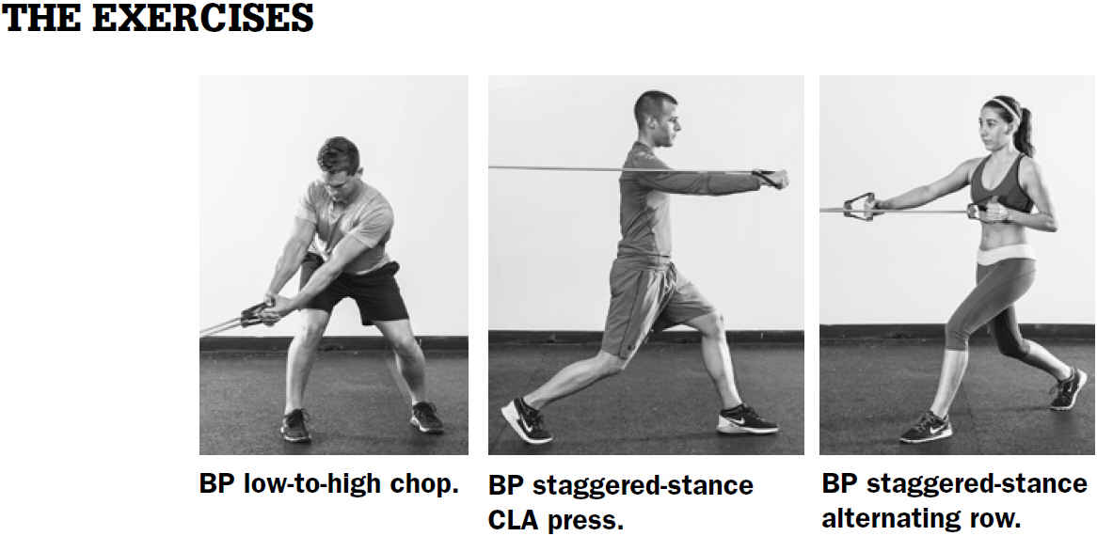
BP = Bands and Pulleys, CLA = Contralateral-Arm

Slide 41
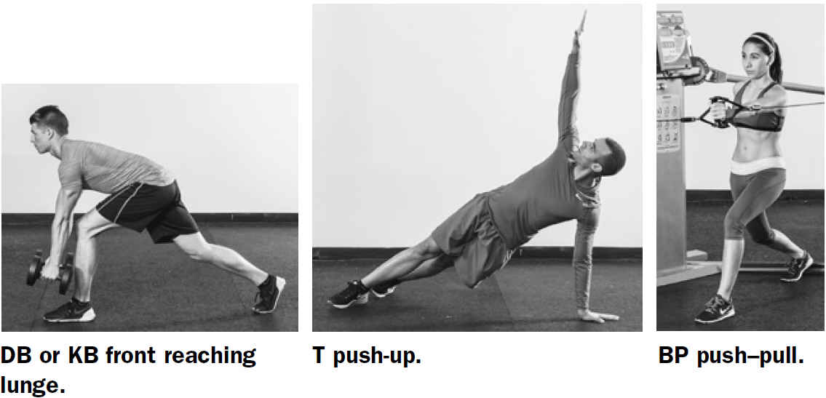
DB = Dumbbells, KB = Kettlebells, BP = Bands and Pulleys

Slide 42
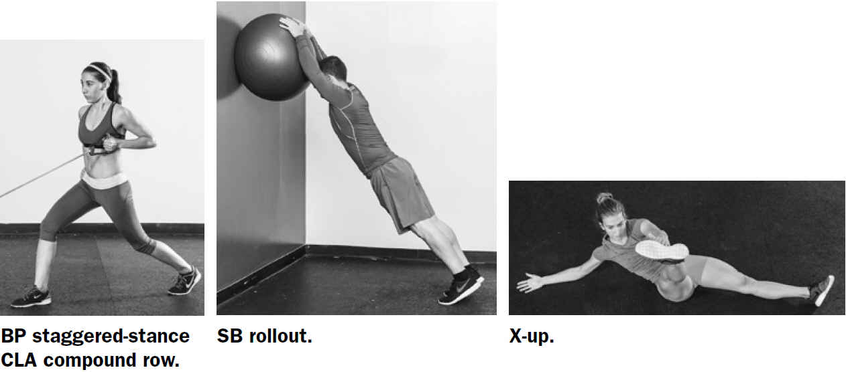
BP = Bands and Pulleys, CLA = Contralateral-Arm, SB = Stability Balls

Slide 43
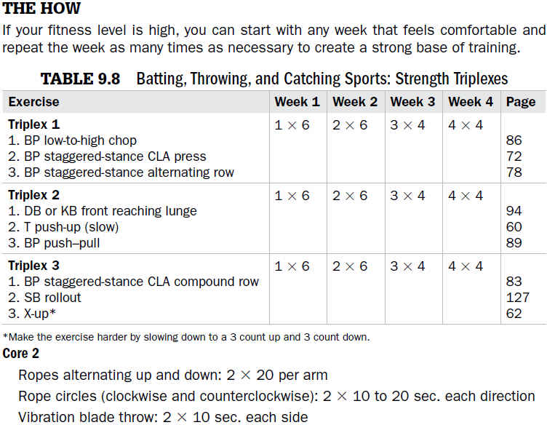

Slide 44
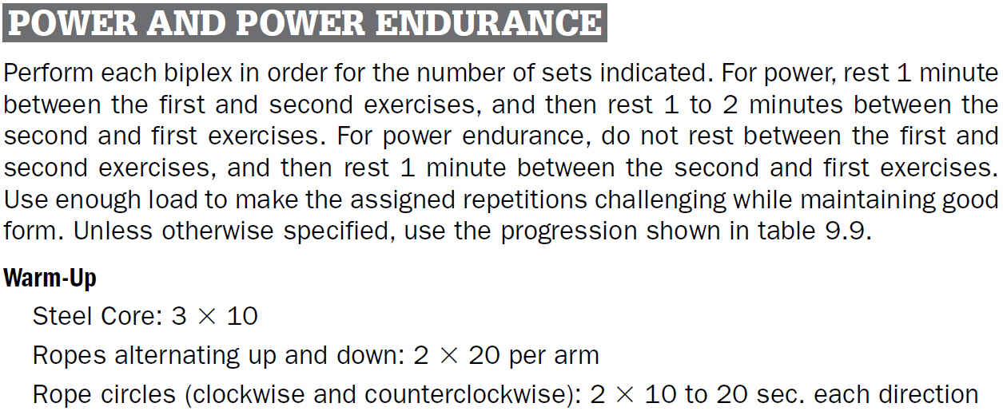

Slide 45
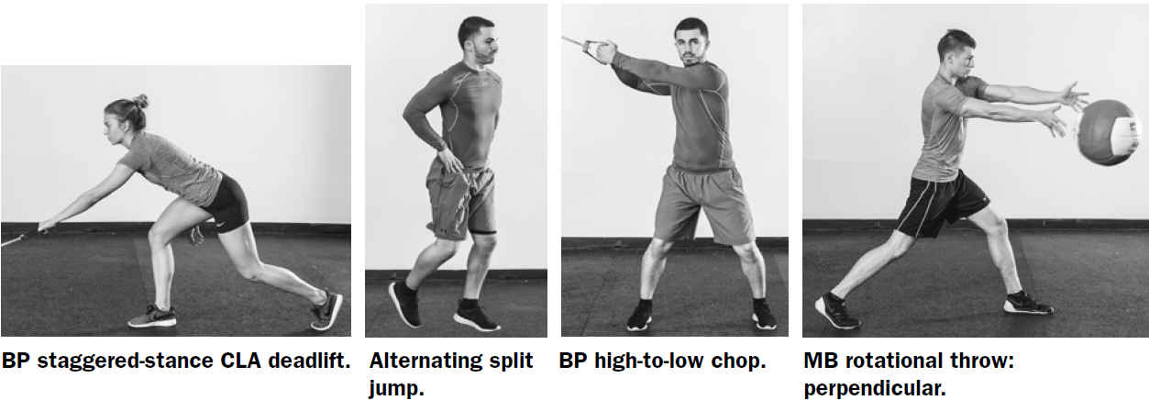
LOS EJERCICIOS
BP = Bands and Pulleys, CLA = Contralateral-Arm, MB = Medicine Balls

Slide 46
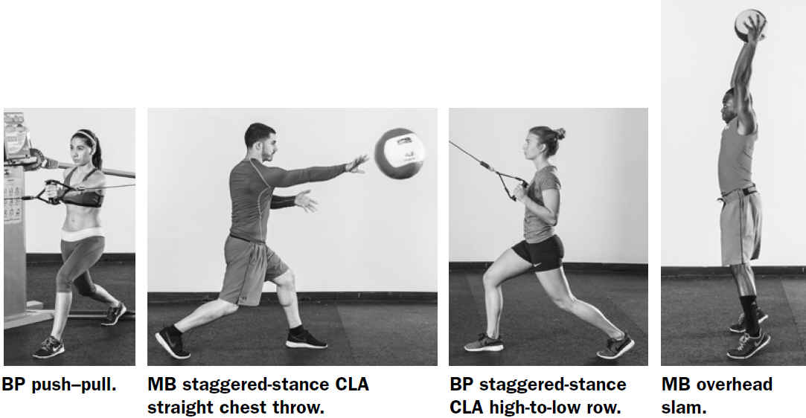
LOS EJERCICIOS - continuación
BP = Bands and Pulleys, MB = Medicine Balls, CLA = Contralateral-Arm

Slide 48
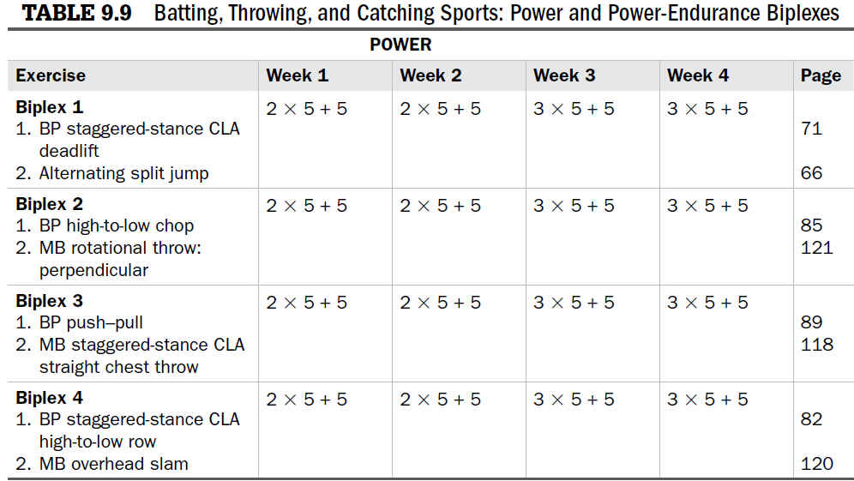

Slide 49
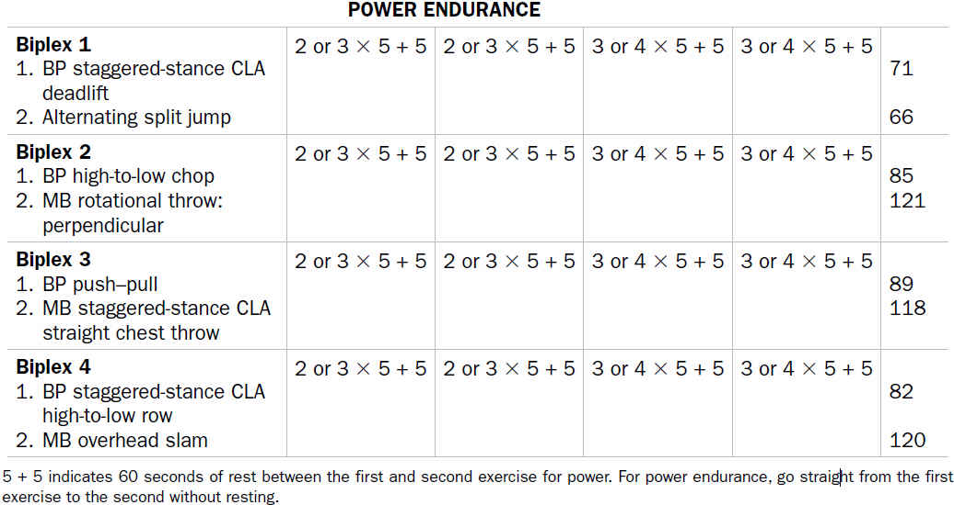
tabla 9.9 Deportes de Batear, Lanzar y Atrapar:
Biplexiones de Potencia y Potencia-Tolerancia - continuación

Slide 50
HOW TO - continuación

Slide 51
DEPORTES DE CORRER

Slide 54
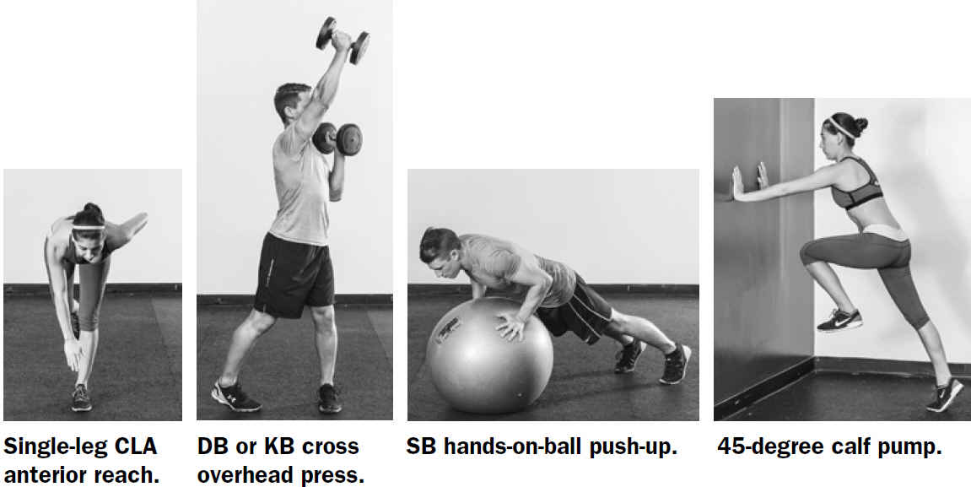
LOS EJERCICIOS
CLA = Contralateral, DB = Dumbbells, KB = Kettlebells, Arm, SB = Stability Balls

Slide 55
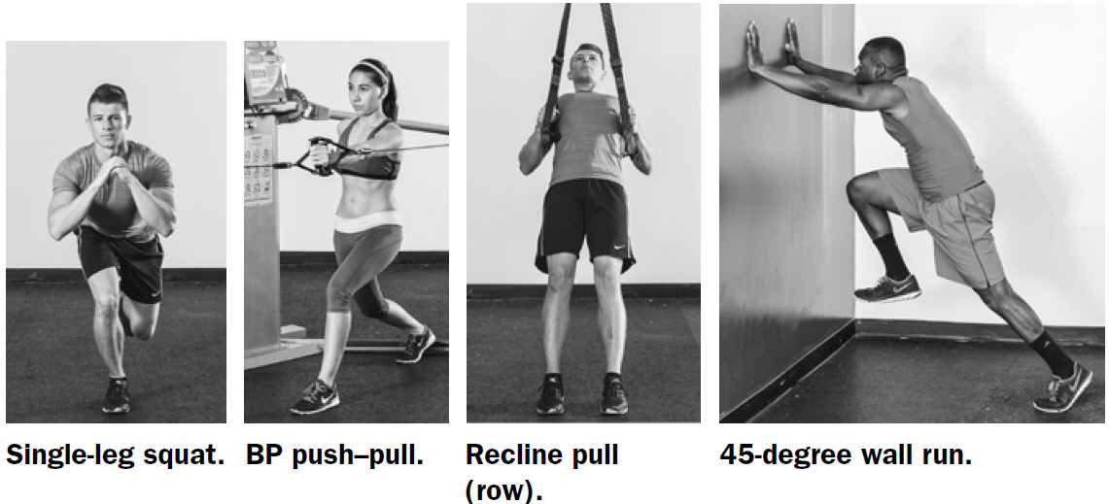
LOS EJERCICIOS - continuación
BP = Bands and Pulleys

Slide 56
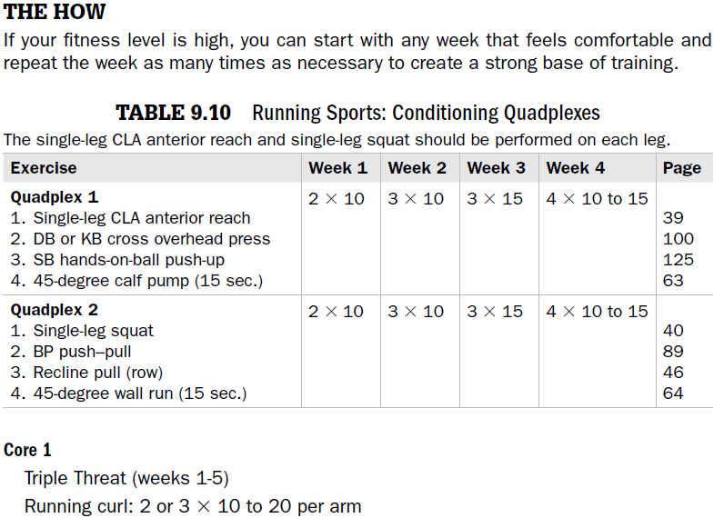
CLA = Contralateral-Arm, DB = Dumbbells, KB = Kettlebells, SB = Stability Balls, BP = Bands and Pulleys

