Slide 1



LA FUNCION DE LOS: MINERALES
en el Ejercicio y Deporte
Prof. Edgar Lopategui Corsino
M.A., Fisiología del Ejercicio
Web: http://www.saludmed.com/
E-Mail: elopategui@intermetro.edu
elopateg@gmail.com
Curso: http://www.saludmed.com/nutricionentrena/nutricionentrena.html

Slide 2
CONTENIDO DE LA PRESENTACIÓN
Conceptos básicos
Origen/Formación
Funciones
Clasificación
Deficiencias
Requisitos vitamínicos (RDA)
Dietary Reference Intakes (DRI)
Suplementación
Toxicidad
Mitos y realidades
Recomendaciones – Atleta en general
Discusión detalada de las vitaminas y su vínculo con el ejercicio
Preguntas

Slide 3
MINERALES
CONCEPTO
Elementos (iones y metales) inorgánicos que se encuentran en cantidades muy pequeñas (4% de la masa corporal) en el tejido animal y que proporcionan fuerza y rigidez a ciertos tejidos del cuerpo e intervienen en muchas funciones vitales
Notes:
Start by articulating a clear vision of what your organization should be. Present the vision clearly, and explain why it is important for your organization to achieve this vision.
Include a picture of the leadership skills this vision will require. For example, global thinking, strategic partnering, etc.

Slide 4
MINERALES
ORIGEN/FORMACIÓN
En la naturaleza:
Los minerales se encuentran en el agua de los ríos, lagos y oceanos, en la capa de la tierra y debajo de la superficie de la tierra
En las plantas y árboles:
Las raíces de las plantas y árboles absorben los minerales y los incorpora en los nutrientes que producen (hidratos de carbono, grasas y proteínas)
Notes:
Start by articulating a clear vision of what your organization should be. Present the vision clearly, and explain why it is important for your organization to achieve this vision.
Include a picture of the leadership skills this vision will require. For example, global thinking, strategic partnering, etc.

Slide 5
MINERALES
ORIGEN/FORMACIÓN
En los animales:
Los minerales se convierten en parte de la estructura del cuerpo de los animales (y ser humanos) al éstos consumir agua, alimentos producidos por las plantas y carne animal
Notes:
Start by articulating a clear vision of what your organization should be. Present the vision clearly, and explain why it is important for your organization to achieve this vision.
Include a picture of the leadership skills this vision will require. For example, global thinking, strategic partnering, etc.

Slide 6
MINERALES
FUNCIONES: General
Regulación de la excitabilidad del sistema nervioso y la contracción muscular
Forma parte de la estructura de varios compuestos esenciales del cuerpo (hormonas, enzimas, vitaminas, hemoglobina y otros), que ayudan a regular las reacciones químicas dentro de las células
Ayudan a mantener la reacción alcalina, ácida o neutra de los tejidos y líquidos corporales
Notes:
Start by articulating a clear vision of what your organization should be. Present the vision clearly, and explain why it is important for your organization to achieve this vision.
Include a picture of the leadership skills this vision will require. For example, global thinking, strategic partnering, etc.

Slide 7
MINERALES
FUNCIONES: General
Aceleran el proceso de las reacciones biológicas que ocurren dentro de las células
Ayudan a mantener un balance constante de agua en los compartimientos extracelular (intravascular o intercelular) e intracelular, que posee el cuerpo
Son esenciales para el crecimiento de los tejidos del cuerpo, como los huesos y dientes
Notes:
Start by articulating a clear vision of what your organization should be. Present the vision clearly, and explain why it is important for your organization to achieve this vision.
Include a picture of the leadership skills this vision will require. For example, global thinking, strategic partnering, etc.

Slide 8
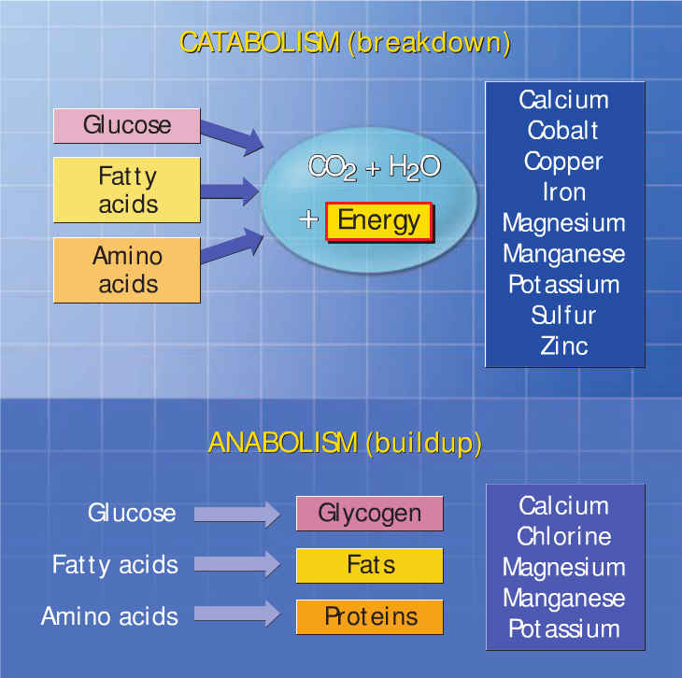
NOTA. Reproducido de: Exercise Physiology: Nutrition, Energy, and Human Performance. 7ma. ed.; (p. 60), por W. D. McArdle, F. I. Katch, & V. I. Katch, 2010, Philadelphia: Lippincott Williams & Wilkins. Copyright 2010 por Lippincott Williams & Wilkins, a Wolters Kluwer business.
Notes:
Start by articulating a clear vision of what your organization should be. Present the vision clearly, and explain why it is important for your organization to achieve this vision.
Include a picture of the leadership skills this vision will require. For example, global thinking, strategic partnering, etc.

Slide 9
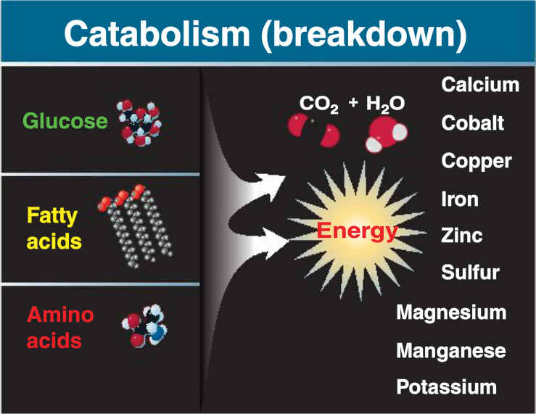
NOTA. Reproducido de: Sports and Exercise Nutrition. 4ta. ed.; (p. 71), por W. D. McArdle, F. I. Katch, & V. I. Katch, 2013, Philadelphia: Lippincott Williams & Wilkins. Copyright 2013 por Lippincott Williams & Wilkins, a Wolters Kluwer business.
Notes:
Start by articulating a clear vision of what your organization should be. Present the vision clearly, and explain why it is important for your organization to achieve this vision.
Include a picture of the leadership skills this vision will require. For example, global thinking, strategic partnering, etc.

Slide 10
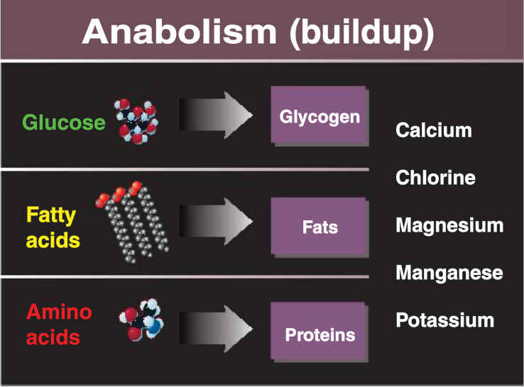
NOTA. Reproducido de: Sports and Exercise Nutrition. 4ta. ed.; (p. 71), por W. D. McArdle, F. I. Katch, & V. I. Katch, 2013, Philadelphia: Lippincott Williams & Wilkins. Copyright 2013 por Lippincott Williams & Wilkins, a Wolters Kluwer business.
Notes:
Start by articulating a clear vision of what your organization should be. Present the vision clearly, and explain why it is important for your organization to achieve this vision.
Include a picture of the leadership skills this vision will require. For example, global thinking, strategic partnering, etc.

Slide 11
MINERALES
CLASIFICACIÓN: Básica
Macronutrientes (Minerales Principales)
Micronutrientes u
Oligoelementos
(Minerales Menores)
Notes:
Start by articulating a clear vision of what your organization should be. Present the vision clearly, and explain why it is important for your organization to achieve this vision.
Include a picture of the leadership skills this vision will require. For example, global thinking, strategic partnering, etc.

Slide 12
MINERALES
CLASIFICACIÓN: Macronutrientes
Elementos macronutrientes (o macroformadores) esenciales para la nutrición humana:
Son elementos que están presentes en cantidades relativamente altas en el tejido animal
Requieren ser consumidos a través de los alimentos en niveles mayores de 100 miligramos por día
Se consideran macronutrientes:
Calcio, fósforo, potasio, azufre, cloro, sodio y magnesio
Notes:
Start by articulating a clear vision of what your organization should be. Present the vision clearly, and explain why it is important for your organization to achieve this vision.
Include a picture of the leadership skills this vision will require. For example, global thinking, strategic partnering, etc.

Slide 13
MINERALES
CLASIFICACIÓN: Micronutrientes
Elementos micronutrientes (o microformadores) esenciales para la nutrición humana:
Son elementos que se hallan en mínimas cantidades en el organismo
Se consideran micronutrientes:
Hierro, cinc, selenio, manganeso, cobre, yodo, molibdeno, cobalto, cromio, flúor, silicio, vanadio, niquel y arsénico
Notes:
Start by articulating a clear vision of what your organization should be. Present the vision clearly, and explain why it is important for your organization to achieve this vision.
Include a picture of the leadership skills this vision will require. For example, global thinking, strategic partnering, etc.

Slide 14
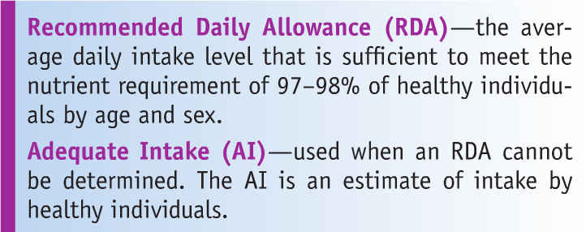
NOTA. Reproducido de: Exercise Physiology for Health, Fitness, and Performance. (p. 155), por S. A. Plowman, & D. L. Smith, 2011, Philadelphia: Lippincott Williams & Wilkins. Copyright 2011 por Lippincott Williams & Wilkins, a Wolters Kluwer business.
Notes:
Start by articulating a clear vision of what your organization should be. Present the vision clearly, and explain why it is important for your organization to achieve this vision.
Include a picture of the leadership skills this vision will require. For example, global thinking, strategic partnering, etc.

Slide 15
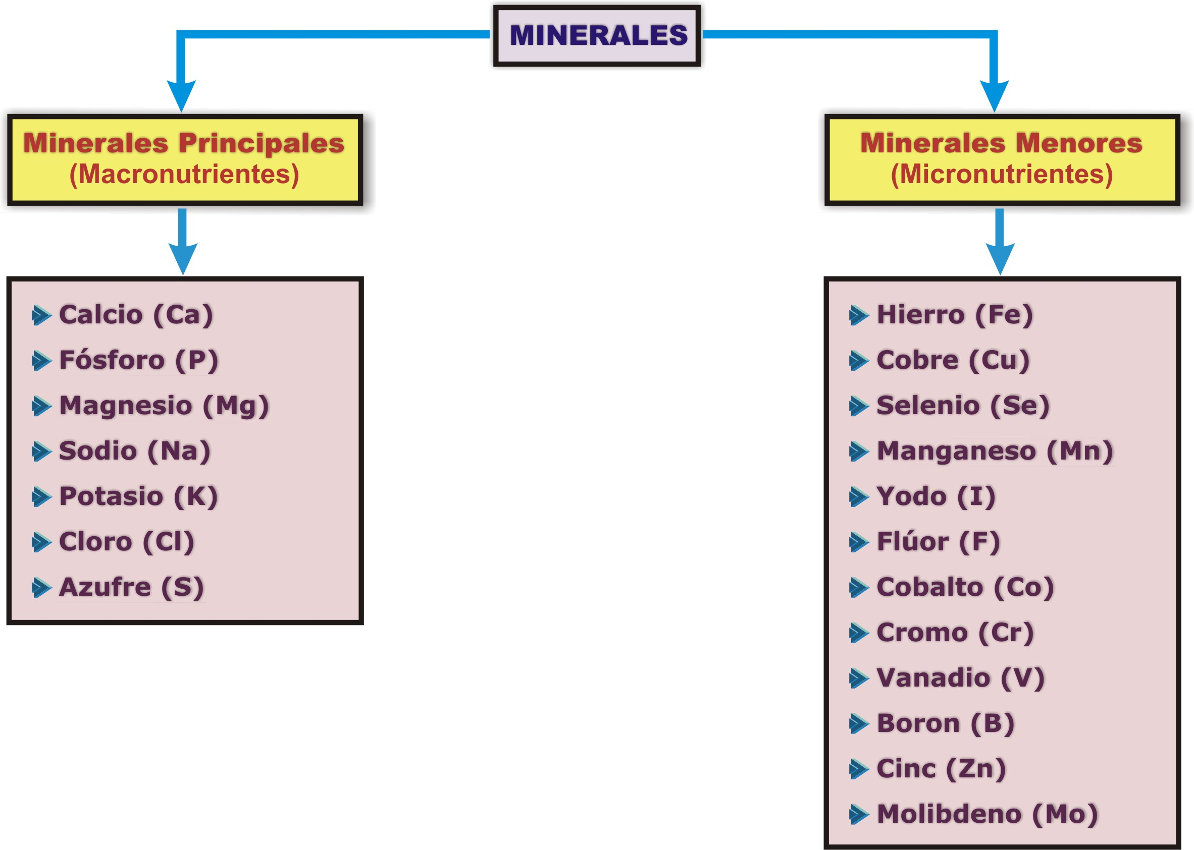
NOTA: Adaptado de: Sports and Fitness Nutrition. (p. 295), por R. E. C., Wildman & B. S., Millar, 2004, Belmont, CA: Wadsworth/Thomson Learning. Copyright 2004 por Wadsworth, a division of Thomson Learning, Inc.
Notes:
Start by articulating a clear vision of what your organization should be. Present the vision clearly, and explain why it is important for your organization to achieve this vision.
Include a picture of the leadership skills this vision will require. For example, global thinking, strategic partnering, etc.

Slide 16
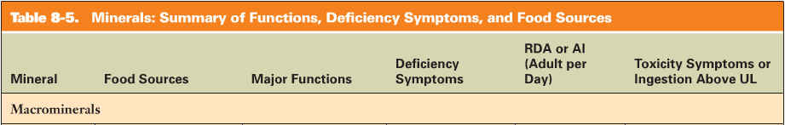
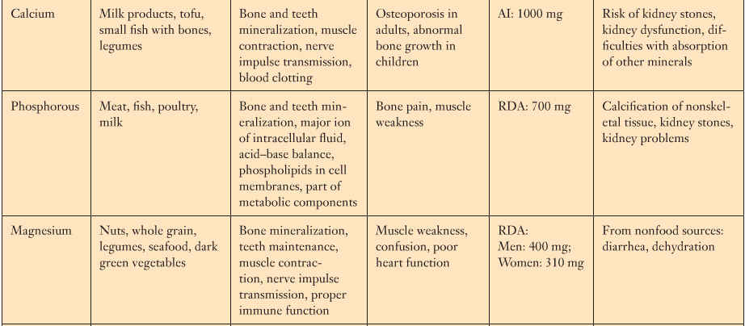
NOTA. Reproducido de: Exercise Physiology: Integrating Theory and Application. (p. 262-263), por W. J. Kraemer, S. J. Fleck, & M. R. Deschemes, 2012, Philadelphia: Lippincott Williams & Wilkins. Copyright 2012 por Lippincott Williams & Wilkins, a Wolters Kluwer business.
Notes:
Start by articulating a clear vision of what your organization should be. Present the vision clearly, and explain why it is important for your organization to achieve this vision.
Include a picture of the leadership skills this vision will require. For example, global thinking, strategic partnering, etc.

Slide 17
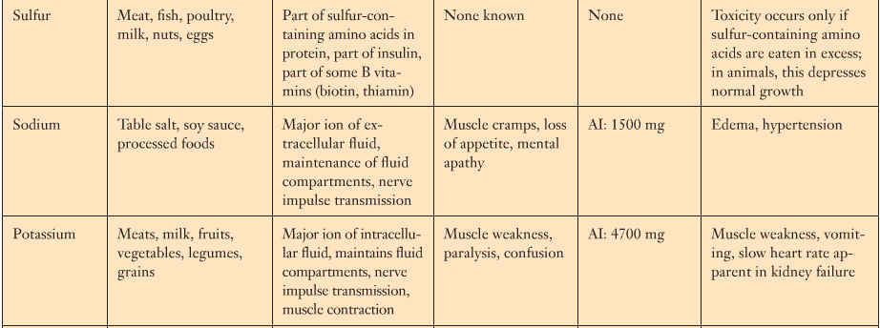
NOTA. Reproducido de: Exercise Physiology: Integrating Theory and Application. (p. 262-263), por W. J. Kraemer, S. J. Fleck, & M. R. Deschemes, 2012, Philadelphia: Lippincott Williams & Wilkins. Copyright 2012 por Lippincott Williams & Wilkins, a Wolters Kluwer business.
Notes:
Start by articulating a clear vision of what your organization should be. Present the vision clearly, and explain why it is important for your organization to achieve this vision.
Include a picture of the leadership skills this vision will require. For example, global thinking, strategic partnering, etc.

Slide 18
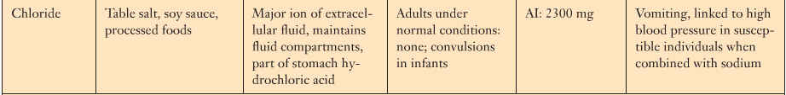
NOTA. Reproducido de: Exercise Physiology: Integrating Theory and Application. (p. 262-263), por W. J. Kraemer, S. J. Fleck, & M. R. Deschemes, 2012, Philadelphia: Lippincott Williams & Wilkins. Copyright 2012 por Lippincott Williams & Wilkins, a Wolters Kluwer business.
Notes:
Start by articulating a clear vision of what your organization should be. Present the vision clearly, and explain why it is important for your organization to achieve this vision.
Include a picture of the leadership skills this vision will require. For example, global thinking, strategic partnering, etc.

Slide 19
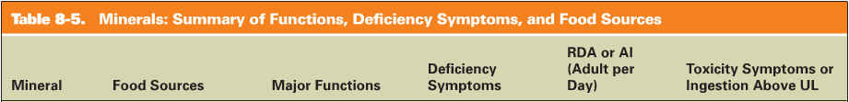
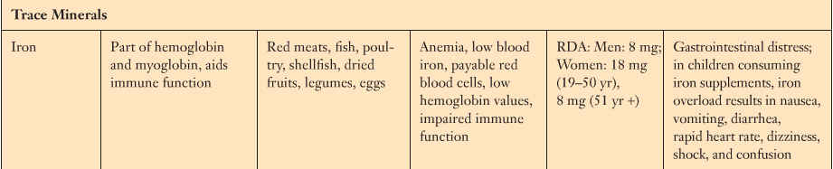
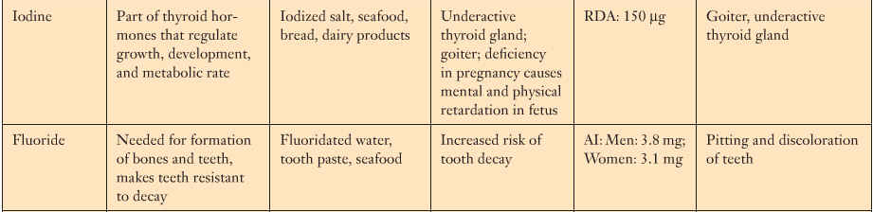
NOTA. Reproducido de: Exercise Physiology: Integrating Theory and Application. (p. 262-263), por W. J. Kraemer, S. J. Fleck, & M. R. Deschemes, 2012, Philadelphia: Lippincott Williams & Wilkins. Copyright 2012 por Lippincott Williams & Wilkins, a Wolters Kluwer business.
Notes:
Start by articulating a clear vision of what your organization should be. Present the vision clearly, and explain why it is important for your organization to achieve this vision.
Include a picture of the leadership skills this vision will require. For example, global thinking, strategic partnering, etc.

Slide 20
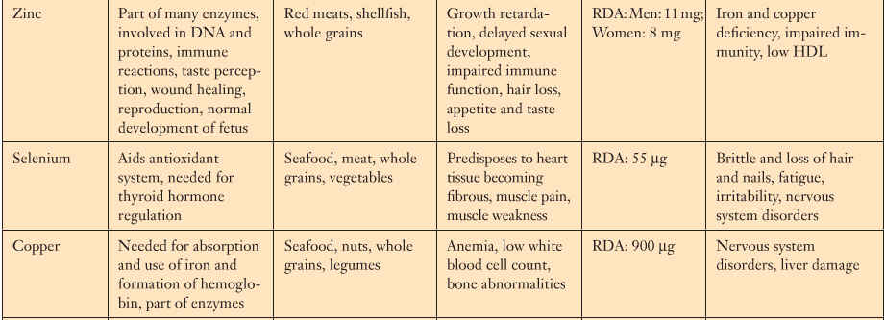
NOTA. Reproducido de: Exercise Physiology: Integrating Theory and Application. (p. 262-263), por W. J. Kraemer, S. J. Fleck, & M. R. Deschemes, 2012, Philadelphia: Lippincott Williams & Wilkins. Copyright 2012 por Lippincott Williams & Wilkins, a Wolters Kluwer business.
Notes:
Start by articulating a clear vision of what your organization should be. Present the vision clearly, and explain why it is important for your organization to achieve this vision.
Include a picture of the leadership skills this vision will require. For example, global thinking, strategic partnering, etc.

Slide 21
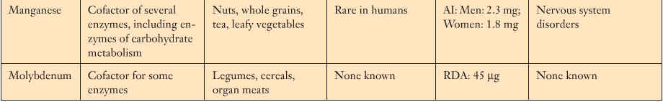
NOTA. Reproducido de: Exercise Physiology: Integrating Theory and Application. (p. 262-263), por W. J. Kraemer, S. J. Fleck, & M. R. Deschemes, 2012, Philadelphia: Lippincott Williams & Wilkins. Copyright 2012 por Lippincott Williams & Wilkins, a Wolters Kluwer business.
Notes:
Start by articulating a clear vision of what your organization should be. Present the vision clearly, and explain why it is important for your organization to achieve this vision.
Include a picture of the leadership skills this vision will require. For example, global thinking, strategic partnering, etc.

Slide 22
MINERALES
CLASIFICACIÓN: Otra
Elementos no Esenciales
Elementos sin Función Metabólica
Notes:
Start by articulating a clear vision of what your organization should be. Present the vision clearly, and explain why it is important for your organization to achieve this vision.
Include a picture of the leadership skills this vision will require. For example, global thinking, strategic partnering, etc.

Slide 23
MINERALES
CLASIFICACIÓN: No Esenciales
Elementos no esenciales para la nutrición humana:
Estos son elementos que no se han establecidos como imprescindibles para el organismo, aunque hay evidencia que participan en algunas reacciones biológicas
Se incluyen en esta categoría:
Bario, estaño, bromo, estroncio y cadmio
Notes:
Start by articulating a clear vision of what your organization should be. Present the vision clearly, and explain why it is important for your organization to achieve this vision.
Include a picture of the leadership skills this vision will require. For example, global thinking, strategic partnering, etc.

Slide 24
MINERALES
CLASIFICACIÓN: Sin Función
Elementos del cuerpo sin función metabólica:
Estos son elementos que pueden hallarse en el tejido animal en forma de contaminantes ambientales, pero hasta ahora no se sabe si desempeñan algún papel esencial en la nutrición
Algunos de estos elementos son:
Oro, plata, aluminio, mercurio, bismuto, galio, plomo, antimonio, boro, litio (puede ser importante para patalogía bipolares) y otros 20 elementos más
Notes:
Start by articulating a clear vision of what your organization should be. Present the vision clearly, and explain why it is important for your organization to achieve this vision.
Include a picture of the leadership skills this vision will require. For example, global thinking, strategic partnering, etc.

Slide 25
MINERALES
SUPLEMENTACIÓN: Indicaciones
Dieta de pobre calidad:
Restricción en la ingesta calórica:
Posibles deficiencias de minerales:
Magnesio
El ejercicio aumenta la pérdida de minerales a través del:
Sudor
Orina (después del ejercicio)
Notes:
Start by articulating a clear vision of what your organization should be. Present the vision clearly, and explain why it is important for your organization to achieve this vision.
Include a picture of the leadership skills this vision will require. For example, global thinking, strategic partnering, etc.

Slide 26
MINERALES
SUPLEMENTACIÓN: Indicaciones
Sudor:
Principales electrólitos que posee:
Sodio
Cloruro
Otros minerales en pequeñas cantidades:
Potasio
Hierro
Magnesio
Cobre
Calcio
Cinc
Notes:
Start by articulating a clear vision of what your organization should be. Present the vision clearly, and explain why it is important for your organization to achieve this vision.
Include a picture of the leadership skills this vision will require. For example, global thinking, strategic partnering, etc.

Slide 27

NOTA. Reproducido de: Sports and Exercise Nutrition. 4ta. ed.; (p. 89), por W. D. McArdle, F. I. Katch, & V. I. Katch, 2013, Philadelphia: Lippincott Williams & Wilkins. Copyright 2013 por Lippincott Williams & Wilkins, a Wolters Kluwer business.
Notes:
Start by articulating a clear vision of what your organization should be. Present the vision clearly, and explain why it is important for your organization to achieve this vision.
Include a picture of the leadership skills this vision will require. For example, global thinking, strategic partnering, etc.

Slide 28
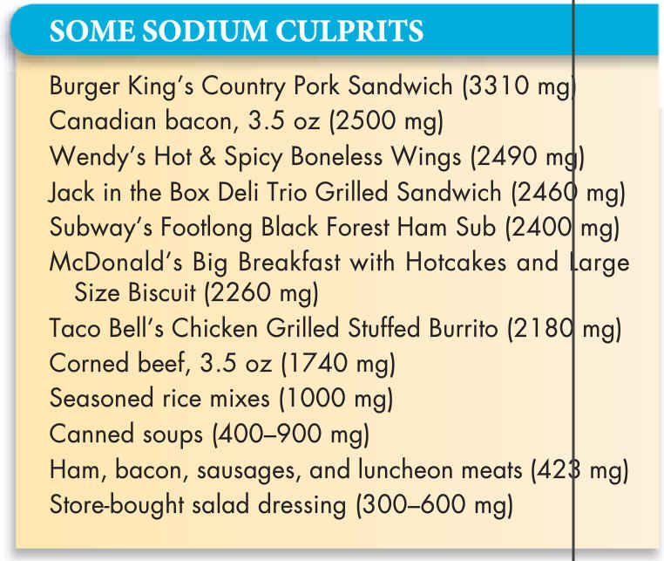
NOTA. Reproducido de: Sports and Exercise Nutrition. 4ta. ed.; (p. 89), por W. D. McArdle, F. I. Katch, & V. I. Katch, 2013, Philadelphia: Lippincott Williams & Wilkins. Copyright 2013 por Lippincott Williams & Wilkins, a Wolters Kluwer business.
Notes:
Start by articulating a clear vision of what your organization should be. Present the vision clearly, and explain why it is important for your organization to achieve this vision.
Include a picture of the leadership skills this vision will require. For example, global thinking, strategic partnering, etc.

Slide 29
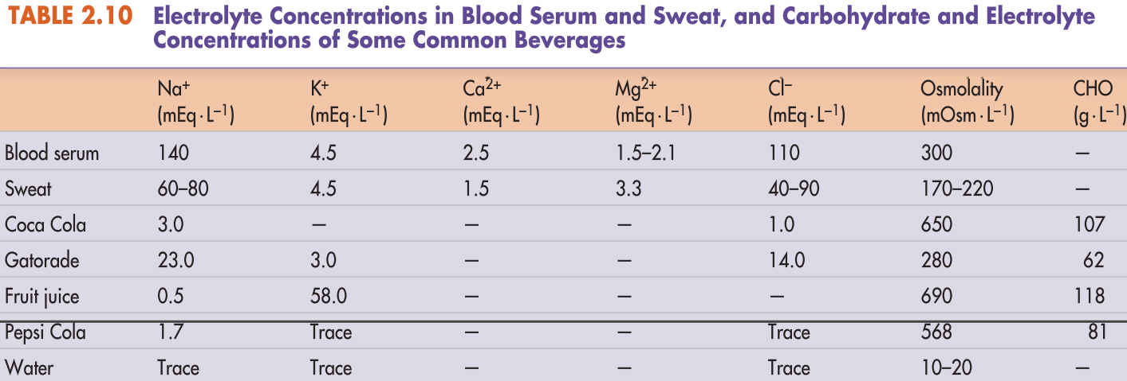
NOTA. Reproducido de: Sports and Exercise Nutrition. 4ta. ed.; (p. 89), por W. D. McArdle, F. I. Katch, & V. I. Katch, 2013, Philadelphia: Lippincott Williams & Wilkins. Copyright 2013 por Lippincott Williams & Wilkins, a Wolters Kluwer business.
Notes:
Start by articulating a clear vision of what your organization should be. Present the vision clearly, and explain why it is important for your organization to achieve this vision.
Include a picture of the leadership skills this vision will require. For example, global thinking, strategic partnering, etc.

Slide 30
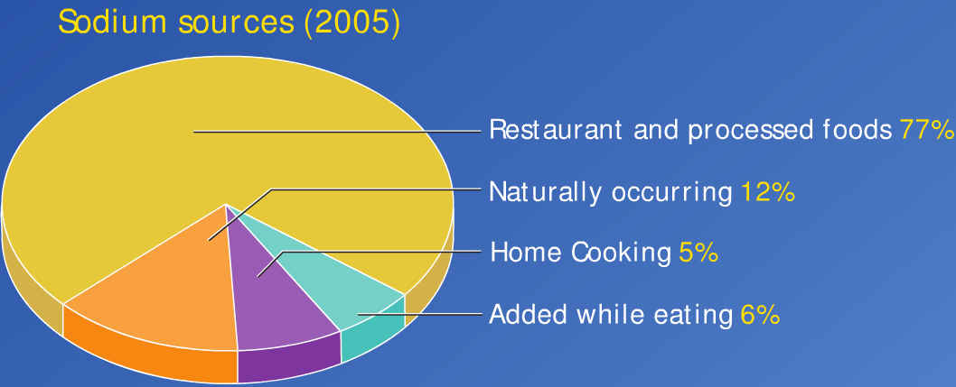
NOTA. Reproducido de: Exercise Physiology: Nutrition, Energy, and Human Performance. 7ma. ed.; (p. 73), por W. D. McArdle, F. I. Katch, & V. I. Katch, 2010, Philadelphia: Lippincott Williams & Wilkins. Copyright 2010 por Lippincott Williams & Wilkins, a Wolters Kluwer business.
Notes:
Start by articulating a clear vision of what your organization should be. Present the vision clearly, and explain why it is important for your organization to achieve this vision.
Include a picture of the leadership skills this vision will require. For example, global thinking, strategic partnering, etc.

Slide 31
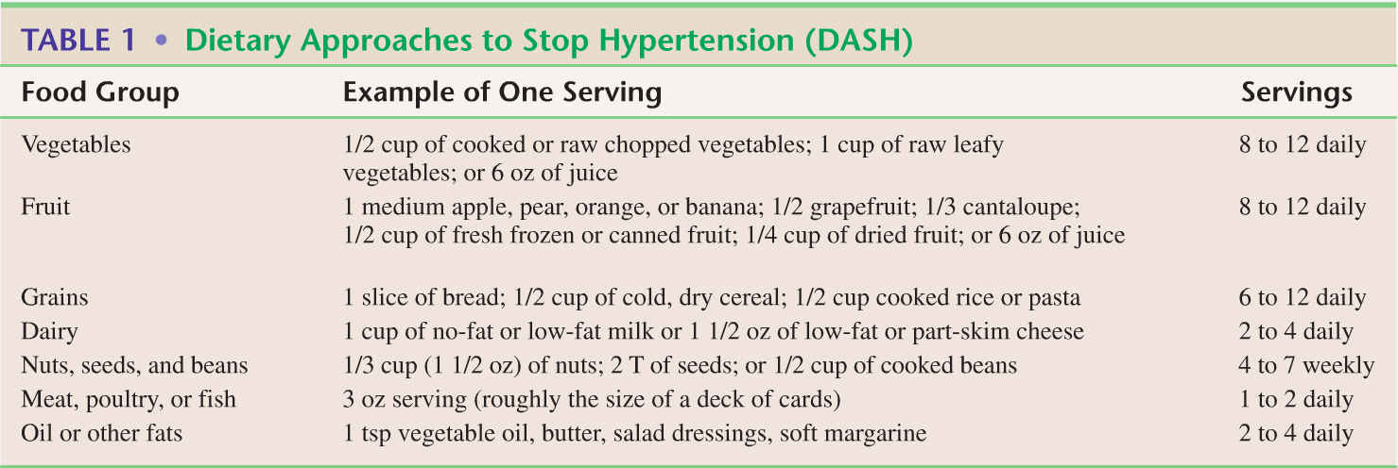
NOTA. Reproducido de: Exercise Physiology: Nutrition, Energy, and Human Performance. 7ma. ed.; (p. 74), por W. D. McArdle, F. I. Katch, & V. I. Katch, 2010, Philadelphia: Lippincott Williams & Wilkins. Copyright 2010 por Lippincott Williams & Wilkins, a Wolters Kluwer business.
Notes:
Start by articulating a clear vision of what your organization should be. Present the vision clearly, and explain why it is important for your organization to achieve this vision.
Include a picture of the leadership skills this vision will require. For example, global thinking, strategic partnering, etc.

Slide 32
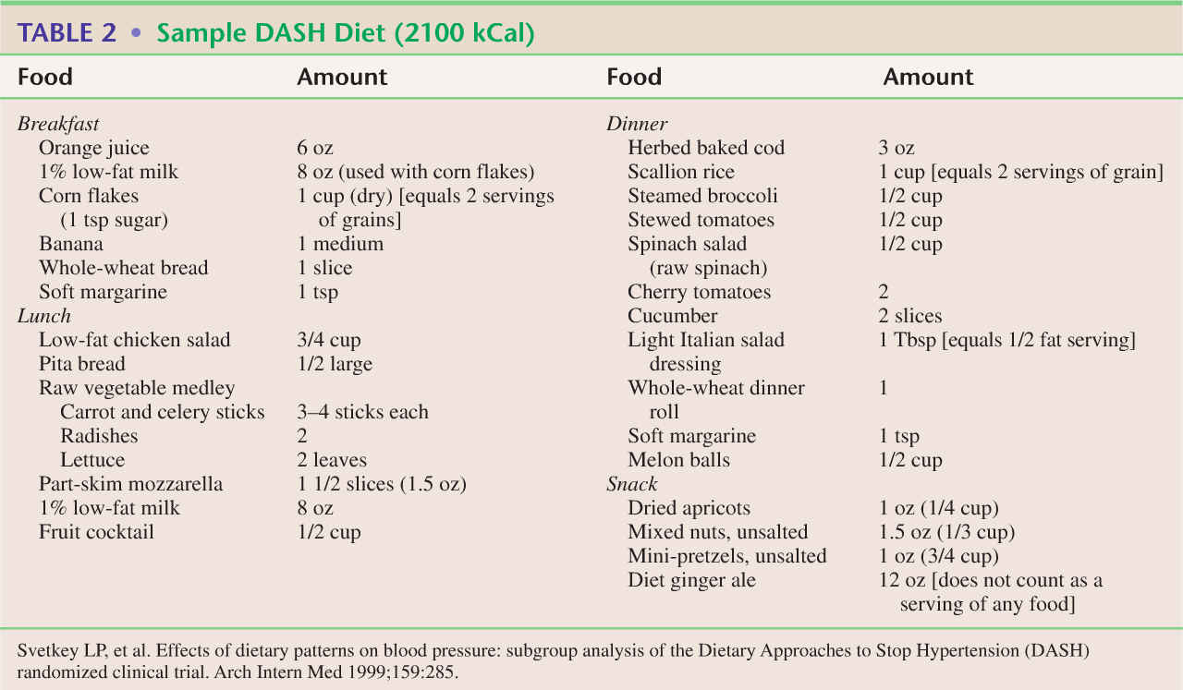
NOTA. Reproducido de: Exercise Physiology: Nutrition, Energy, and Human Performance. 7ma. ed.; (p. 74), por W. D. McArdle, F. I. Katch, & V. I. Katch, 2010, Philadelphia: Lippincott Williams & Wilkins. Copyright 2010 por Lippincott Williams & Wilkins, a Wolters Kluwer business.
Notes:
Start by articulating a clear vision of what your organization should be. Present the vision clearly, and explain why it is important for your organization to achieve this vision.
Include a picture of the leadership skills this vision will require. For example, global thinking, strategic partnering, etc.

Slide 33
MINERALES
CONSIDERACIONES ESPECIALES: Atleta Femenina
Deficiencias Nutricionales
Calcio
Hierro
Notes:
Start by articulating a clear vision of what your organization should be. Present the vision clearly, and explain why it is important for your organization to achieve this vision.
Include a picture of the leadership skills this vision will require. For example, global thinking, strategic partnering, etc.

Slide 34
MINERALES
SUPLEMENTACIÓN: Calcio
Edades: 19 - 25 años:
Deficiente consumo de calcio (< 800 mg/día)
Notes:
Start by articulating a clear vision of what your organization should be. Present the vision clearly, and explain why it is important for your organization to achieve this vision.
Include a picture of the leadership skills this vision will require. For example, global thinking, strategic partnering, etc.

Slide 35
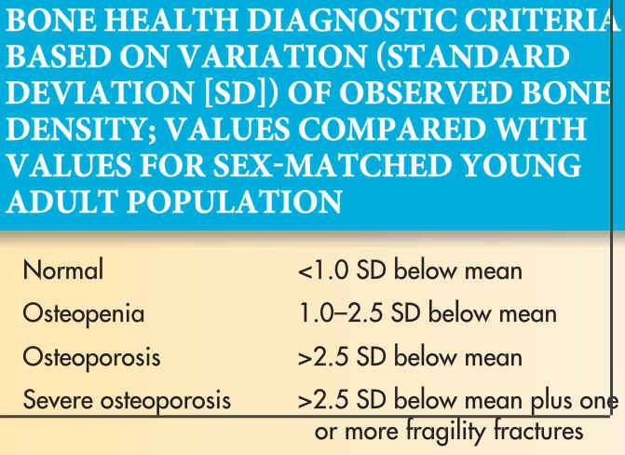
NOTA. Reproducido de: Sports and Exercise Nutrition. 4ta. ed.; (p. 72), por W. D. McArdle, F. I. Katch, & V. I. Katch, 2013, Philadelphia: Lippincott Williams & Wilkins. Copyright 2013 por Lippincott Williams & Wilkins, a Wolters Kluwer business.
Notes:
Start by articulating a clear vision of what your organization should be. Present the vision clearly, and explain why it is important for your organization to achieve this vision.
Include a picture of the leadership skills this vision will require. For example, global thinking, strategic partnering, etc.

Slide 36
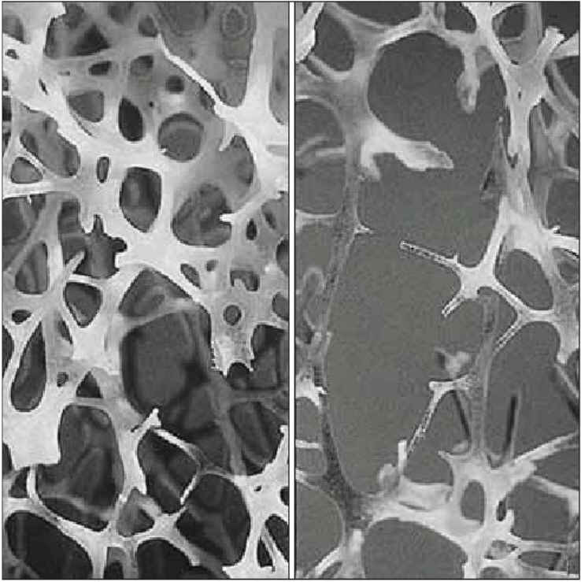
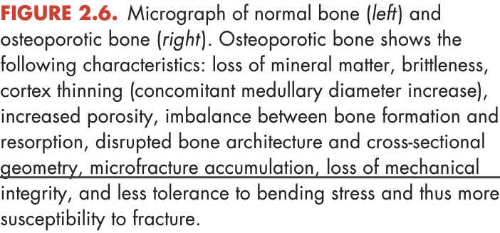
NOTA. Reproducido de: Sports and Exercise Nutrition. 4ta. ed.; (p. 72), por W. D. McArdle, F. I. Katch, & V. I. Katch, 2013, Philadelphia: Lippincott Williams & Wilkins. Copyright 2013 por Lippincott Williams & Wilkins, a Wolters Kluwer business.
Notes:
Start by articulating a clear vision of what your organization should be. Present the vision clearly, and explain why it is important for your organization to achieve this vision.
Include a picture of the leadership skills this vision will require. For example, global thinking, strategic partnering, etc.

Slide 37
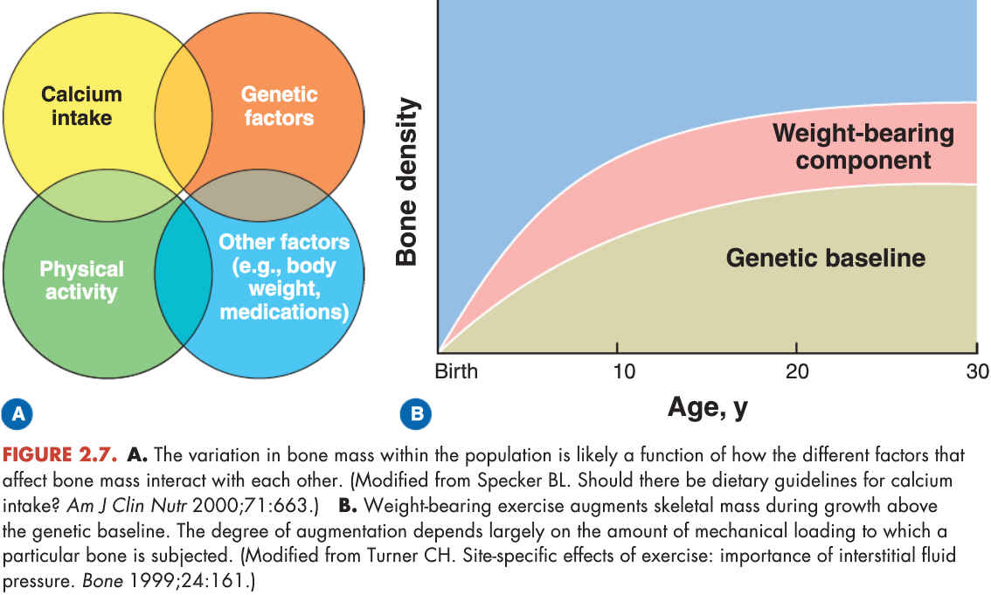
NOTA. Reproducido de: Sports and Exercise Nutrition. 4ta. ed.; (p. 74), por W. D. McArdle, F. I. Katch, & V. I. Katch, 2013, Philadelphia: Lippincott Williams & Wilkins. Copyright 2013 por Lippincott Williams & Wilkins, a Wolters Kluwer business.
Notes:
Start by articulating a clear vision of what your organization should be. Present the vision clearly, and explain why it is important for your organization to achieve this vision.
Include a picture of the leadership skills this vision will require. For example, global thinking, strategic partnering, etc.

Slide 38

NOTA. Reproducido de: Sports and Exercise Nutrition. 4ta. ed.; (p. 74), por W. D. McArdle, F. I. Katch, & V. I. Katch, 2013, Philadelphia: Lippincott Williams & Wilkins. Copyright 2013 por Lippincott Williams & Wilkins, a Wolters Kluwer business.
Notes:
Start by articulating a clear vision of what your organization should be. Present the vision clearly, and explain why it is important for your organization to achieve this vision.
Include a picture of the leadership skills this vision will require. For example, global thinking, strategic partnering, etc.

Slide 39
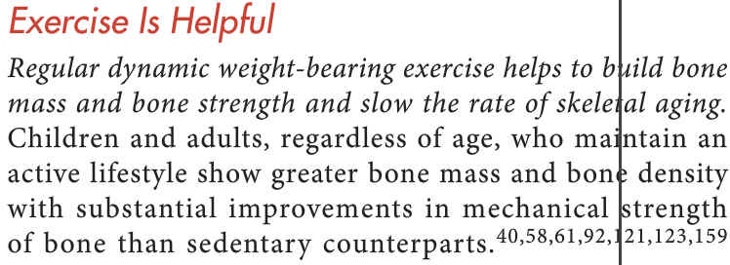
NOTA. Reproducido de: Sports and Exercise Nutrition. 4ta. ed.; (p. 75), por W. D. McArdle, F. I. Katch, & V. I. Katch, 2013, Philadelphia: Lippincott Williams & Wilkins. Copyright 2013 por Lippincott Williams & Wilkins, a Wolters Kluwer business.
Notes:
Start by articulating a clear vision of what your organization should be. Present the vision clearly, and explain why it is important for your organization to achieve this vision.
Include a picture of the leadership skills this vision will require. For example, global thinking, strategic partnering, etc.

Slide 40
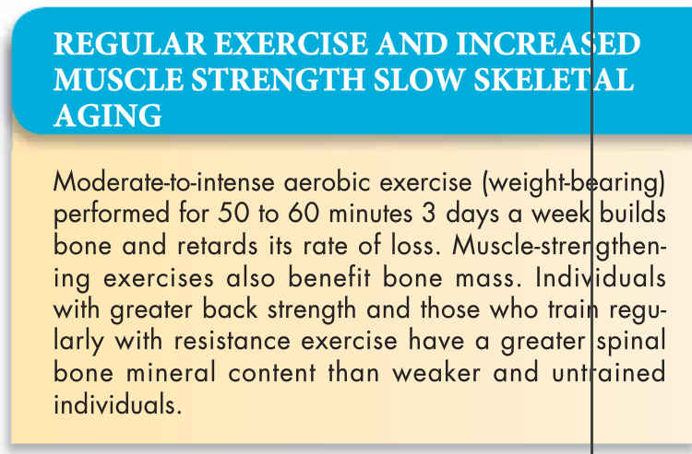
NOTA. Reproducido de: Sports and Exercise Nutrition. 4ta. ed.; (p. 75), por W. D. McArdle, F. I. Katch, & V. I. Katch, 2013, Philadelphia: Lippincott Williams & Wilkins. Copyright 2013 por Lippincott Williams & Wilkins, a Wolters Kluwer business.
Notes:
Start by articulating a clear vision of what your organization should be. Present the vision clearly, and explain why it is important for your organization to achieve this vision.
Include a picture of the leadership skills this vision will require. For example, global thinking, strategic partnering, etc.

Slide 41
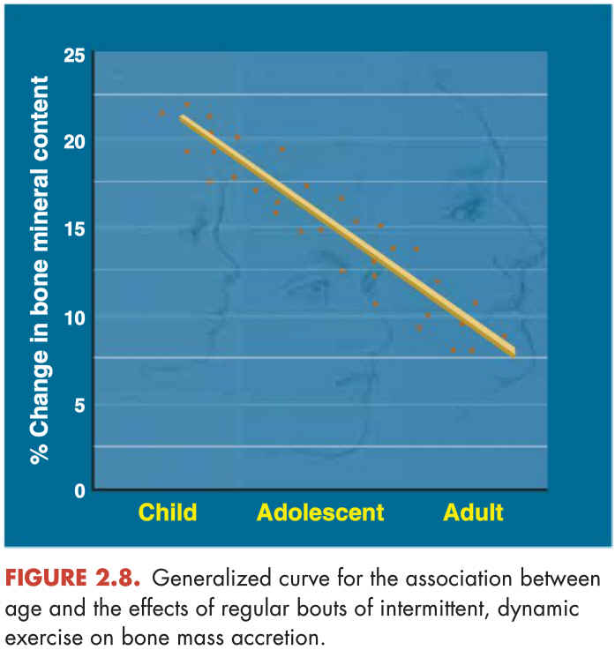
NOTA. Reproducido de: Sports and Exercise Nutrition. 4ta. ed.; (p. 76), por W. D. McArdle, F. I. Katch, & V. I. Katch, 2013, Philadelphia: Lippincott Williams & Wilkins. Copyright 2013 por Lippincott Williams & Wilkins, a Wolters Kluwer business.
Notes:
Start by articulating a clear vision of what your organization should be. Present the vision clearly, and explain why it is important for your organization to achieve this vision.
Include a picture of the leadership skills this vision will require. For example, global thinking, strategic partnering, etc.

Slide 42
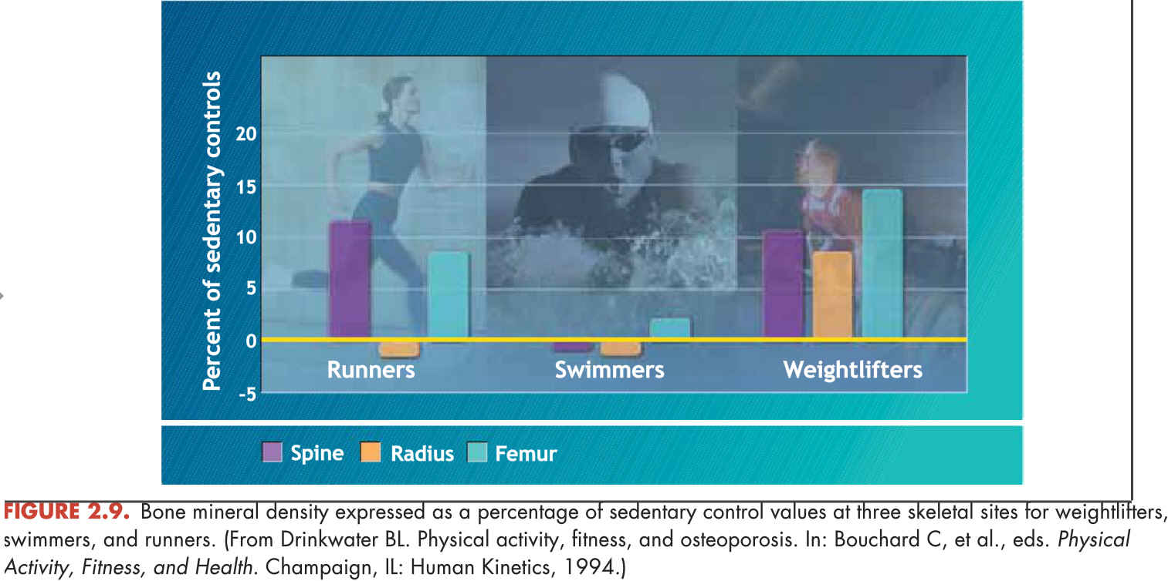
NOTA. Reproducido de: Sports and Exercise Nutrition. 4ta. ed.; (p. 76), por W. D. McArdle, F. I. Katch, & V. I. Katch, 2013, Philadelphia: Lippincott Williams & Wilkins. Copyright 2013 por Lippincott Williams & Wilkins, a Wolters Kluwer business.
Notes:
Start by articulating a clear vision of what your organization should be. Present the vision clearly, and explain why it is important for your organization to achieve this vision.
Include a picture of the leadership skills this vision will require. For example, global thinking, strategic partnering, etc.

Slide 43
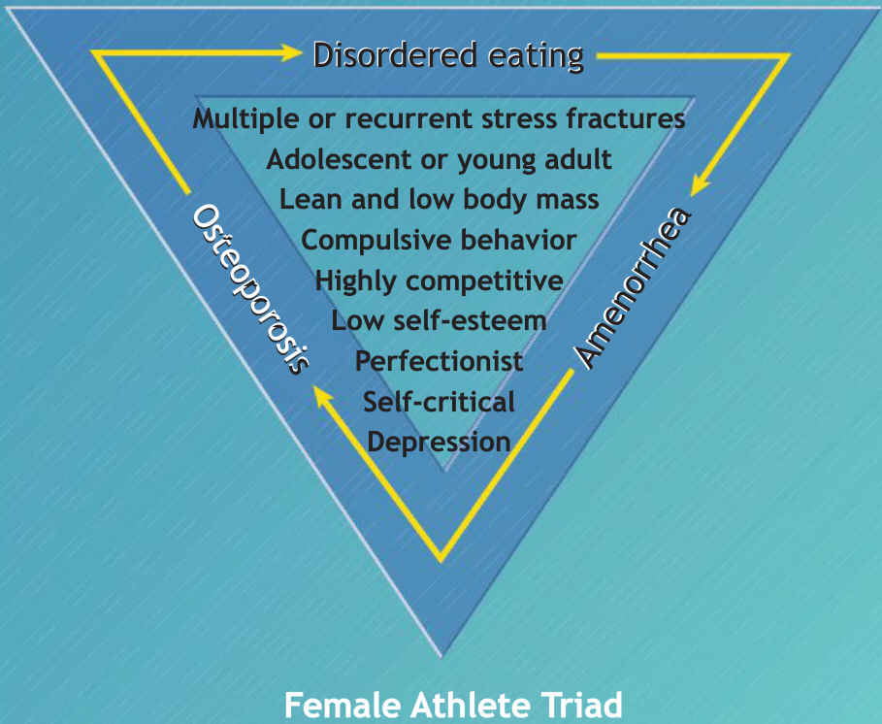
NOTA. Reproducido de: Sports and Exercise Nutrition. 4ta. ed.; (p. 80), por W. D. McArdle, F. I. Katch, & V. I. Katch, 2013, Philadelphia: Lippincott Williams & Wilkins. Copyright 2013 por Lippincott Williams & Wilkins, a Wolters Kluwer business.
Notes:
Start by articulating a clear vision of what your organization should be. Present the vision clearly, and explain why it is important for your organization to achieve this vision.
Include a picture of the leadership skills this vision will require. For example, global thinking, strategic partnering, etc.

Slide 44
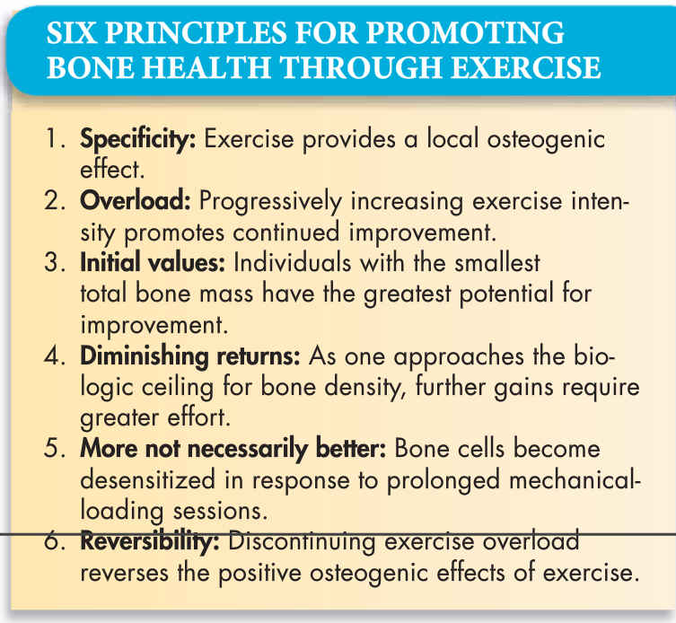
NOTA. Reproducido de: Sports and Exercise Nutrition. 4ta. ed.; (p. 80), por W. D. McArdle, F. I. Katch, & V. I. Katch, 2013, Philadelphia: Lippincott Williams & Wilkins. Copyright 2013 por Lippincott Williams & Wilkins, a Wolters Kluwer business.
Notes:
Start by articulating a clear vision of what your organization should be. Present the vision clearly, and explain why it is important for your organization to achieve this vision.
Include a picture of the leadership skills this vision will require. For example, global thinking, strategic partnering, etc.

Slide 45
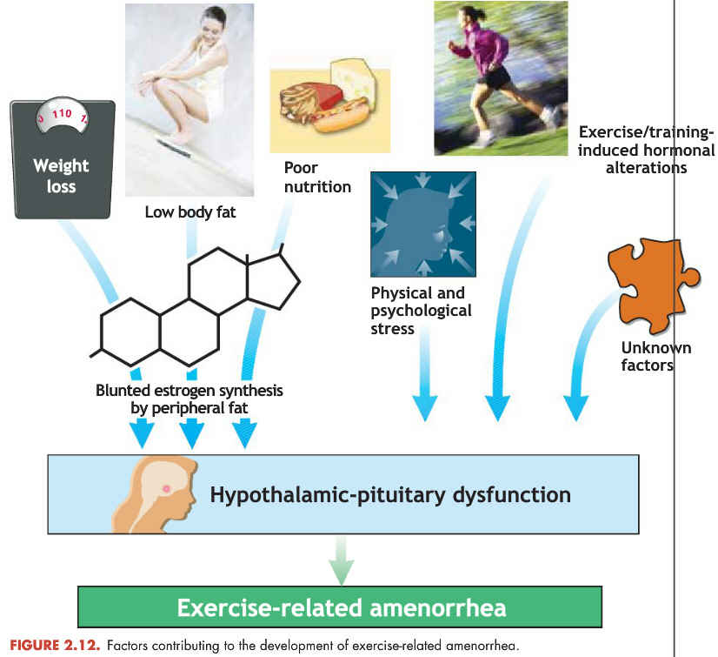
NOTA. Reproducido de: Sports and Exercise Nutrition. 4ta. ed.; (p. 81), por W. D. McArdle, F. I. Katch, & V. I. Katch, 2013, Philadelphia: Lippincott Williams & Wilkins. Copyright 2013 por Lippincott Williams & Wilkins, a Wolters Kluwer business.
Notes:
Start by articulating a clear vision of what your organization should be. Present the vision clearly, and explain why it is important for your organization to achieve this vision.
Include a picture of the leadership skills this vision will require. For example, global thinking, strategic partnering, etc.

Slide 46
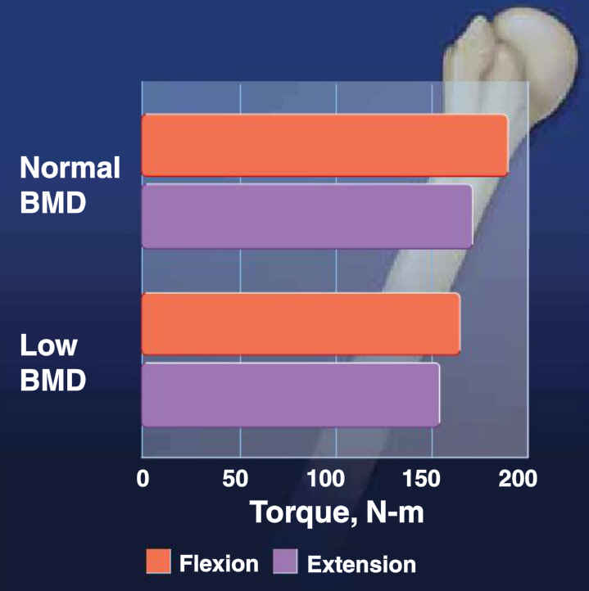
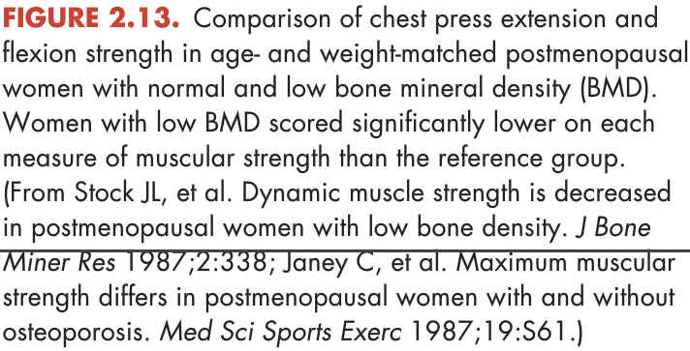
NOTA. Reproducido de: Sports and Exercise Nutrition. 4ta. ed.; (p. 82), por W. D. McArdle, F. I. Katch, & V. I. Katch, 2013, Philadelphia: Lippincott Williams & Wilkins. Copyright 2013 por Lippincott Williams & Wilkins, a Wolters Kluwer business.
Notes:
Start by articulating a clear vision of what your organization should be. Present the vision clearly, and explain why it is important for your organization to achieve this vision.
Include a picture of the leadership skills this vision will require. For example, global thinking, strategic partnering, etc.

Slide 47

NOTA. Reproducido de: Sports and Exercise Nutrition. 4ta. ed.; (p. 84), por W. D. McArdle, F. I. Katch, & V. I. Katch, 2013, Philadelphia: Lippincott Williams & Wilkins. Copyright 2013 por Lippincott Williams & Wilkins, a Wolters Kluwer business.
Notes:
Start by articulating a clear vision of what your organization should be. Present the vision clearly, and explain why it is important for your organization to achieve this vision.
Include a picture of the leadership skills this vision will require. For example, global thinking, strategic partnering, etc.

Slide 48
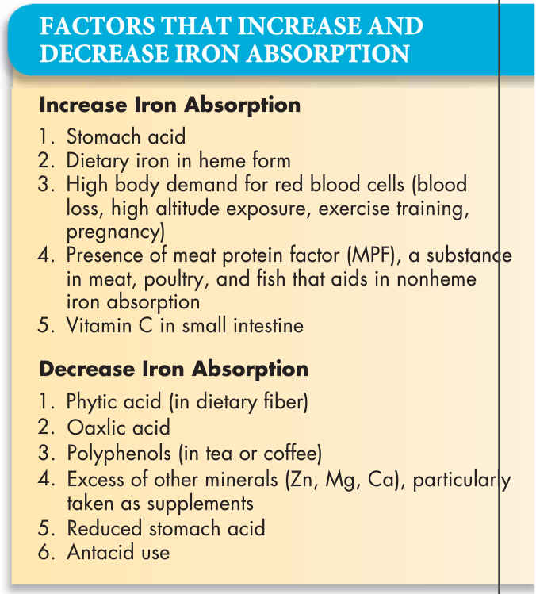
NOTA. Reproducido de: Sports and Exercise Nutrition. 4ta. ed.; (p. 84), por W. D. McArdle, F. I. Katch, & V. I. Katch, 2013, Philadelphia: Lippincott Williams & Wilkins. Copyright 2013 por Lippincott Williams & Wilkins, a Wolters Kluwer business.
Notes:
Start by articulating a clear vision of what your organization should be. Present the vision clearly, and explain why it is important for your organization to achieve this vision.
Include a picture of the leadership skills this vision will require. For example, global thinking, strategic partnering, etc.

Slide 49
MINERALES
SUPLEMENTACIÓN: Hierro
Indicaciones
Deportistas que se abstienen de los productos de carnes (Ej: vegetarianos)
Atletas que participan en deportes que deben controlar el peso (consumen muy pocas calorías)
Atletas femeninas que participan en eventos de tolerancia aeróbica (Ej: maratonistas, triatletas)
Notes:
Start by articulating a clear vision of what your organization should be. Present the vision clearly, and explain why it is important for your organization to achieve this vision.
Include a picture of the leadership skills this vision will require. For example, global thinking, strategic partnering, etc.

Slide 50
MINERALES
SUPLEMENTACIÓN: Hierro
INDICACIONES:
Mujeres Adultas
Los requisitos de hierro aumentan por:
Embarazo
Lactación
Entrenamiento con resistencias
Notes:
Start by articulating a clear vision of what your organization should be. Present the vision clearly, and explain why it is important for your organization to achieve this vision.
Include a picture of the leadership skills this vision will require. For example, global thinking, strategic partnering, etc.

Slide 51
MINERALES
SUPLEMENTACIÓN: Hierro - Dosis
Suplemento Multi-Vitamínico/Mineral
Dosis: 10 - 15 miligramos:
Esta dosis se encuentra en:
Suplemento vitamínico/mineral común
Algunos cereales fortificados
Notes:
Start by articulating a clear vision of what your organization should be. Present the vision clearly, and explain why it is important for your organization to achieve this vision.
Include a picture of the leadership skills this vision will require. For example, global thinking, strategic partnering, etc.

Slide 52
MINERALES
SUPLEMENTACIÓN: Hierro - Precausión
Recomendaciones
Asegurar una absorción efectiva del hierro:
Consumo moderado de carnes rojas (hierro hemático), particularmente si se consumen suplementos de calcio
Evitar el café y el té
Notes:
Start by articulating a clear vision of what your organization should be. Present the vision clearly, and explain why it is important for your organization to achieve this vision.
Include a picture of the leadership skills this vision will require. For example, global thinking, strategic partnering, etc.

Slide 53
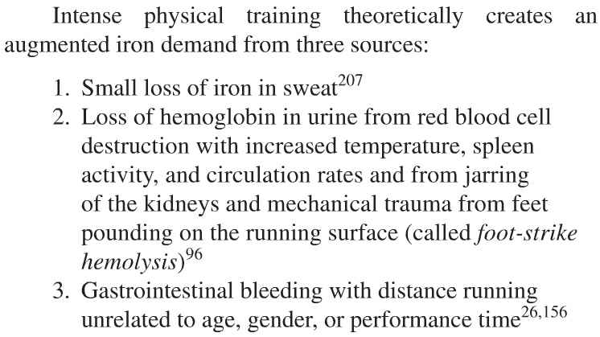
ANEMIA INDUCIDA POR EL EJERCICIO
NOTA. Reproducido de: Exercise Physiology: Nutrition, Energy, and Human Performance. 7ma. ed.; (p. 69), por W. D. McArdle, F. I. Katch, & V. I. Katch, 2010, Philadelphia: Lippincott Williams & Wilkins. Copyright 2010 por Lippincott Williams & Wilkins, a Wolters Kluwer business.
Notes:
Start by articulating a clear vision of what your organization should be. Present the vision clearly, and explain why it is important for your organization to achieve this vision.
Include a picture of the leadership skills this vision will require. For example, global thinking, strategic partnering, etc.

Slide 54
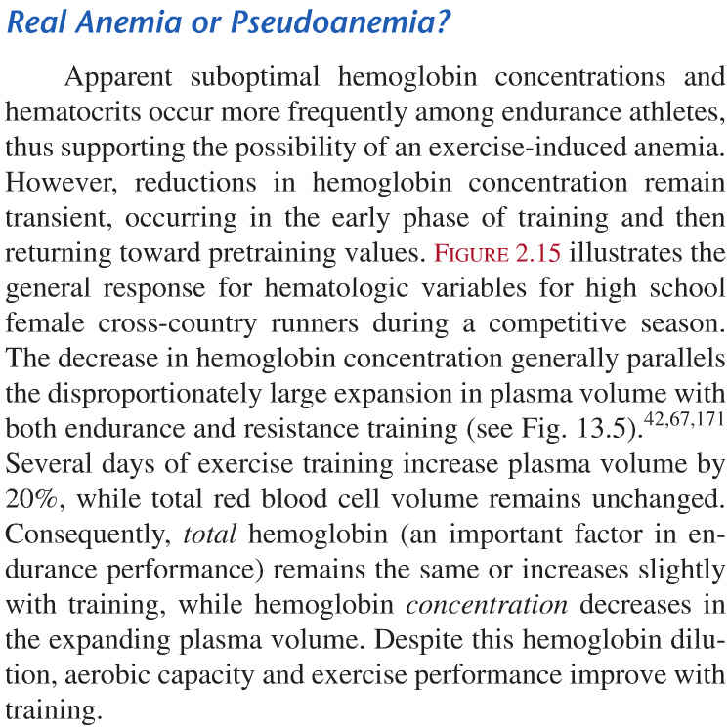
ANEMIA
INDUCIDA
POR EL
EJERCICIO
NOTA. Reproducido de: Exercise Physiology: Nutrition, Energy, and Human Performance. 7ma. ed.; (p. 69), por W. D. McArdle, F. I. Katch, & V. I. Katch, 2010, Philadelphia: Lippincott Williams & Wilkins. Copyright 2010 por Lippincott Williams & Wilkins, a Wolters Kluwer business.
Notes:
Start by articulating a clear vision of what your organization should be. Present the vision clearly, and explain why it is important for your organization to achieve this vision.
Include a picture of the leadership skills this vision will require. For example, global thinking, strategic partnering, etc.

Slide 55
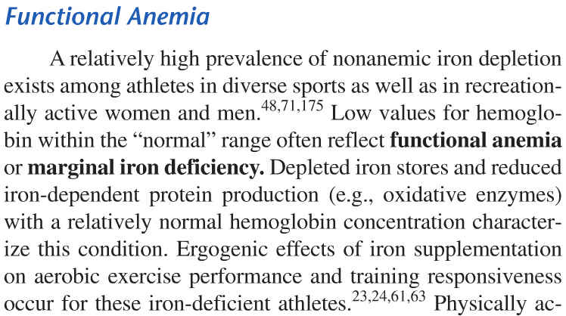
NOTA. Reproducido de: Exercise Physiology: Nutrition, Energy, and Human Performance. 7ma. ed.; (p. 70), por W. D. McArdle, F. I. Katch, & V. I. Katch, 2010, Philadelphia: Lippincott Williams & Wilkins. Copyright 2010 por Lippincott Williams & Wilkins, a Wolters Kluwer business.
Notes:
Start by articulating a clear vision of what your organization should be. Present the vision clearly, and explain why it is important for your organization to achieve this vision.
Include a picture of the leadership skills this vision will require. For example, global thinking, strategic partnering, etc.

Slide 56
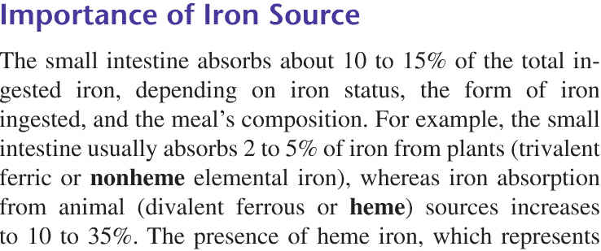
NOTA. Reproducido de: Exercise Physiology: Nutrition, Energy, and Human Performance. 7ma. ed.; (p. 70), por W. D. McArdle, F. I. Katch, & V. I. Katch, 2010, Philadelphia: Lippincott Williams & Wilkins. Copyright 2010 por Lippincott Williams & Wilkins, a Wolters Kluwer business.
Notes:
Start by articulating a clear vision of what your organization should be. Present the vision clearly, and explain why it is important for your organization to achieve this vision.
Include a picture of the leadership skills this vision will require. For example, global thinking, strategic partnering, etc.

Slide 57
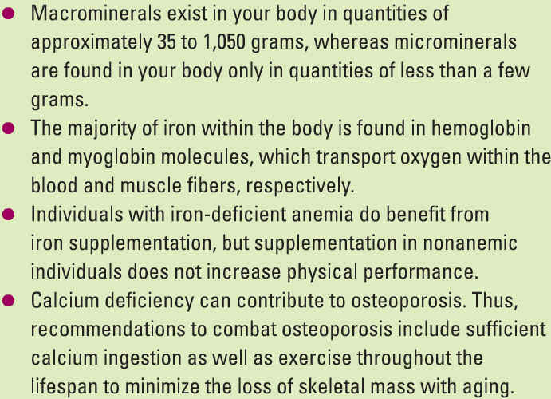
MINERALES
NOTA. Reproducido de: Exercise Physiology: Integrating Theory and Application. (p. 265), por W. J. Kraemer, S. J. Fleck, & M. R. Deschemes, 2012, Philadelphia: Lippincott Williams & Wilkins. Copyright 2012 por Lippincott Williams & Wilkins, a Wolters Kluwer business.
Notes:
Start by articulating a clear vision of what your organization should be. Present the vision clearly, and explain why it is important for your organization to achieve this vision.
Include a picture of the leadership skills this vision will require. For example, global thinking, strategic partnering, etc.

Slide 58
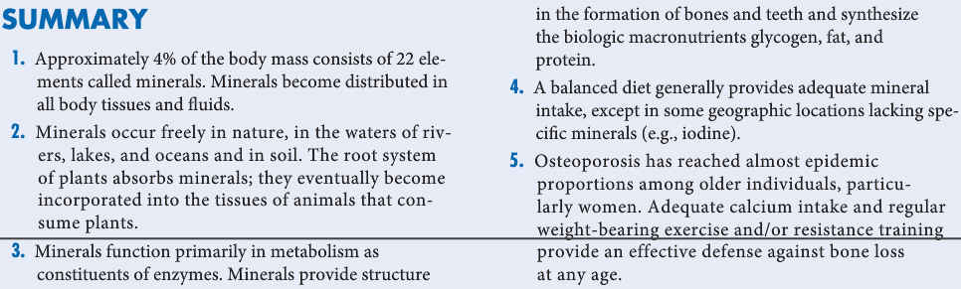
MINERALES
NOTA. Reproducido de: Sports and Exercise Nutrition. 4ta. ed.; (p. 93), por W. D. McArdle, F. I. Katch, & V. I. Katch, 2013, Philadelphia: Lippincott Williams & Wilkins. Copyright 2013 por Lippincott Williams & Wilkins, a Wolters Kluwer business.
Notes:
Start by articulating a clear vision of what your organization should be. Present the vision clearly, and explain why it is important for your organization to achieve this vision.
Include a picture of the leadership skills this vision will require. For example, global thinking, strategic partnering, etc.

Slide 59
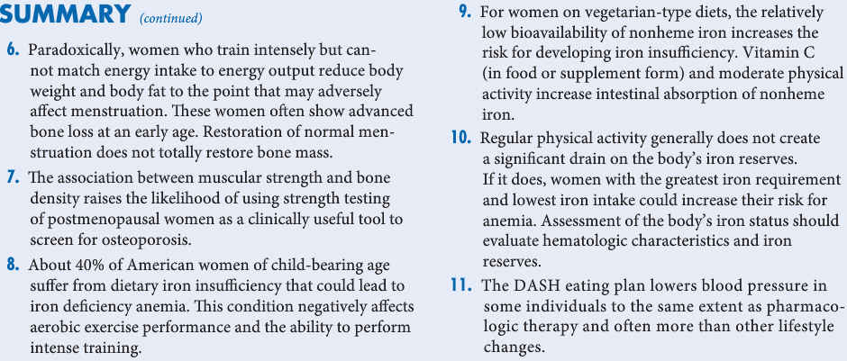
MINERALES
NOTA. Reproducido de: Sports and Exercise Nutrition. 4ta. ed.; (p. 94), por W. D. McArdle, F. I. Katch, & V. I. Katch, 2013, Philadelphia: Lippincott Williams & Wilkins. Copyright 2013 por Lippincott Williams & Wilkins, a Wolters Kluwer business.
Notes:
Start by articulating a clear vision of what your organization should be. Present the vision clearly, and explain why it is important for your organization to achieve this vision.
Include a picture of the leadership skills this vision will require. For example, global thinking, strategic partnering, etc.

Slide 60
¿PREGUNTAS?
Notes:
60

