Slide 1
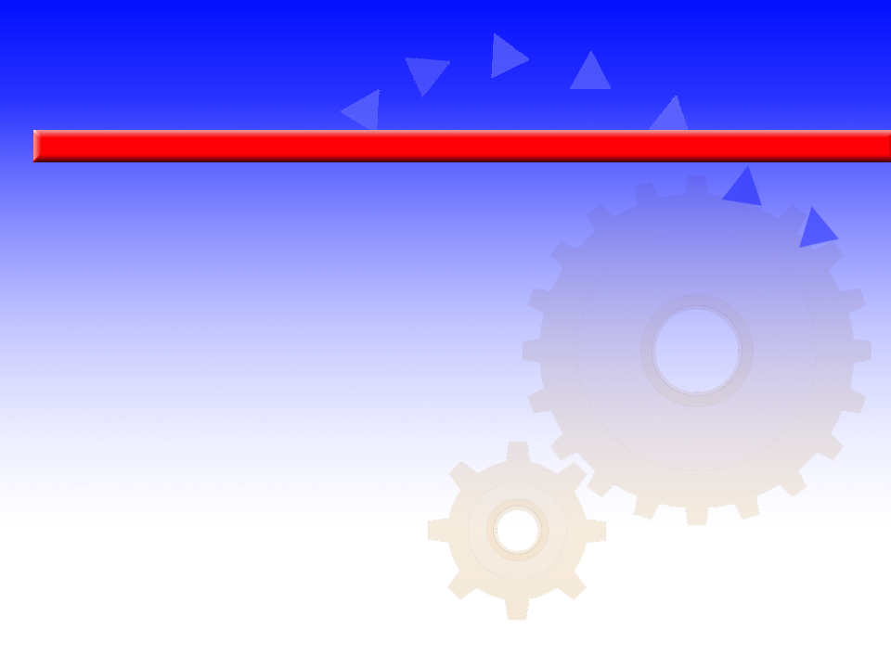
INTRODUCTION
INTRODUCTION
AN INTRODUCTION
TO EXERCISE AND
SPORT PHYSIOLOGY
AN INTRODUCTION
TO EXERCISE AND
SPORT PHYSIOLOGY

Slide 2


Learning Objectives
w Learn to differentiate exercise physiology and sport physiology.
w Become familiar with the evolution of exercise physiology.
w Note the differences between acute responses
to exercise and chronic adaptations to training.
(continued)

Slide 3
Learning Objectives
w Learn what factors affect the body's acute response
to exercise.
w Understand the six basic principles of training.
w Learn whether cross-sectional studies or
longitudinal studies are more accurate.

Slide 4

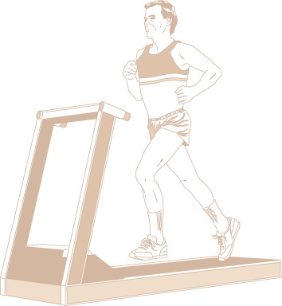
Exercise Physiology vs Sport Physiology
Exercise physiology studies how the body’s structures and functions are altered when exposed to acute and chronic bouts of exercise.
Sport physiology applies exercise physiology concepts to an athlete's training and performance.

Slide 5
Early Exercise Physiologists
Archibald V. Hill
w Nobel Prize winner (1921)
w Studied energy metabolism
w First studies on runners
John S. Haldane
w Developed methods to measure oxygen use during exercise

Slide 6


The Harvard Fatigue Laboratory
w Founded by Lawrence J. Henderson
w Directed by David Bruce Dill
w Focused on the physiology of human movement and the effects of environmental stress on exercise

Slide 7
The Scandinavian Influence
Erik Hohwü-Christensen
w Published important early research on carbohydrate and fat metabolism
Per-Olof Åstrand
w Conducted studies on physical fitness and endurance capacity
Jonas Bergstrom
w Reintroduced biopsy needle to study human muscle biochemistry

Slide 8
Contemporary Exercise Physiologists
John Holloszy and Charles Tipton
w Introduced biochemical approach to exercise physiology research
w First to use rats and mice to study muscle metabolism and fatigue
Reggie Edgerton, Phil Gollnick, and Bengt Saltin
w Studied individual muscle fiber characteristics and their responses to training

Slide 9
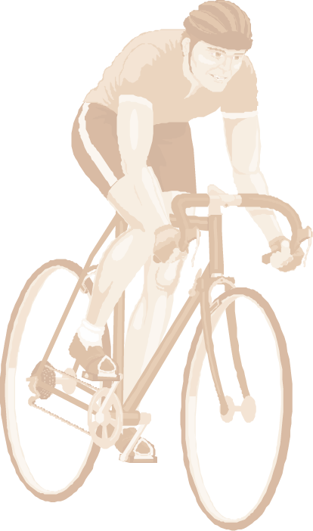
Acute Responses vs Chronic Adaptations
Acute responses to training involve how the body responds to one bout of exercise.
Chronic physiological adaptations to training mark how the body responds over time to the stress of repeated exercise bouts.

Slide 10
Measurable Physiological Variables
w Heart rate
w Respiration rate
w Skin and deep body temperature
w Muscle activity

Slide 11

Key Points
Acute Responses to Exercise
w Control environmental factors such as temperature, humidity, light, and noise.
w Account for diurnal cycles, menstrual cycles, and sleep patterns.
w Use ergometers to measure physical work in standardized conditions.
w Match the mode of testing to the type of activity the subject usually performs.

Slide 12
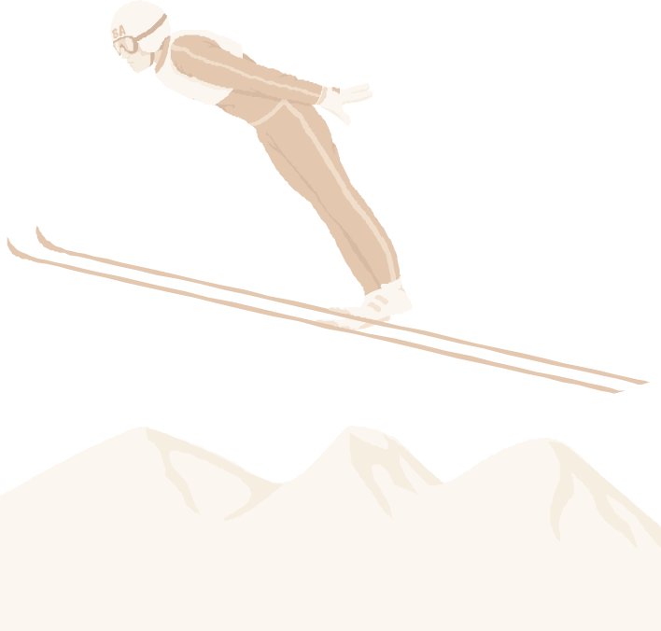
Basic Training Principles
Individuality—Consider the specific needs and abilities of the individual.
Specificity—Stress the physiological systems critical for the specific sport.
Disuse—Include a program to maintain fitness.
Progressive overload—Increase the training stimulus as the body adapts.
Hard/easy—Alternate high-intensity
with low-intensity workouts.
Periodization—Cycle specificity,
intensity, and volume of training.

Slide 13
Key Points
Research Methodology
w Longitudinal research tests the same subjects and compares results over time.
w Cross-sectional research collects data from a diverse population and compares against groups in that population.
w Longitudinal studies are often more accurate than cross-sectional studies,
but can’t always be done.
(continued)

Slide 14
Key Points
Research Methodology
w Laboratory research allows investigators to carefully control variables and use accurate equipment.
w Field research allows for less control of variables and equipment, but participant’s activities are often more natural.

