Slide 1
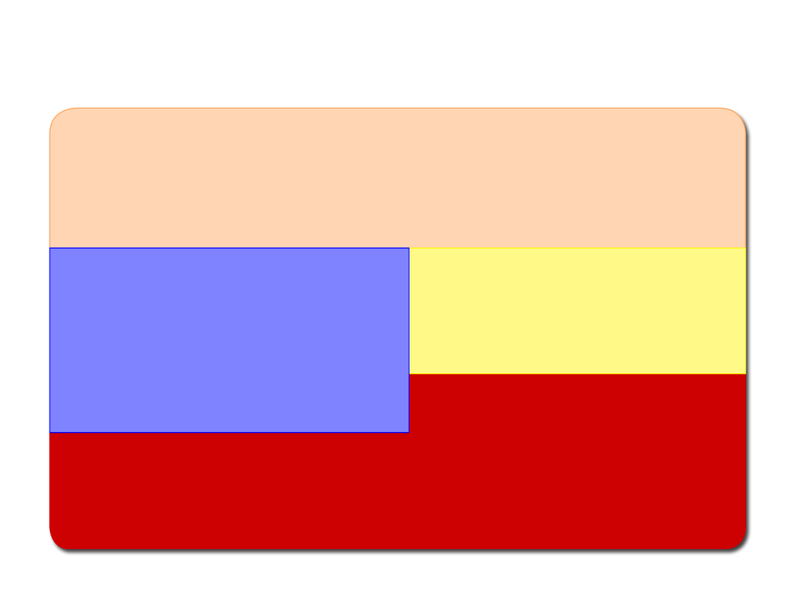
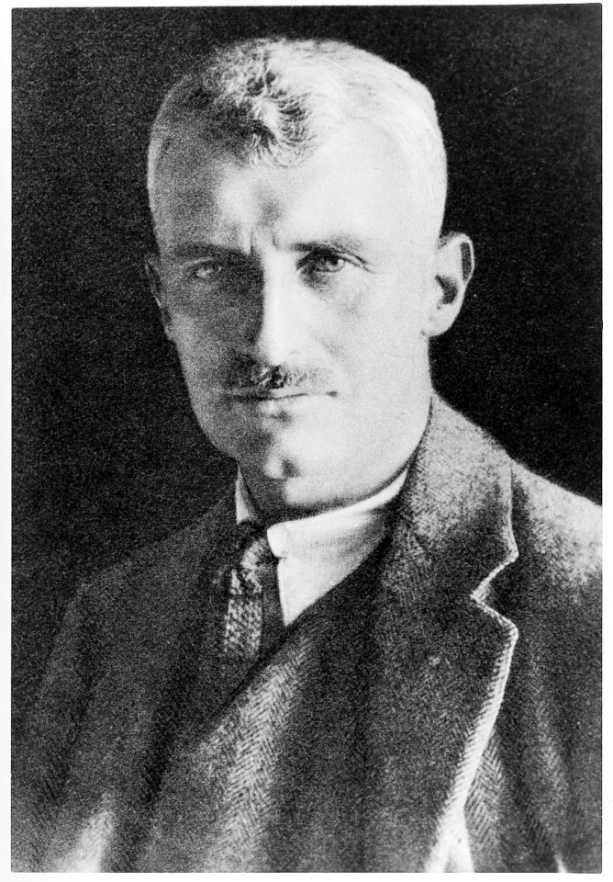
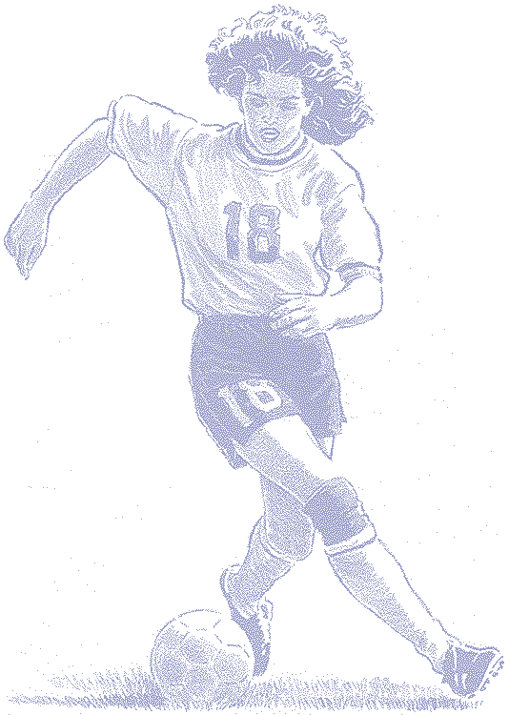
I N T R O D U C T I O N
AN INTRODUCTION TO EXERCISE AND SPORT PHYSIOLOGY

Slide 2
Learning Objectives
w Learn to differentiate exercise physiology and sport physiology.
w Become familiar with the evolution of exercise physiology and its early scholars.
w Note the differences between acute responses to exercise and chronic adaptations to training.
(continued)

Slide 3
Learning Objectives
w Learn what factors affect the body's acute response to exercise.
w Understand the six basic principles of training.
w Learn how to accurately read and interpret tables and graphs.
w Learn whether cross-sectional studies or longitudinal studies are more accurate.

Slide 4
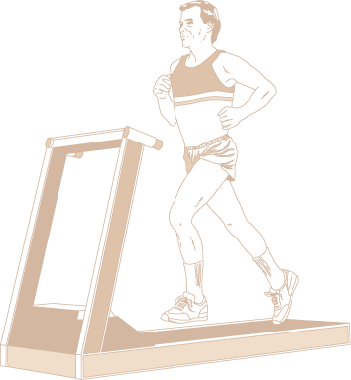
Exercise Physiology vs Sport Physiology
Exercise physiology studies how the body’s structures and functions are altered when exposed to acute and chronic bouts of exercise.
Sport physiology applies exercise physiology concepts to an athlete's training and performance.

Slide 5
Early Exercise Physiologists
Archibald V. Hill
w Nobel Prize winner (1921)
w Studied energy metabolism
w First studies on runners
John S. Haldane
w Developed methods to measure oxygen use during exercise

Slide 6
Harvard Fatigue Laboratory
w Founded by Lawrence J. Henderson in 1927
w Directed by David Bruce Dill
w Focused on the physiology of human movement and the effects of environmental stress on exercise
w Pioneered studies that resulted in an explosion of
interest in exercise physiology
w Closed in 1947

Slide 7
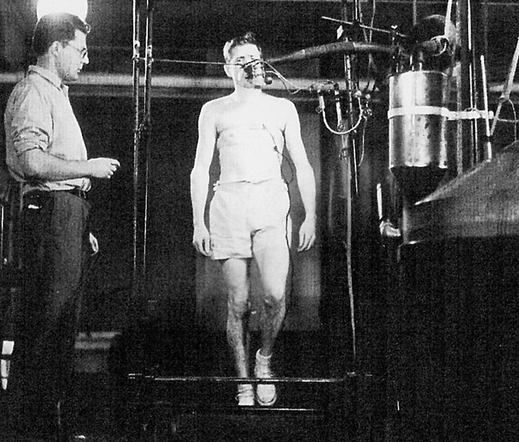
Early Exercise Physiologists
David Bruce (“D.B.”) Dill
w Directed Harvard Fatigue Laboratory (HFL) from 1927-1947
w Later studied human tolerance to exercise in the desert and at altitude
Sid Robinson
w Studied exercise and aging while a student at HFL

Slide 8
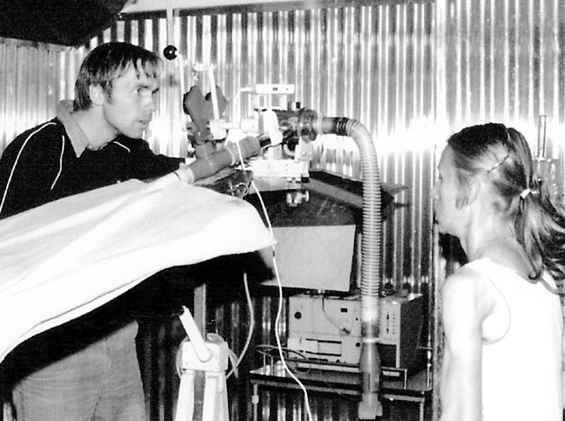
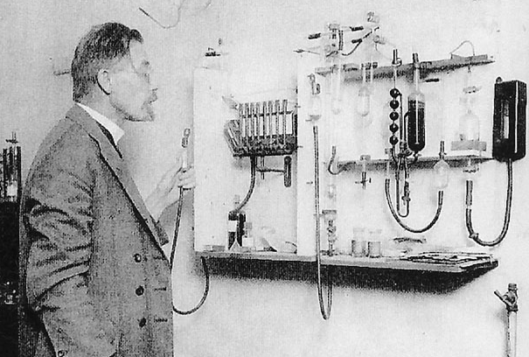
EARLY MEASUREMENT DEVICES

Slide 9
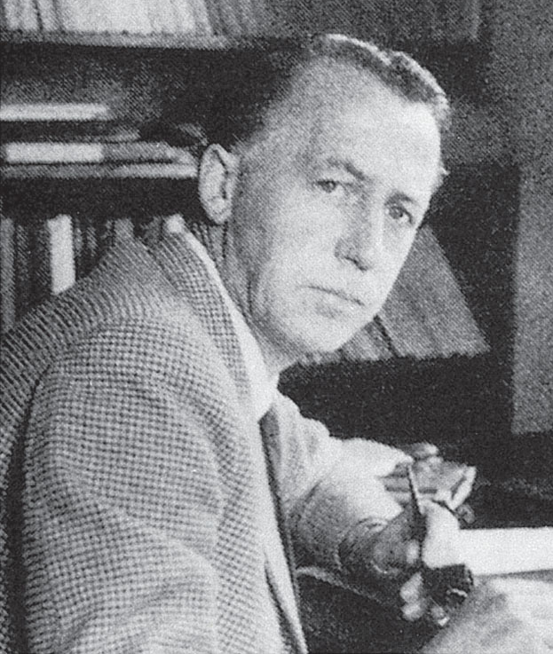
Scandinavian Influence
Erik Hohwü-Christensen
w Published important early research on carbohydrate and fat metabolism
Per-Olof Åstrand
w Conducted studies on physical fitness and endurance capacity

Slide 10
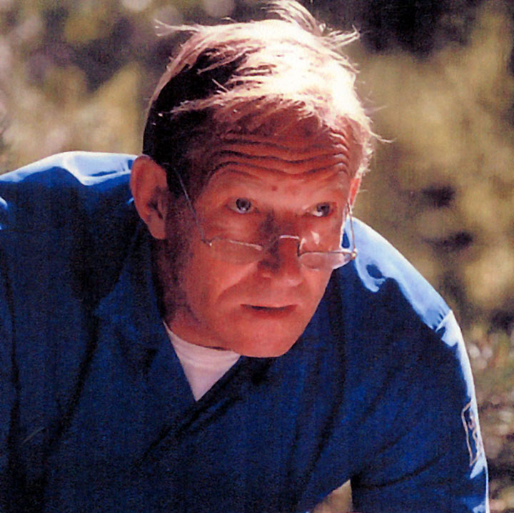
Scandinavian Influence
Bengt Saltin
w Contributed greatly to exercise and clinical physiology
Jonas Bergstrom
w Reintroduced biopsy needle to study human muscle biochem- istry

Slide 11
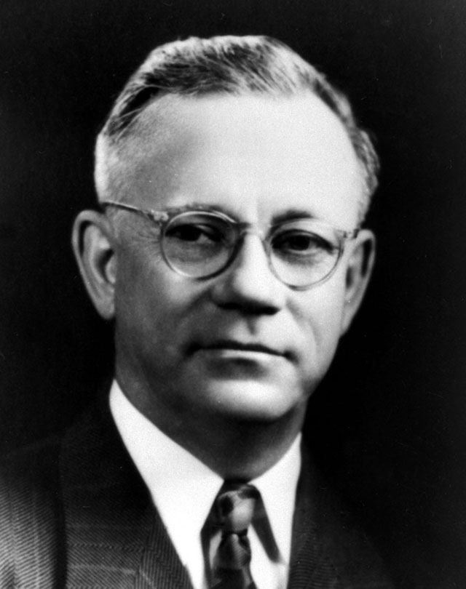
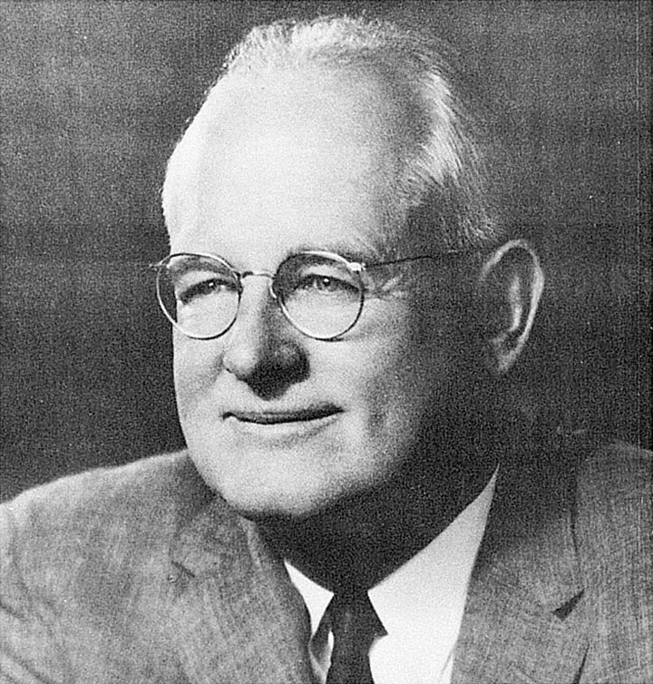
Exercise Physiology and Physical Fitness
Peter Karpovich
w Introduced physiology to physical education
Thomas K. Cureton
w Taught many of today’s leaders in physical fitness and exercise physiology

Slide 12
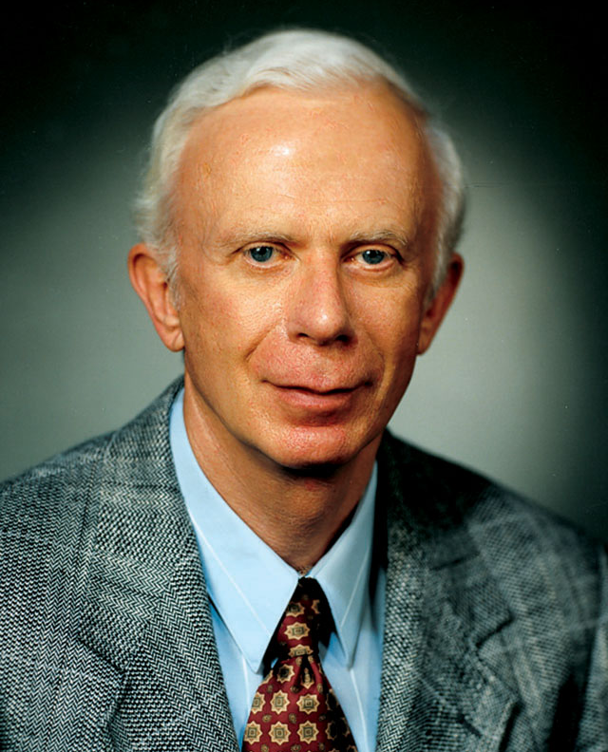
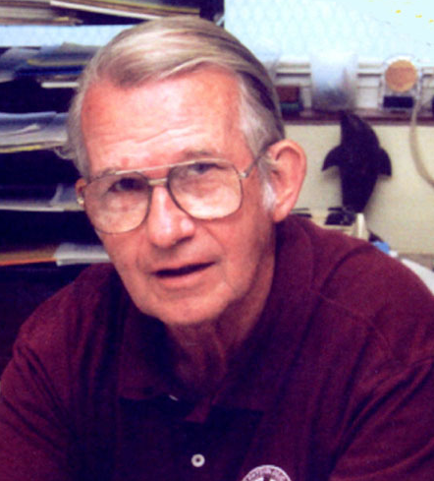
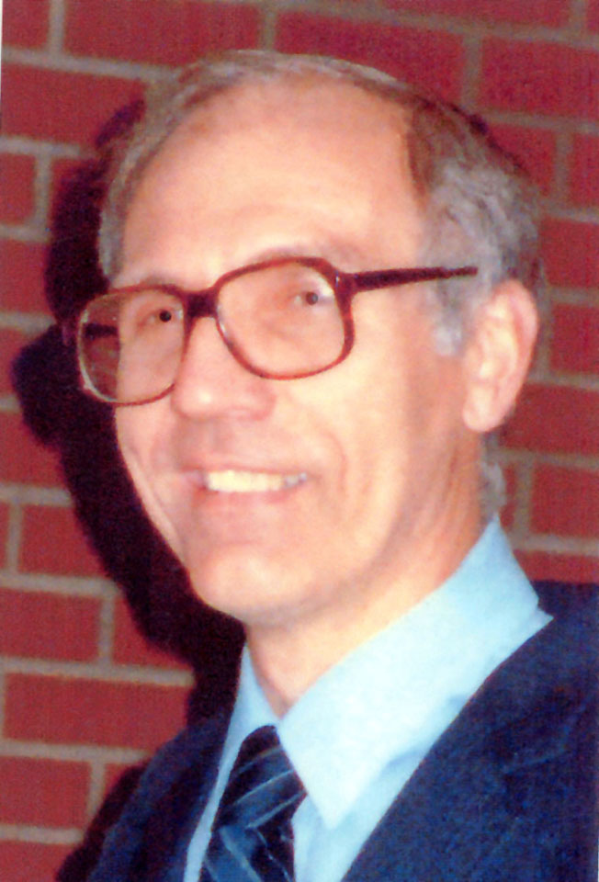
Contemporary Exercise Physiologists
John Holloszy, Charles Tipton, and Phil Gollnick
w Introduced biochemical approach to exercise physiology research
w First to use rats and mice to study muscle metabolism and fatigue

Slide 13
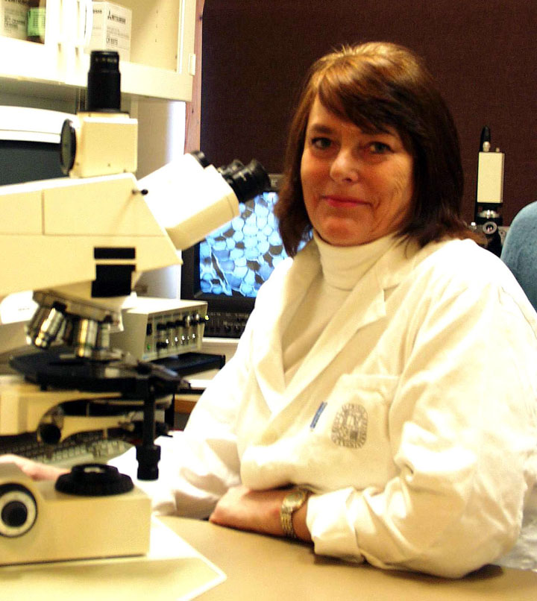
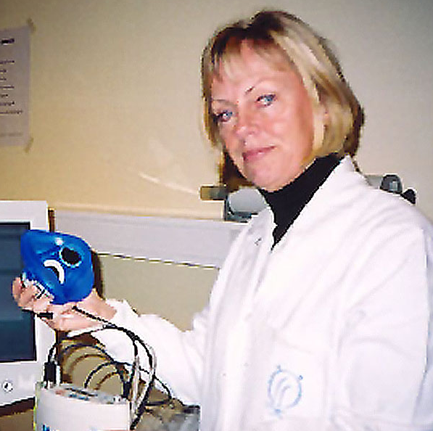
Women in Exercise Physiology
Birgitta Essen
w Adapted micro-biochemical methods for better studying muscle samples obtained with muscle biopsy
Karen Piehl
w Published several studies illustrating which fibers were activated during aerobic and anaerobic exercise

Slide 14
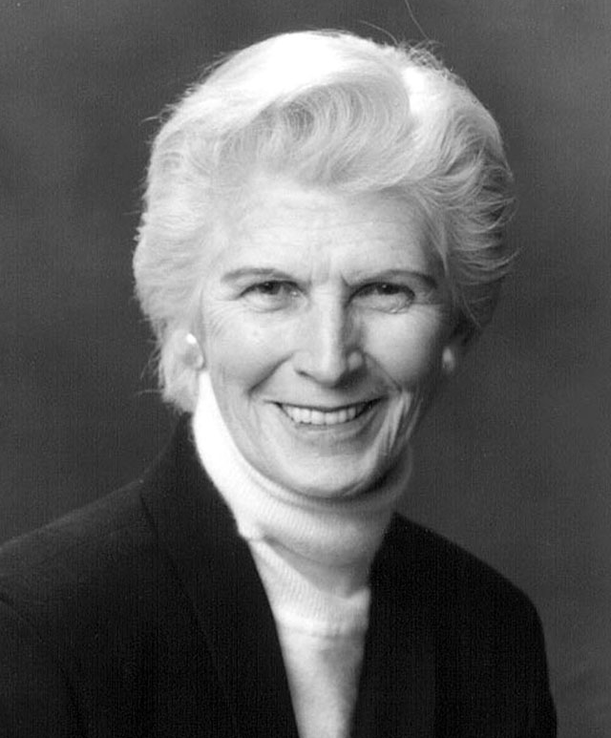
Women in Exercise Physiology
Bodil Nielsen
w Studied human responses to environmental heat
stress and dehydration
Barbara Drinkwater
w Studied environmental physiology and the physiologi- cal issues unique to female athletes

Slide 15
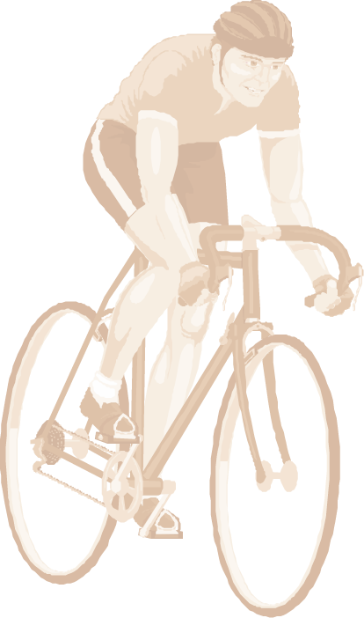
Acute Responses vs Chronic Adaptations
Acute responses to training involve how the body responds to one bout of exercise.
Chronic physiological adaptations to training mark how the body responds over time to the stress of repeated exercise bouts.

Slide 16
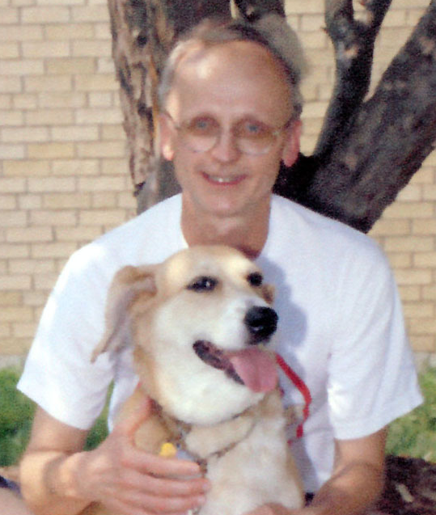
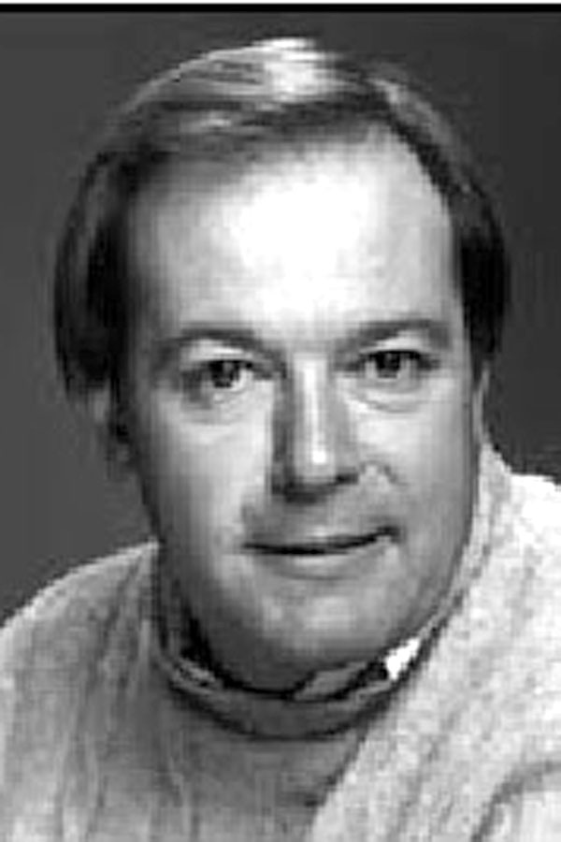
Molecular Biology & Exercise Physiology
Frank Booth and Ken Baldwin
w Dedicated their careers to understanding the
molecular regulation of muscle fibers
w Contributed to what we now know of the genetic
controls of muscle growth and atrophy

Slide 17
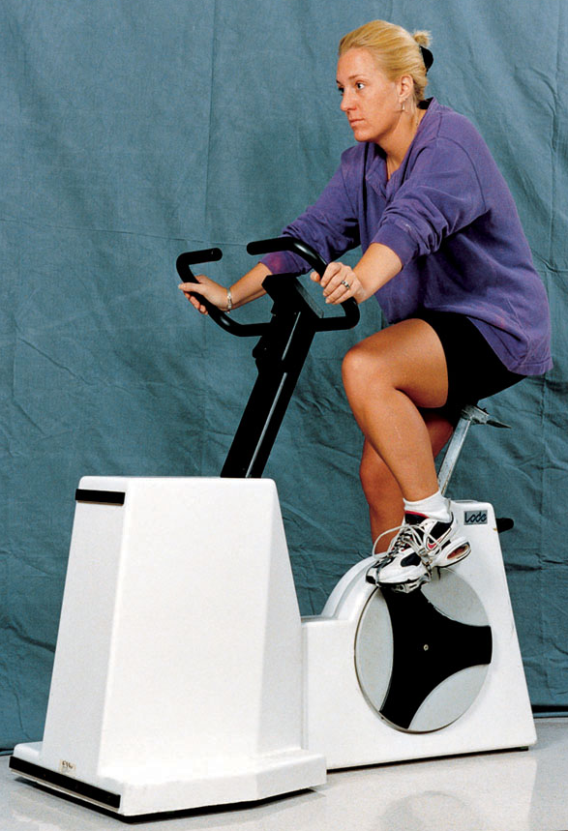
Cycle Ergometer
w Makes it easier to assess blood pressure and collect blood because upper body is relatively immobile
w Results are not greatly affected by body weight or changes in body weight

Slide 18
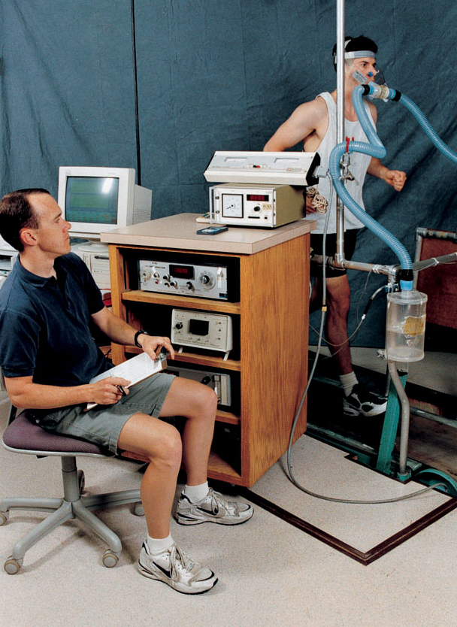
Treadmill
w Results in generally higher maximal physiological values—heart rate, ventila- tion, and oxygen uptake— than cycle ergometer

Slide 19
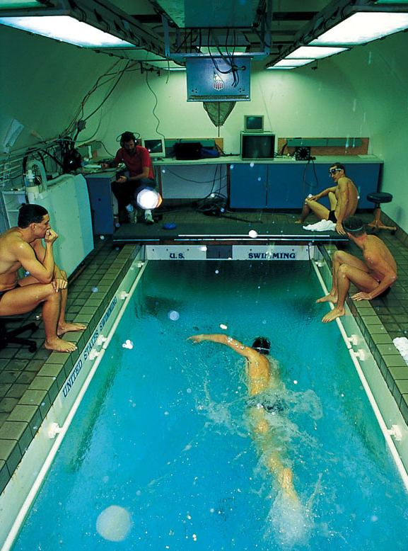
Swimming Flume
w Allows swimmers to closely simulate their natural swimming strokes while researchers collect data

Slide 20
Key Points
Acute Responses to Exercise
w Control environmental factors such as temperature, humidity, light, and noise.
w Account for diurnal cycles, menstrual cycles, and sleep patterns.
w Use ergometers to measure physical work in standardized conditions.
w Match the mode of testing to the type of activity the subject usually performs.

Slide 21
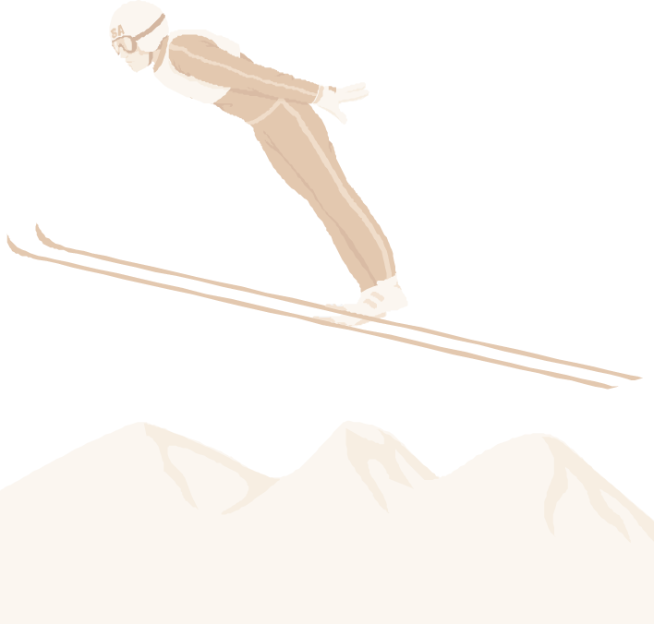
Basic Training Principles
Individuality—Consider the specific needs and abilities of the individual.
Specificity—Training adaptations are highly specific to the type of activity and the volume and intensity of training.
Disuse—Include a program to maintain fitness.
Progressive overload—Increase the training stimulus as the body adapts.
Hard/easy—Alternate high-intensity with low-intensity workouts.
Periodization—Cycle specificity, intensity, and volume of training.

Slide 22
An Example of Diurnal Variations in Heart Rate at Rest and During Exercise
Time of day
2 a.m. 6 a.m. 10 a.m. 2 p.m. 6 p.m. 10 p.m.
Condition Heart rate (beats/min)
Resting 65 69 73 74 72 69
Light exercise 100 103 109 109 105 104
Moderate exercise 130 131 138 139 135 134
Maximal exercise 179 179 183 184 181 181
Recovery, 3 min 118 122 129 128 128 125
Data from Reilly and Brooks (1990).

Slide 23
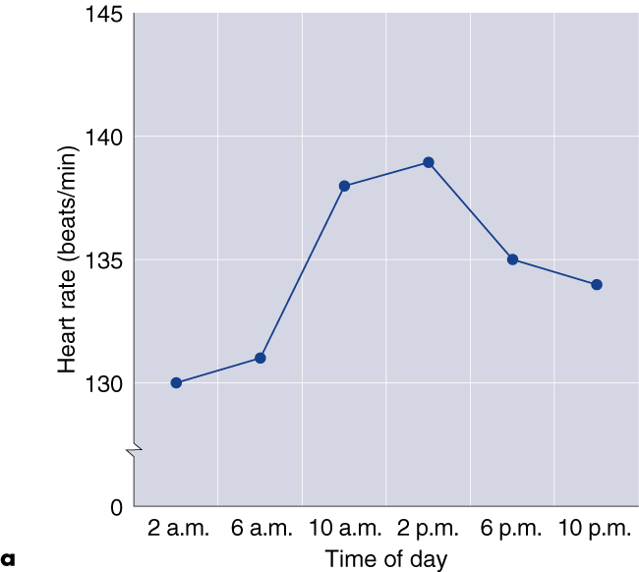
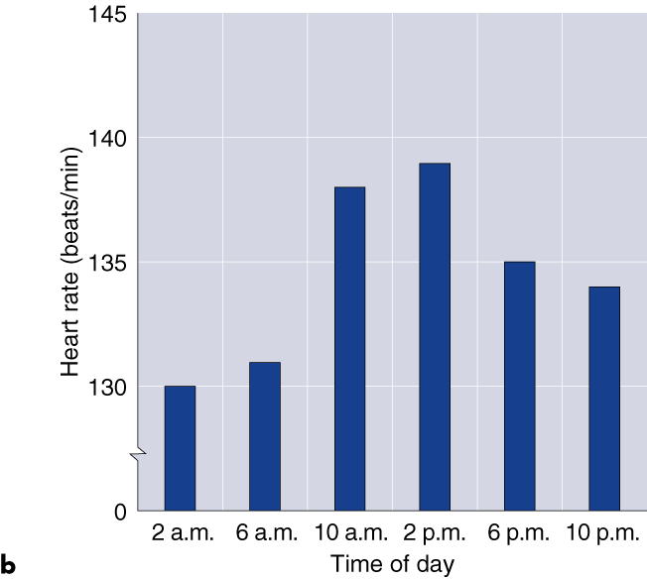
READING AND INTERPRETING GRAPHS

Slide 24
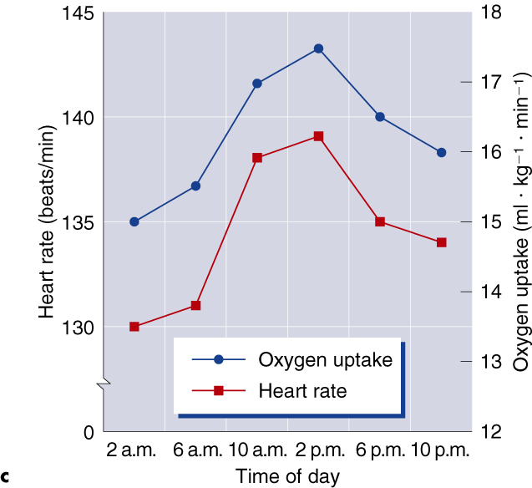
READING AND INTERPRETING GRAPHS

Slide 25
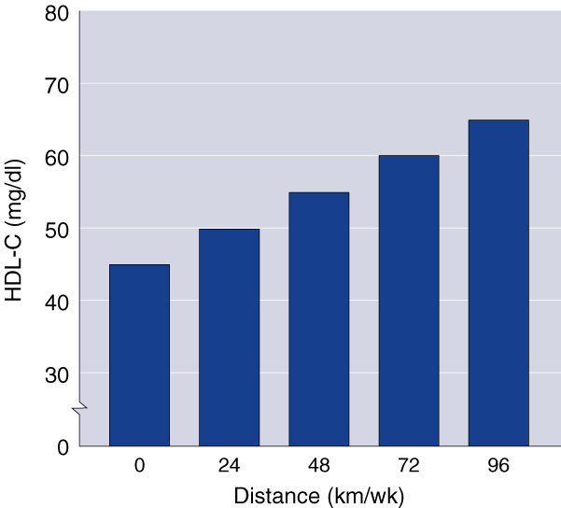
CROSS-SECTIONAL RESEARCH

Slide 26
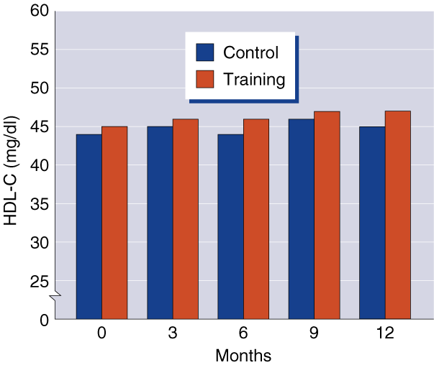
LONGITUDINAL RESEARCH

Slide 27
Key Points
Research Methodology
w Longitudinal research tests the same subjects and compares results over time.
w Cross-sectional research collects data from a diverse population and compares the data for each group in that population.
w Longitudinal studies are often more accurate than cross-sectional studies, but they can’t always be done.
(continued)

Slide 28
Key Points
Research Methodology
w Laboratory research allows investigators to carefully control variables and use accurate equipment.
w Field research allows for less control of variables and equipment, but participant’s activities are often more natural.

