Slide 1
CHAPTER 1
CHAPTER 1
MUSCULAR CONTROL OF MOVEMENT
MUSCULAR CONTROL OF MOVEMENT

Slide 2
Learning Objectives
w Learn the basic components of skeletal muscle, the muscle fiber, and the myofibril.
w Note the cellular events leading to a basic muscle action.
w Discover how muscle functions during exercise.
w Consider the differences in fiber types and their impact on physical performance.
w Learn how muscles generate force and movement by pulling on bones.

Slide 3
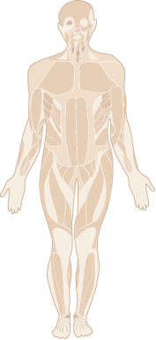
Types of Muscles
Smooth
w Involuntary muscle; controlled unconsciously
w In the walls of blood vessels and internal organs
Cardiac
w Controls itself with help from nervous and endocrine systems
w Only in the heart
Skeletal
w Voluntary muscle; controlled consciously
w Over 600 throughout the body

Slide 4
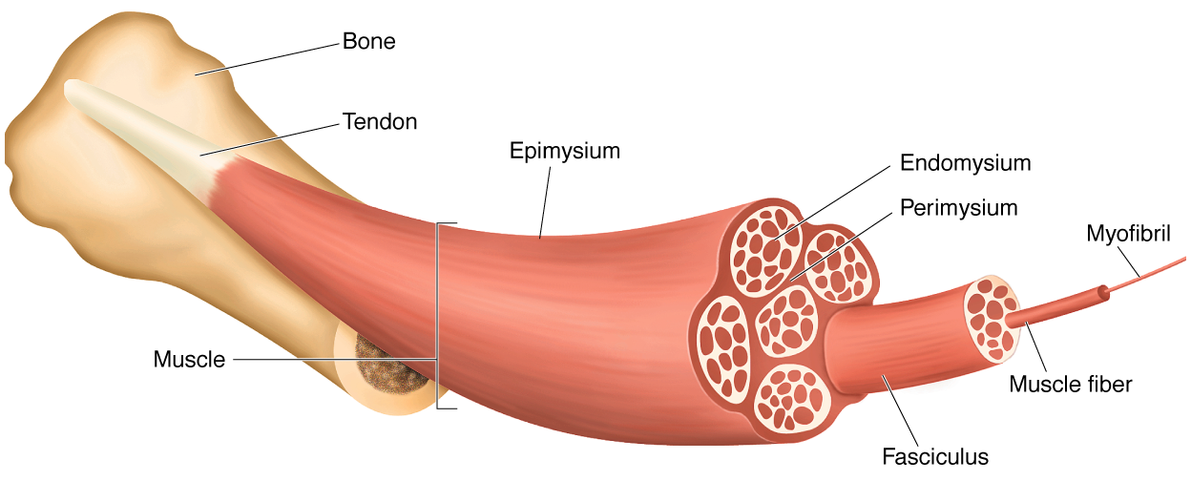
SKELETAL MUSCLE STRUCTURE

Slide 5
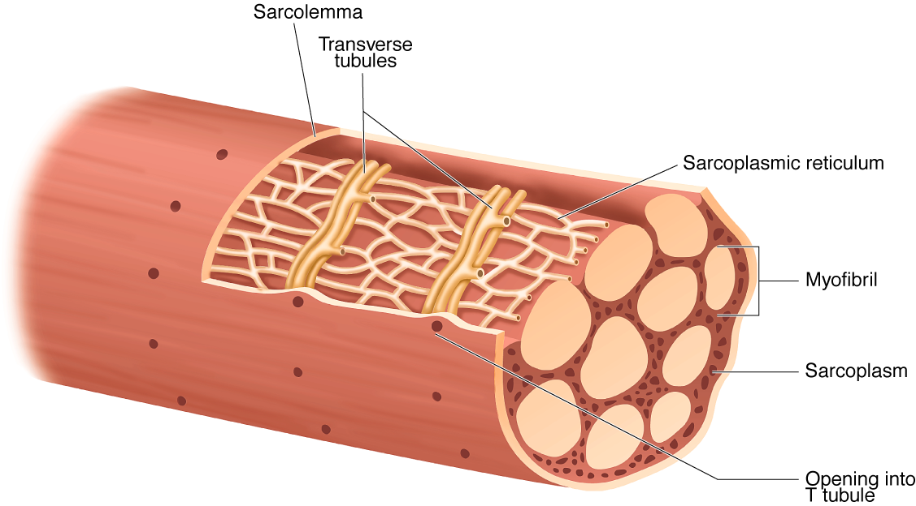
A MUSCLE FIBER

Slide 6
Key Points
The Muscle Fiber
w An individual muscle cell is called a muscle fiber.
w A muscle fiber is enclosed by a plasma membrane called the sarcolemma.
w The cytoplasm of a muscle fiber is called a sarcoplasm.
w Within the sarcoplasm, the T tubules allow transport of substances throughout the muscle fiber and the sarcoplasmic reticulum stores calcium.

Slide 7
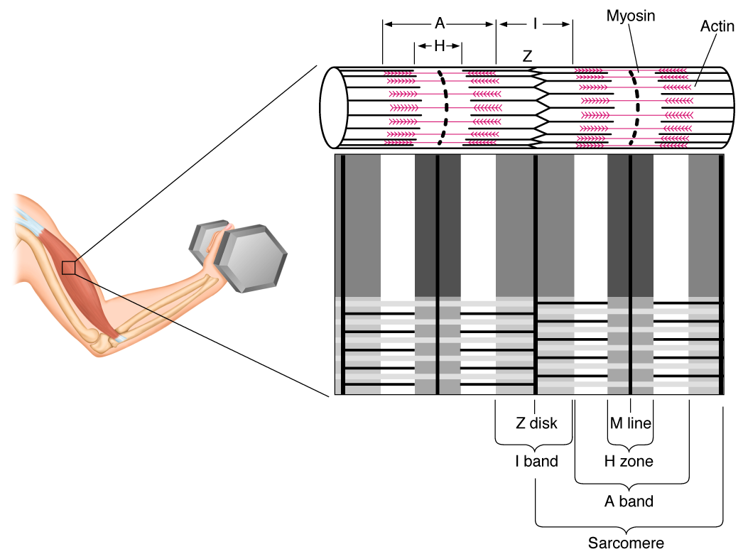
ARRANGEMENT OF FILAMENTS

Slide 8
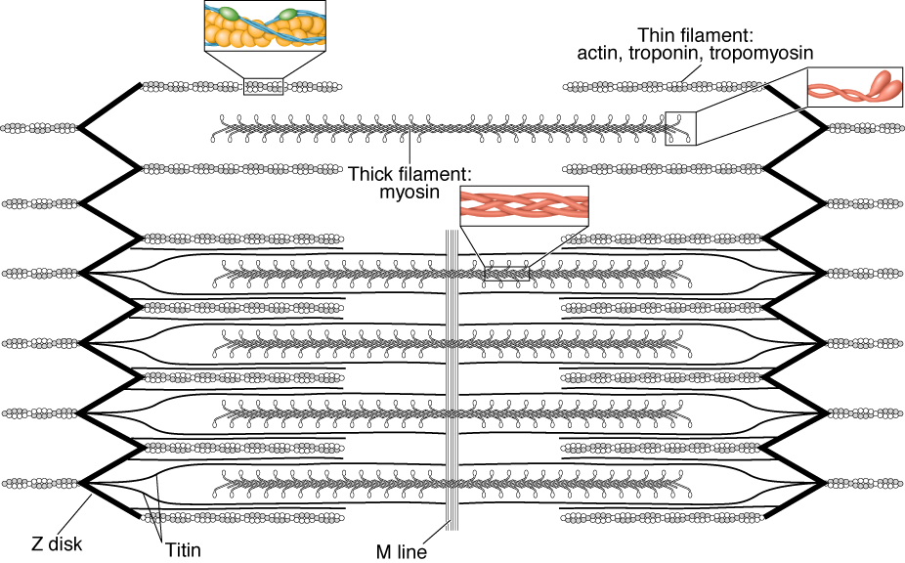
ARRANGEMENT OF FILAMENTS IN A SARCOMERE

Slide 9
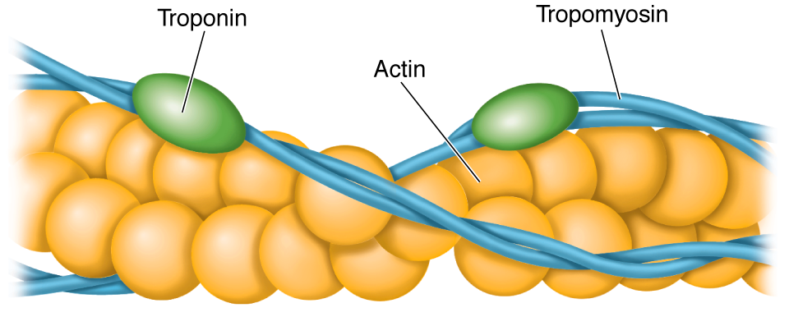
AN ACTIN FILAMENT

Slide 10
Key Points
The Myofibril
w Myofibrils are made up of sarcomeres, the smallest functional units of a muscle.
w A sarcomere is composed of filaments of two proteins, myosin and actin, which are responsible for muscle contraction.
w Myosin is a thick filament with a globular head at one end.
w An actin filament—composed of actin, tropomyosin, and troponin—is attached to a Z disk.

Slide 11
Events Leading to Muscle Fiber Action
1. A motor neuron releases acetylcholine (ACh).
2. ACh binds to receptors on the sarcolemma.
3. The action potential triggers release of Ca²⁺.
4. The Ca²⁺ binds to troponin on the actin filament, and the troponin pulls tropomyosin off the active sites, allowing myosin heads to attach to the actin filament.

Slide 12
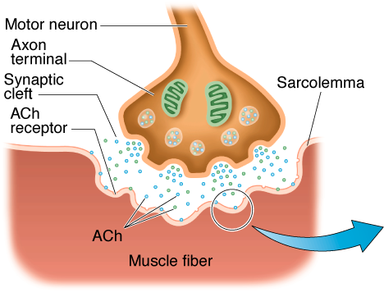
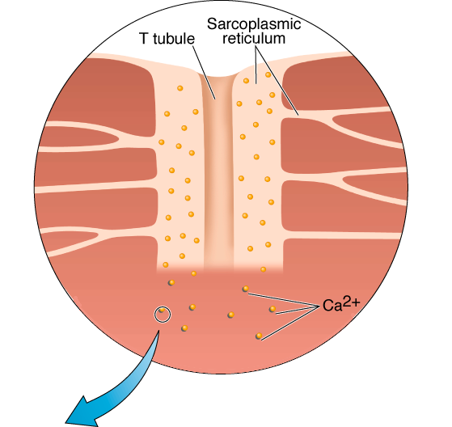
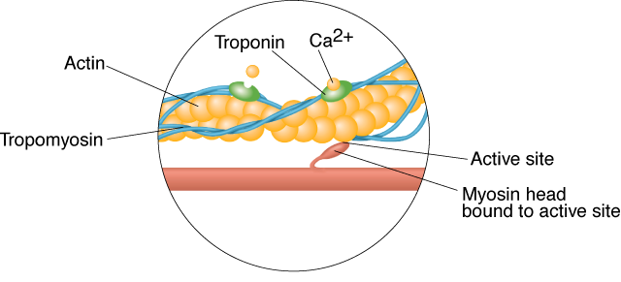
EVENTS LEADING TO MUSCLE ACTION

Slide 13
The Sliding Filament Theory
w When myosin cross-bridges are activated, they bind strongly with actin, resulting in a change in the cross-bridge.
w The change in the cross-bridge causes the myosin head to tilt toward the arm of the cross-bridge and drag the actin and myosin filaments in opposite directions.
w The tilt of the myosin head is known as a power stroke.
w The pulling of the actin filament past the myosin results in muscle shortening and generation of muscle force.

Slide 14
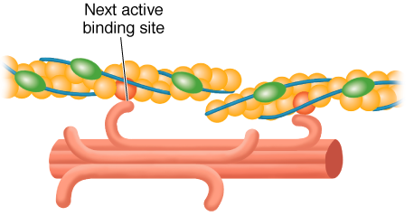
CONTRACTING MUSCLE FIBER

Slide 15
Key Points
Muscle Fiber Action
w Muscle action is initiated by a nerve impulse.
w The nerve releases ACh, which allows sodium to enter and depolarize the cell. If the cell is sufficiently depolarized, an action potential occurs which releases stored Ca²⁺ ions.
w Ca²⁺ ions bind with troponin, which lifts the tropomyosin molecules off the active sites on the actin filament. These open sites allow the myosin heads to bind to them.
(continued)

Slide 16
Key Points
Muscle Fiber Action
w Once myosin binds with actin, the myosin head tilts and pulls the actin filament so they slide across each other.
w Muscle action ends when calcium is pumped out of the sarcoplasm to the sarcoplasmic reticulum for storage.
w Energy for muscle action is provided when the myosin head binds to ATP. ATPase on the myosin head splits the ATP into a usable energy source.

Slide 17
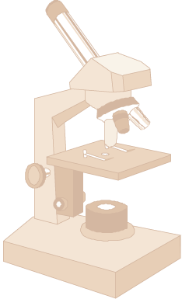
Muscle Biopsy
w Hollow needle is inserted into muscle to take a sample.
w Sample is mounted, frozen, thinly sliced, and examined under a microscope.
w Allows study of muscle fibers and the effects of exercise and training on fiber composition.

Slide 18
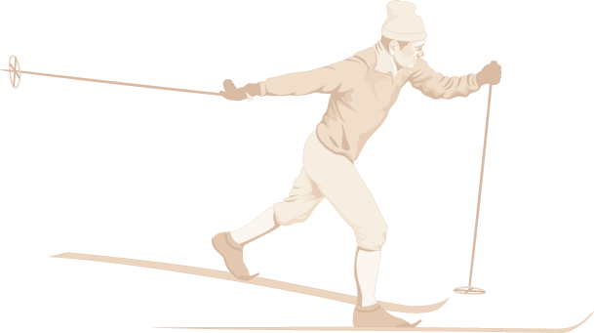
Slow-Twitch (ST) Muscle Fibers
w High aerobic (oxidative) capacity and fatigue resistance
w Low anaerobic (glycolytic) capacity and motor unit strength
w Slow contractile speed (110 ms) and myosin ATPase
w 10–180 fibers per motor neuron
w Low sarcoplasmic reticulum development

Slide 19
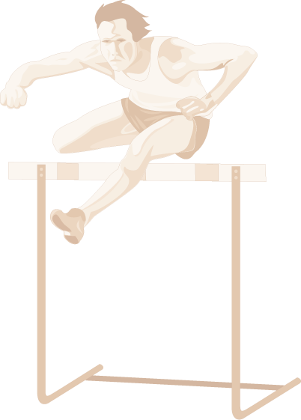
Fast-Twitch (FT_{a}) Muscle Fibers
w Moderate aerobic (oxidative) capacity and fatigue resistance
w High anaerobic (glycolytic) capacity and motor unit strength
w Fast contractile speed (50 ms) and myosin ATPase
w 300–800 fibers per motor neuron
w High sarcoplasmic reticulum development

Slide 20
Fast-Twitch (FT_{b}) Muscle Fibers
w Low aerobic (oxidative) capacity and fatigue resistance
w High anaerobic (glycolytic) capacity and motor unit strength
w Fast contractile speed (50 ms) and myosin ATPase
w 300–800 fibers per motor neuron
w High sarcoplasmic reticulum development

Slide 21
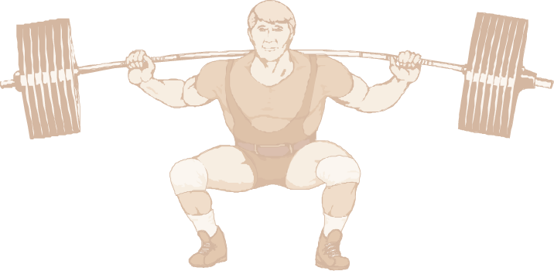
Did You Know…?
The difference in force development between FT and ST motor units is due to the number of muscle fibers per motor unit, not the force generated by each fiber.

Slide 22
What Determines Fiber Type?
w Genetics determine which motor neurons innervate our individual muscle fibers.
w Muscle fibers become specialized according to the type of neuron that stimulates them.
w Endurance training and muscular inactivity may result in small changes in the percentage of FT and ST fibers.
w Aging may result in changes in the percentage of FT to ST fibers.

Slide 23
Key Points
Slow- and Fast-Twitch Muscle Fibers
w Skeletal muscles contain both ST and FT fibers.
w ATPase in FT fibers acts faster providing energy for muscle action more quickly than ATPase in ST fibers.
w FT fibers have a more developed sarcoplasmic reticulum enhancing calcium delivery.
(continued)

Slide 24
Key Points
Slow- and Fast-Twitch Muscle Fibers
w Motor units supplying FT fibers are larger than those supplying ST fibers; thus, FT motor units can recruit more fibers.
w ST fibers have high aerobic endurance and are suited to low-intensity endurance activities.
w FT fibers are better for anaerobic or explosive activities.

Slide 25
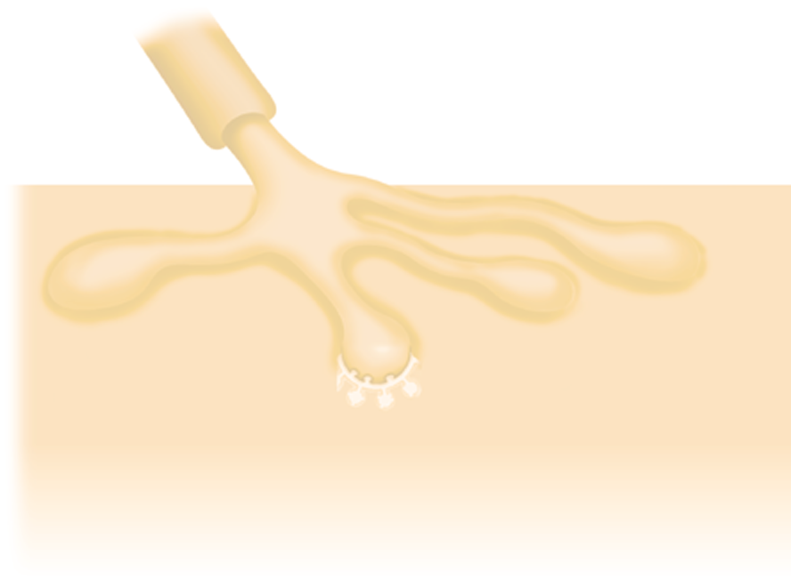
The All-Or-None-Response
w For a motor unit to be recruited into activity the motor nerve impulse must meet or exceed the threshold.
w When this occurs, all muscle fibers in the motor unit act maximally.
w If the threshold is not met no fibers in that unit act.
w More force is produced by activating more motor units.

Slide 26
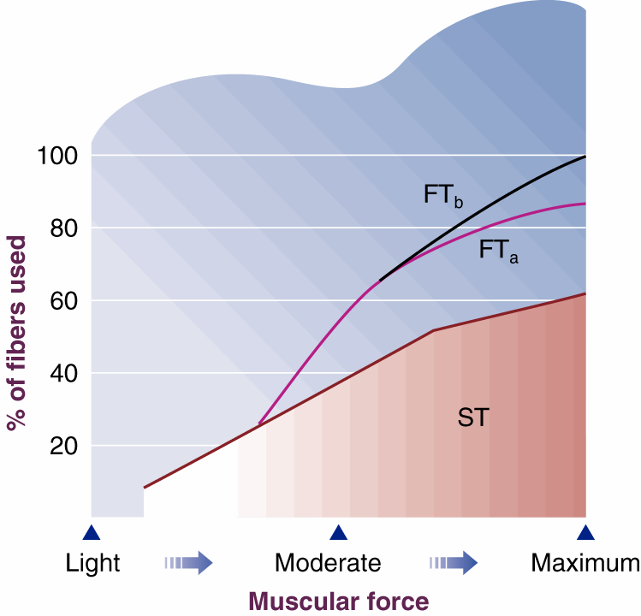
RAMPLIKE RECRUITMENT OF FIBERS

Slide 27
Functional Classification of Muscles
Agonists—prime movers; responsible for the movement
Antagonists—oppose the agonists to prevent overstretching of them
Synergists—assist the agonists and sometimes fine-tune the direction of movement

Slide 28
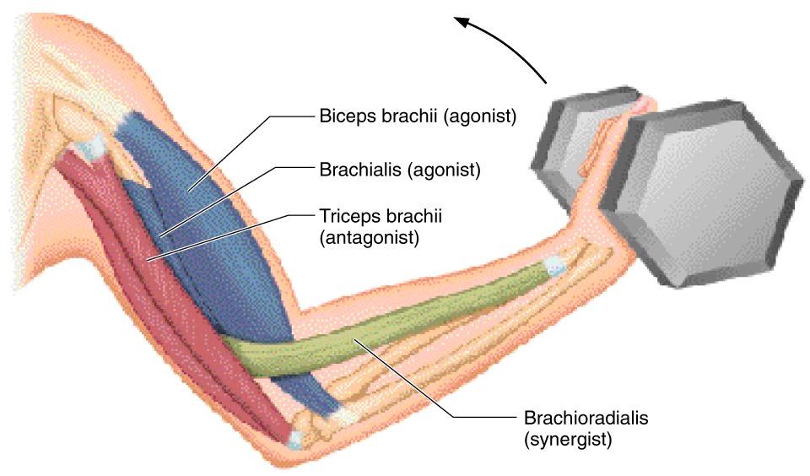
MUSCLE ACTION DURING ELBOW FLEXION

Slide 29
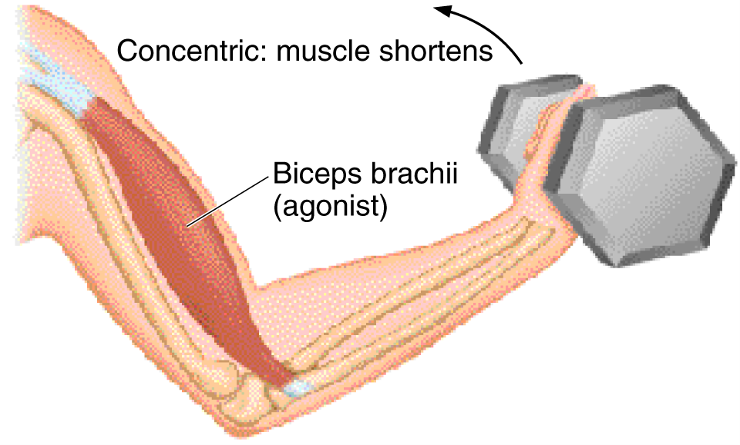
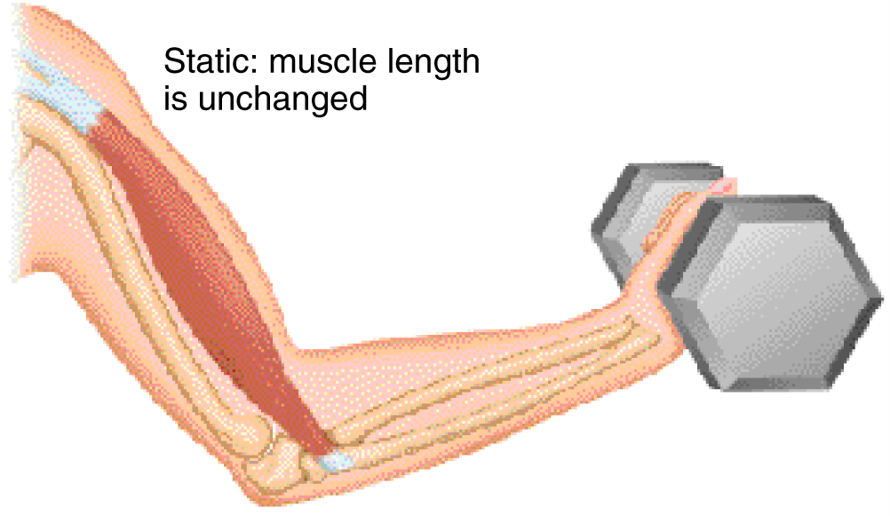
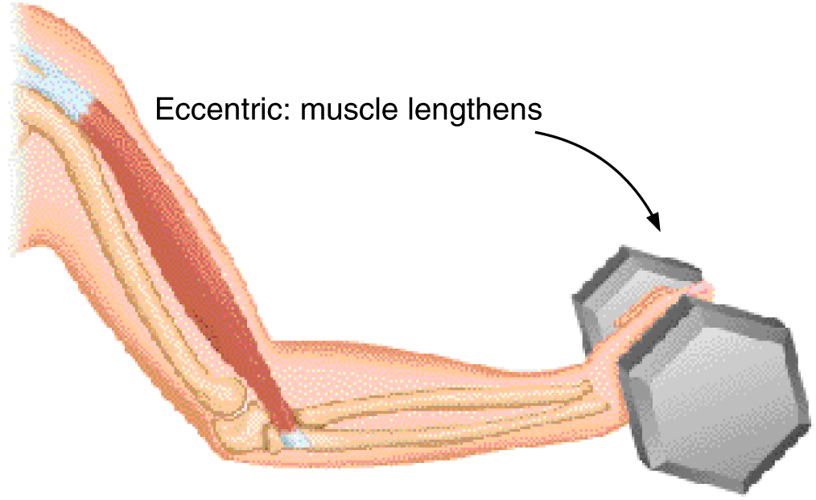
TYPES OF MUSCLE ACTION

Slide 30
Factors Influencing Force Generation
w Number of motor units activated
w Type of motor units activated (FT or ST)
w Muscle size
w Initial muscle length
w Joint angle
w Speed of muscle action (shortening or lengthening)

Slide 31
Key Points
Use of Muscles
w Muscles involved in movement can be classified as agonists, antagonists, and synergists.
w Three types of muscle action are concentric, static, and eccentric.
w Force production is increased by recruiting more motor units.
(continued)

Slide 32
Key Points
Use of Muscles
w All joints have an optimal angle at which the muscles crossing the joint produce maximal force.
w The angle of maximal force depends on the relative position of the muscle's insertion on the bone and the load placed on the muscle.
w Speed of action affects the amount of force produced.

Slide 33
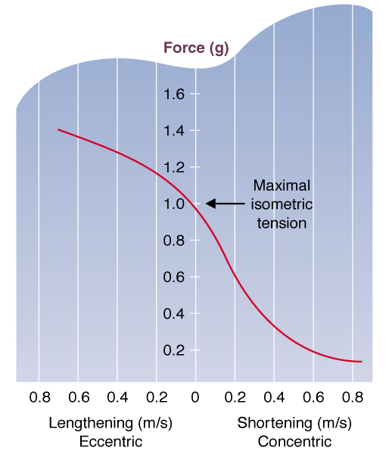
MUSCLE LENGTH vs FORCE PRODUCTION

