Slide 1
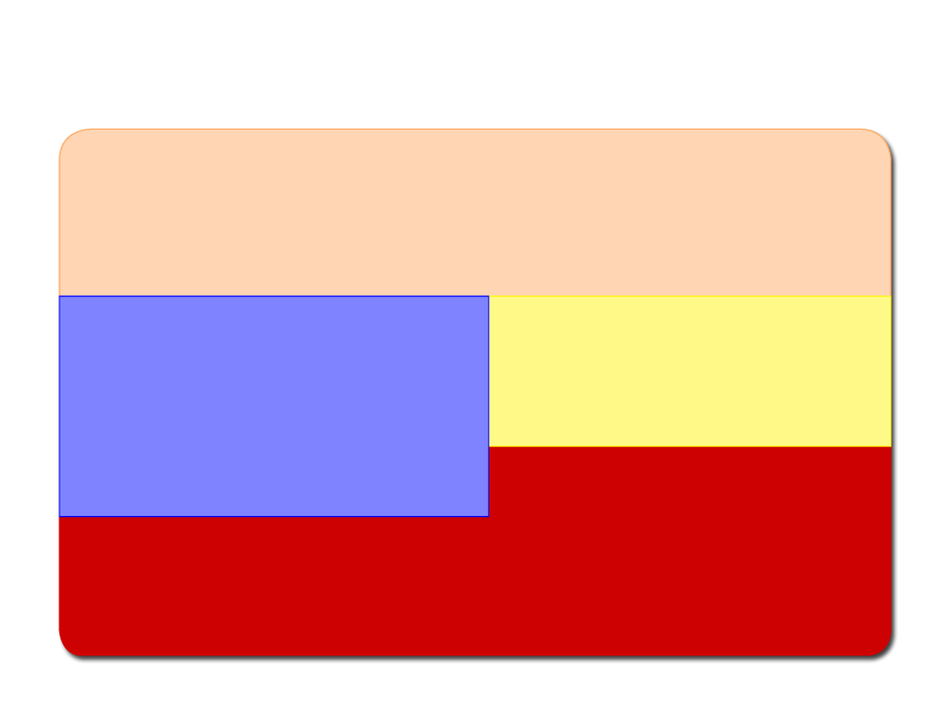
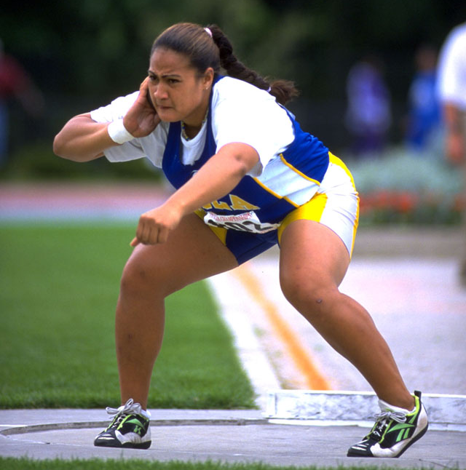
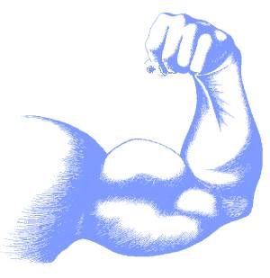
C H A P T E R 1
MUSCLES
AND HOW THEY MOVE

Slide 2
Learning Objectives
w Learn the basic components of skeletal muscle, the muscle fiber, and the myofibril.
w Note the cellular events leading to a basic muscle action.
w Discover how muscle functions during exercise.
w Consider the differences in fiber types and their impact on physical performance.
w Learn how muscles generate force and movement by pulling on bones.

Slide 3
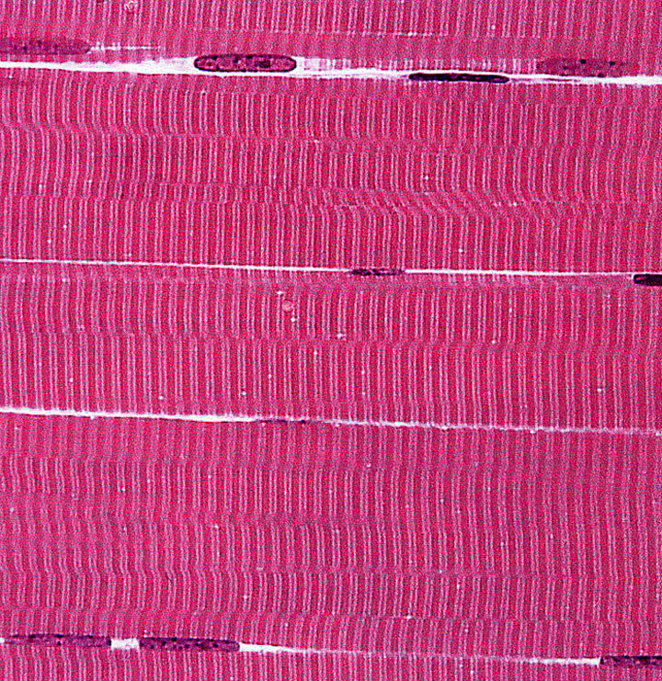
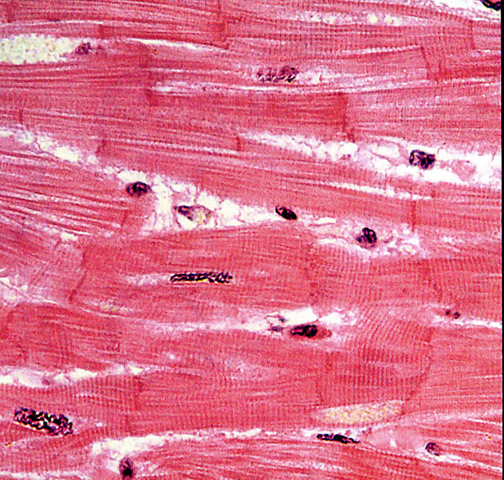
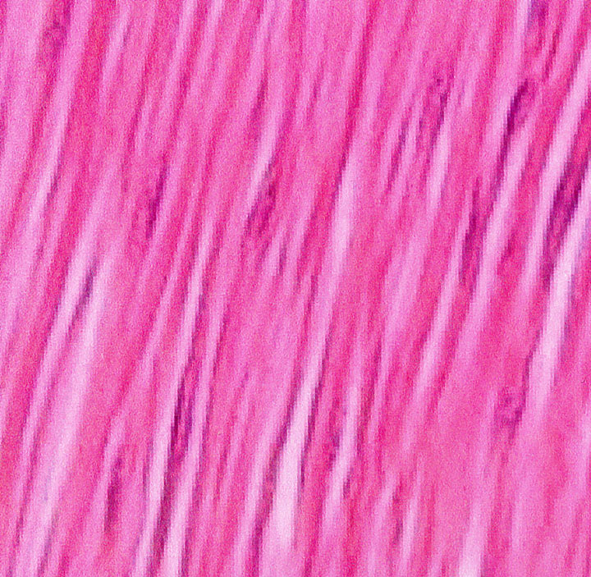
Types of Muscles
Skeletal
w Voluntary muscle; controlled consciously
Over 600 throughout the body
Cardiac
w Controls itself with assistance from the nervous and endocrine systems
w Only in the heart
Smooth
w Involuntary muscle; controlled unconsciously
In the walls of blood vessels and internal organs

Slide 4
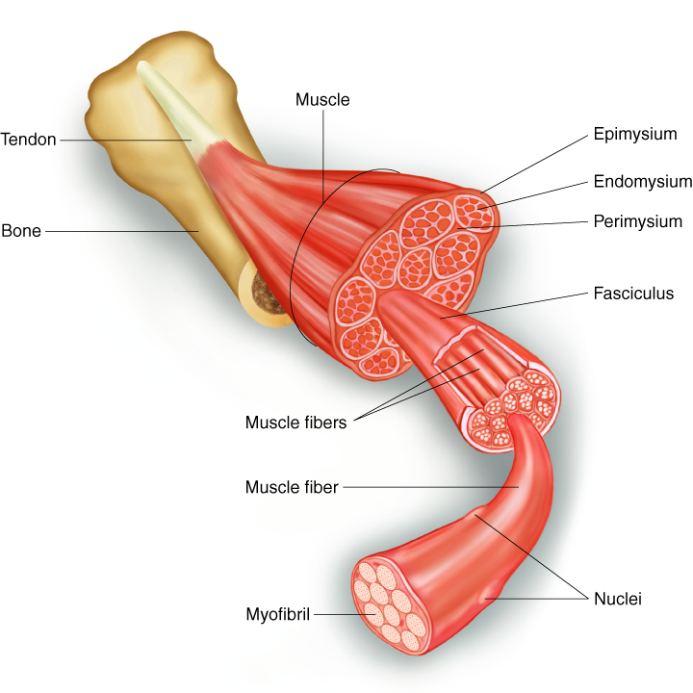
SKELETAL MUSCLE STRUCTURE

Slide 5
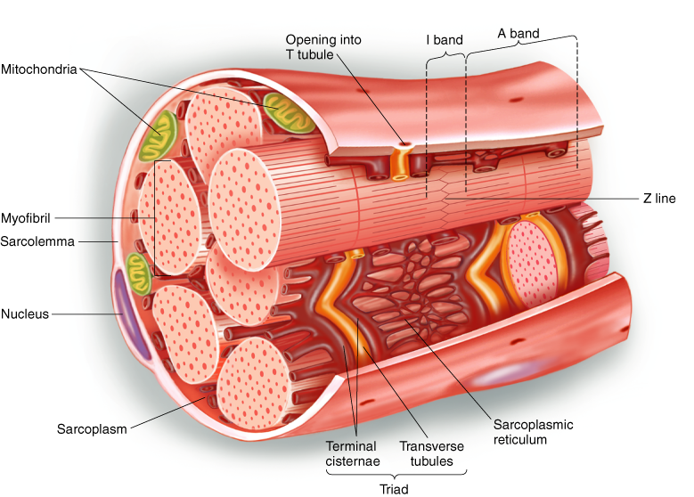
MUSCLE FIBER

Slide 6
Key Points
Muscle Fiber
w An individual muscle cell is called a muscle fiber.
w A muscle fiber is enclosed by a plasma membrane called the sarcolemma.
w The cytoplasm of a muscle fiber is called the sarcoplasm.
w Within the sarcoplasm, the T tubules allow transport of substances throughout the muscle fiber.
w The sarcoplasmic reticulum stores calcium.

Slide 7
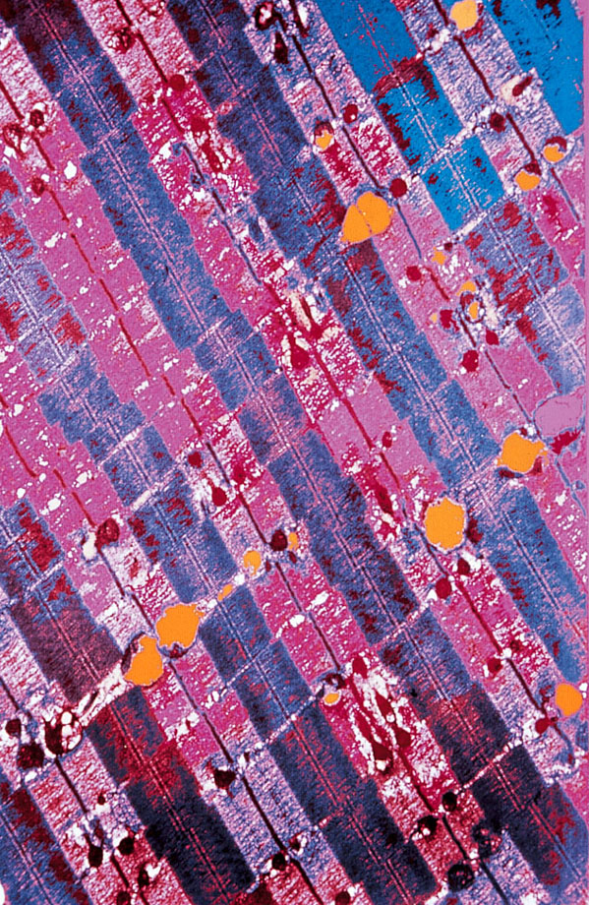
MICROGRAPH OF MYOFIBRILS

Slide 8
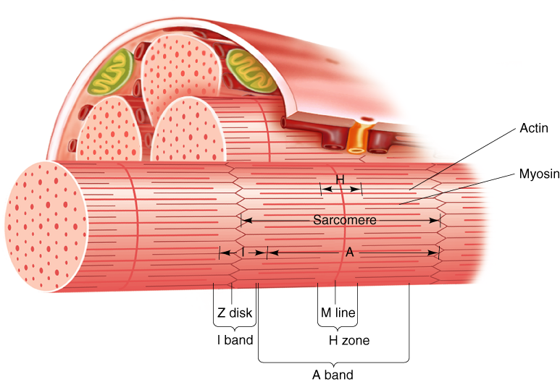
ARRANGEMENT OF FILAMENTS

Slide 9
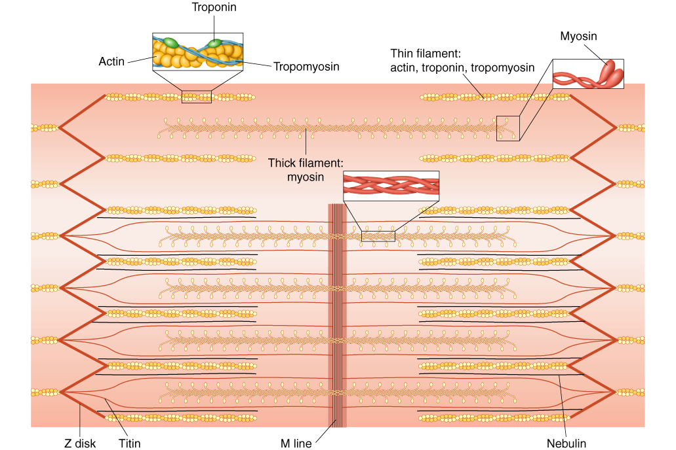
ARRANGEMENT OF FILAMENTS IN A SARCOMERE

Slide 10
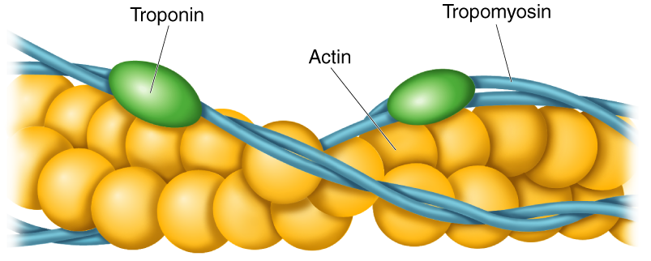
ACTIN FILAMENT

Slide 11
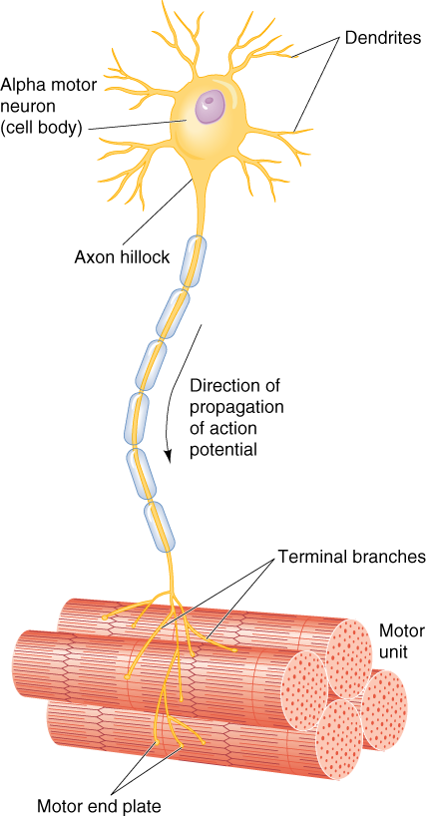
MOTOR UNIT

Slide 12
Key Points
Myofibrils
w Myofibrils are the contractile elements of skeletal muscle, with several hundred to several thousand composing a single muscle.
w Myofibrils are made up of sarcomeres, the smallest functional units of a muscle.
w A sarcomere is composed of filaments of two proteins, myosin and actin, which are responsible for muscle contraction.
w Myosin is a thick filament with a globular head at one end.
w An actin filament—composed of actin, tropomyosin, and troponin—is attached to a Z disk.

Slide 13
Excitation/Contraction Coupling
1. A motor neuron, with signals from the brain or spinal cord, releases the neurotransmitter acetylcholine (Ach) at the neuromuscular junction.
2. ACh crosses the junction and binds to receptors on the sarcolemma.
3. This initiates an action potential, providing sufficient ACh.
4. The action potential travels along the sarcolemma and through the T tubules to the SR releasing Ca²⁺.
5. The Ca²⁺ binds to troponin on the actin filament, and the troponin pulls tropomyosin off the active sites, allowing myosin heads to attach to the actin filament.
(continued)

Slide 14
Excitation/Contraction Coupling
6. Once a strong binding state is extablished with actin, the myosin head tilts, pulling the actin filament (power stroke).
7. The myosin head binds to ATP, and ATPase found on the head splits ATP into ADP and P_{i}, releasing energy.
8. Muscle action ends when calcium is actively pumped out of the sarcoplasm back into the sarcoplasmic reticulum for storage.

Slide 15
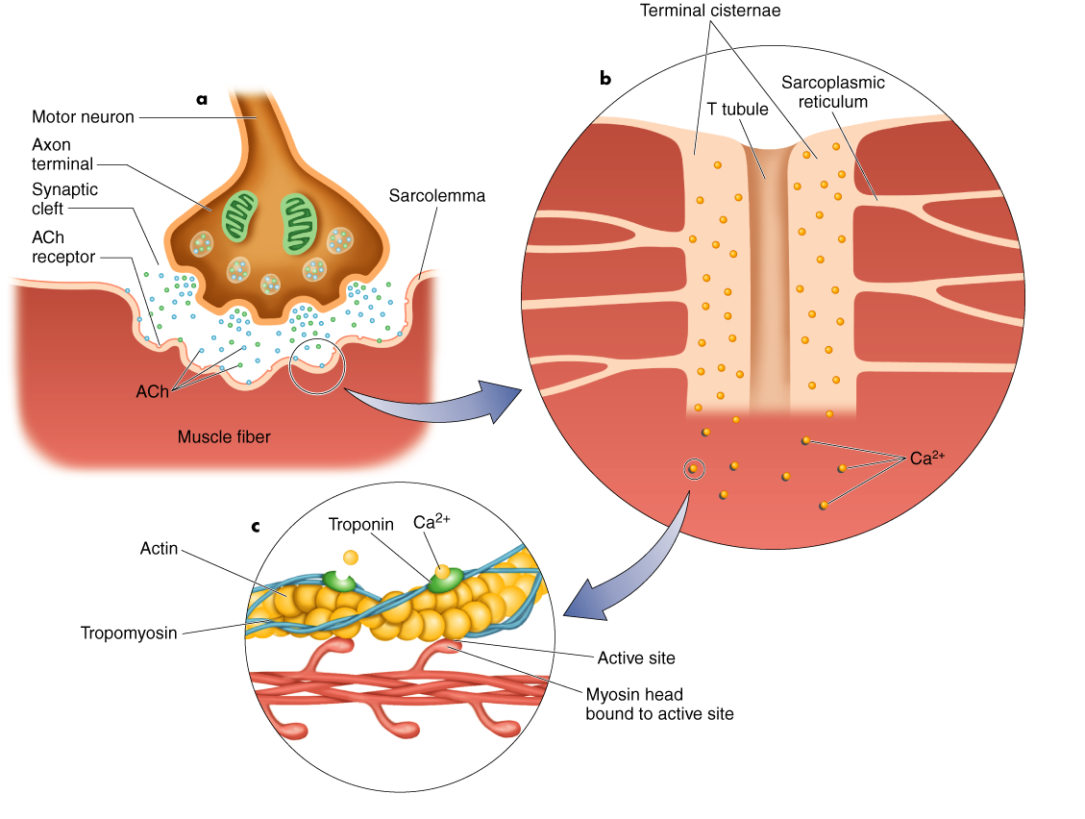
EVENTS LEADING TO MUSCLE ACTION

Slide 16
Sliding Filament Theory
w When myosin cross-bridges are activated, they bind strongly with actin, resulting in a change in the cross-bridge.
w The change in the cross-bridge causes the myosin head to tilt toward the arm of the cross-bridge and drag the actin and myosin filaments in opposite directions.
w The tilt of the myosin head is known as a power stroke.
w The pulling of the actin filament past the myosin results in muscle shortening and generation of muscle force.

Slide 17
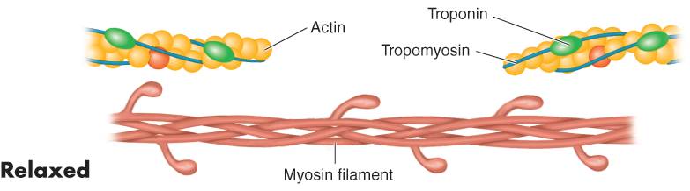
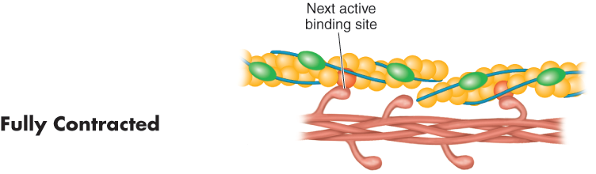
CONTRACTING MUSCLE FIBER

Slide 18
Key Points
Muscle Fiber Action
w Muscle action is initiated by a nerve impulse.
w The nerve releases ACh, which allows sodium to enter and depolarize the cell. If the cell is sufficiently depolarized, an action potential occurs which releases stored Ca²⁺ ions.
w Ca²⁺ ions bind with troponin, which lifts the tropomyosin molecules off the active sites on the actin filament. These open sites allow the myosin heads to bind to them.
(continued)

Slide 19
Key Points
Muscle Fiber Action
w Once myosin binds with actin, the myosin head tilts and pulls the actin filament so they slide across each other.
w Muscle action ends when calcium is pumped out of the sarcoplasm to the sarcoplasmic reticulum for storage.
w Energy for muscle action is provided when the myosin head binds to ATP. ATPase on the myosin head splits the ATP into a usable energy source.

Slide 20
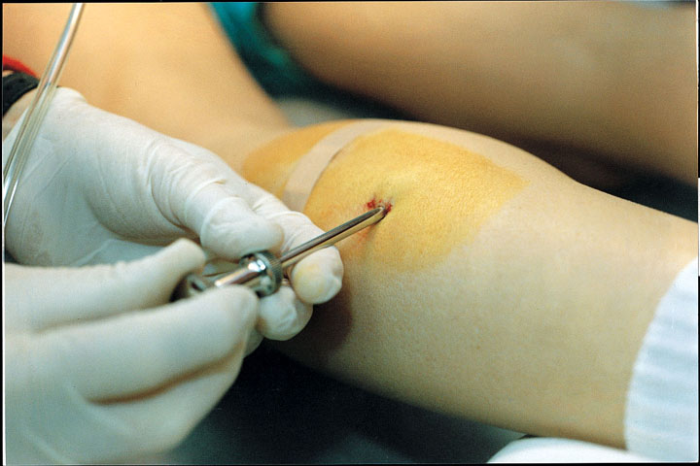
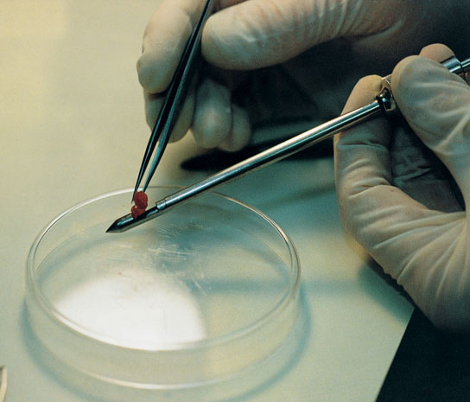
Muscle Biopsy
w Hollow needle is inserted into muscle to take a sample.
w Sample is mounted, frozen, thinly sliced, and examined under a microscope.
w Allows study of muscle fibers and the effects of acute exercise and exercise training on fiber composition.

Slide 21
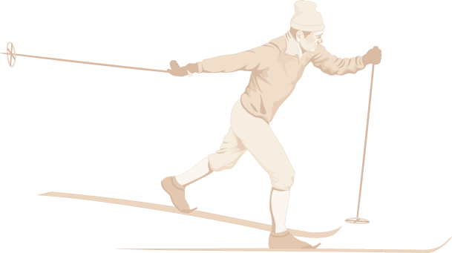
Slow-Twitch (ST) Muscle Fibers
w High aerobic (oxidative) capacity and fatigue resistance
w Low anaerobic (glycolytic) capacity and motor unit strength
w Slow contractile speed (110 ms to reach peak tension) and myosin ATPase
w 10–180 fibers per motor neuron
w Low sarcoplasmic reticulum development

Slide 22
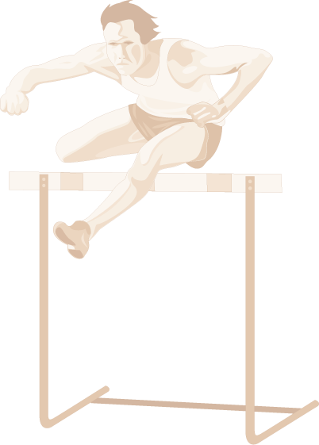
Fast-Twitch (FT_{a}) Muscle Fibers
w Moderate aerobic (oxidative) capacity and fatigue resistance
w High anaerobic (glycolytic) capacity and motor unit strength
w Fast contractile speed (50 ms to reach peak tension) and myosin ATPase
w 300–800 fibers per motor neuron
w High sarcoplasmic reticulum development

Slide 23
Fast-Twitch (FT_{b}) Muscle Fibers
w Low aerobic (oxidative) capacity and fatigue resistance
w High anaerobic (glycolytic) capacity and motor unit strength
w Fast contractile speed (50 ms to reach peak tension) and myosin ATPase
w 300–800 fibers per motor neuron
w High sarcoplasmic reticulum development

Slide 24
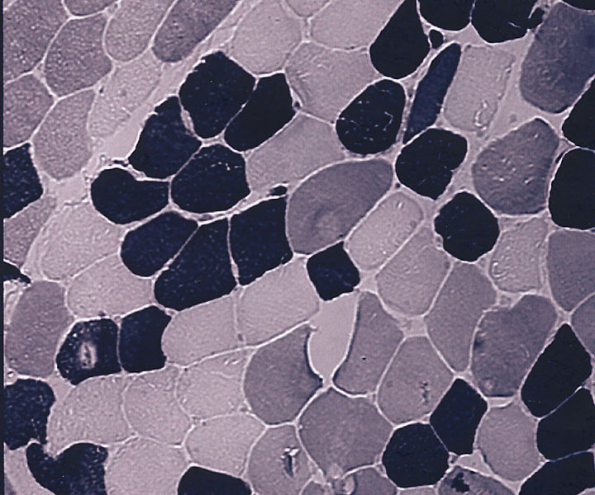
SLOW- AND FAST-TWITCH FIBERS

Slide 25
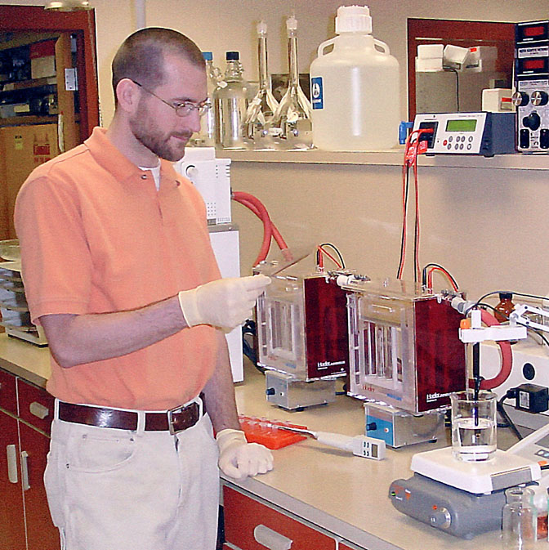
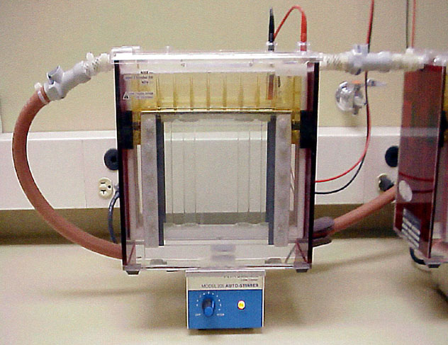
GEL ELECTROPHORESIS

Slide 26
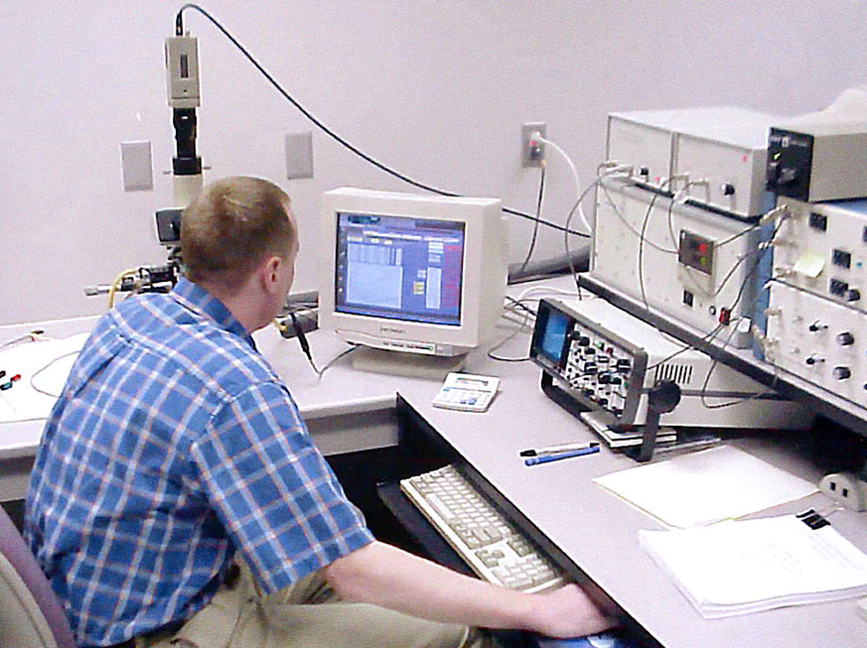
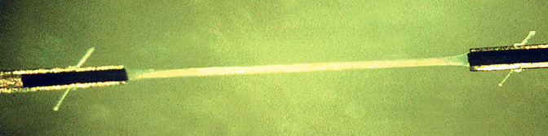
SINGLE MUSCLE FIBER PHYSIOLOGY

Slide 27
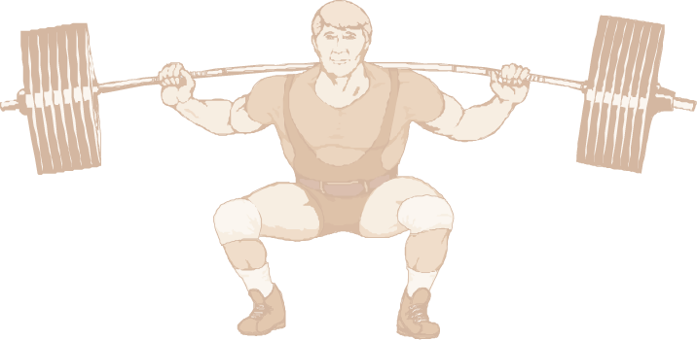
Did You Know…?
The difference in force development between FT and ST motor units is due to the number of muscle fibers per motor unit and the larger diameter of the FT fibers.

Slide 28
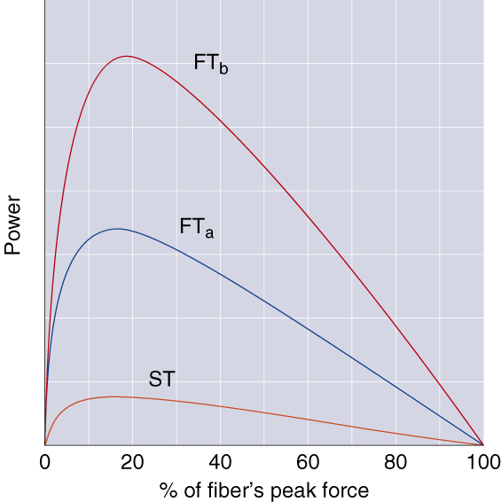
PEAK POWER GENERATED BY FIBERS

Slide 29
What Determines Fiber Type?
w Genetics determine which type of motor neurons innervate our individual muscle fibers.
w Muscle fibers become specialized according to the type of neuron that stimulates them.
w Endurance training, strength training, and muscular inactivity may result in small changes (less than 10%) in the percentage of FT and ST fibers.
w Endurance training has been shown to reduce the percentage of FT_{b} fibers, while increasing the fraction of FT_{a} fibers.
Aging may result in changes in the percentage of FT and ST fibers.

Slide 30
Key Points
Slow- and Fast-Twitch Muscle Fibers
w Skeletal muscles contain both ST and FT fibers.
w ATPase in FT fibers acts faster providing energy for muscle action more quickly than ATPase in ST fibers.
w FT fibers have a more highly developed sarcoplasmic reticulum enhancing calcium delivery.
(continued)

Slide 31
Key Points
Slow- and Fast-Twitch Muscle Fibers
w Motor units supplying FT fibers are larger (e.g., more fibers per motor neuron) than those supplying ST fibers; thus, FT motor units can recruit more fibers.
w ST fibers have high aerobic endurance and are suited to low-intensity endurance activities.
w FT fibers are better for anaerobic or explosive activities.

Slide 32
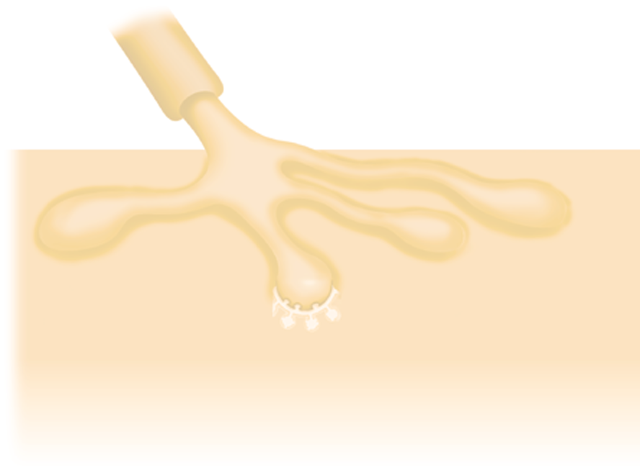
All-Or-None-Response
w For a motor unit to be recruited into activity the motor nerve impulse must meet or exceed the threshold.
w When this occurs, all muscle fibers in the motor unit act maximally.
w If the threshold is not met no fibers in that unit act.
w More force is produced by activating more motor units.

Slide 33
Orderly Recruitment of Muscle Fibers
Principle of orderly recruitment states that motor units are activated in a fixed order, based on their ranking in the muscle.
Size principle states that the order of recruitment is directly related to their motor neuron size.
Slow-twitch fibers, which have smaller motor neurons, are recruited before fast-twitch fibers.

Slide 34
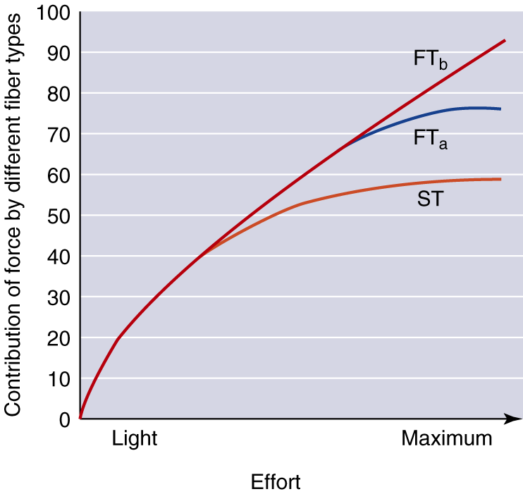
RAMPLIKE RECRUITMENT OF FIBERS

Slide 35
Functional Classification of Muscles
Agonists—prime movers; responsible for the movement
Antagonists—oppose the agonists to prevent overstretching of them
Synergists—assist the agonists and sometimes fine-tune the direction of movement

Slide 36
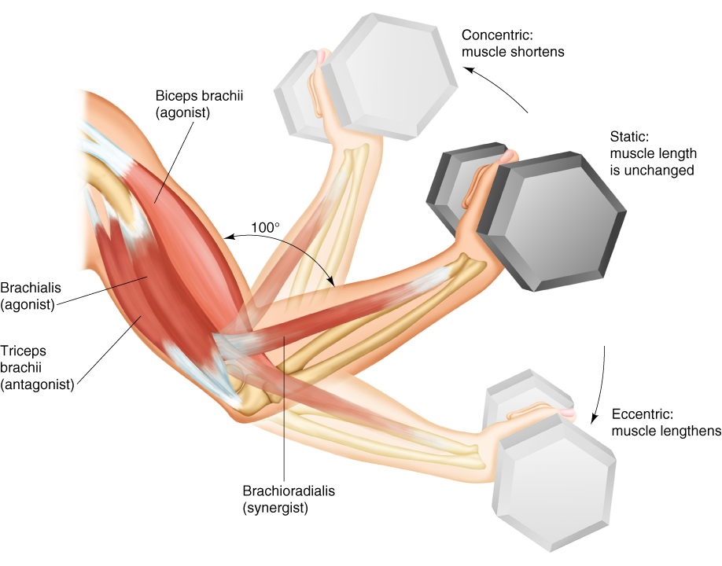
TYPES OF MUSCLE ACTION

Slide 37
Factors Influencing Force Generation
w Number of motor units activated
w Type of motor units activated (FT or ST)
w Muscle size
w Initial muscle length
w Joint angle
w Speed of muscle action (shortening or lengthening)

Slide 38
Key Points
Use of Muscles
w Muscles involved in movement can be classified as agonists, antagonists, and synergists.
w Three types of muscle action are concentric, static, and eccentric.
w Force production is increased by recruiting more motor units.
(continued)

Slide 39
Key Points
Use of Muscles
w All joints have an optimal angle at which the muscles crossing the joint produce maximal force.
w The angle of maximal force depends on the relative position of the muscle's insertion on the bone and the load placed on the muscle.
w Speed of action affects the amount of force produced.

Slide 40
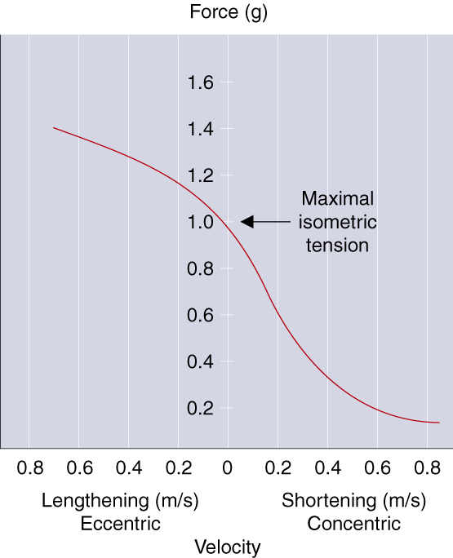
MUSCLE LENGTH vs FORCE PRODUCTION

