Slide 1
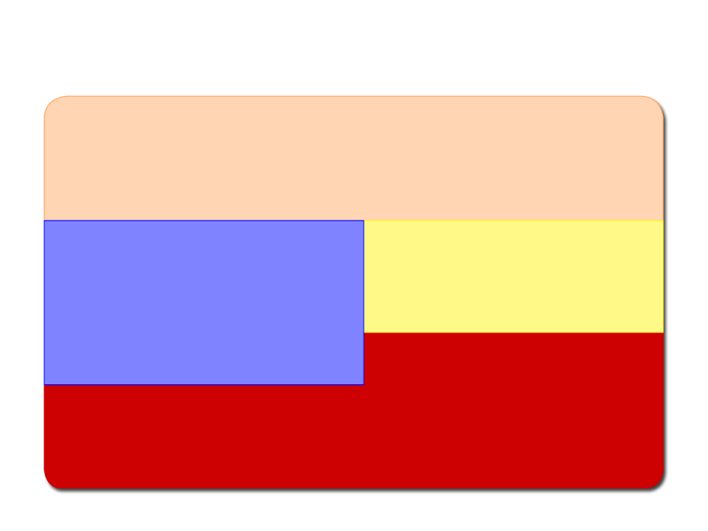
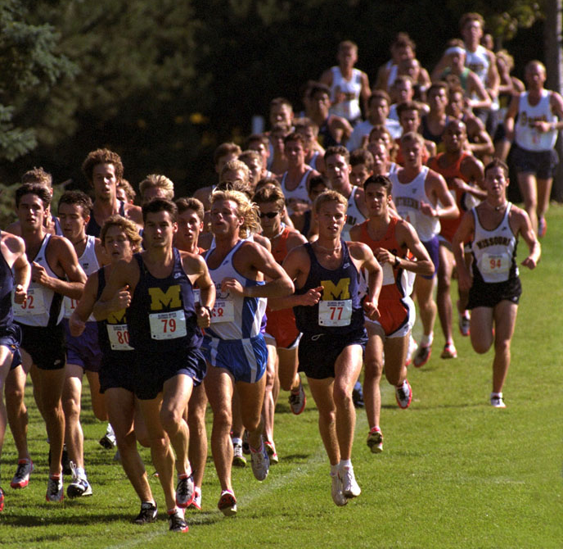
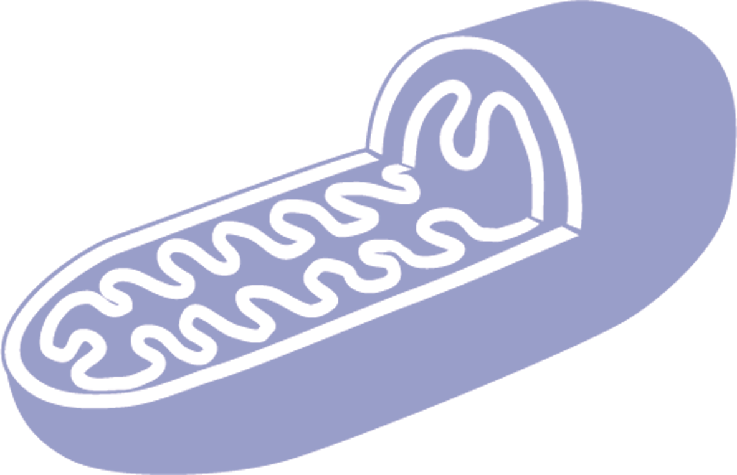
C H A P T E R 4
METABOLISM, ENERGY, AND THE BASIC ENERGY SYSTEMS

Slide 2
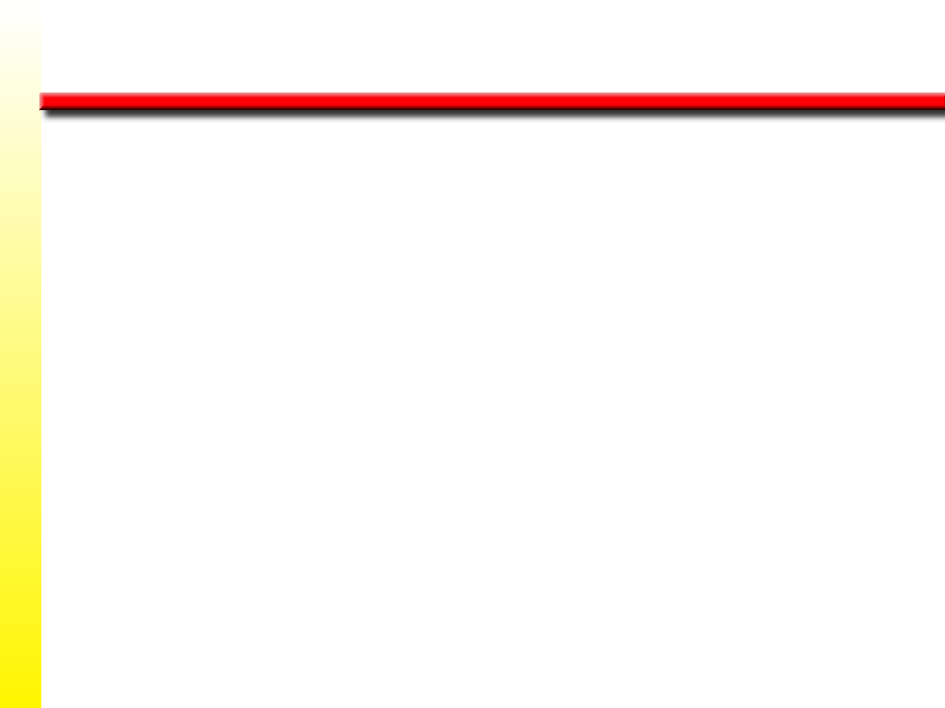
Learning Objectives
w Learn how our bodies change the food we
eat into ATP to provide our muscles with
the energy they need to move.
w Examine three systems that generate energy
for muscles.
w Explore how energy production and
availability can limit performance.
(continued)

Slide 3
Learning Objectives
w Learn how exercise affects metabolism and
how metabolism can be monitored to
determine energy expenditure.
w Discover the underlying causes and sites of
fatigue in muscles.

Slide 4
Calorie and Kilocalorie
w Energy in biological systems is measured in calories (cal).
1 cal is the amount of heat energy needed to raise 1 g of water 1°C from 14.5°C to 15.5°C.
w In humans, energy is expressed in kilocalories (kcal), where 1 kcal equals 1,000 cal.
w People often mistakenly say “calories” when they mean more accurately kilocalories. When we speak of someone expending 3,000 cal per day, we really mean that person is expending 3,000 kcal per day.

Slide 5

Energy for Cellular Activity
w Food sources are processed via catabolism—the process of “breaking down.”
w Energy is transferred from food sources to our cells to be stored as ATP.
w ATP is a high-energy compound stored in our cells and is the source of all energy used at rest and during exercise.

Slide 6

Energy Sources
w At rest, the body uses carbohydrates and fats for energy.
w Protein provides little energy for cellular activity, but serves as building blocks for the body's tissues.
w During moderate to severe muscular effort, the body relies mostly on carbohydrate for fuel.

Slide 7

Carbohydrate
w Readily available (if included in diet) and easily metabolized by muscles
w Once ingested, it is transported as glucose and taken up by muscles and liver and converted to glycogen
w Glycogen stored in the liver is converted back to glucose as needed and transported by the blood to the muscles where it is used to form ATP
w Glycogen stores are limited, which can affect performance

Slide 8

Fat
w Provides substantial energy at rest and during prolonged, low-intensity activity
w Body stores of fat are larger than carbohydrate reserves
w Less accessible for metabolism because it must be reduced to glycerol and free fatty acids (FFA)
w Only FFAs are used to form ATP
w Fat is limited as an energy source by its rate of energy release

Slide 9

Body Stores of Fuels and Energy
g kcal
Carbohydrates
Liver glycogen 110 451
Muscle glycogen 500 2,050
Glucose in body fluids 15 62
Total 625 2,563
Fat
Subcutaneous and visceral 7,800 73,320
Intramuscular 161 1,513
Total 7,961 74,833
Note. These estimates are based on an average body weight of 65 kg (143 lb) with 12% body fat.

Slide 10

Protein
w Can be used as an energy source if converted to
glucose via gluconeogenesis
w Can generate FFAs in times of starvation through lipogenesis
w Only basic units of protein—amino acids—can be
used for energy: ~4.1 kcal of energy per g of protein

Slide 11
Enzymes
w Specific protein molecules that control the breakdown of chemical compounds
w Names are often complex, but always end in “ase”
w Work at different rates and can limit a reaction
w Glycolytic enzymes act in the cytoplasm, while oxidative enzymes act in the mitochondria

Slide 12
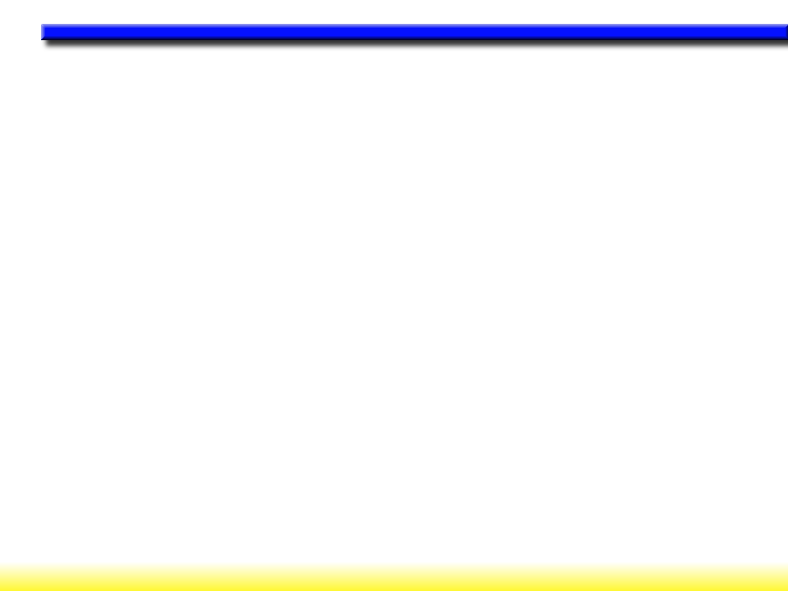
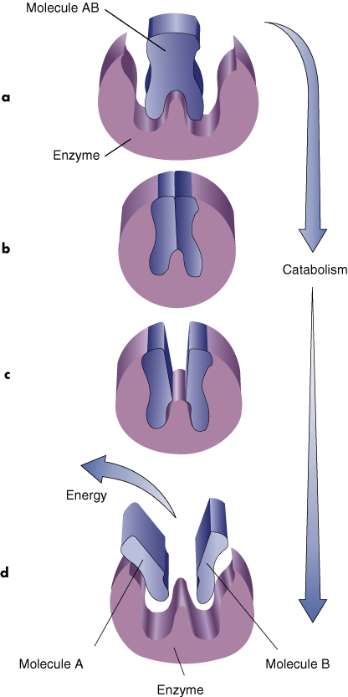
ACTION OF
ENZYMES

Slide 13

Key Points
Energy for Cellular Metabolism
w Carbohydrate, fats, and protein provide us with fuel that our bodies convert to ATP.
w ATP is the high-energy compound released and stored within our cells.
w Carbohydrate and protein provide about
4.1 kcal/g while fat provides about 9.4 kcal/g.
w Carbohydrate energy is more accessible
to the muscles than protein or fat.

Slide 14
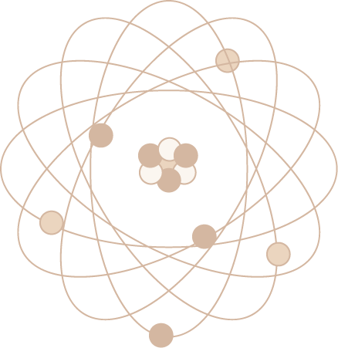
Basic Energy Systems
1. ATP-PCr system (phosphagen system)—cytoplasm
2. Glycolytic system—cytoplasm
3. Oxidative system—mitochondria or powerhouses of cell

Slide 15
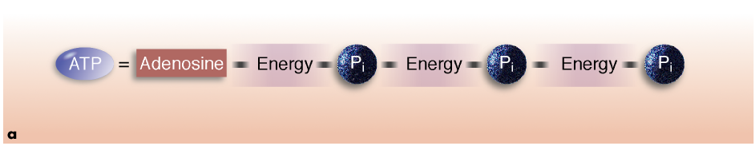
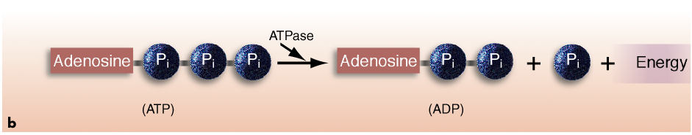
ATP MOLECULE

Slide 16

ATP-PCr System
w This system can prevent energy depletion by quickly reforming ATP from ADP and P_{i}.
w This process is anaerobic—it occurs without oxygen.
w 1 mole of ATP is produced per 1 mole of
phosphocreatine (PCr). The energy from the breakdown of PCr is not used for cellular work but solely for regenerating ATP.

Slide 17
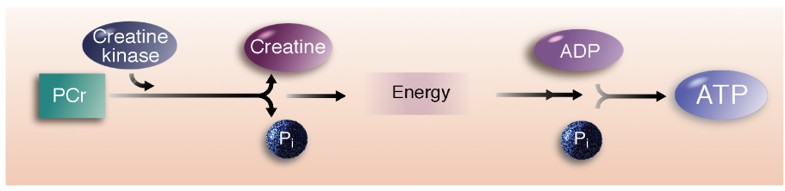
RECREATING ATP WITH PCr

Slide 18
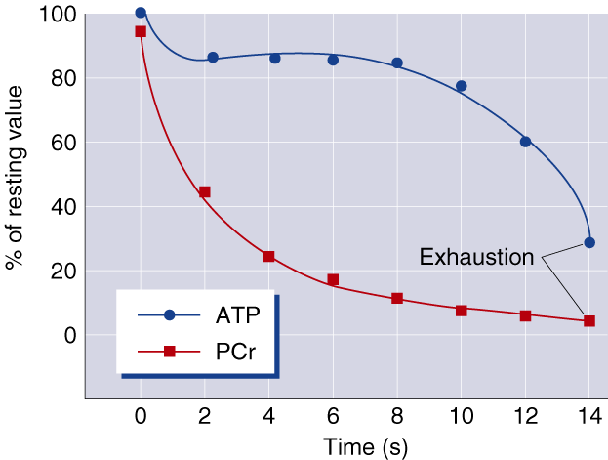
ATP AND PCr DURING SPRINTING

Slide 19
Glycogen Breakdown and Synthesis
Glycolysis—Breakdown of glucose; may be anaerobic or aerobic
Glycogenesis—Process by which glycogen is synthesized from glucose to be stored in the liver
Glycogenolysis—Process by which glycogen is broken
into glucose-1-phosphate to be used by muscles

Slide 20
Glycolytic System
w Requires 12 enzymatic reactions to breakdown glucose and glycogen into ATP
w Glycolysis that occurs in glycolytic system is generally anaerobic (without oxygen)
w The pyruvic acid produced by anaerobic glycolysis becomes lactic acid
w 1 mole of glycogen produces 3 mole ATP; 1 mole of glucose produces 2 mole of ATP. The difference is due to the fact that it takes 1 mole of ATP to convert glucose to glucose-6-phosphate, where glycogen is converted to glucose-1-phosphate and then to glucose-6-phosphate without the loss of 1 ATP.

Slide 21

Did You Know…?
The combined actions of the ATP-PCr and glycolytic systems allow muscles to generate force in the absence of oxygen; thus these two energy systems are the major energy contributors during the early minutes of high-intensity exercise.

Slide 22

Oxidative System
w Relies on oxygen to breakdown fuels for energy
w Produces ATP in mitochondria of cells
w Can yield much more energy (ATP) than anaerobic systems
w Is the primary method of energy production during endurance events

Slide 23

Oxidative Production of ATP
1. Aerobic glycolysis—cytoplasm
2. Krebs cycle—mitochondria
3. Electron transport chain—mitochondria

Slide 24
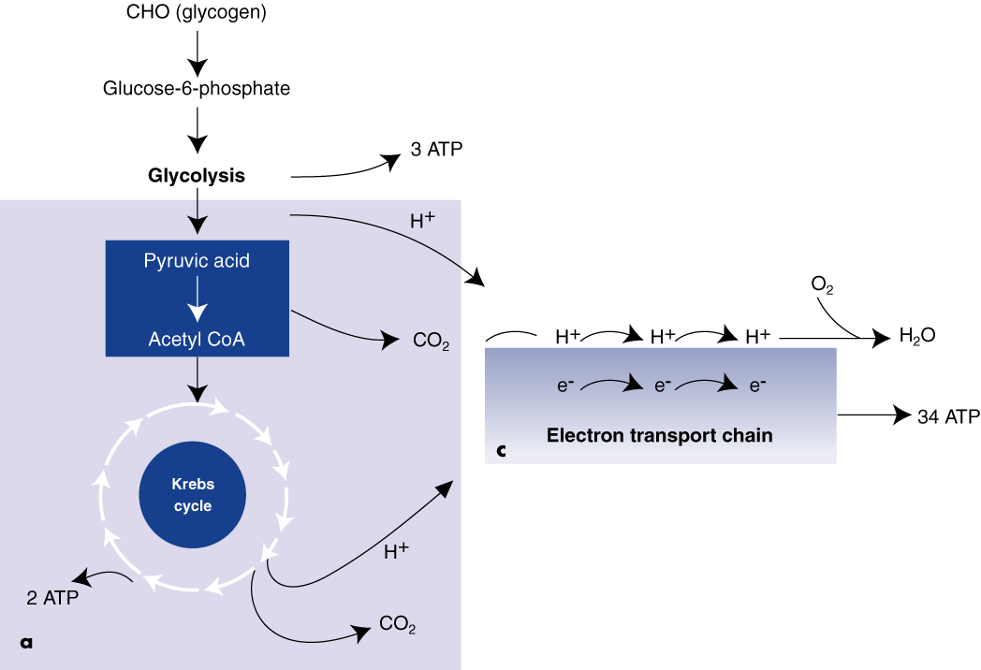
AEROBIC GLYCOLYSIS AND THE ELECTRON TRANSPORT CHAIN

Slide 25
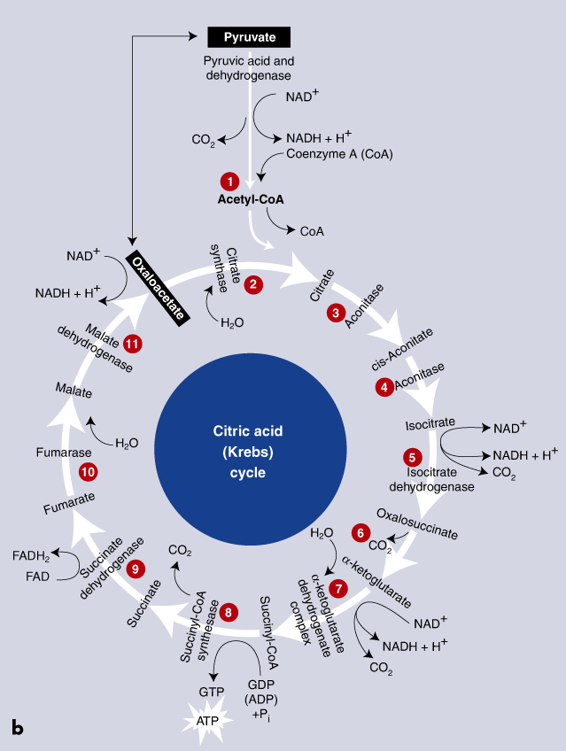
KREBS CYCLE

Slide 26
Oxidation of Carbohydrate
1. Pyruvic acid from glycolysis is converted to acetyl coenzyme A (acetyl CoA).
2. Acetyl CoA enters the Krebs cycle and forms 2 ATP, carbon dioxide, and hydrogen.
3. Hydrogen in the cell combines with two coenzymes that carry it to the electron transport chain.
4. Electron transport chain recombines hydrogen atoms to produce ATP and water.
5. One molecule of glycogen can generate up to 39 molecules of ATP.

Slide 27
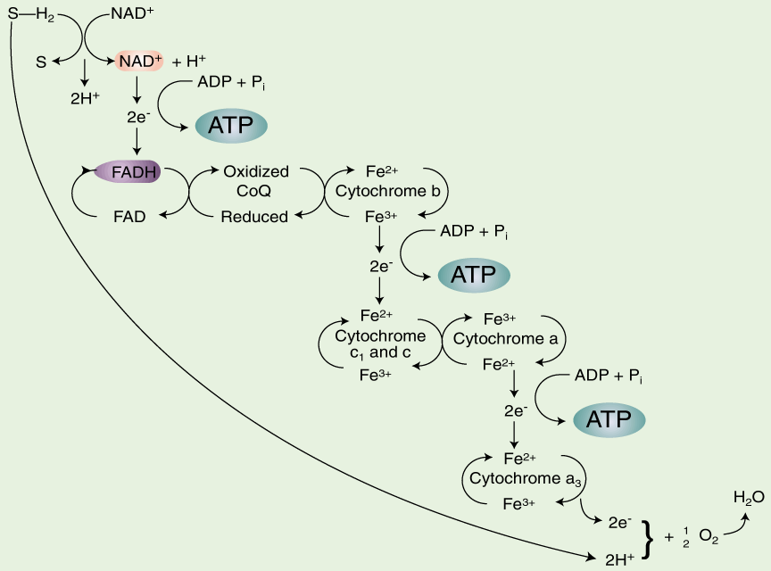
OXIDATIVE PHOSPHORYLATION
¯

Slide 28
Oxidation of Fat
w Lypolysis—breakdown of triglycerides into glycerol and free fatty acids (FFAs).
w FFAs travel via blood to muscle fibers and are broken down by enzymes in the mitochondria into acetic acid which is converted to acetyl CoA.
w Aceytl CoA enters the Krebs cycle and the electron transport chain.
w Fat oxidation requires more oxygen and generates more energy than carbohydrate oxidation.

Slide 29

Energy Production From the Oxidation
of Liver Glycogen
By oxidative
Stage of process Direct phosphorylationª
Glycolysis (glucose to pyruvic acid) 3 4-6^{b}
Pyruvic acid to acetyl coenzyme A 0 6
Krebs cycle 2 22
Subtotal 5 32-34
Total 37-39
ªRefers to adenosine triphosphate (ATP) produced by transferring H⁺ and electrons to the electron transport chain. ^{b}The energy yield differs depending on whether reduced nicotinamide adenine dinucleotide (NADH) or reduced flavin adenine dinucleotide (FADH) is the carrier molecule to transport the electron through the mitochondrial membrane and the electron transport chain, with NADH yielding up to 39 molecules of a ATP and FADH yielding 37 molecules of ATP.

Slide 30
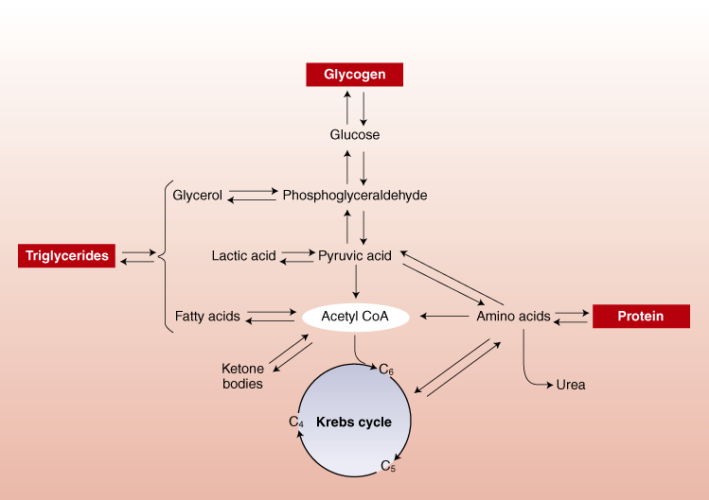
METABOLISM OF FAT

Slide 31
Energy Production From the Oxidation
of Palmitic Acid (C₁₆H₃₂O₂)
Adenosine triphosphate produced from 1 molecule
of palmitic acid
By oxidative
Stage of process Direct phosphorylation
Fatty acid activation 0 –2
β-oxidation 0 35
Krebs cycle 8 88
Subtotal 8 121
Total 129

Slide 32
Protein Metabolism
w Body uses little protein during rest and exercise
(less than 5% to 10%).
w Some amino acids that form proteins can be converted
into glucose.
w The nitrogen in amino acids (which cannot be oxidized) makes the energy yield of protein difficult to determine.

Slide 33
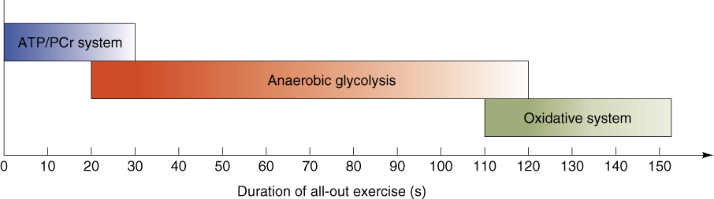
INTERACTION OF ENERGY SYSTEMS ILLUSTRATING THE PREDOMINANT ENERGY SYSTEM

Slide 34

What Determines Oxidative Capacity?
w Oxidative enzyme activity within the muscle
w Fiber-type composition and number of mitochondria
w Endurance training
w Oxygen availability and uptake in the lungs

Slide 35
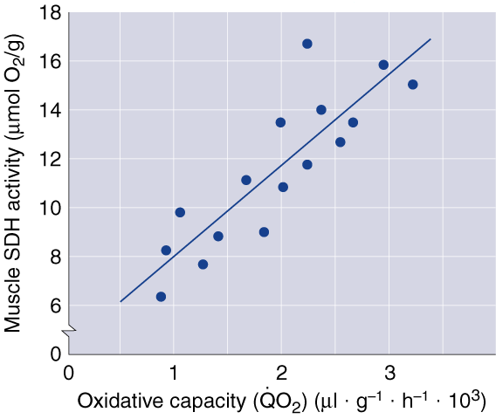
OXIDATIVE ENZYME ACTIVITY AND OXIDATIVE CAPACITY

Slide 36
Key Points
Bioenergetics: ATP Production
w The ATP-PCr and glycolytic systems produce small amounts of ATP anaerobically and are the major energy contributors in the early minutes of high-intensity exercise.
w The oxidative system uses oxygen and produces more energy than the anaerobic systems.
w Carbohydrate oxidation involves glycolysis, the Krebs cycle, and the electron transport chain to produce up to 39 ATP per molecule of glycogen aerobically.
(continued)

Slide 37
Key Points
Bioenergetics: ATP Production
w Fat oxidation involves β oxidation of free fatty acids, the Krebs cycle, and the electron transport chain to produce more ATP than carbohydrate, but it is O₂-limited.
w Protein generally contributes little to energy production (less than 5%), and its oxidation is complex because amino acids contain nitrogen, which cannot be oxidized.
w The oxidative capacity of muscle fibers depends on their oxidative enzyme levels, fiber-type composition, how they have been trained, and oxygen availability.

Slide 38

Measuring Energy Costs of Exercise
Direct calorimetry—measures the body's heat production to calculate energy expenditure.
Indirect calorimetry—calculates energy expenditure from the respiratory exchange ratio (RER) of VCO₂ and VO₂.
.
.

Slide 39
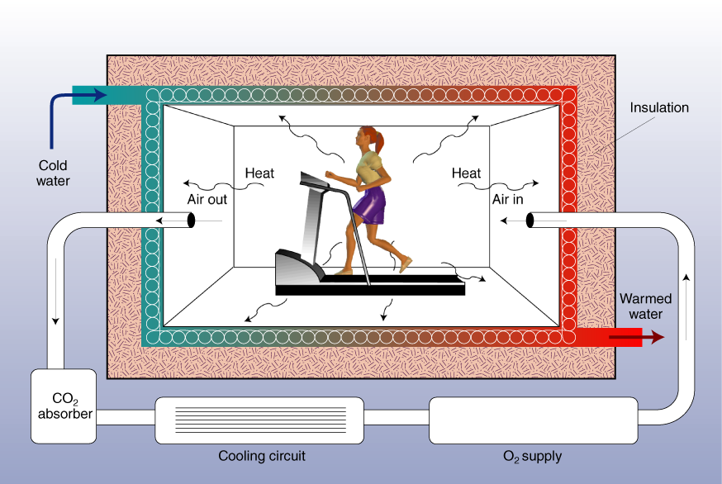
CALORIMETRIC CHAMBER

Slide 40
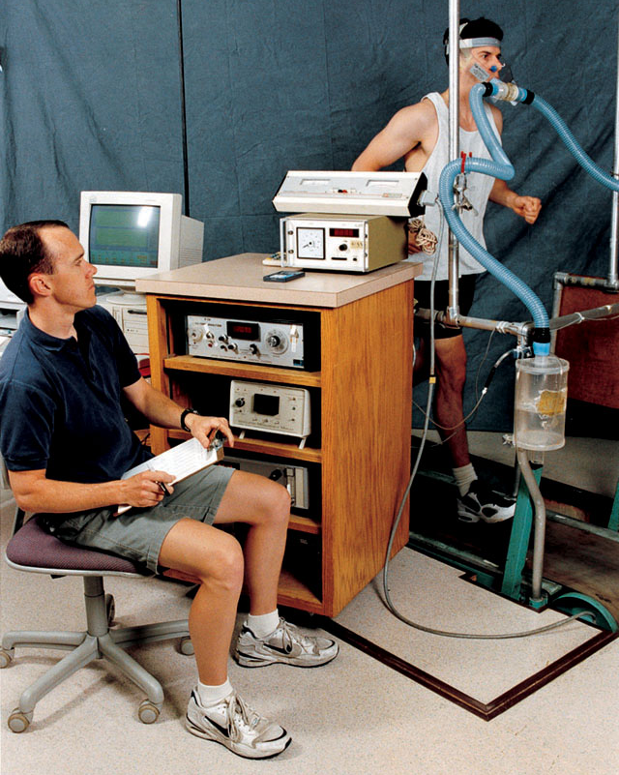
MEASURING RESPIRATORY GAS EXCHANGE

Slide 41
Measuring Energy Costs of Exercise
.
VO₂—volume of O₂ consumed per minute (L/min).
.
VCO₂—volume of CO₂ produced per minute (L/min).
.
.
.
VO₂ = (V_{I} × F_{I}O₂) - (V_{E} × F_{E}O₂)
.
.
.
VCO₂ = (V_{E} × F_{E}CO₂) - (V_{I} × F_{I}CO₂)
.
.
Where V_{E} = expired ventilation; V_{I} = inspired ventilation;
F_{I}O₂ = fraction of oxygen inspired; F_{I}CO₂ = fraction of carbon dioxide inspired; F_{E}O₂ = fraction of oxygen expired; and F_{E}CO₂ = fraction of carbon dioxide expired.

Slide 42
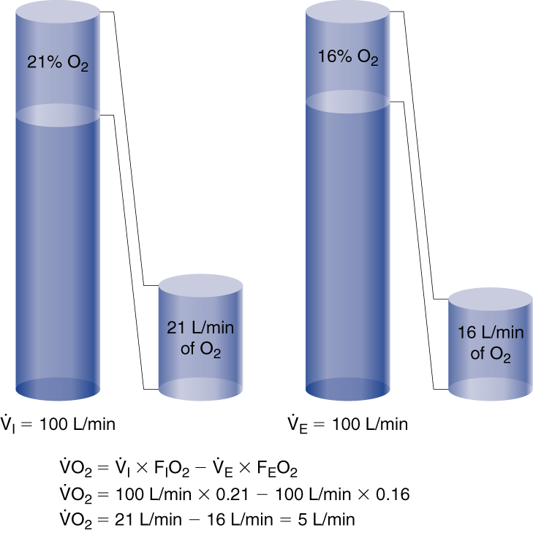
CALCULATING OXYGEN CONSUMPTION

Slide 43
Haldane Transformation
.
.
You can use V_{E} to calculate V_{I} knowing that the volume of nitrogen expired is constant:
.
.
V_{I} = (V_{E} × F_{E}N₂)/F_{I}N₂ and F_{E}N₂ = 1 - (F_{E}O₂ + F_{E}CO₂)
.
.
.
VO₂ = (V_{I} × F_{I}O₂) - (V_{E} × F_{E}O₂)
.
.
.
VO₂ = [(V_{E} × F_{E}N₂)/(F_{I}N₂ × F_{I}O₂)] – (V_{E)} × F_{E}O₂)
Then substitute known values for F_{I}O₂ of 0.2093 and F_{I}N₂ of 0.7903:
.
.
VO₂ = (V_{E} × {[(1 – (F_{E}O₂ + F_{E}CO₂)) × 0.265] – F_{E}O₂}

Slide 44

Respiratory Exchange Ratio
.
w The ratio between CO₂ released (VCO₂) and oxygen consumed (VO₂)
.
.
.
w RER = VCO₂/VO₂
w The RER value at rest is usually 0.78 to 0.80
w The RER value can be used to determine energy substrate used at rest and during exercise, with a value of 1.00 indicating CHO and 0.70 indicating fat.

Slide 45
Caloric Equivalence of the Respiratory Exchange Ratio (RER) and % kcal From Carbohydrates and Fats
Energy % kcal
RER kcal/L O₂ Carbohydrates Fats
0.71 4.69 0.0 100.0
0.75 4.74 15.6 84.4
0.80 4.80 33.4 66.6
0.85 4.86 50.7 49.3
0.90 4.92 67.5 32.5
0.95 4.99 84.0 16.0
1.00 5.05 100.0 0.0

Slide 46
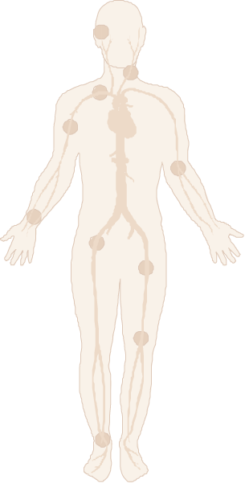
Measurements of Energy Expenditure
Carbon-13—Infused and selectively traced to determine its movement and distribution
Doubly labeled water—²H₂¹⁸O is ingested and the rate at which ²H and ¹⁸O diffuses throughout the body’s water and bicarbonate stores and leaves the body is monitored and used to calculate how much energy is expended

Slide 47
Key Points
Measuring Energy Use
During Exercise
w Direct calorimetry measures the heat produced by the body while indirect calorimetry estimates caloric expenditure by measuring O₂ consumption.
w The RER value can be used to determine what fuels are being oxidized and is used in the calculation of the energy expended per liter of O₂ consumed.
w Tracking ingested or injected isotopes in the body can also be used to calculate caloric expenditure.

Slide 48
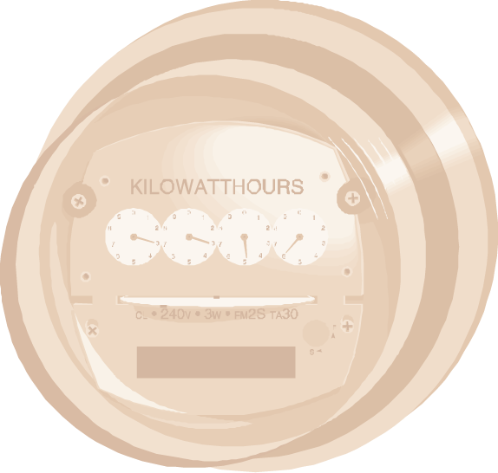
Metabolic Rate
w Rate at which the body expends energy at rest and
during exercise
w Measured as whole-body oxygen consumption and
its caloric equivalent
w Basal or resting metabolic rate (BMR) is the minimum energy required for essential physiological function
(varies between 1,200 and 2,400 kcal/24 hr)
w The minimum energy required for normal daily activity is about 1,800 to 3,000 kcal/24 hr

Slide 49
Factors Affecting BMR/RMR
w The more fat-free mass, the higher the BMR
w The more body surface area, the higher the BMR
w BMR gradually decreases with increasing age
w BMR increases with increasing body temperature
w The more stress, the higher the BMR
w The higher the levels of thyroxine and epinephrine,
the higher the BMR

Slide 50
Caloric Equivalents
w Food energy equivalents
CHO: 4.1 kcal/g
Fat: 9.4 kcal/g
Protein: 4.1 kcal/g
w Energy per liter of oxygen consumed
CHO: 5.0 kcal/L
Fat: 4.7 kcal/L
Protein: 4.5 kcal/L
.
Example: VO₂ rest = 0.300 L/min × 60 min/hr × 24 hr/day = 432 L/day × 4.8 kcal/L = 2,074 kcal/day

Slide 51
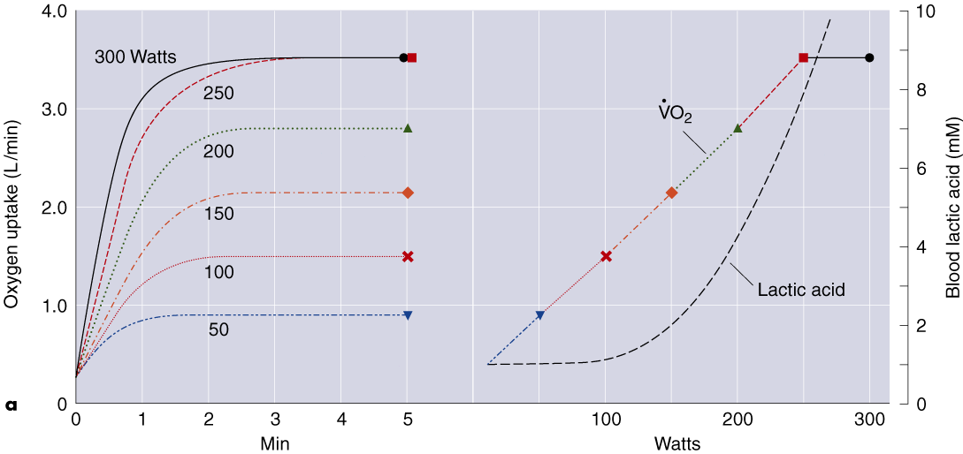
O₂ UPTAKE vs POWER OUTPUT (1986)

Slide 52
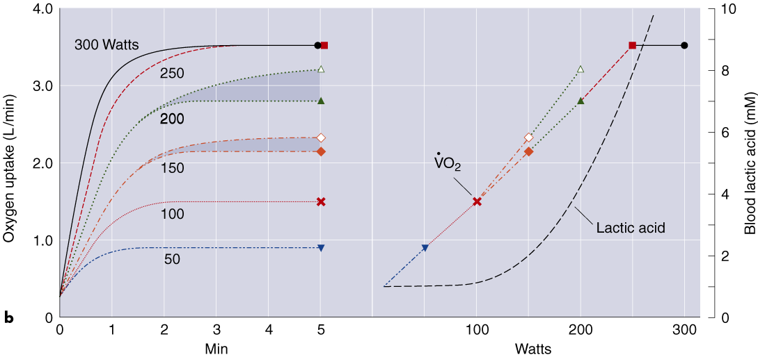
O₂ UPTAKE vs POWER OUTPUT (1996)

Slide 53
.
Maximal Oxygen Uptake (VO₂max)
w Upper limit of a person's ability to increase oxygen uptake.
w Good indicator of cardiorespiratory endurance and aerobic fitness.
w Can differ according to sex, body size, age, and is greatly influenced by the level of aerobic training.
w Expressed relative to body weight in ml of O₂ consumed per kg body weight per min (ml · kg⁻¹ · min⁻¹).

Slide 54
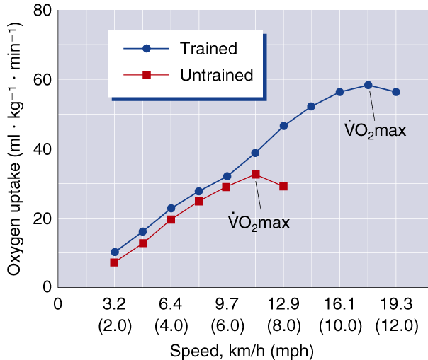
EXERCISE INTENSITY AND OXYGEN UPTAKE

Slide 55
Estimating Anaerobic Effort
There is not yet available a method that definitively measures anaerobic capacity, however there are ways to estimate it:
w Examine excess postexercise oxygen consumption (EPOC)—the mismatch between O₂ consumption and energy requirements during recovery from exercise
w Estimate lactate accumulation in muscles through blood analysis; estimate lactate threshold (LT)
w Use the maximal accumulated oxygen deficit test, the critical power test, or the Wingate anaerobic test which also show good promise for estimating the metabolic potential of anaerobic capacity

Slide 56
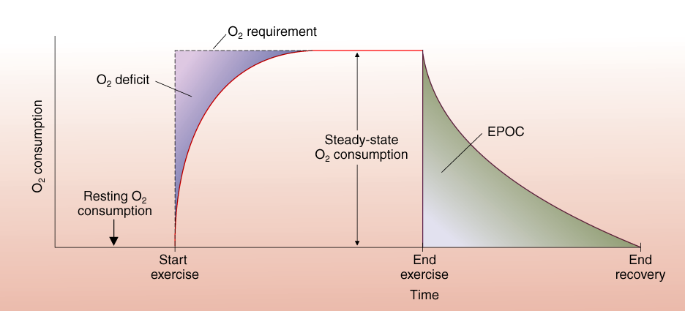
OXYGEN DEFICIT AND EPOC

Slide 57
Factors Responsible for EPOC
w Rebuilding depleted ATP supplies
w Clearing lactate produced by anaerobic metabolism
w Replenishing O₂ supplies borrowed from hemoglobin
and myoglobin
w Removing CO₂ that has accumulated in body tissues
w Increased metabolic and respiratory rates due to increased body temperature and norepinephrine and epinephrine levels

Slide 58

Lactate Threshold
w The point at which blood lactate begins to accumulate above resting levels during exercise of increasing intensity, where lactate production exceeds lactate clearance
w Sudden increase in blood lactate with increasing effort can be the result of an increase in the production of lactate or a decrease in the removal of lactate from the blood
w Can indicate potential for endurance exercise; lactate formation contributes to fatigue

Slide 59
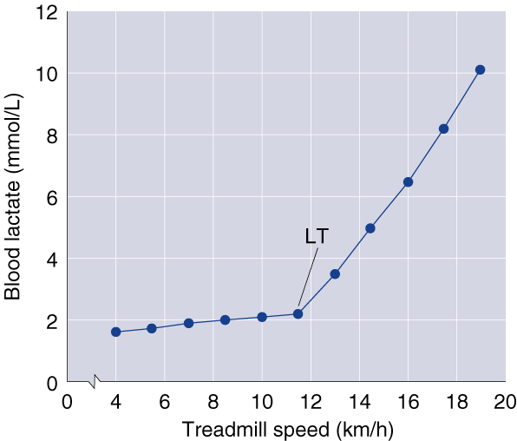
EXERCISE INTENSITY AND BLOOD LACTATE ACCUMULATION

Slide 60

Did You Know…?
Lactate threshold (LT), when expressed as a percentage of VO₂max, is one of the best determinants of an athlete's pace in endurance events such as running and cycling. While untrained people typically have LT around 50% to 60% of their VO₂max, elite athletes may not reach LT until around 70% or 80% VO₂max.
.
.
.

Slide 61
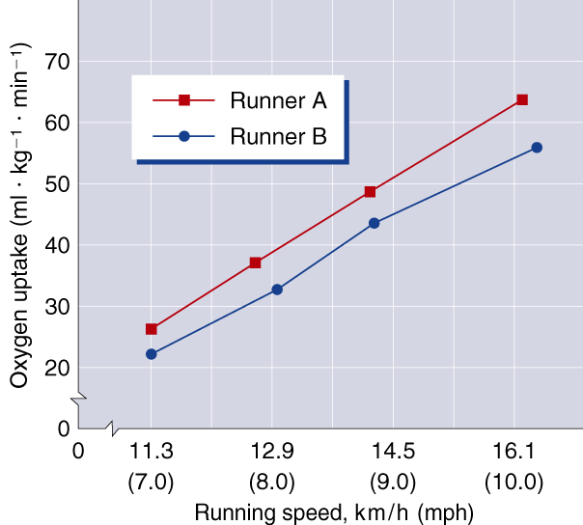
OXYGEN REQUIREMENTS OF TWO RUNNERS

Slide 62

Determining Endurance Performance Success
.
w High maximal oxygen uptake (VO₂max)
w High lactate threshold
w High economy of effort
w High percentage of slow-twitch muscle fibers

Slide 63

Factors Influencing Energy Costs
w Type of activity
w Size, weight, and body composition
w Activity level
w Intensity of the activity
w Age
w Duration of the activity
w Sex
w Efficiency of movement

Slide 64
Key Points
Energy Expenditure at Rest and During Exercise
w The basal metabolic rate (BMR) is the minimum amount of energy required by the body for basic physiological functions.
w The resting metabolic rate (RMR) is nearly identical to the BMR.
w Your metabolism increases with increased exercise intensity.
w Oxygen consumption increases during exercise to its upper limit (VO₂max).
.
(continued)

Slide 65
Key Points
Energy Expenditure at Rest and During Exercise
w Excess postexercise oxygen consumption (EPOC) is the elevation of O₂ consumption above resting levels after exercise; it is caused by a combination of several factors.
w Lactate threshold is the point at which blood lactate begins to accumulate above resting levels during exercise, where lactate production exceeds lactate clearance.
(continued)

Slide 66
Key Points
Energy Expenditure at Rest and During Exercise
w Individuals with higher lactate thresholds, expressed as a percentage of VO₂max, are capable of the best endurance performance.
.
w Performance improvements often mean that an individual can perform for longer periods at a higher percentage of his or her VO₂max.
.
w Performance capacity can be improved by increasing one's economy of effort.

Slide 67

Fatigue and Its Causes
w Phosphocreatine (PCr) depletion
w Glycogen depletion (especially in activities lasting longer than 30 minutes)
w Accumulation of lactate and H⁺ (especially in events shorter than 30 minutes)
w Neuromuscular fatigue

Slide 68
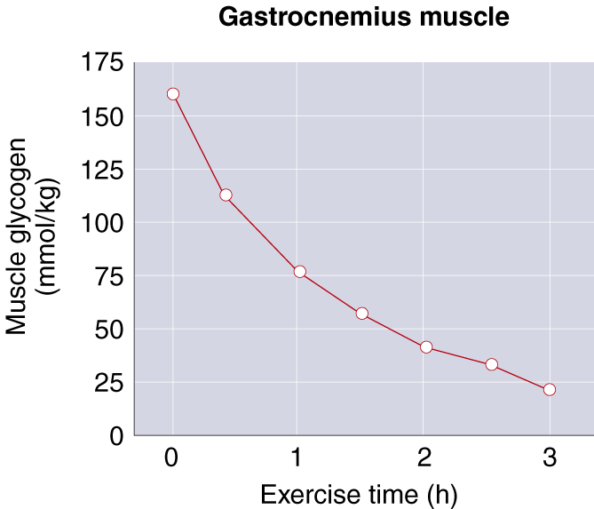
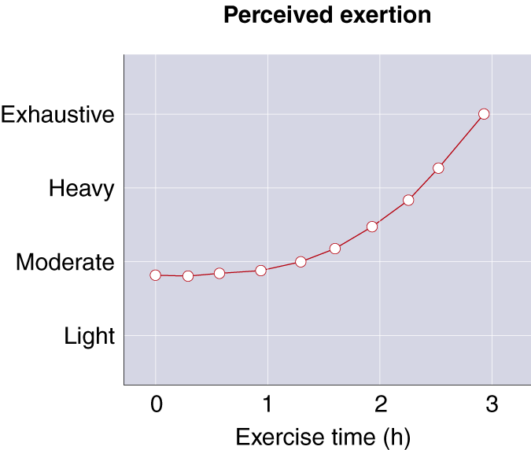
USE OF MUSCLE GLYCOGEN DURING EXERCISE

Slide 69
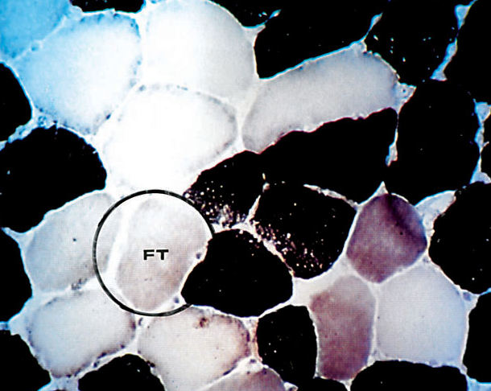
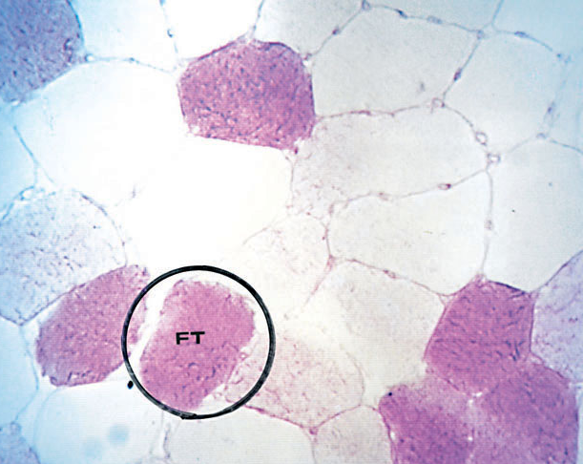
MUSCLE FIBERS STAINED TO SHOW GLYCOGEN

Slide 70
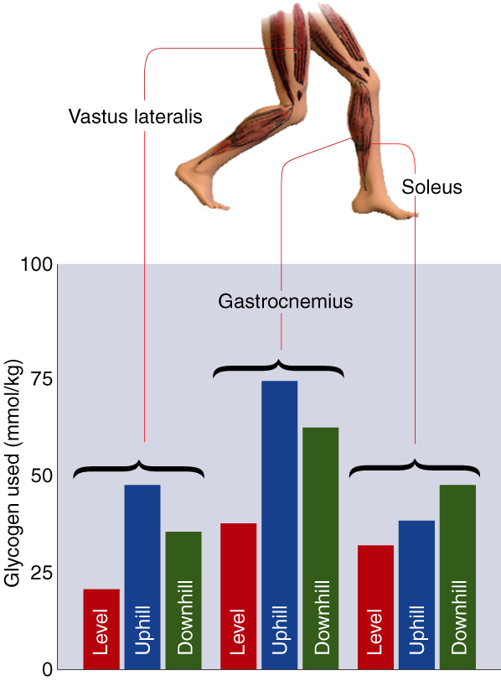
GLYCOGEN USE DURING RUNNING

Slide 71

Metabolic By-Products and Fatigue
w Short duration activities depend on anaerobic glycolysis and produce lactate and H⁺.
w Cells buffer H⁺ with bicarbonate (HCO₃) to keep cell pH between 6.4 and 7.1.
w Intercellular pH lower than 6.9, however, slows glycolysis and ATP production.
w When pH reaches 6.4, H⁺ levels stop any further glycolysis and result in exhaustion.

Slide 72
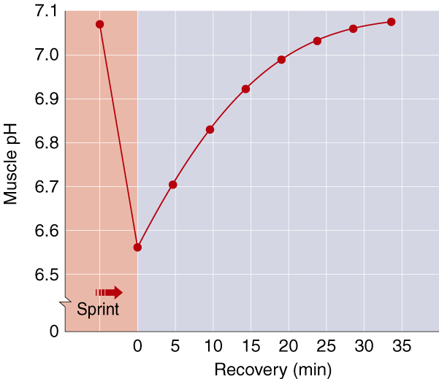
CHANGES IN MUSCLE pH

Slide 73
Key Points
Fatigue and Its Causes
w Fatigue may result from a depletion of PCr or glycogen, which then impairs ATP production.
w The H⁺ generated by lactic acid causes fatigue in that it decreases muscle pH and impairs the cellular processes of energy production and muscle contraction.
w Failure of neural transmission may cause some fatigue.
w The central nervous system may also perceive fatigue as a protective mechanism.

