Slide 1
Prof. Edgar Lopategui Corsino
M.A., Fisiología del Ejercicio
Web: http://www.saludmed.com/
E-Mail: elopateg@intermetro.edu
Artículo: http://www.saludmed.com/articulos/Emprendedorismo/ ejercicioaprendizaje.html

Slide 4
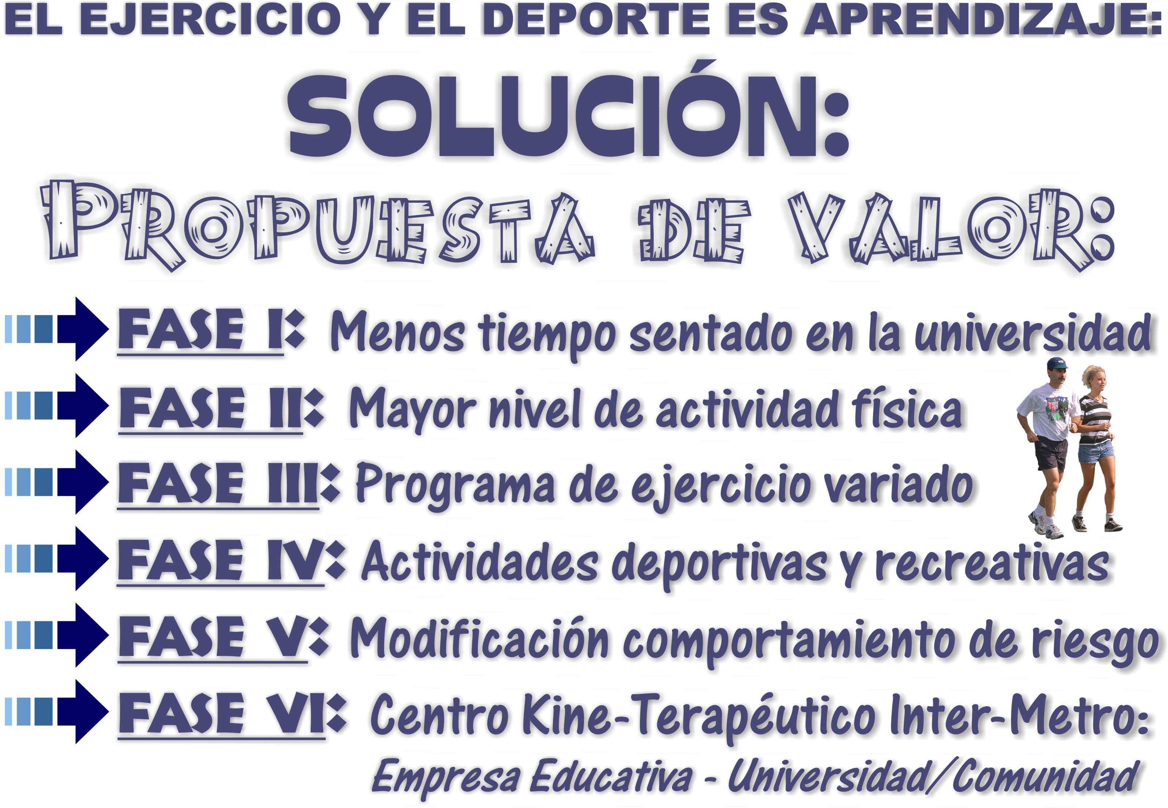

Slide 6
Etnier, J. L. (2014). Research . . . How Fun Is That? Interesting Questions Relative to the Effects of Exercise on Cognitive Performance. Kinesiology Review, 3(3), 151-160.
Sattelmair, J., & Ratey, J. J. (2009). Physically active play and cognition: An academic matter? American Journal of Play, 1(3), 365-374.
Keeley, T. J. H., & Fox, K. R. (2009). The impact of physical activity and fitness on academic achievement and cognitive performance in children. International Review of Sport and Exercise Psychology, 2(2), 198-214.
Hillman, C. H., Erickson, K. I., & Kramer, A. F. (2008). Be smart, exercise your heart: exercise effects on brain and cognition. Nature Reviews. Neuroscience, 9(1), 58-65.
Kramer, A. F., Colcombe, S. J., McAuley, E., Scalf, P. E., Erickson, K. I. (2006). Fitness, aging and neurocognitive function. Neurobiology of Aging, 26(Suppl 1), 124-127. Recuperado de

